Slide 1
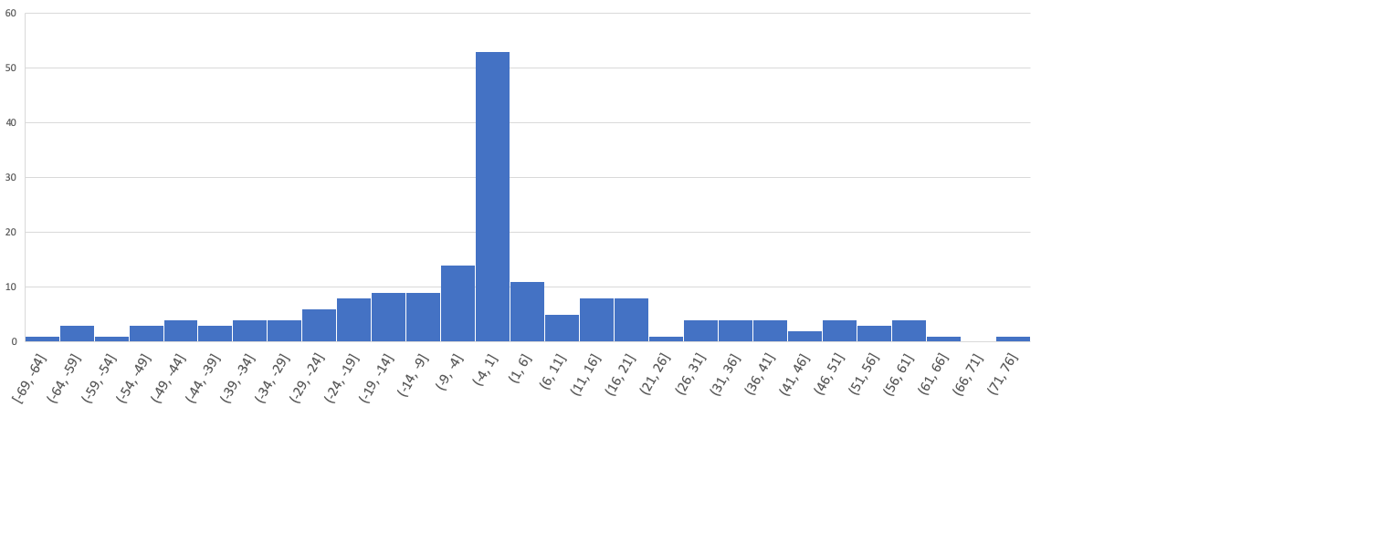
CANADA

Slide 2
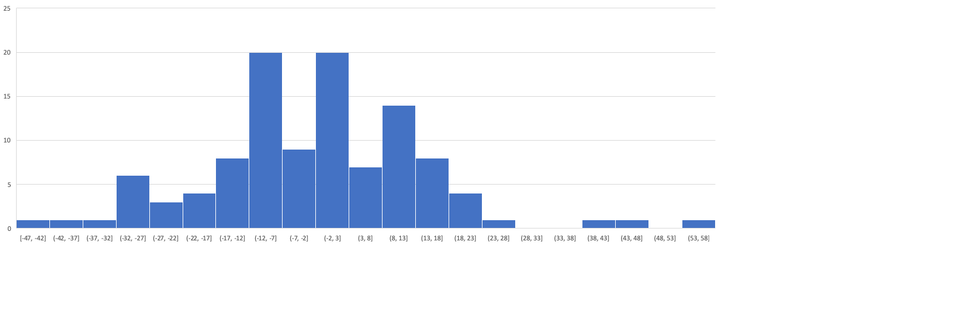
FRANCE

Slide 3

ITALY

Slide 4
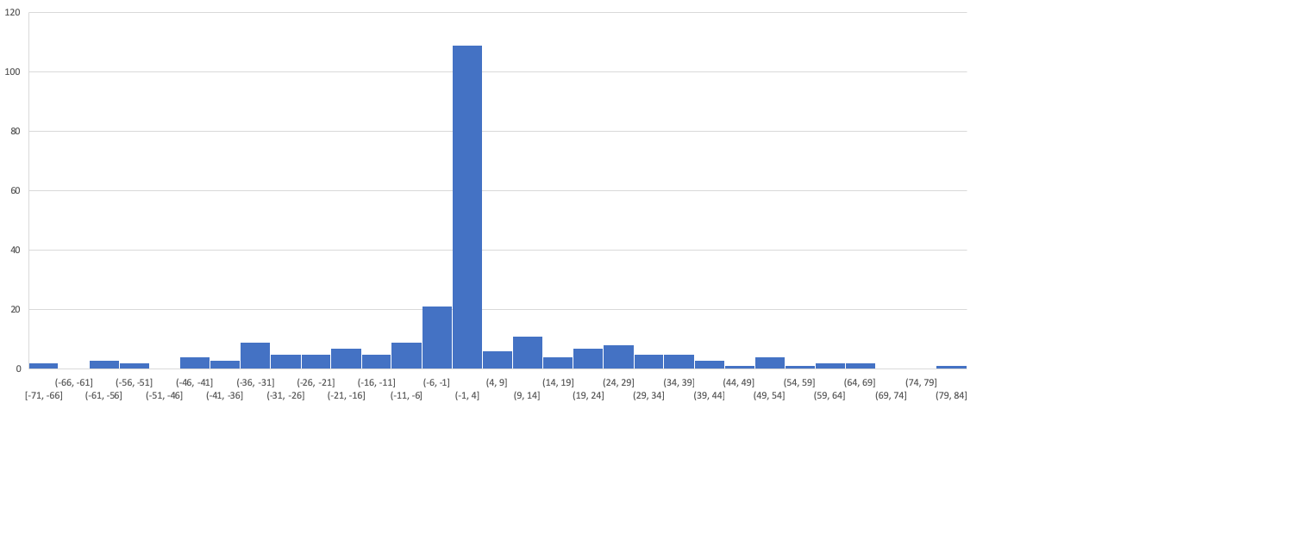
MEXICO

Slide 5

SPAIN

Slide 6

UK

Slide 7

USA

Slide 8
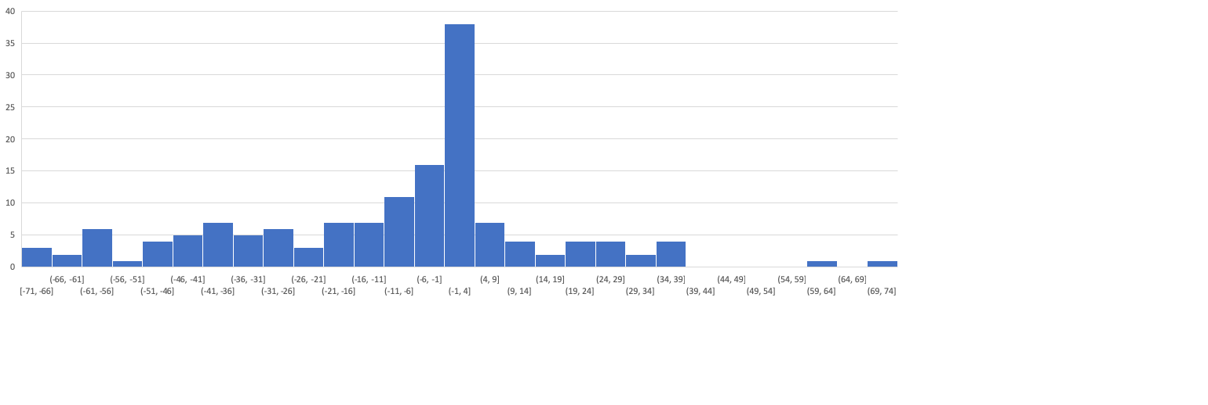
JAPAN

