Slide 1


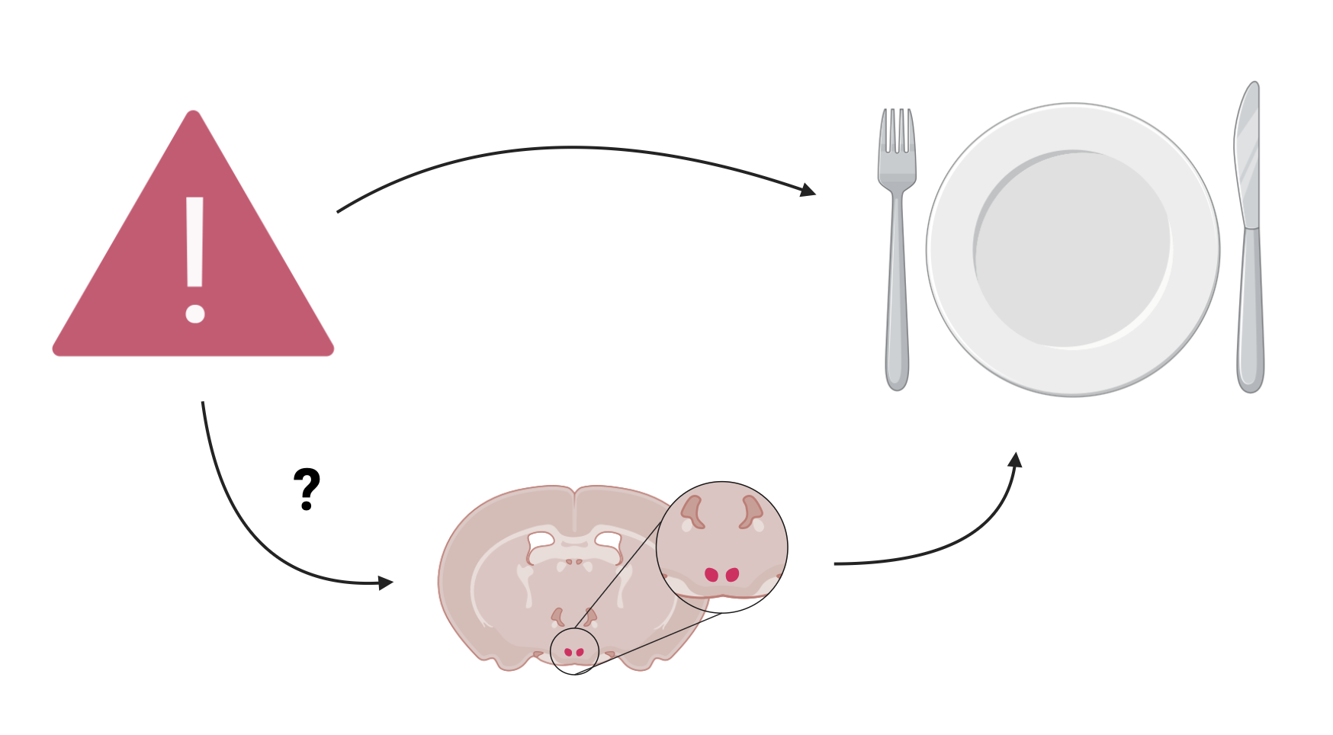
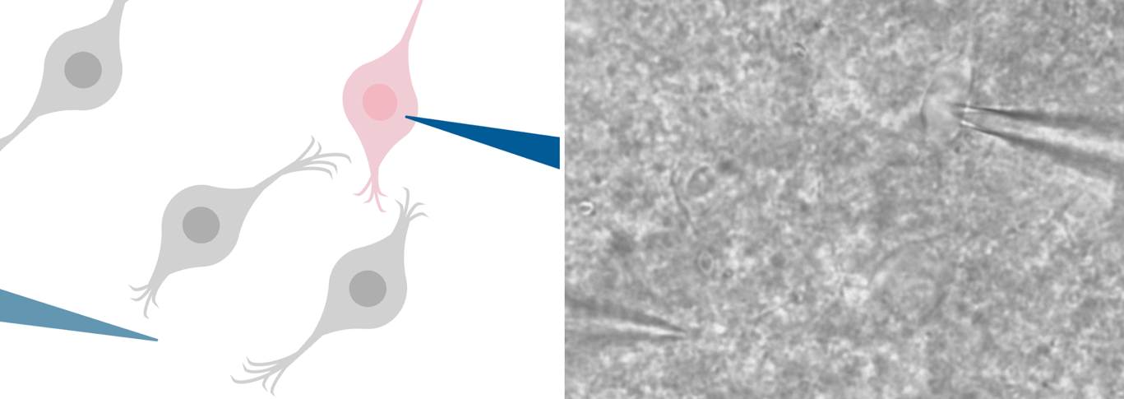
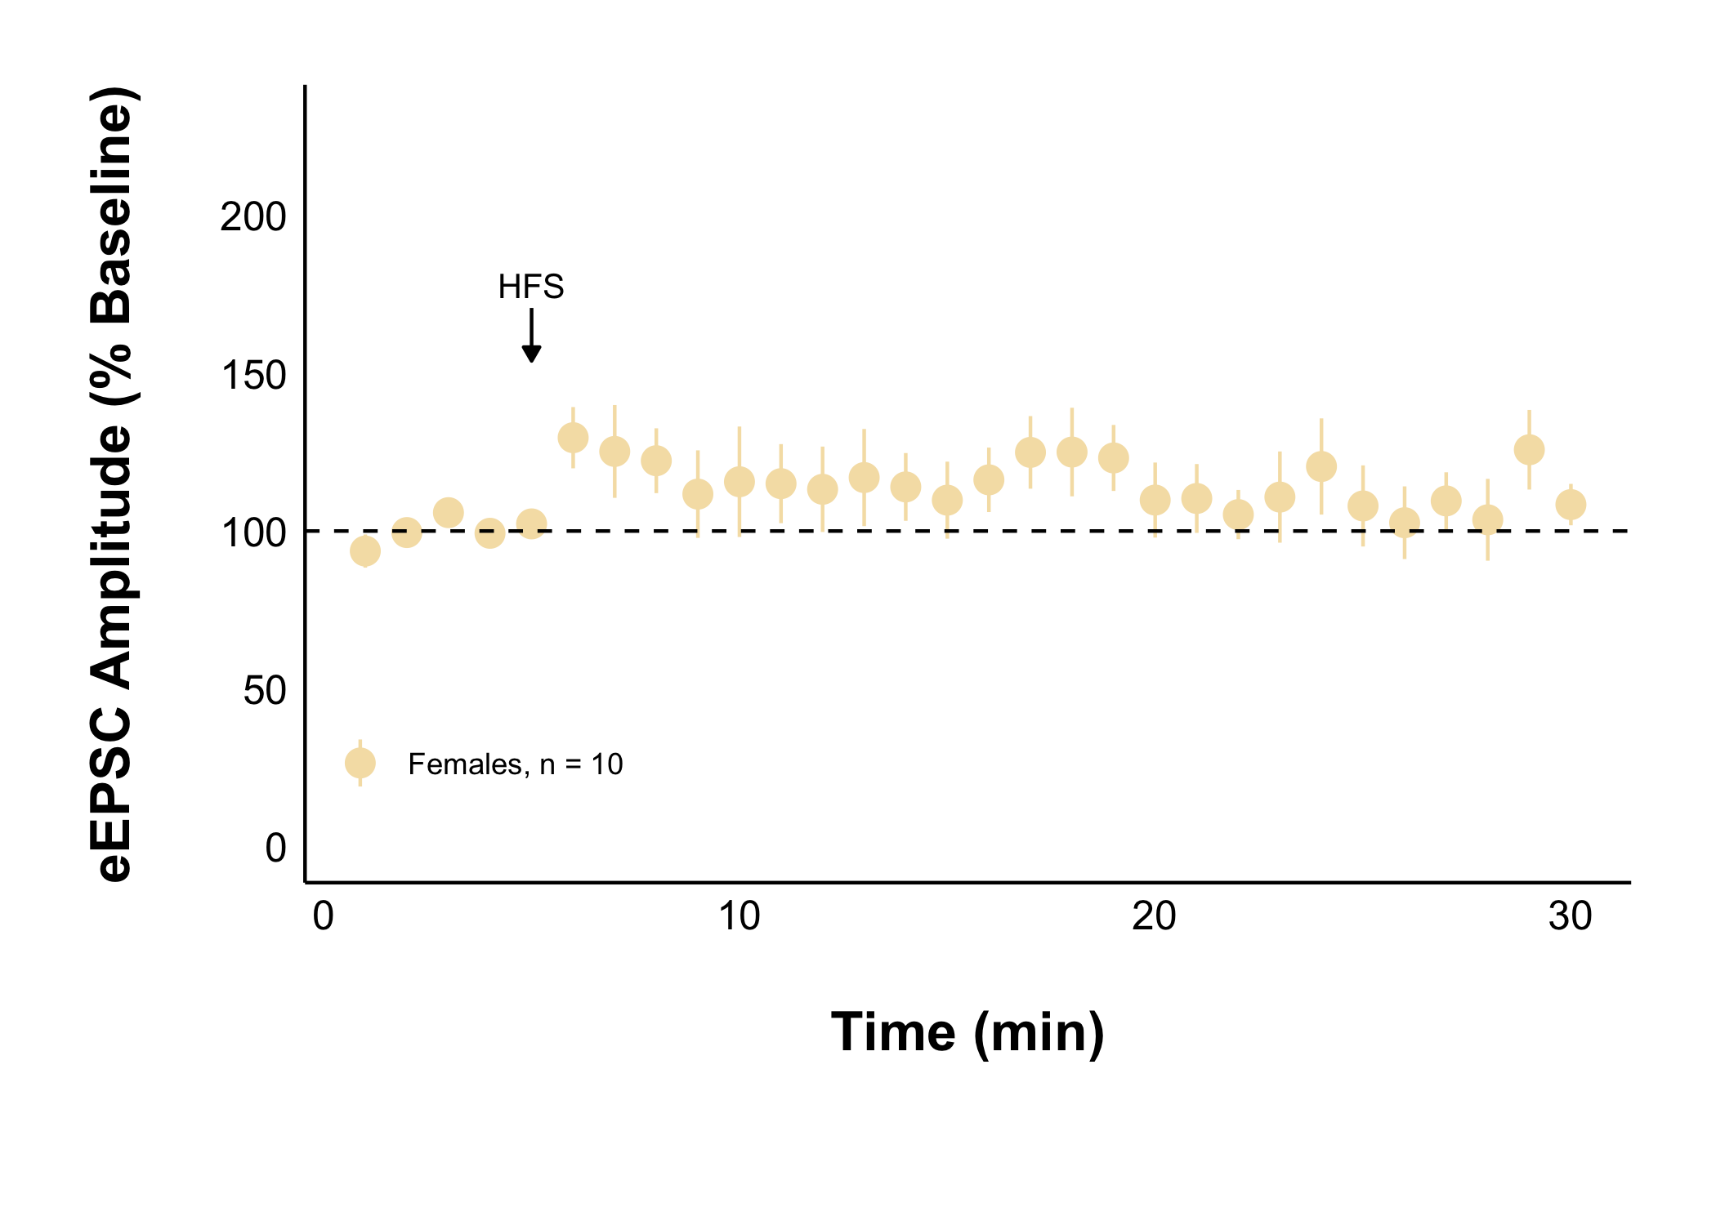
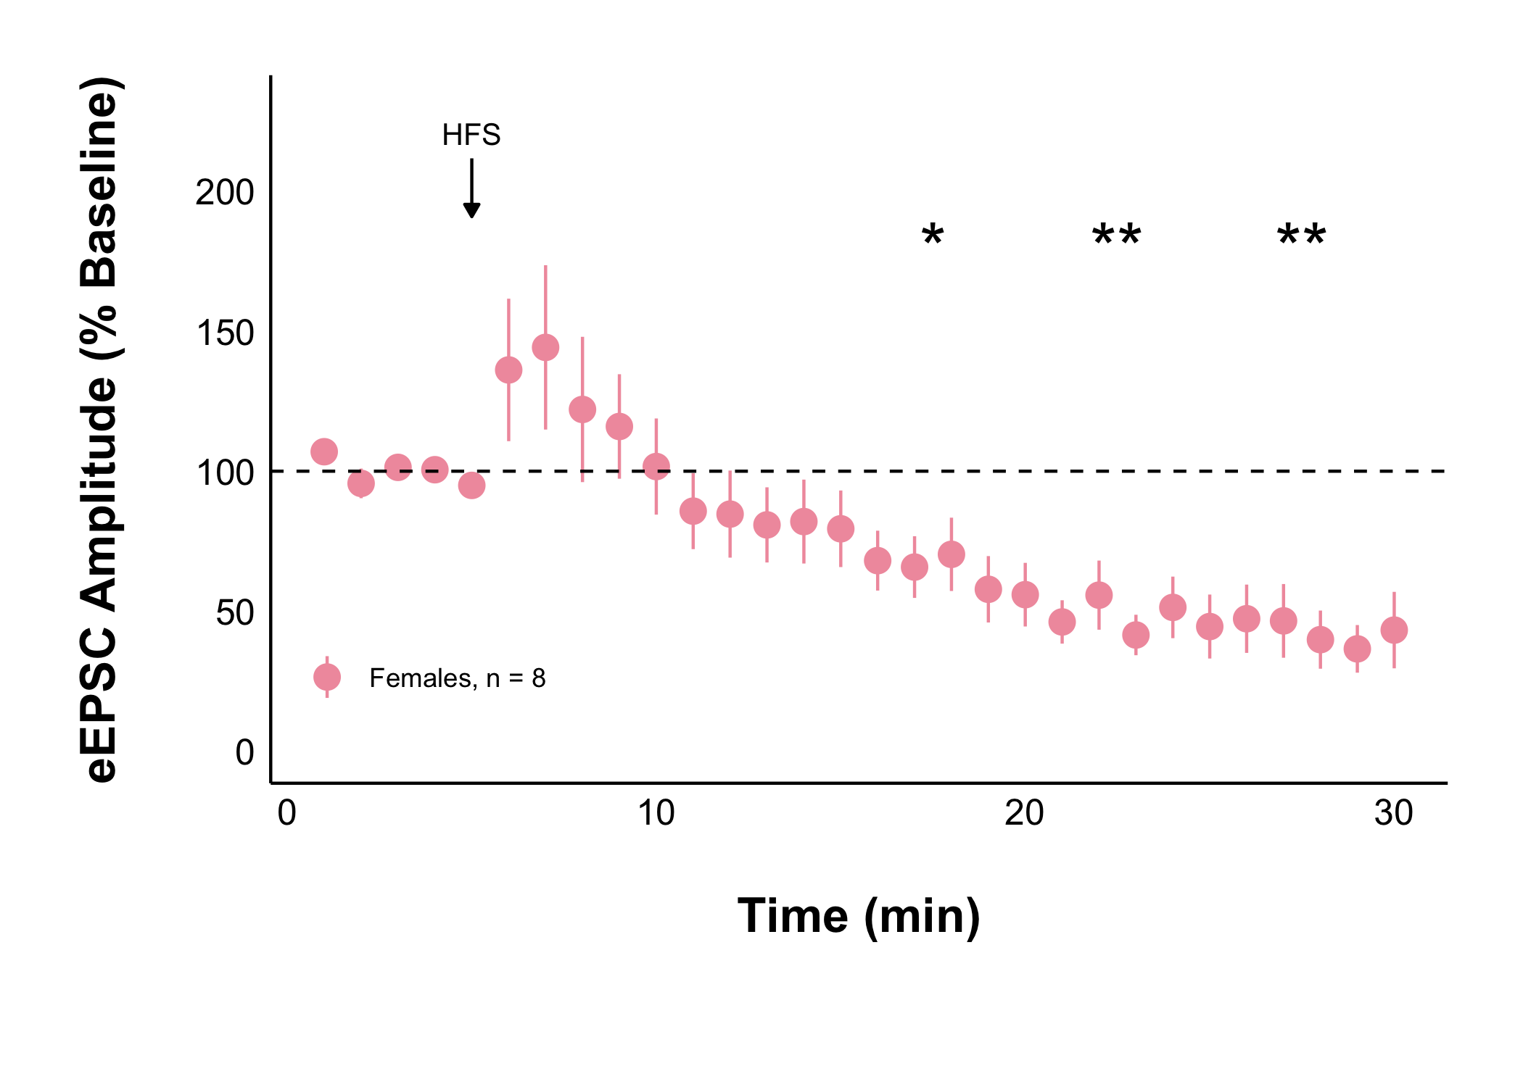
Acute Stress Decreases Activity of Appetite Regulating Neurons in the Female Rat Dorsomedial Hypothalamus
Ruby Muzzatti, Dr Karen Crosby
Department of Biology, Mount Allison University, Sackville, New Brunswick, Canada
All experiments were performed according to protocol #104140 approved by the Mount Allison University Animal Care Committee in accordance with the Canadian Council on Animal Care Guidelines

Slide 2
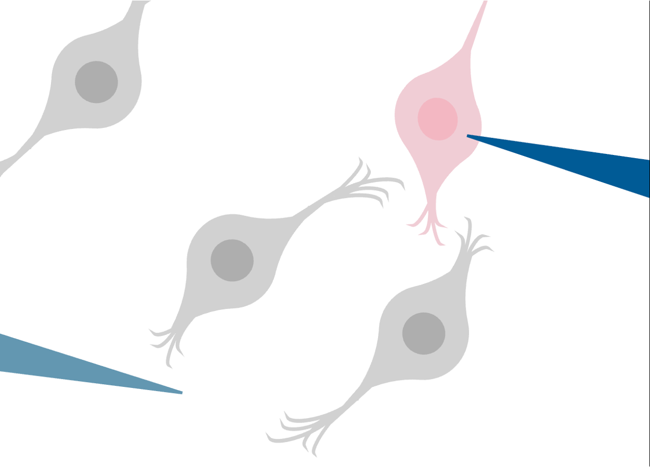
Acute Stress Decreases Activity of Appetite Regulating Neurons in the Female Rat Dorsomedial Hypothalamus
Ruby Muzzatti, Dr Karen Crosby
Department of Biology, Mount Allison University, Sackville, New Brunswick, Canada
Acute stress decreases excitatory activity in the long term in females but not males

Slide 3
Acute Stress Decreases Activity of Appetite Regulating Neurons in the Female Rat Dorsomedial Hypothalamus
Ruby Muzzatti, Dr Karen Crosby
Department of Biology, Mount Allison University, Sackville, New Brunswick, Canada
Acute stress decreases long term excitatory activity of neurons in the female rat dorsomedial hypothalamus

