Slide 1
Acute stress decreases the long-term activity of appetite regulating neurons in the hypothalamus
Ruby Muzzatti
July 3, 2025

Slide 2
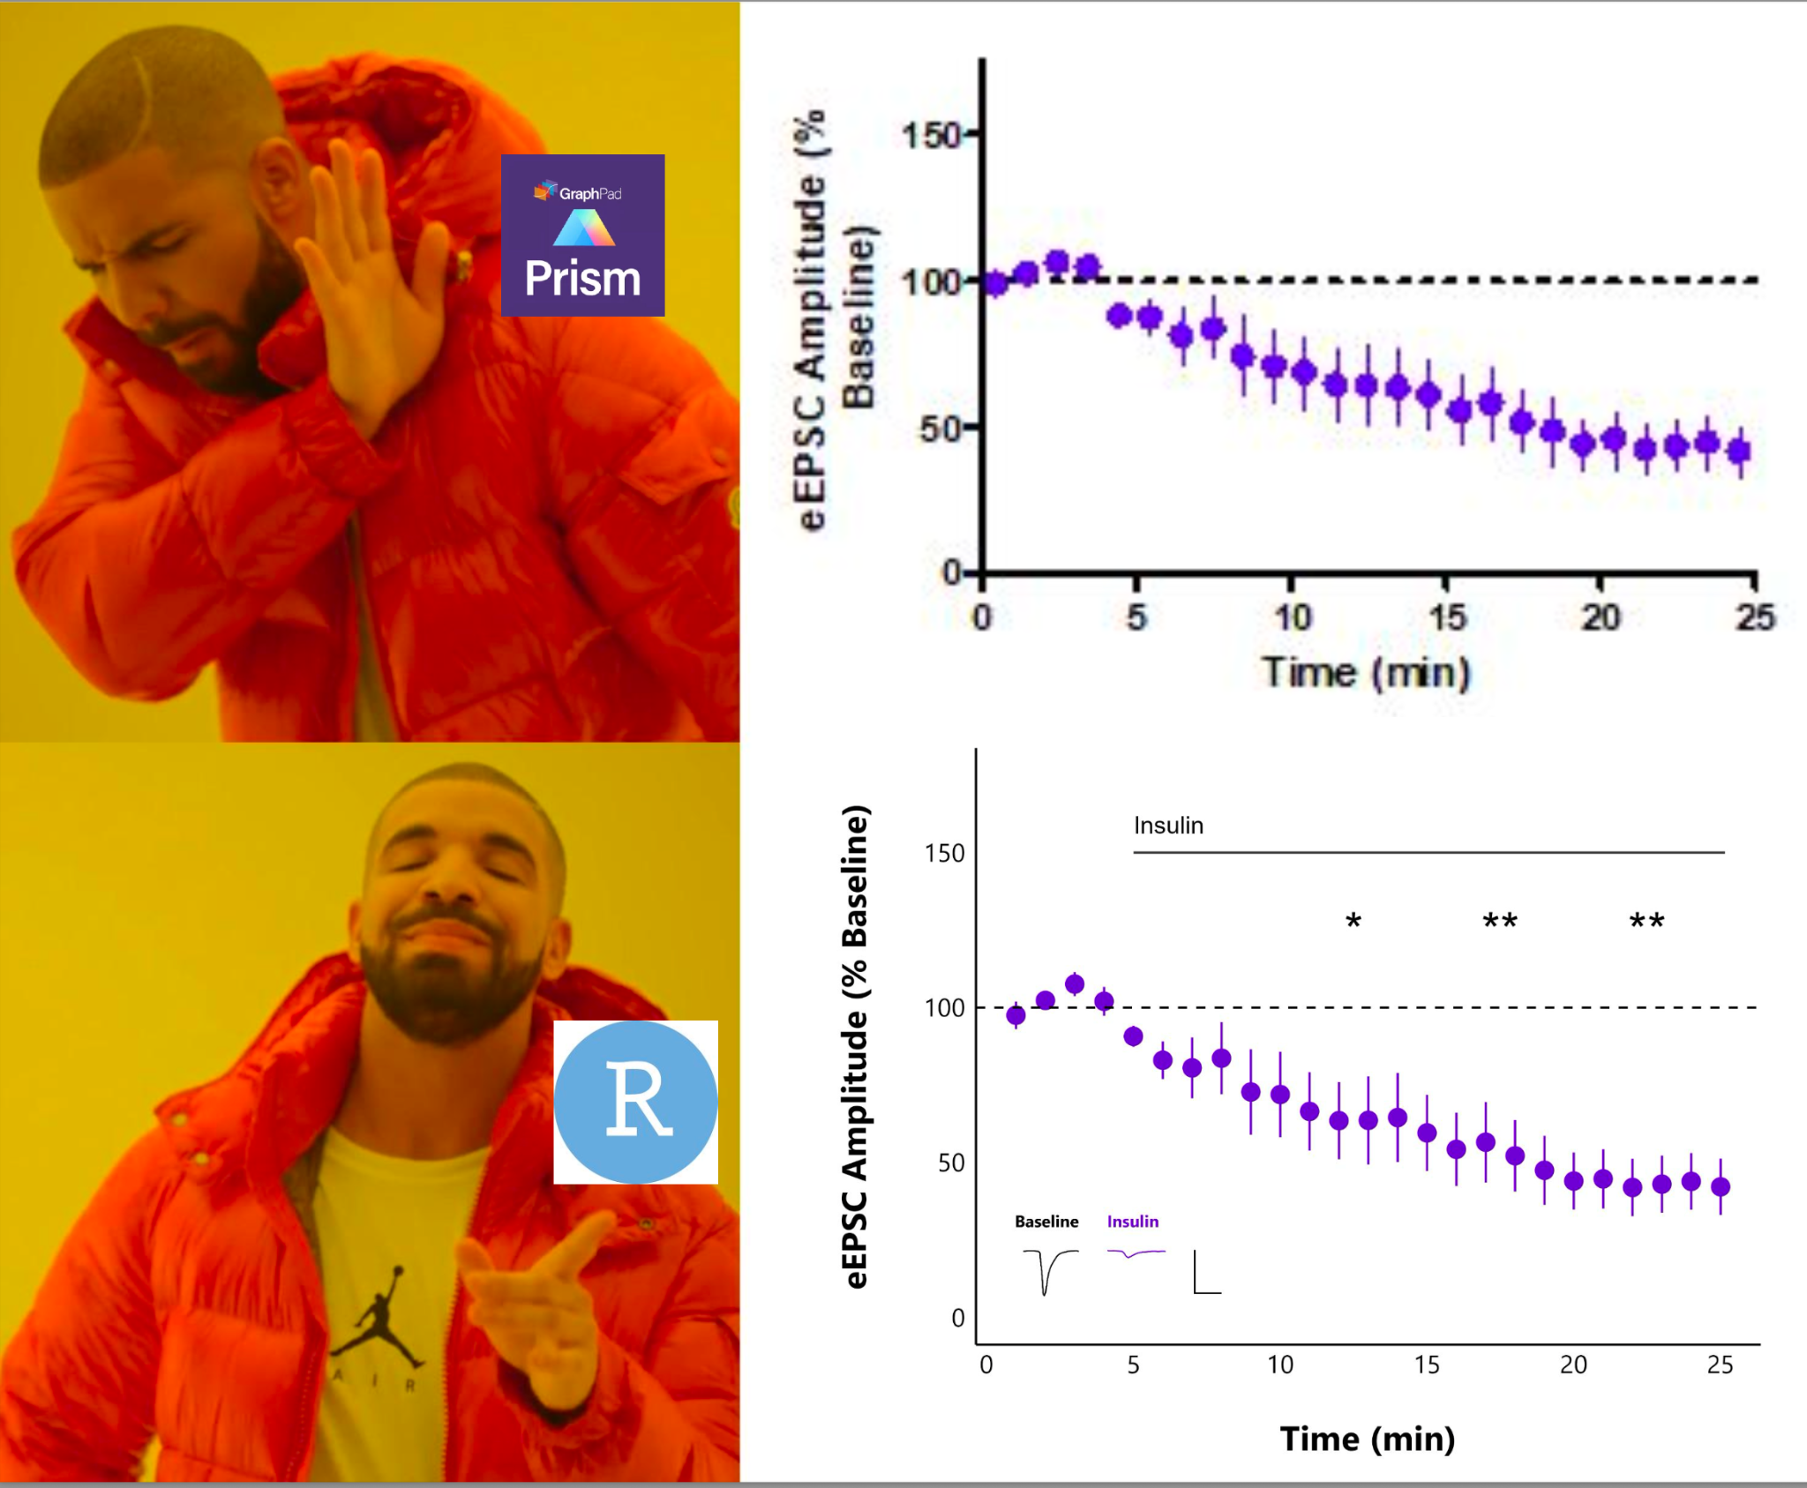

Slide 3
Notes:
BACKGROUND

Slide 4
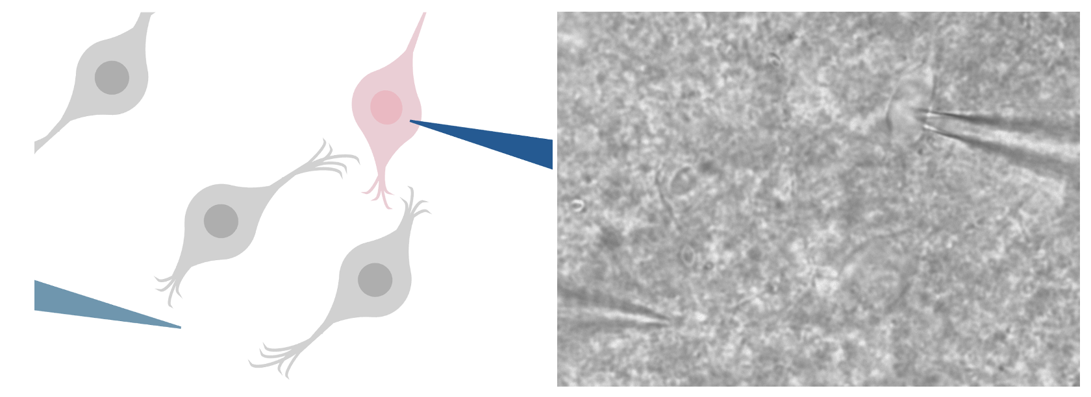
Notes:
Figure 1: Recording of live neuron. Stimulating electrode (light blue) stimulates DMH neurons
(gray) in the surrounding tissue to release neurotransmitter, while the recording electrode (dark
blue) records from the target DMH neuron (pink), visualized at 40X magnification.

Slide 5
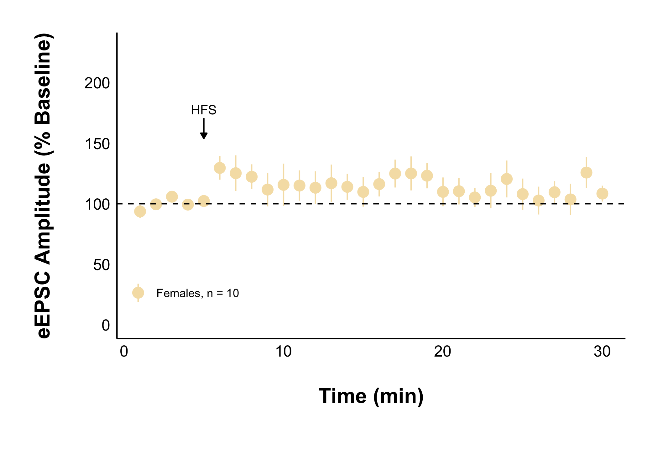
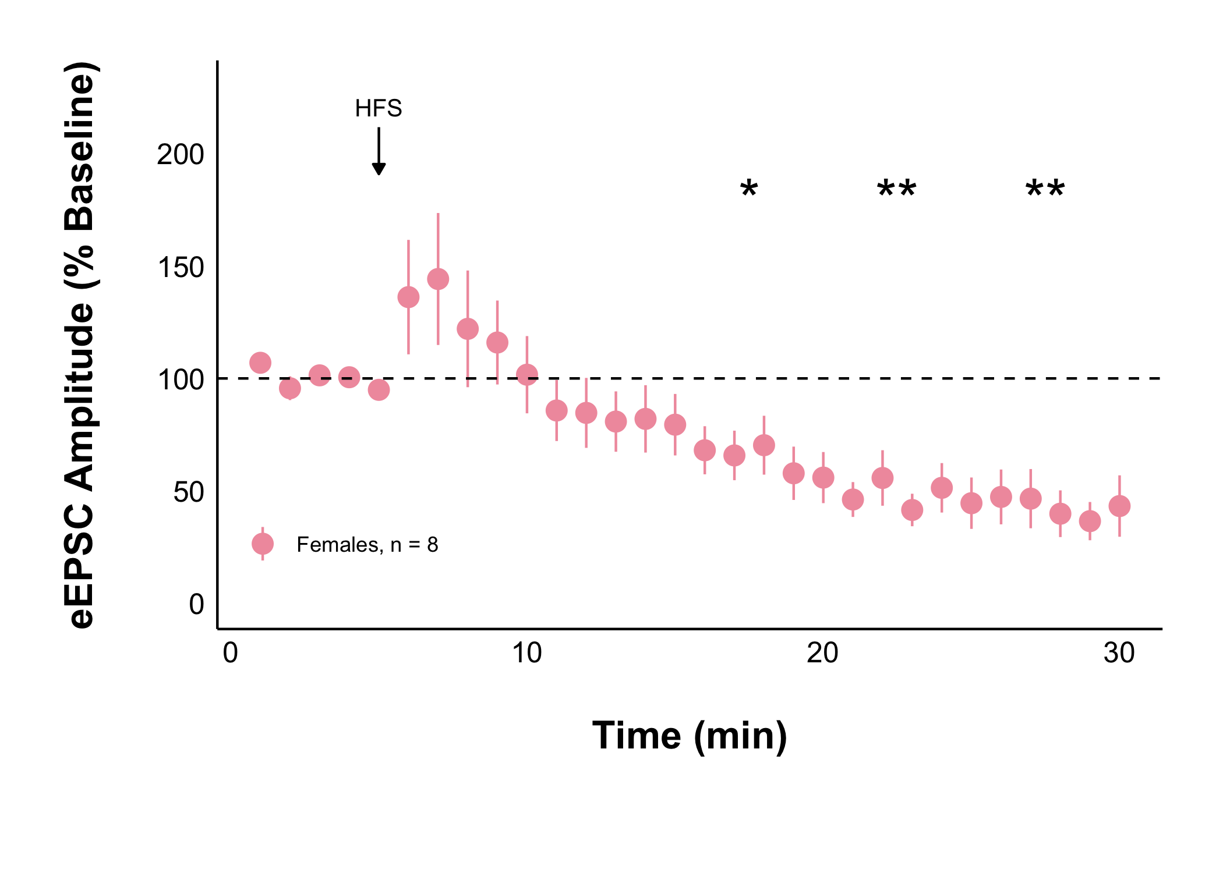
Naïve + Control Treatment
Acute Stress + Control Treatment
Acute stress decreases evoked excitatory current amplitude after HFS

Slide 6
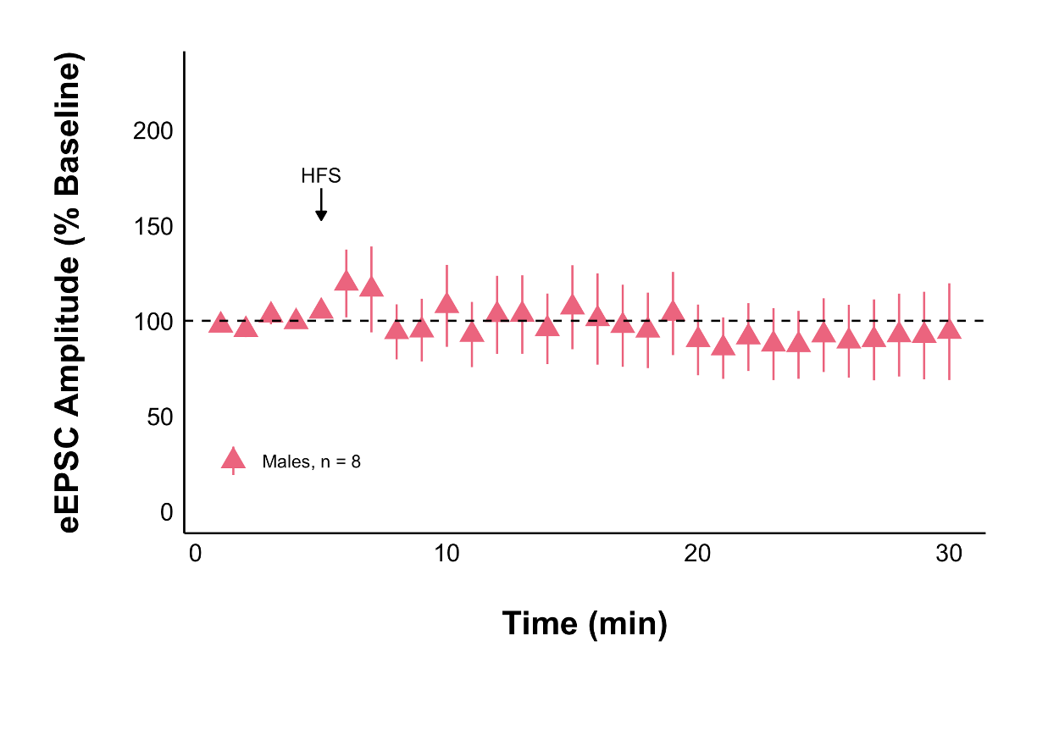
Acute Stress + Control Treatment
Acute Stress + Control Treatment
Acute stress decreases evoked excitatory current amplitude after HFS in females but not males

Slide 7
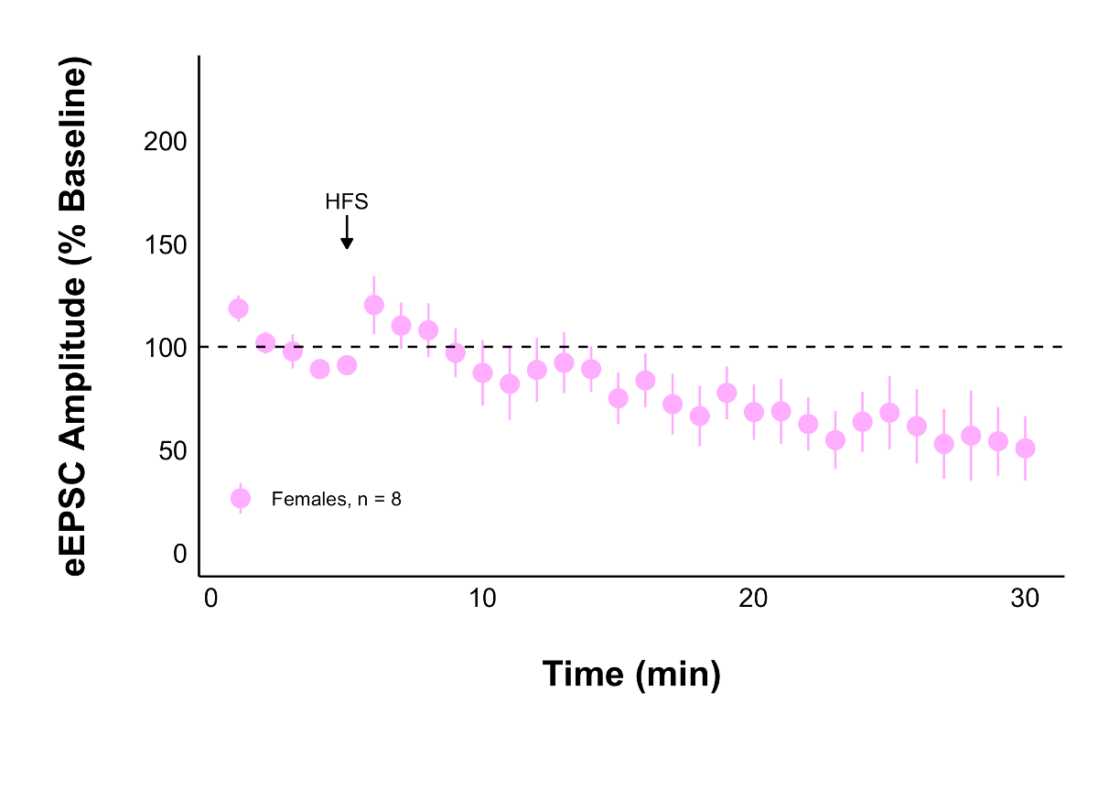
Acute Stress + AM251
Acute Stress + Control Treatment
Acute stress decreases evoked excitatory current amplitude after HFS independently of CB1Rs

Slide 8
Notes:
Next steps: repeated group
Live injections of the medication that blocks corticosterone

