Slide 1
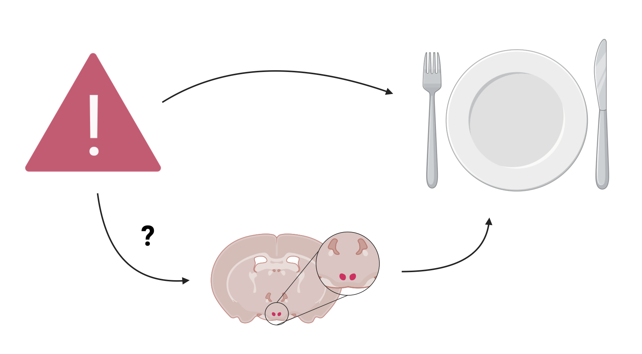
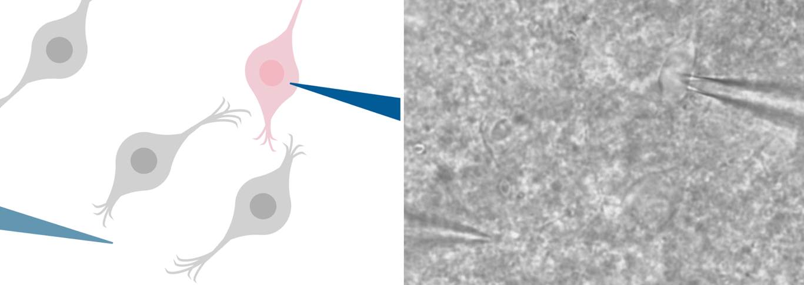
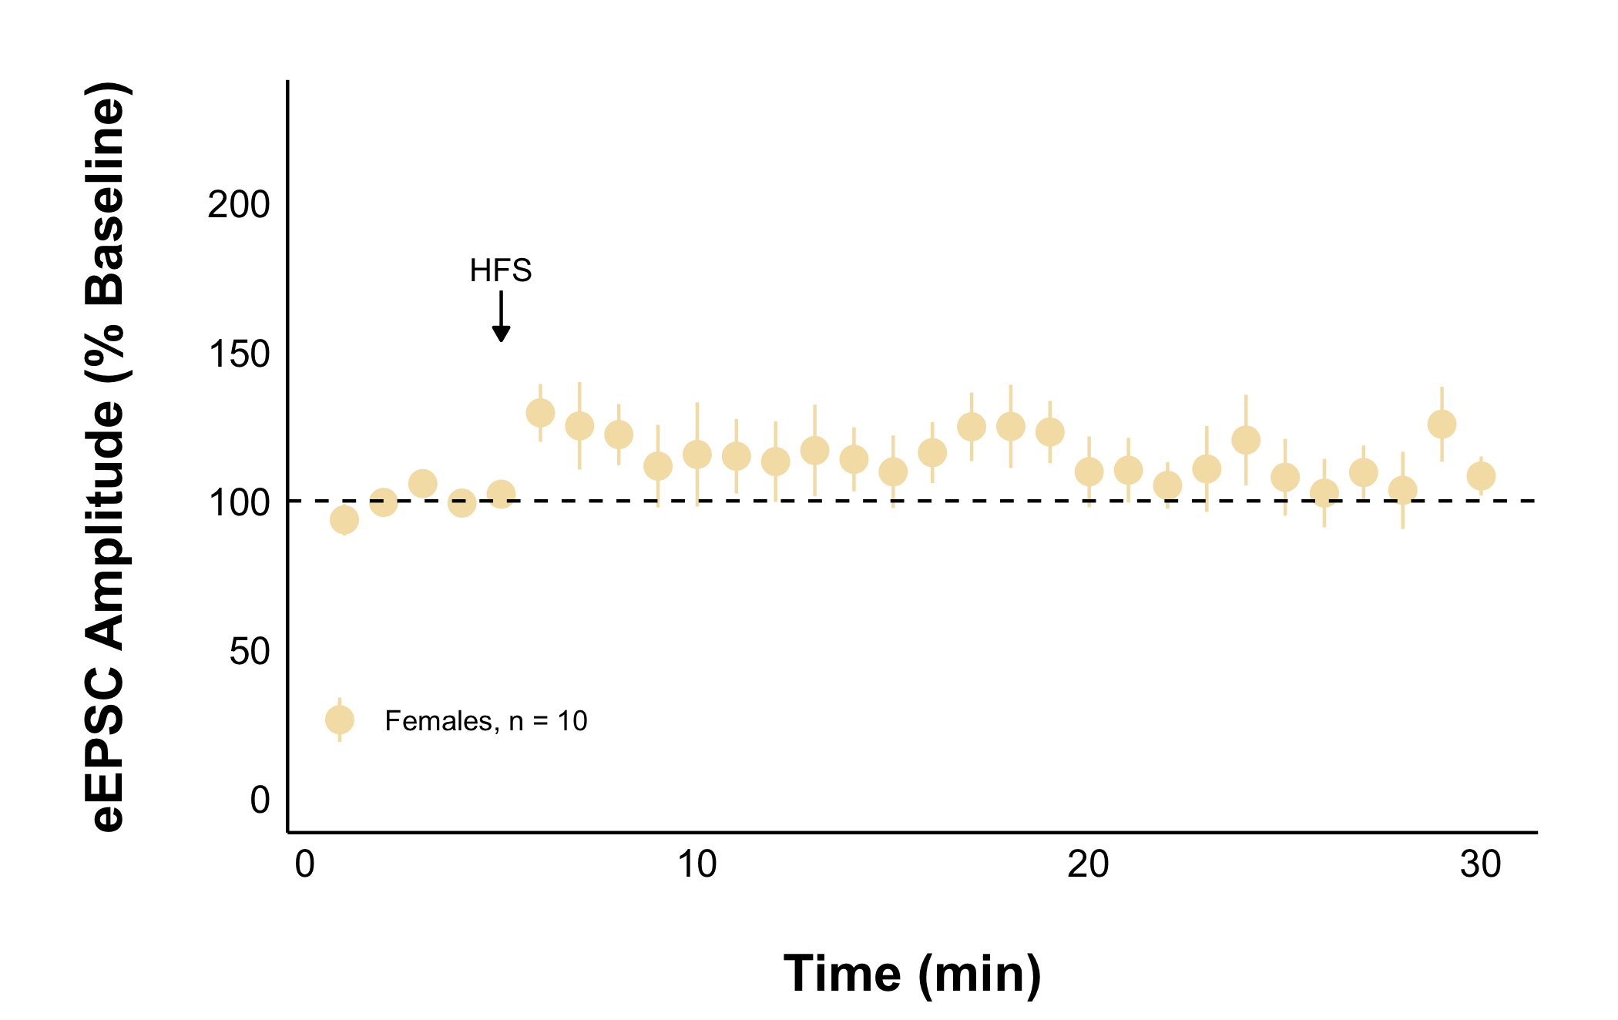
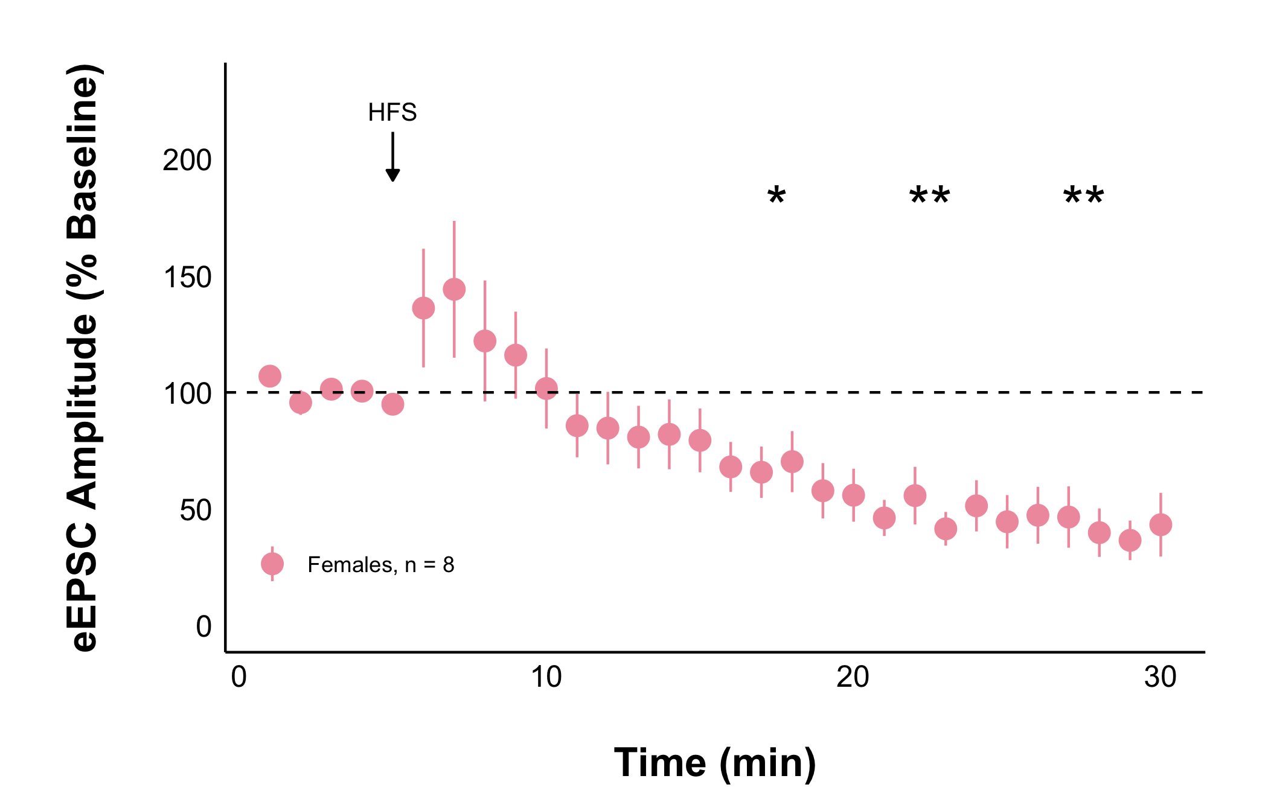
Acute Stress Decreases Activity of Appetite Regulating Neurons in the Female Rat Dorsomedial Hypothalamus
Ruby Muzzatti, Dr Karen Crosby
Department of Biology, Mount Allison University, Sackville, New Brunswick, Canada
Acute stress decreases activity of neurons that regulate appetite
Current Amplitude
Current Amplitude
Time (minutes)
Time (minutes)

