Slide 1
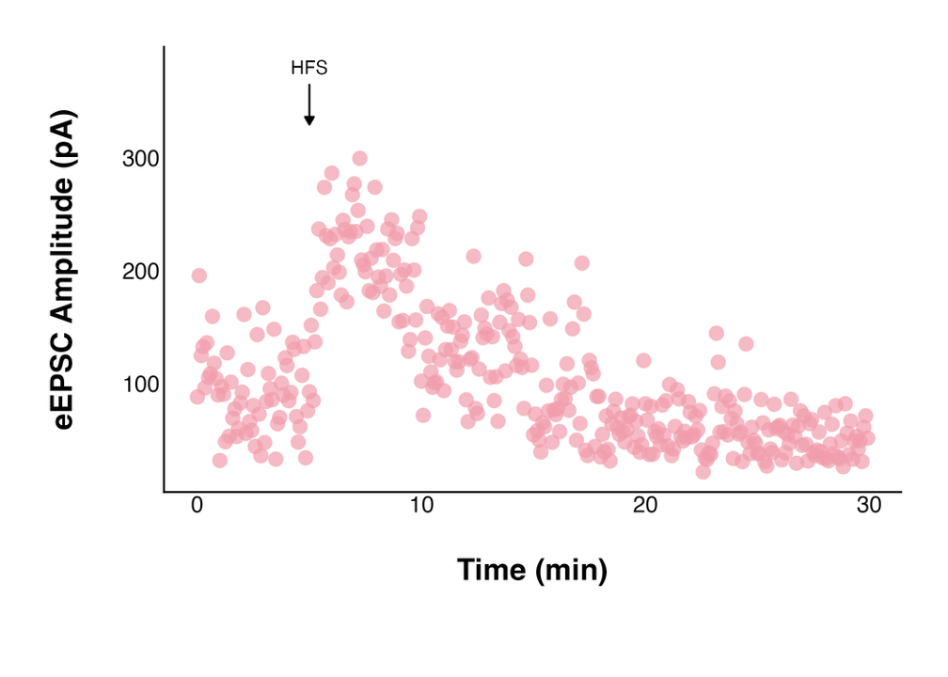
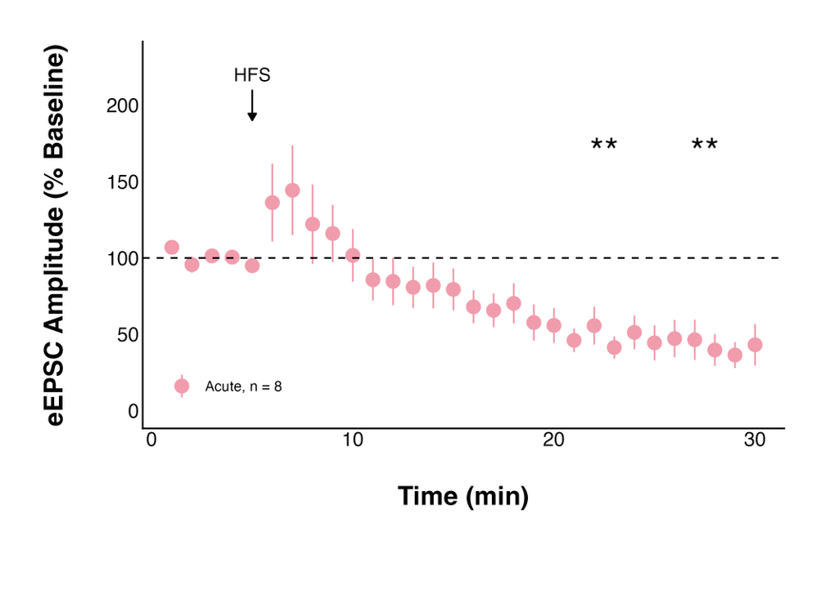
A.
Baseline
Post-HFS
B.
C.

Slide 2
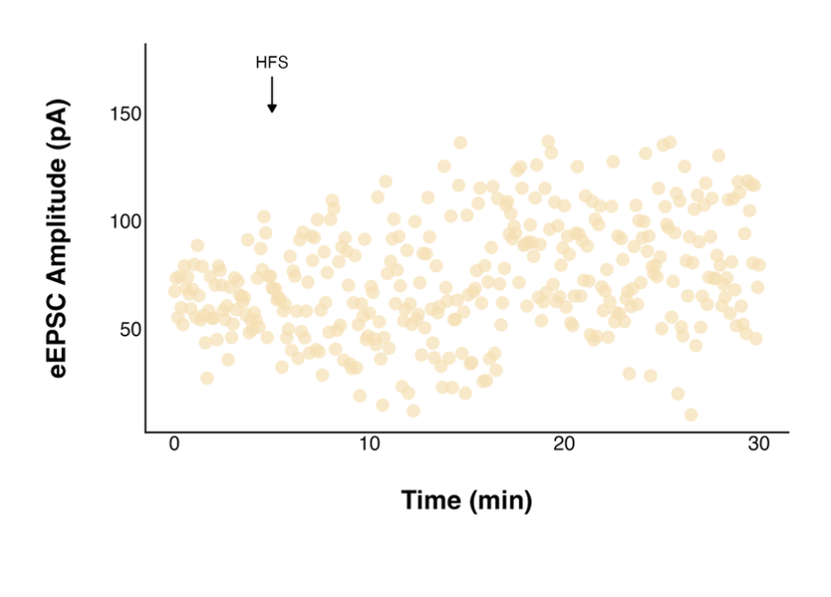
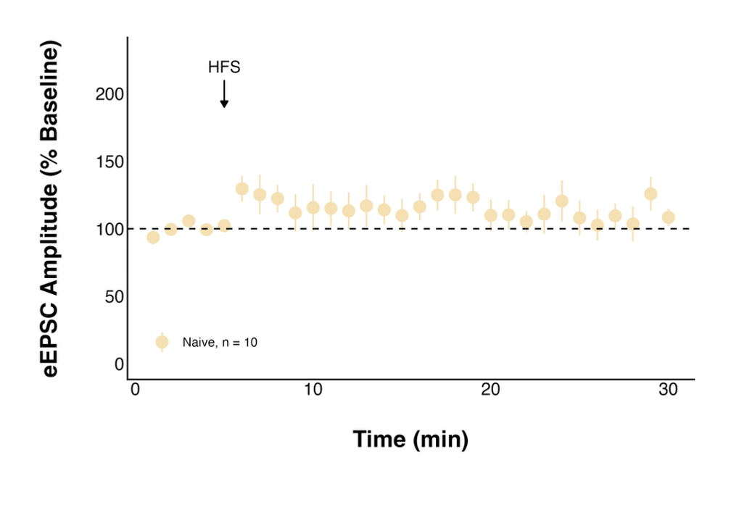
A.
Baseline
Post-HFS
B.
C.

Slide 3
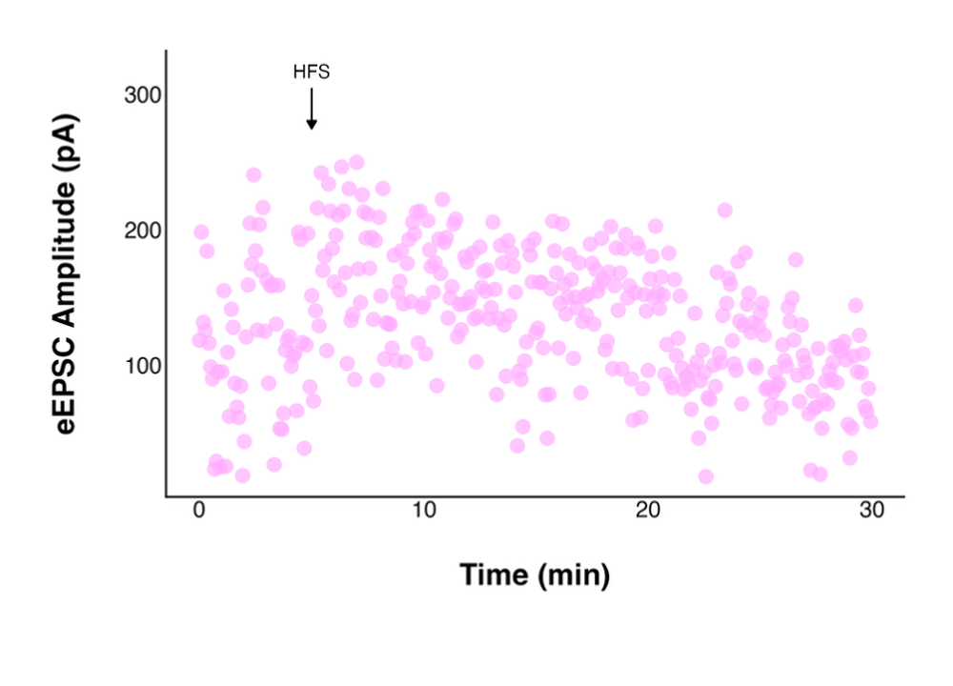
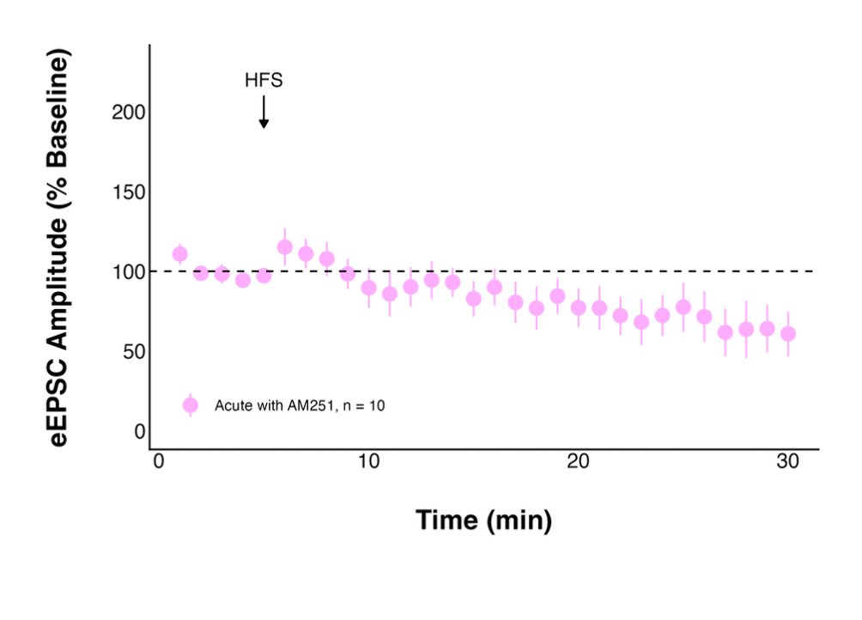
A.
Baseline
Post-HFS
B.
C.

Slide 4
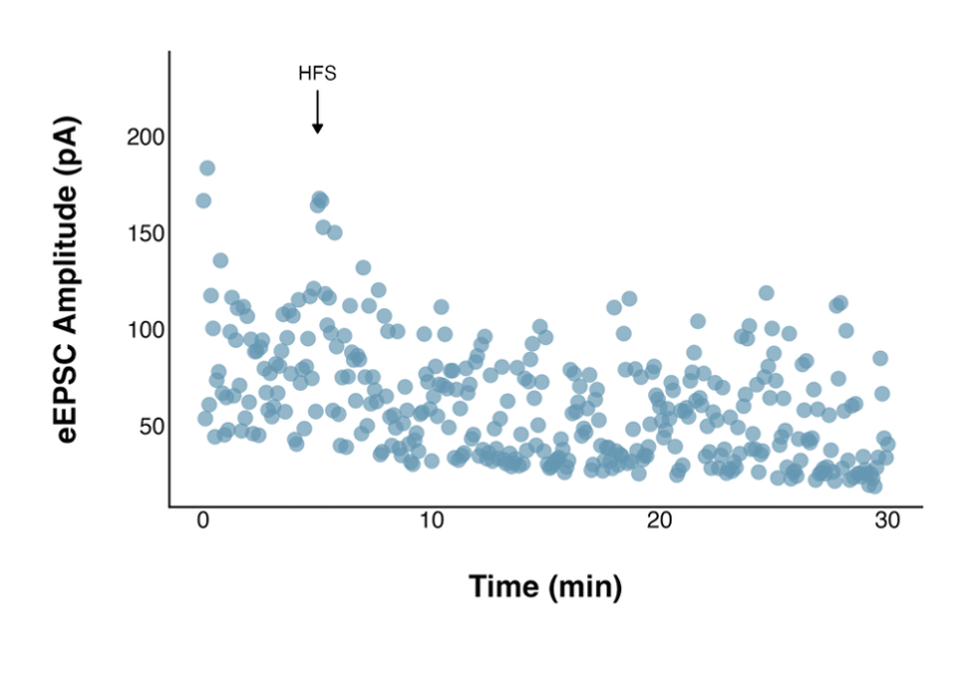
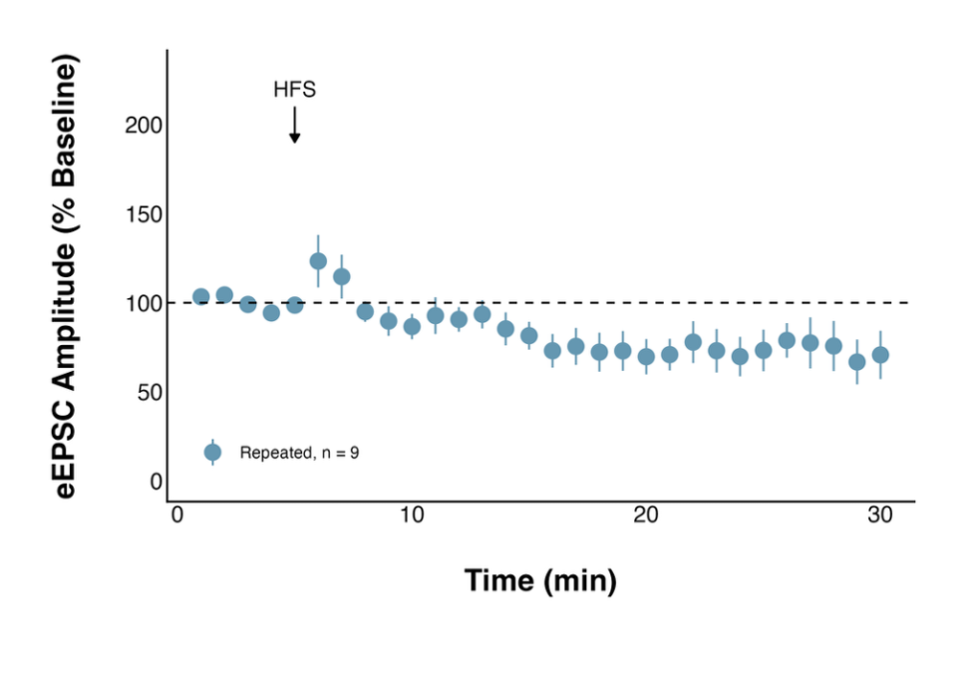
A.
Baseline
Post-HFS
B.
C.

Slide 5
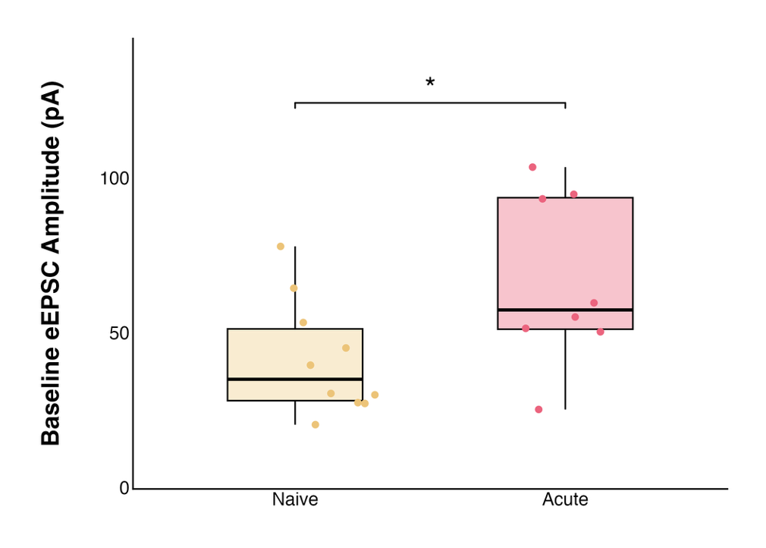
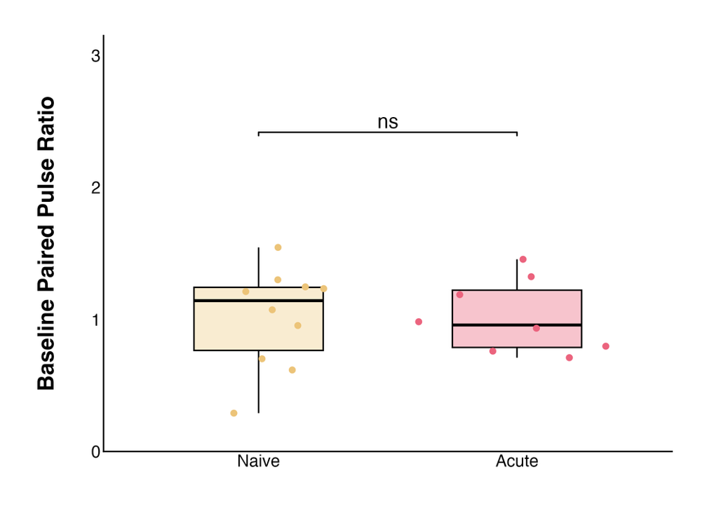
A.
B.
Notes:
PPR: 1.02 ± 0.10 at baseline to 1.46 ± 0.17 post-HFS, n = 8, paired t-test
t = 2.8363, df = 7, p-value = 0.02518
t = -2.2068, df = 7, p-value = 0.06309

Slide 6
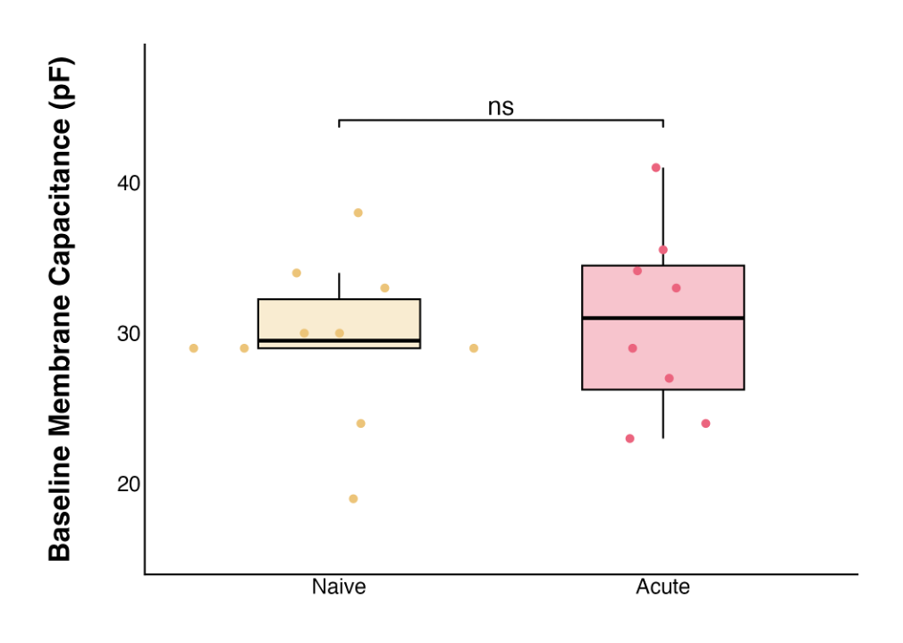
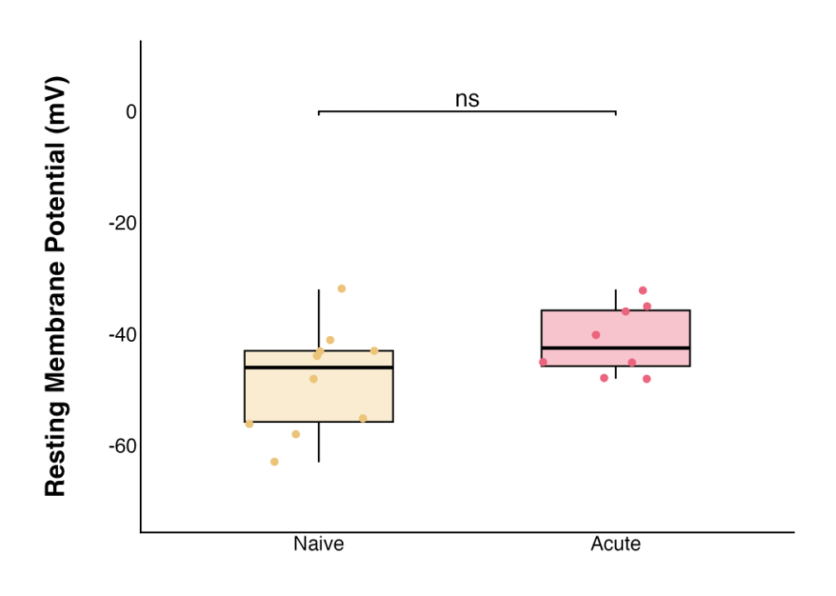
A.
B.
Notes:
PPR: 1.02 ± 0.10 at baseline to 1.46 ± 0.17 post-HFS, n = 8, paired t-test
t = 2.8363, df = 7, p-value = 0.02518
t = -2.2068, df = 7, p-value = 0.06309

Slide 7
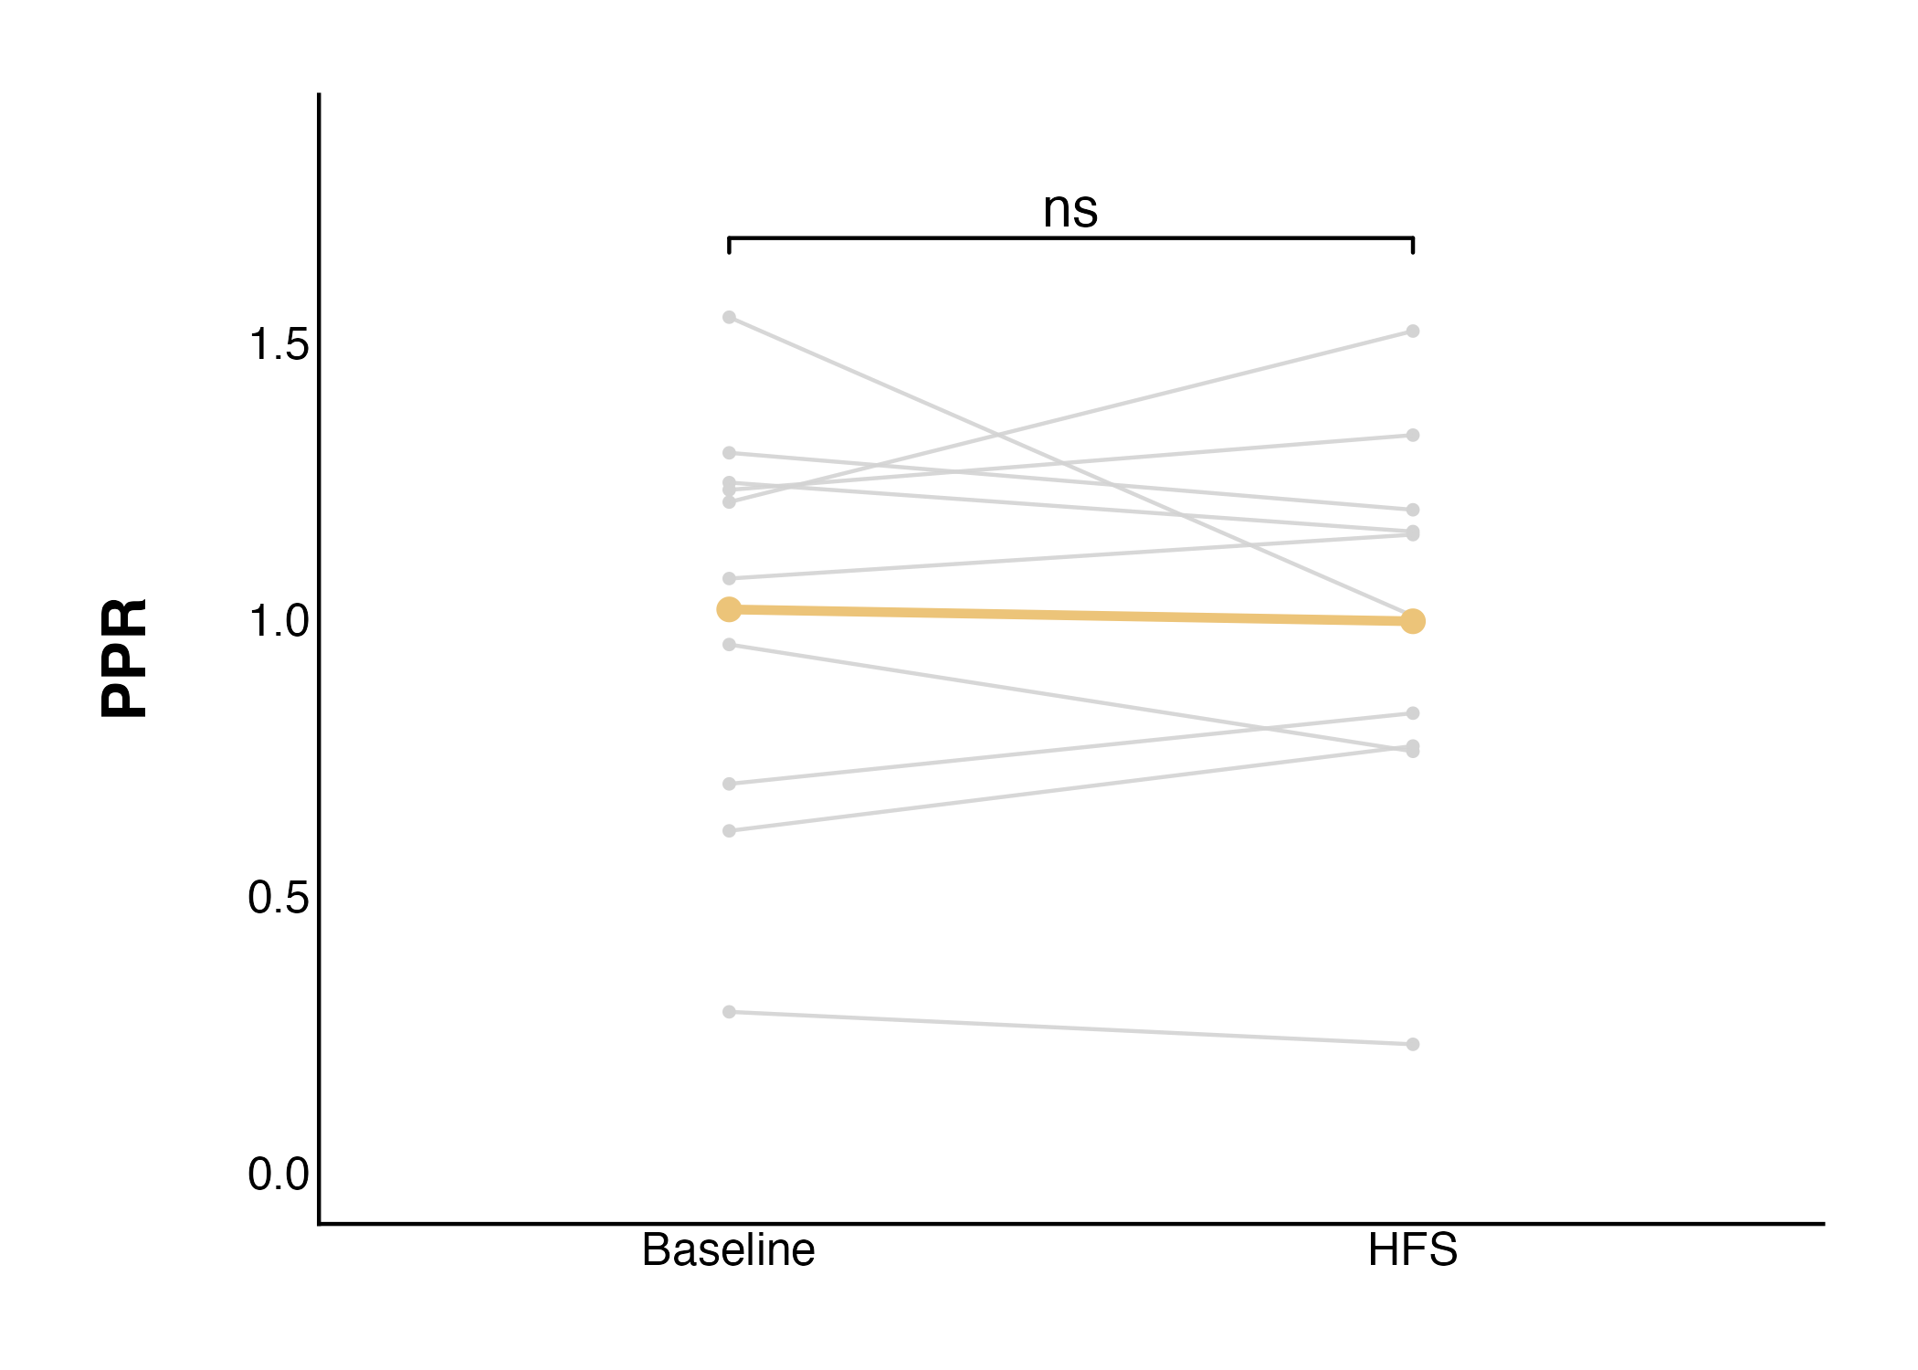
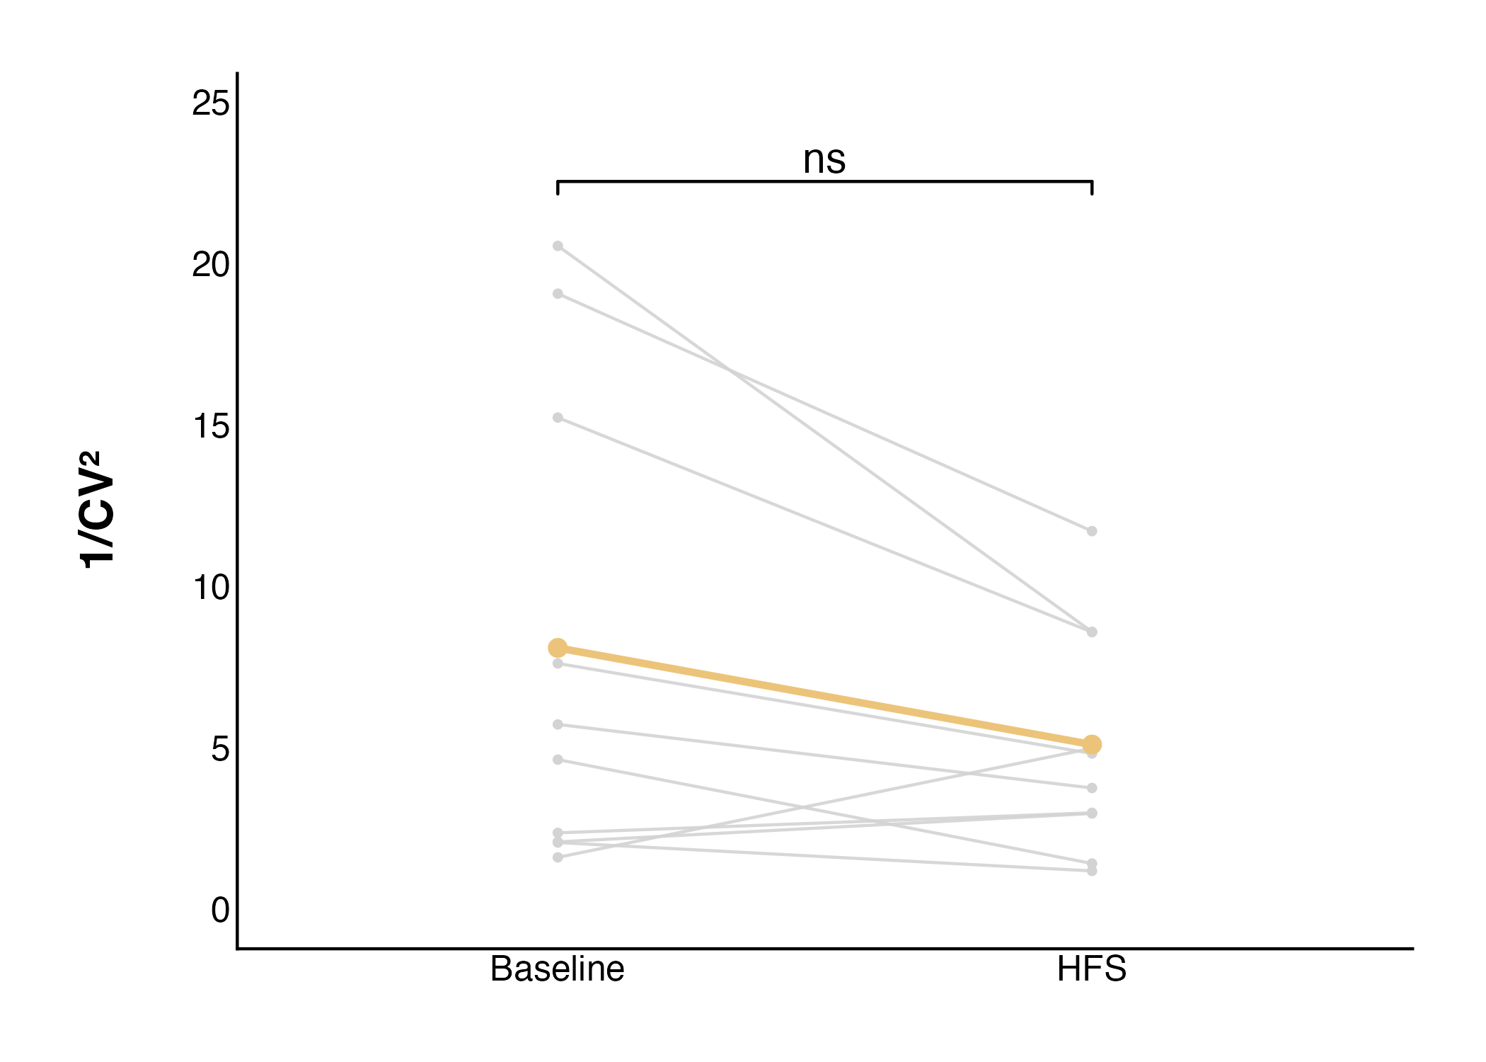
A.
B.
Notes:
PPR: 1.02 ± 0.12 at baseline to 1.00 ± 0.12 post-HFS, n = 10, paired t-test
PPR: t = -0.28857, df = 9, p-value = 0.7794

Slide 8
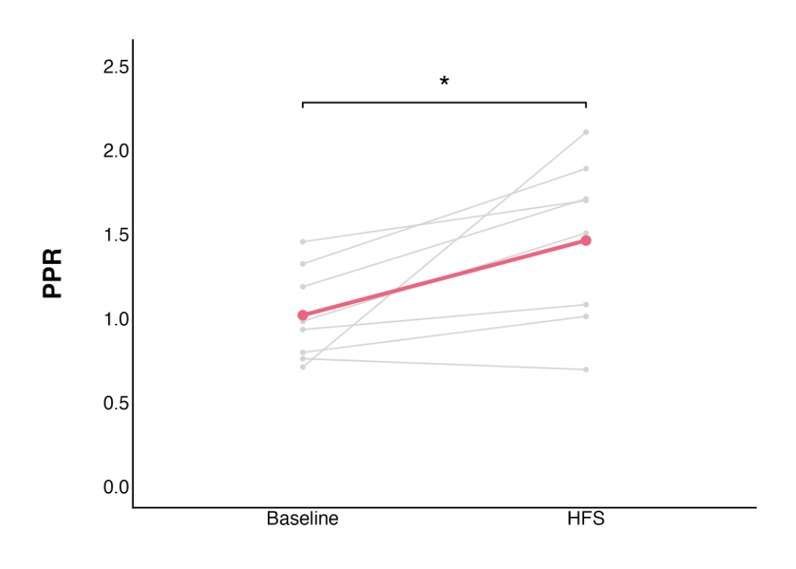
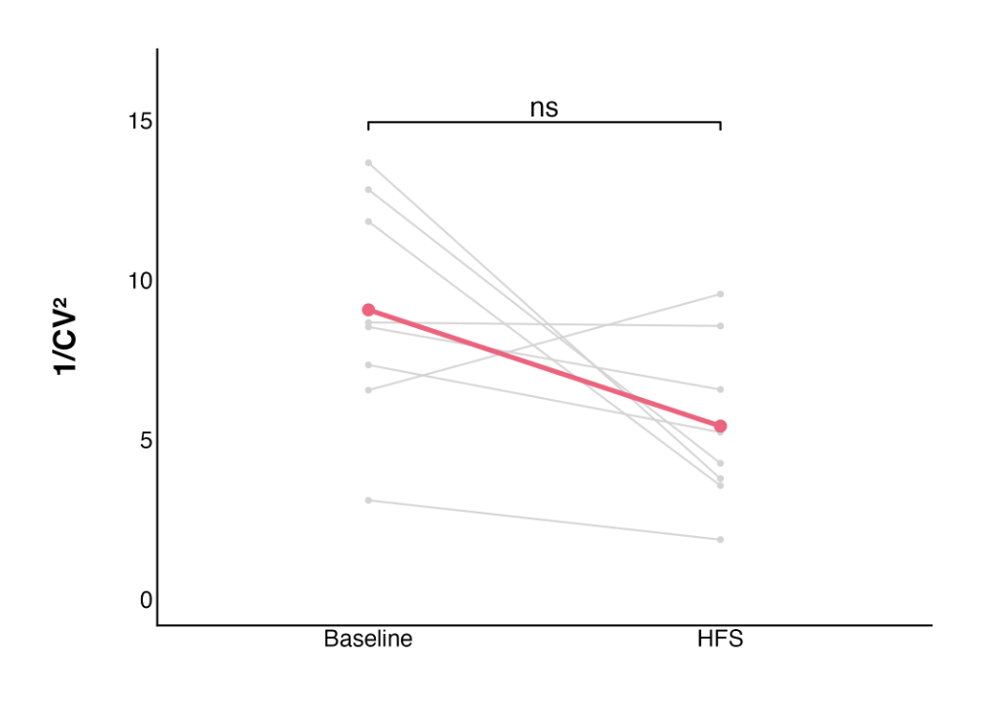
A.
B.
Notes:
PPR: 1.02 ± 0.10 at baseline to 1.46 ± 0.17 post-HFS, n = 8, paired t-test
t = 2.8363, df = 7, p-value = 0.02518
t = -2.2068, df = 7, p-value = 0.06309

Slide 9
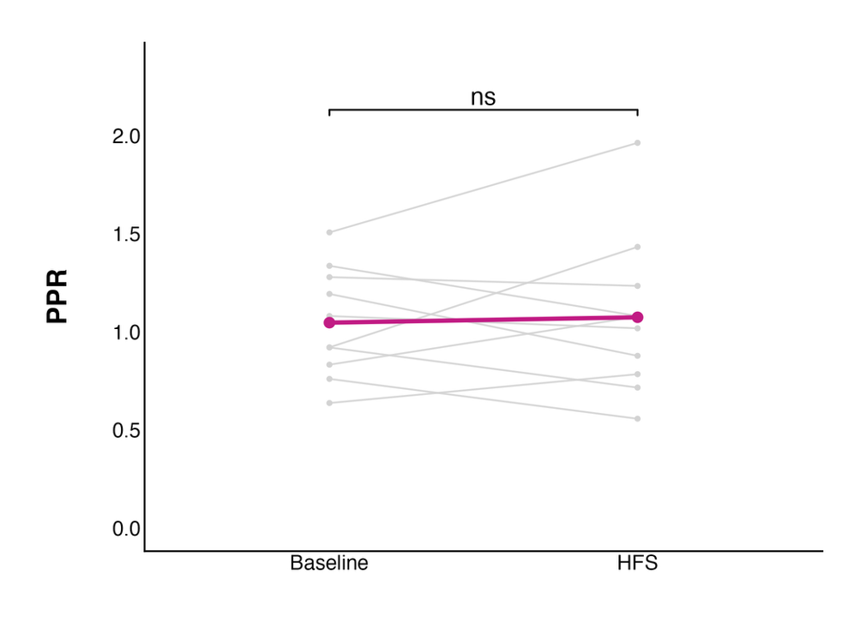
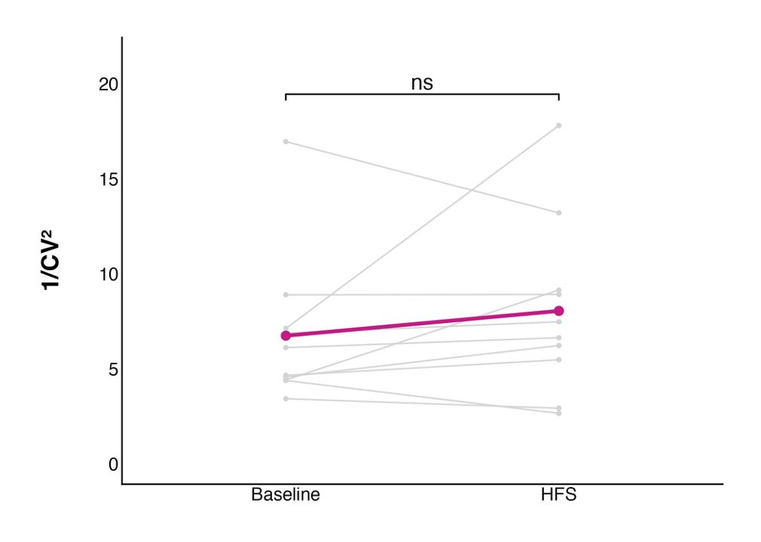
A.
B.
Notes:
PPR: 1.05 ± 0.09 to 1.07 ± 0.13, n = 10, paired t-test
t = 0.29187, df = 9, p-value = 0.777
t = 1.0427, df = 9, p-value = 0.3243

Slide 10
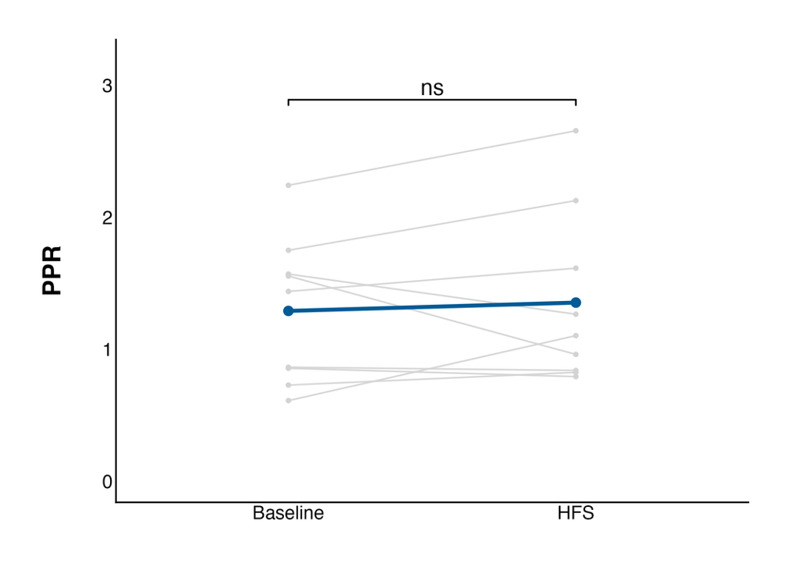
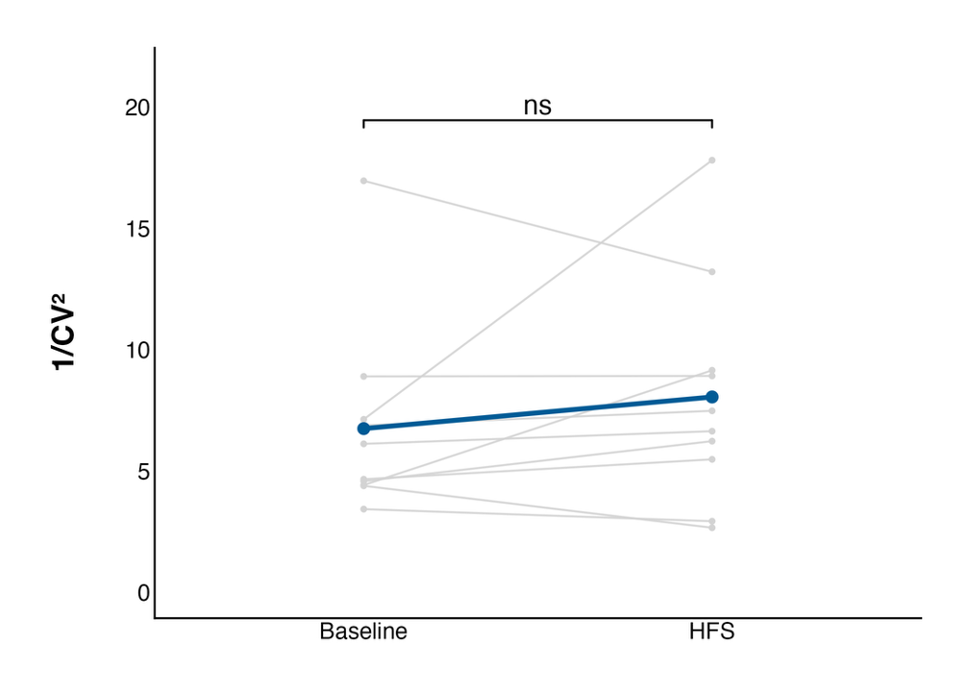
A.
B.
Notes:
PPR: 1.29 ± 0.18 to 1.35 ± 0.22, n = 9, paired t-test
t = 0.53352, df = 8, p-value = 0.6082
t = 0.32925, df = 8, p-value = 0.7504

Slide 11
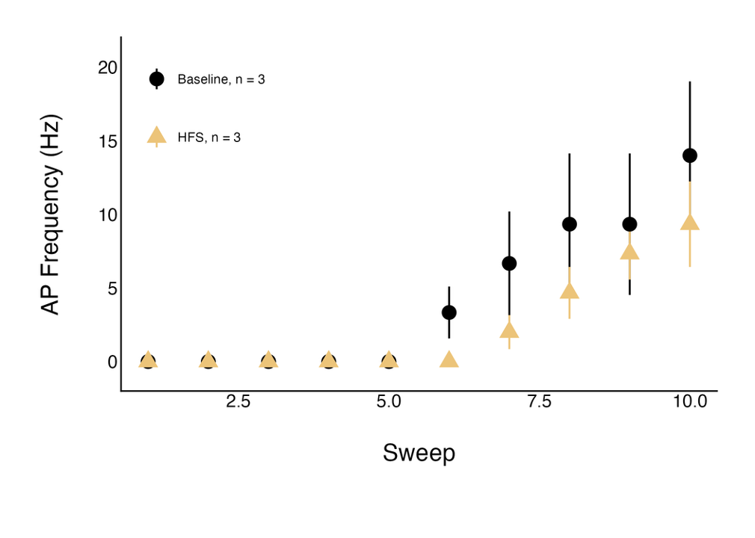
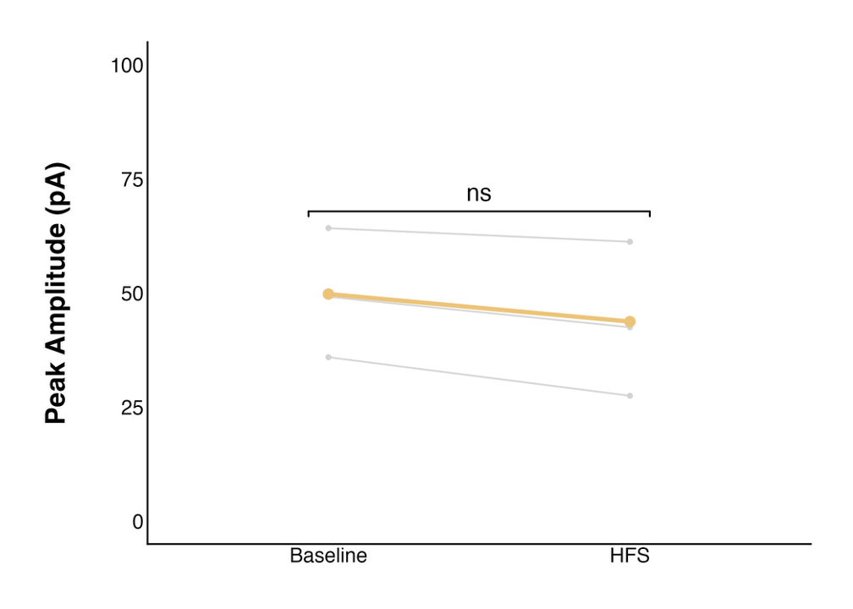
A.
Effect of state on AP frequency : p = 0.1553
B.

Slide 12
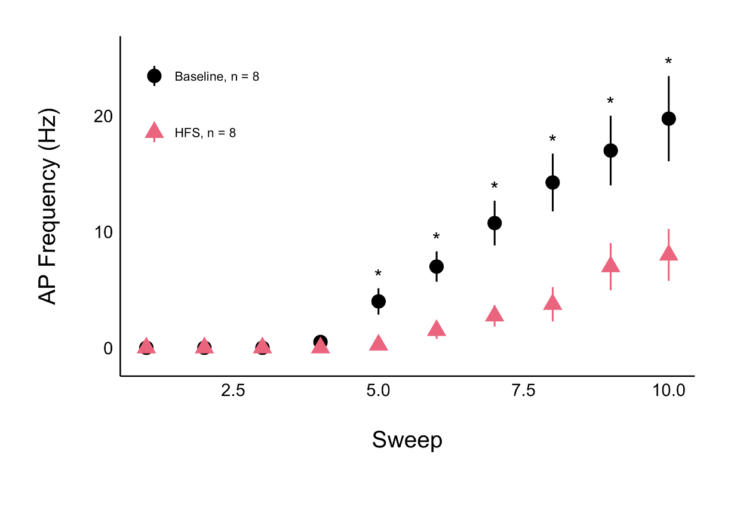
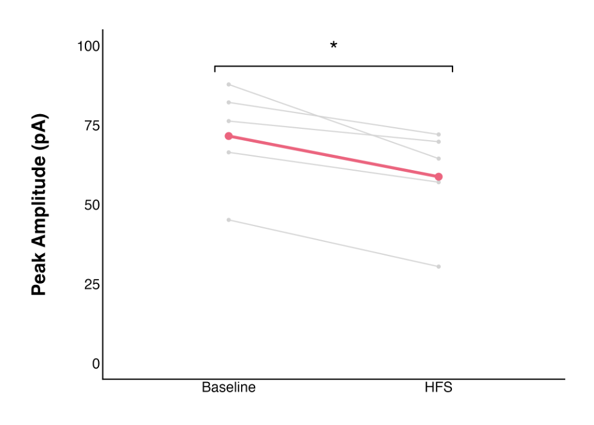
A.
Effect of state on AP frequency : p < 0.0001
B.

Slide 13
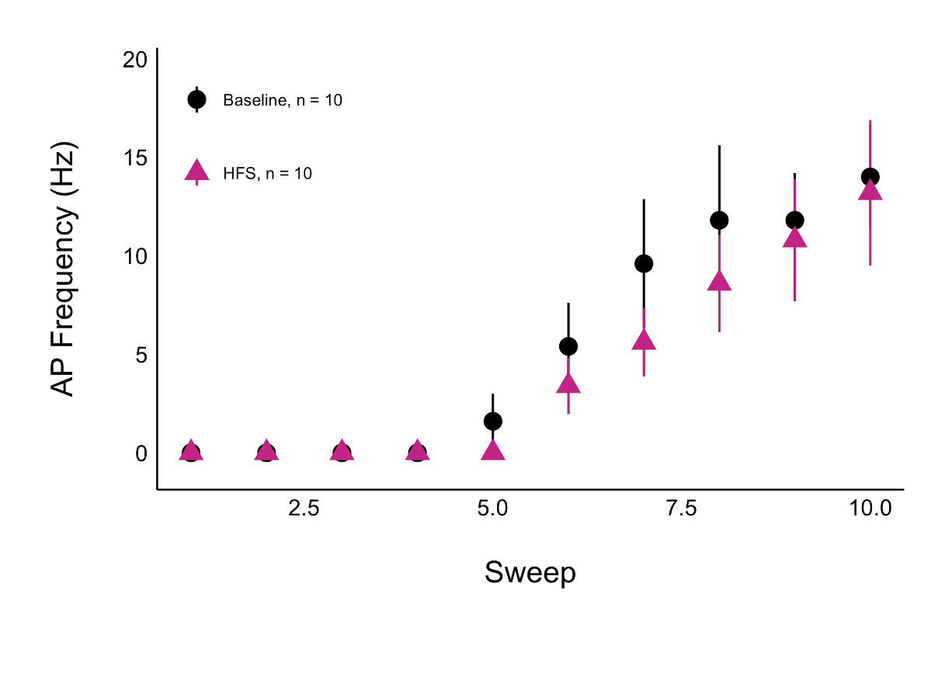
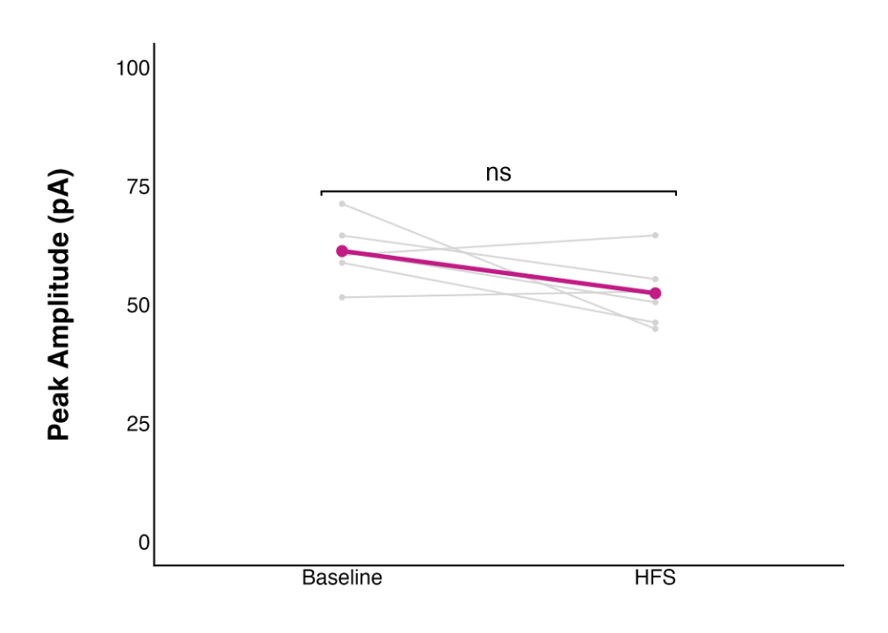
A.
Effect of state on AP frequency : p = 0.2245
B.

Slide 14
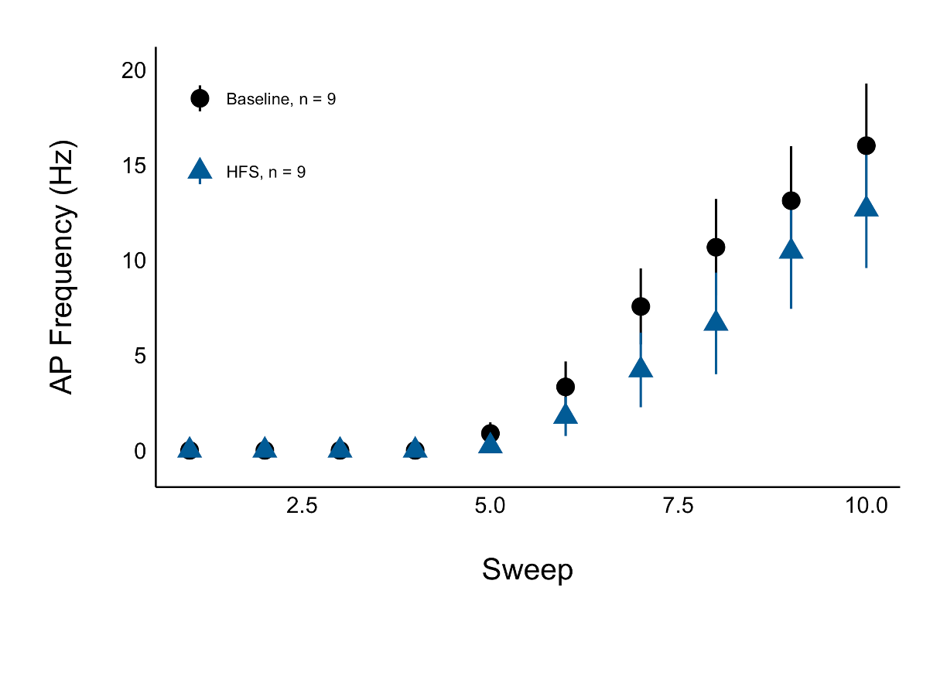
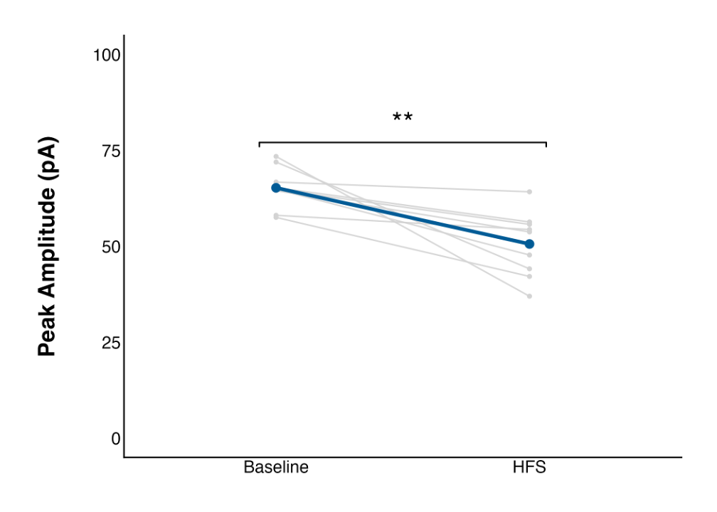
A.
Effect of state on AP frequency : p = 0.1197
B.

