Slide 1
Acute stress decreases the long-term activity of appetite regulating neurons in the hypothalamus
Ruby Muzzatti
July 3, 2025

Slide 2
May & June Wrapped
19
17
4
Full-length cells recorded
Good full- length cells
Record cell day
450
2.1
1.9
Minutes spent watching tube
Cells:Animal
ratio
Good cells:Animal ratio

Slide 3
May & June Wrapped
19
17
4
Full-length cells recorded
Good full- length cells
Record cell day
450
2.1
1.9
Minutes spent watching tube
Cells:Animal
ratio
Good cells:Animal ratio

Slide 4
May & June Wrapped
19
17
4
Full-length cells recorded
Good full- length cells
Record cell day
450
2.1
1.9
Minutes spent watching tube
Cells:Animal
ratio
Good cells:Animal ratio

Slide 5
May & June Wrapped
19
17
4
Full-length cells recorded
Good full- length cells
Record cell day
450
2.1
1.9
Minutes spent watching tube
Cells:Animal
ratio
Good cells:Animal ratio

Slide 6
May & June Wrapped
19
17
4
Full-length cells recorded
Good full- length cells
Record cell day
450
2.1
1.9
Minutes spent watching tube
Cells:Animal
ratio
Good cells:Animal ratio

Slide 7
May & June Wrapped
19
17
4
Full-length cells recorded
Good full- length cells
Record cell day
450
2.1
1.9
Minutes spent watching tube
Cell:Animal
ratio
Good cells:Animal ratio

Slide 8
May & June Wrapped
19
17
4
Full-length cells recorded
Good full- length cells
Record cell day
450
2.1
1.9
Minutes spent watching tube
Cell:Animal
ratio
Good cell:Animal ratio

Slide 9
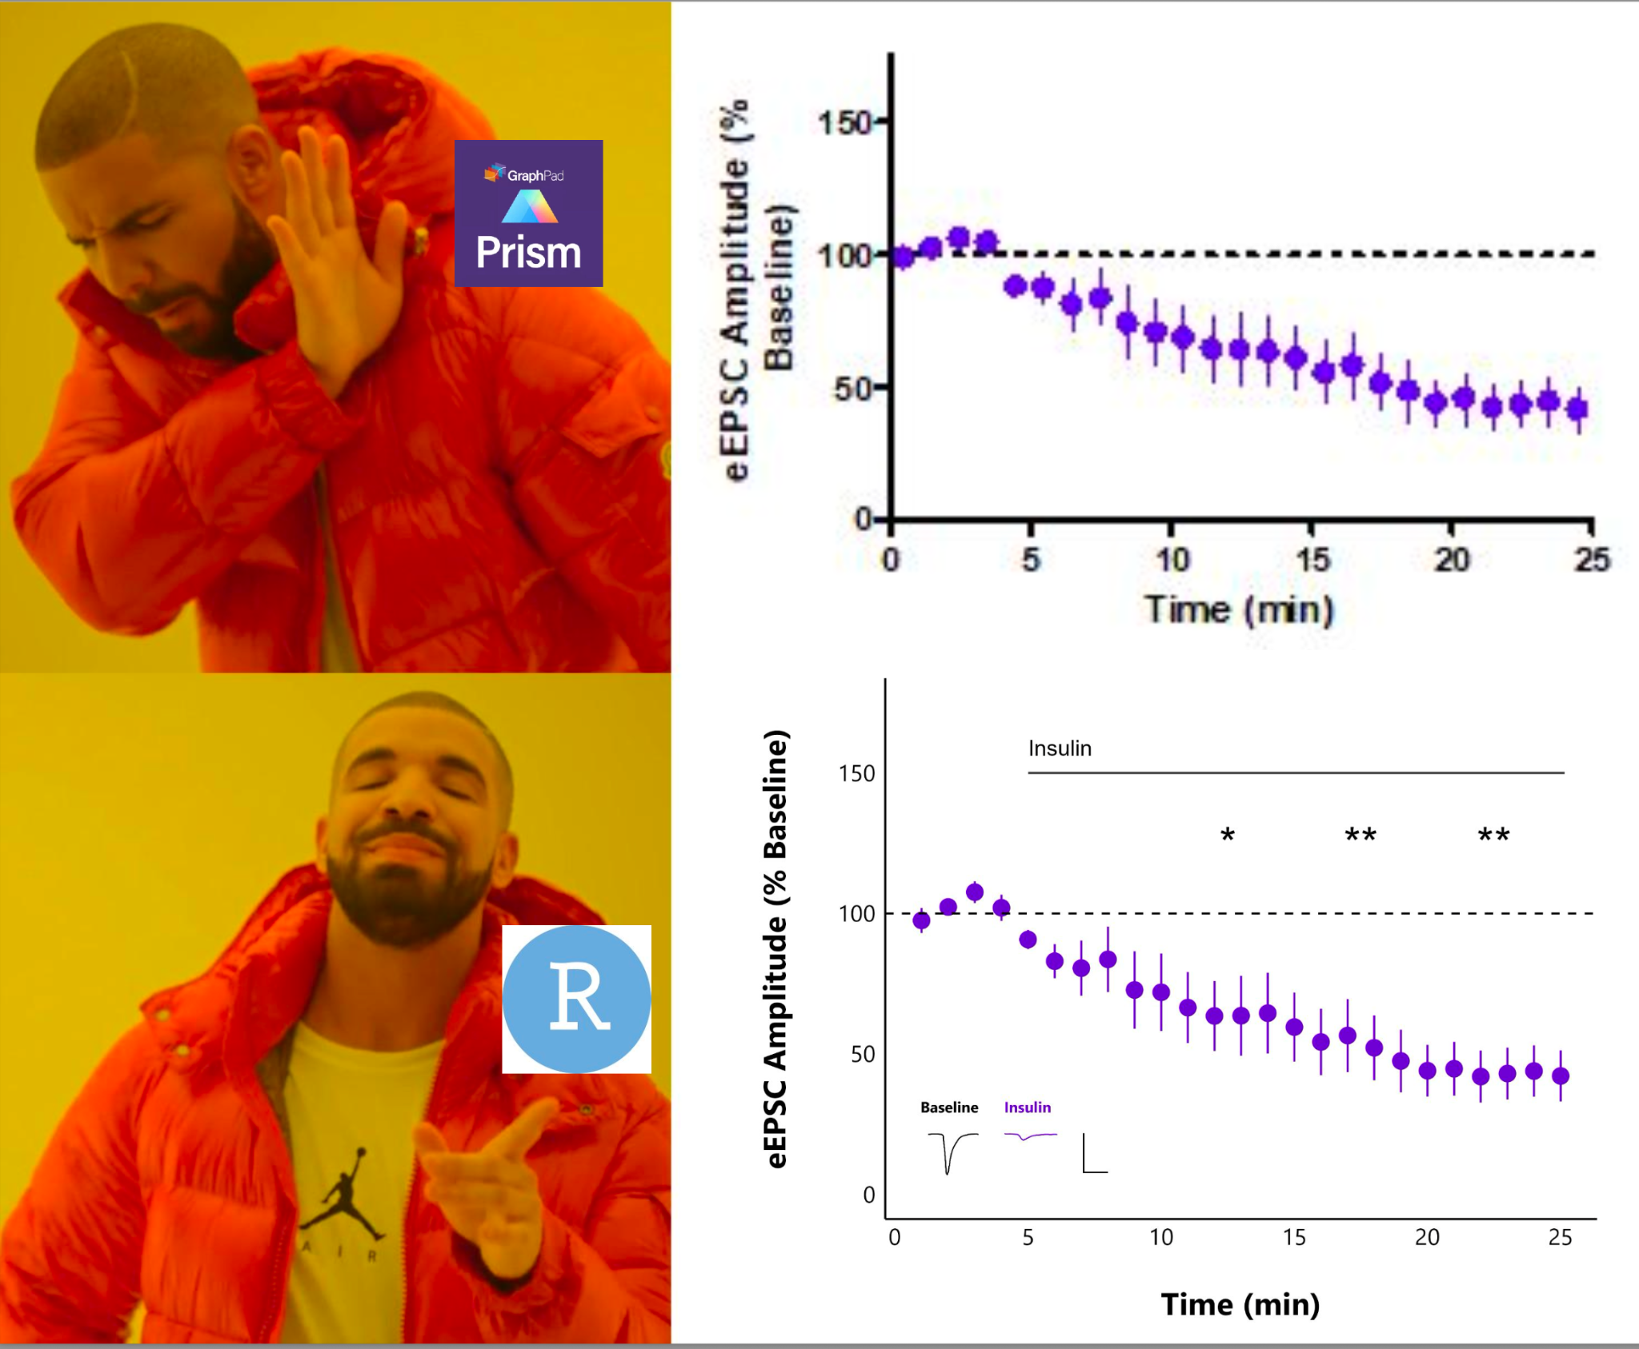

Slide 10
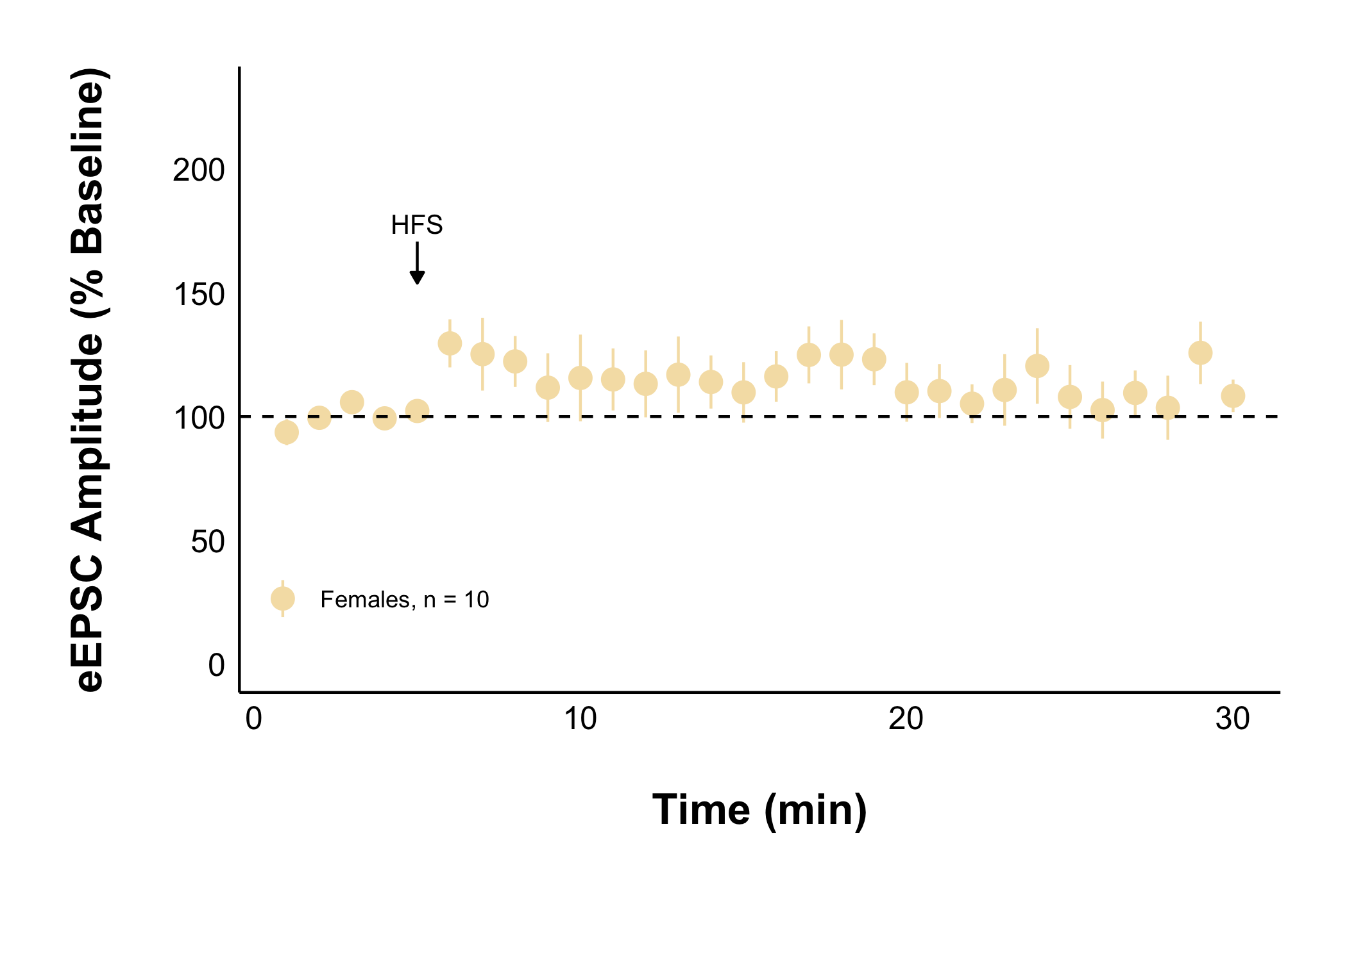
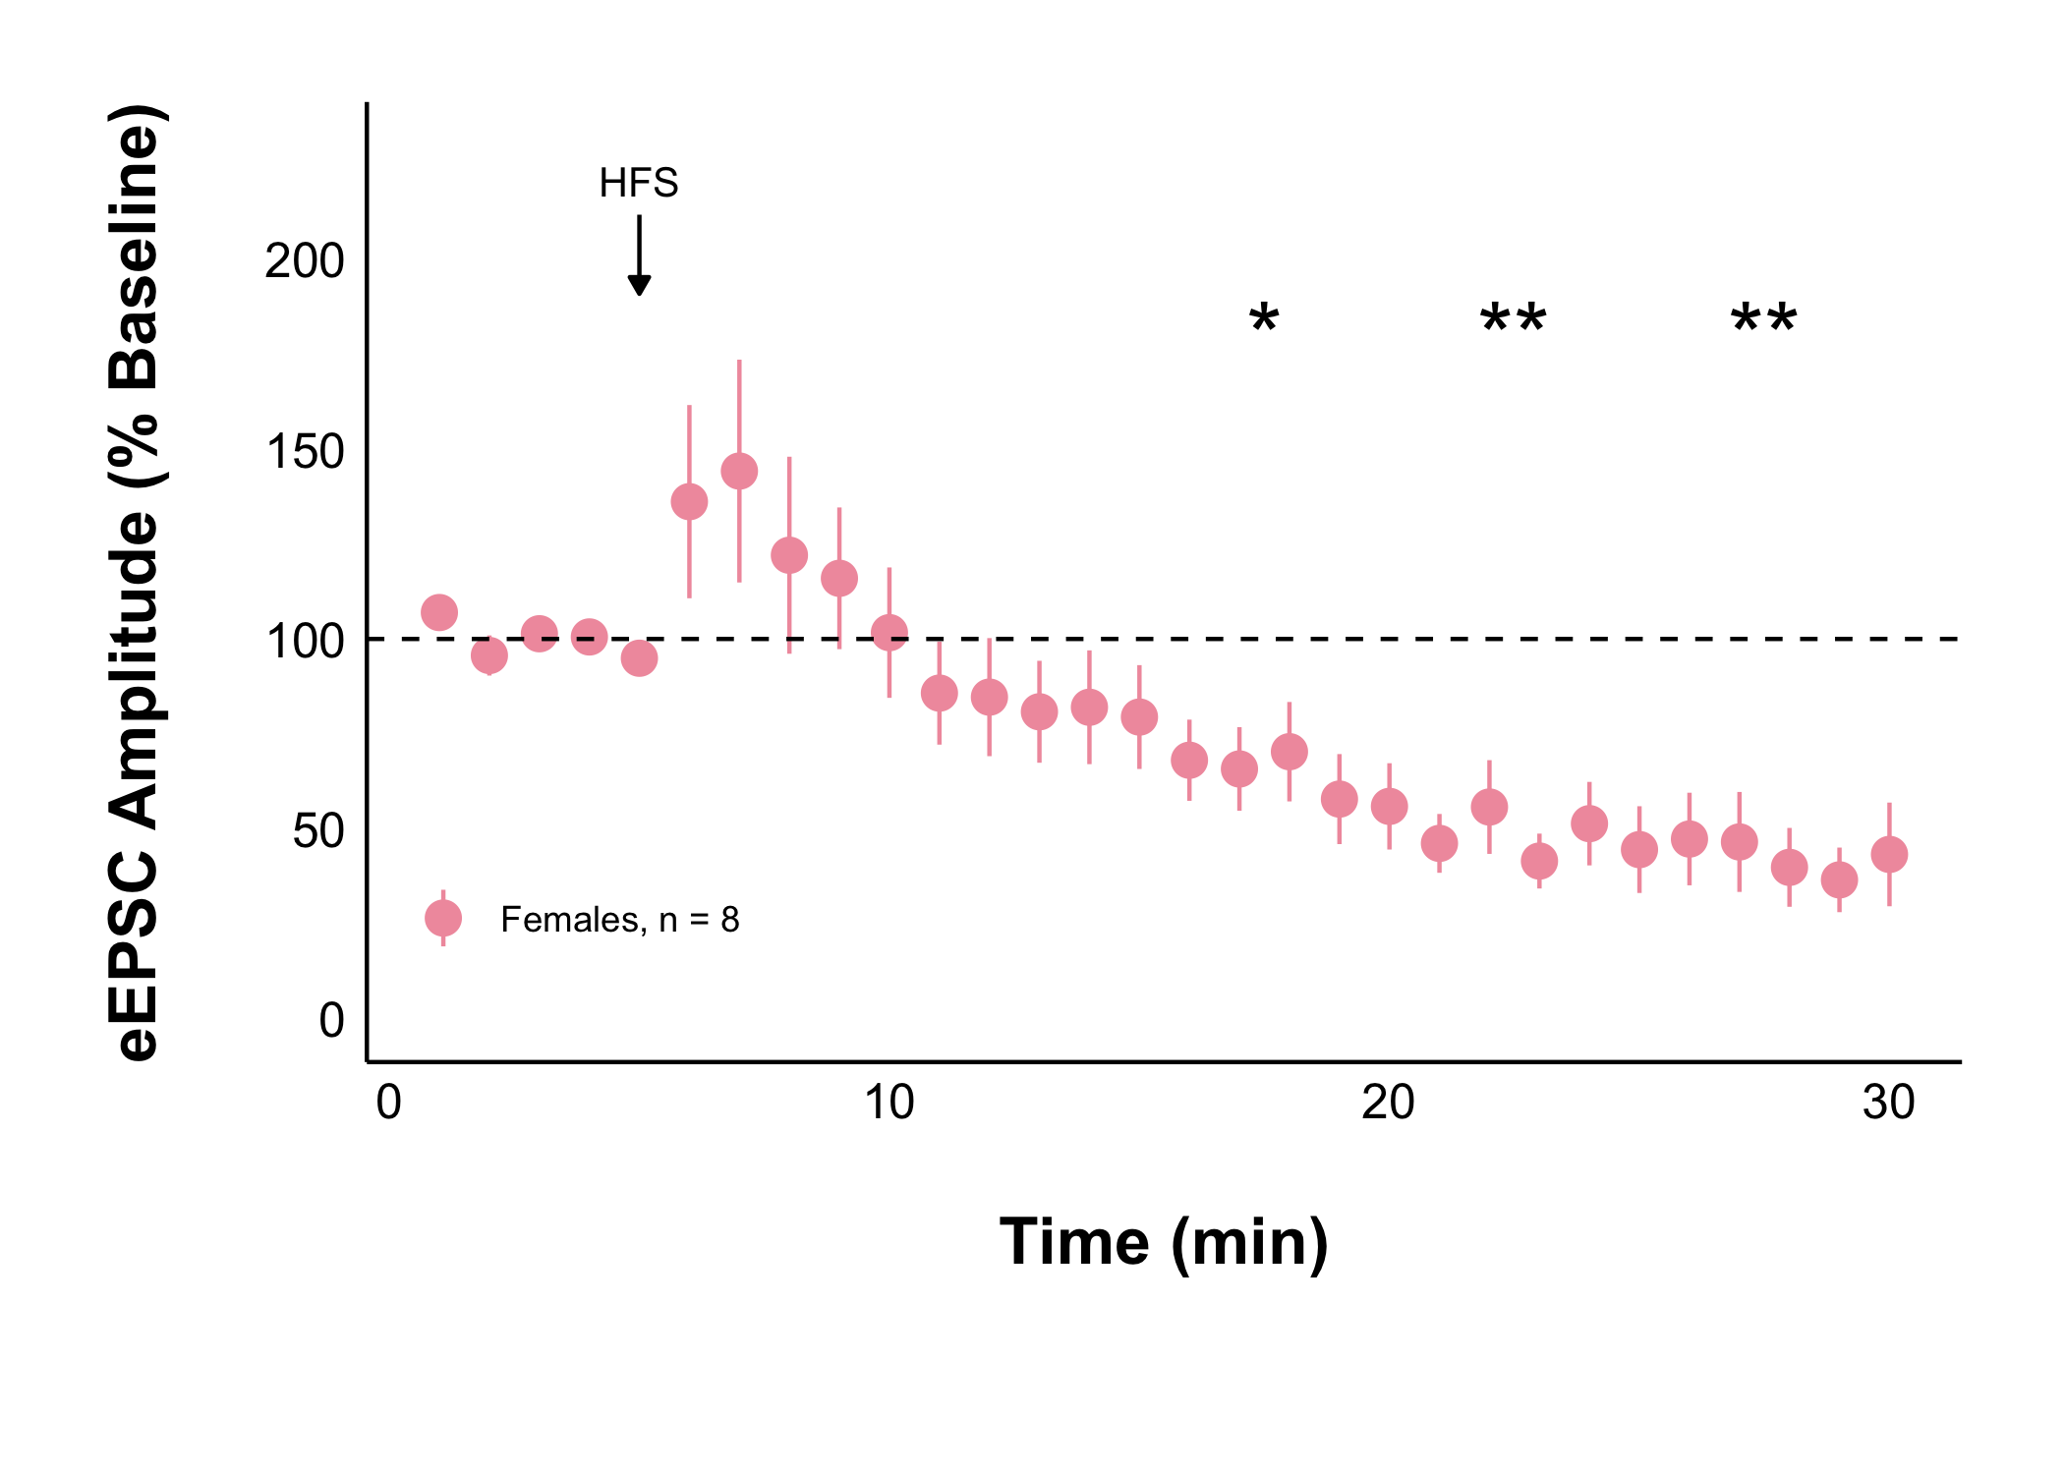
Naïve + Control Treatment
Acute Stress + Control Treatment
Acute stress decreases evoked excitatory current amplitude after HFS

Slide 11
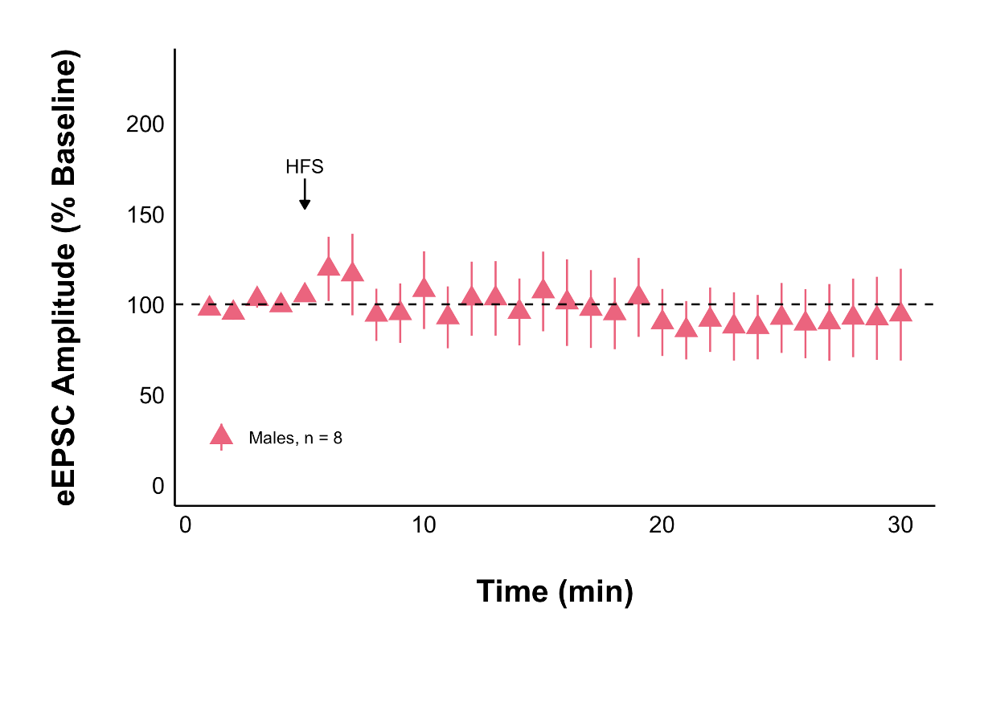
Acute Stress + Control Treatment
Acute Stress + Control Treatment
Acute stress decreases evoked excitatory current amplitude after HFS in females but not males

Slide 12
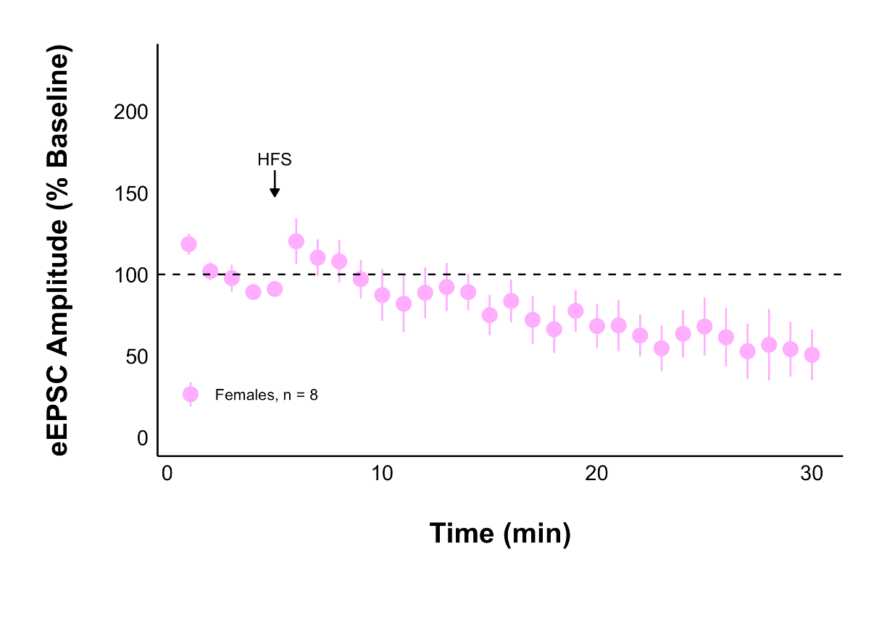
Acute Stress + AM251
Acute Stress + Control Treatment
Acute stress decreases evoked excitatory current amplitude after HFS (statistically) depending on CB1Rs

Slide 13
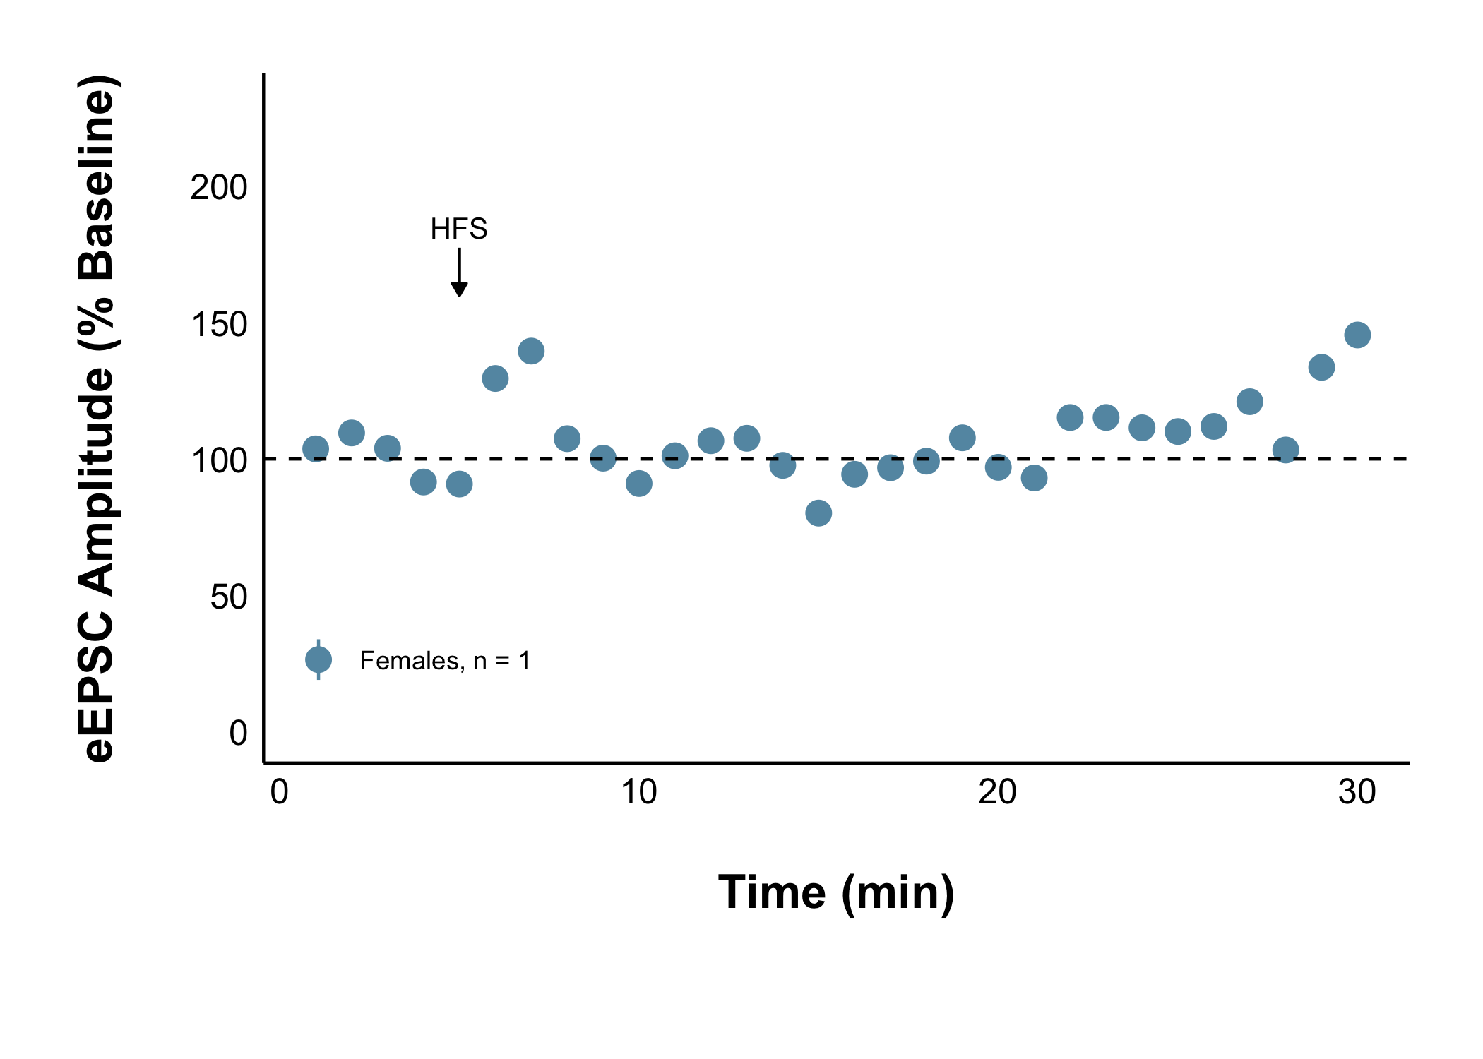
Repeated Stress + Control Treatment

Slide 14
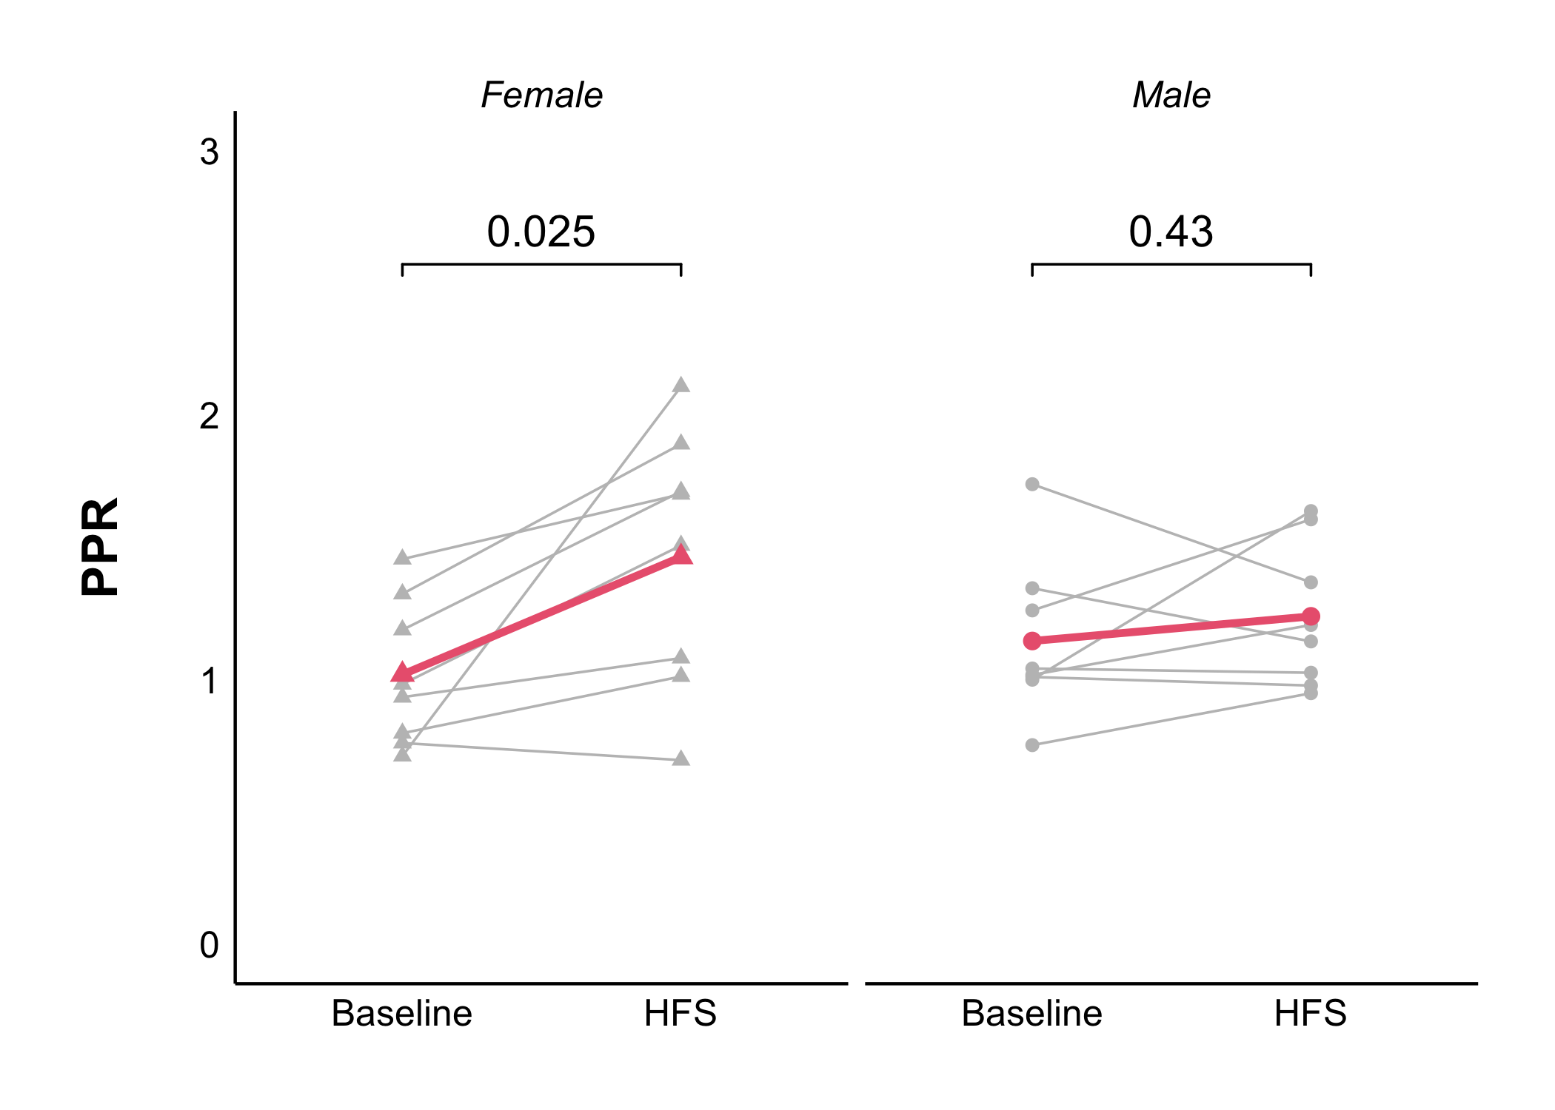
Acute Stress + Control Treatment
Acute stress decreases the probability of glutamate release after HFS in females but not males

Slide 15
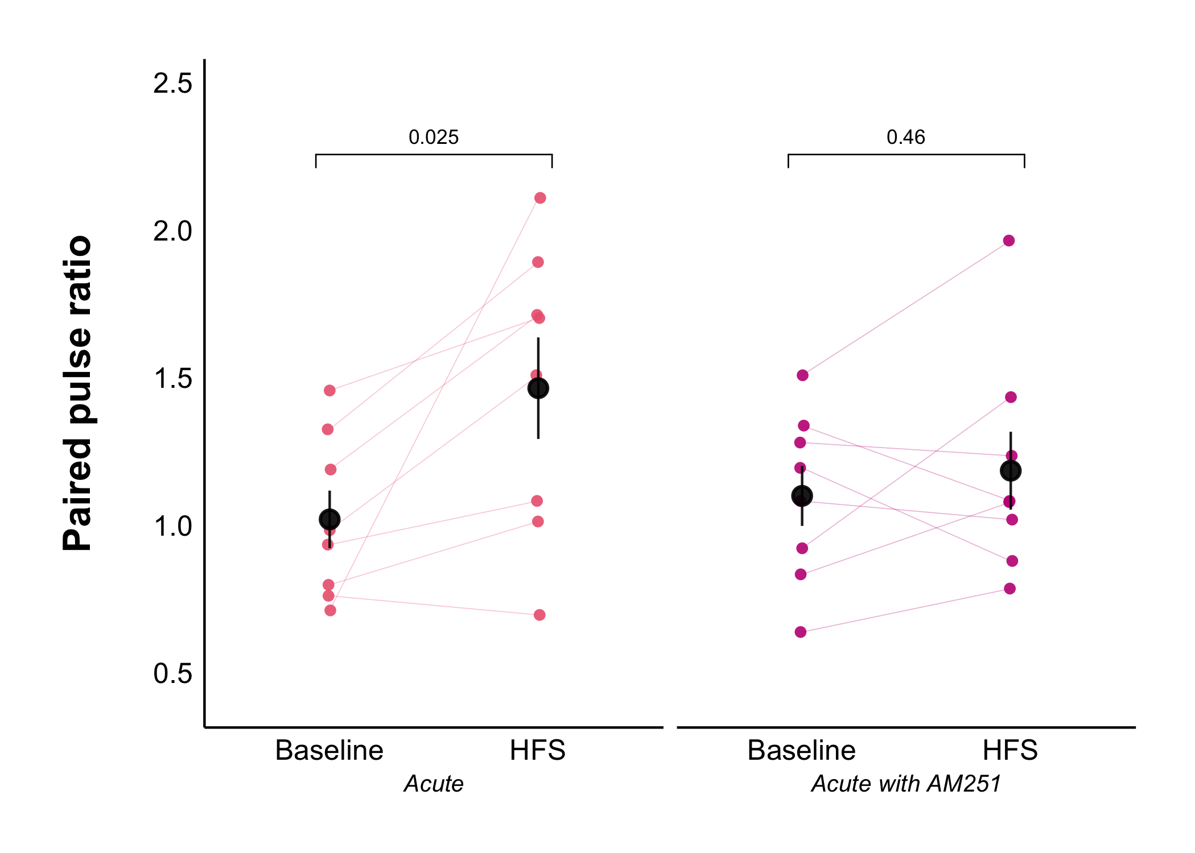
The effect of acute stress on the probability of glutamate release after HFS is dependent on CB1Rs

Slide 16
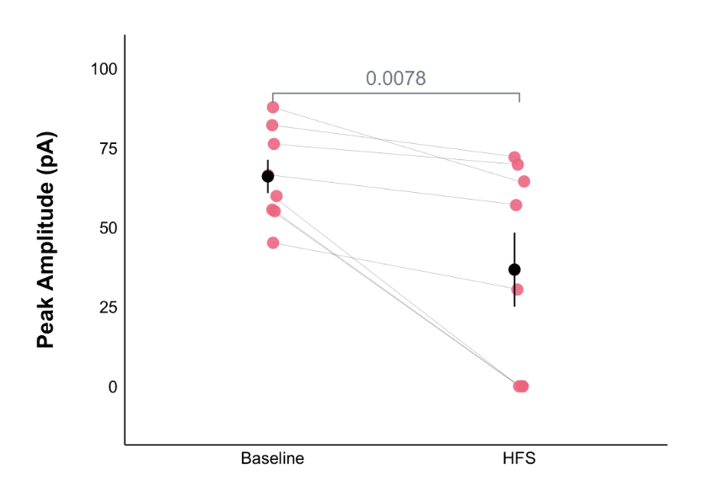
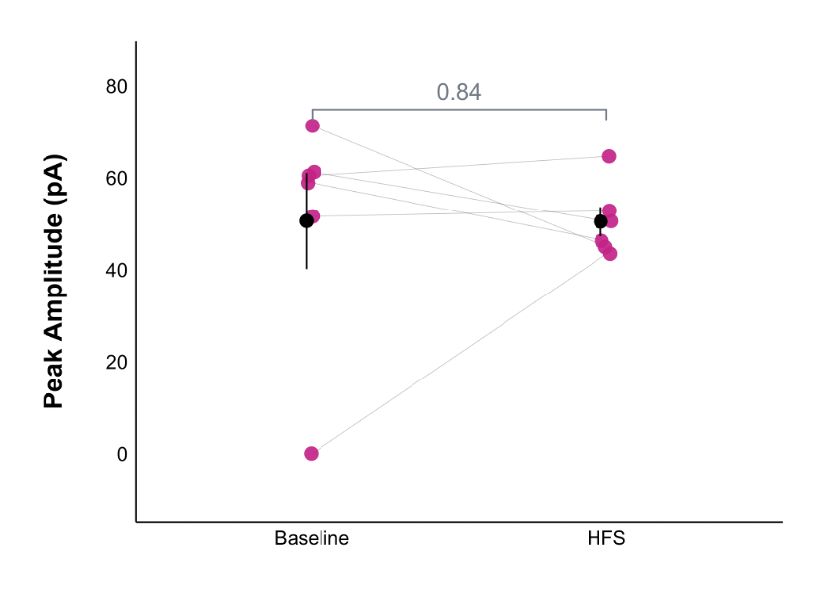
Acute Stress + Control Treatment
Acute Stress + AM251
Acute stress decreases AP peak amplitude after HFS depending on CB1Rs

Slide 17
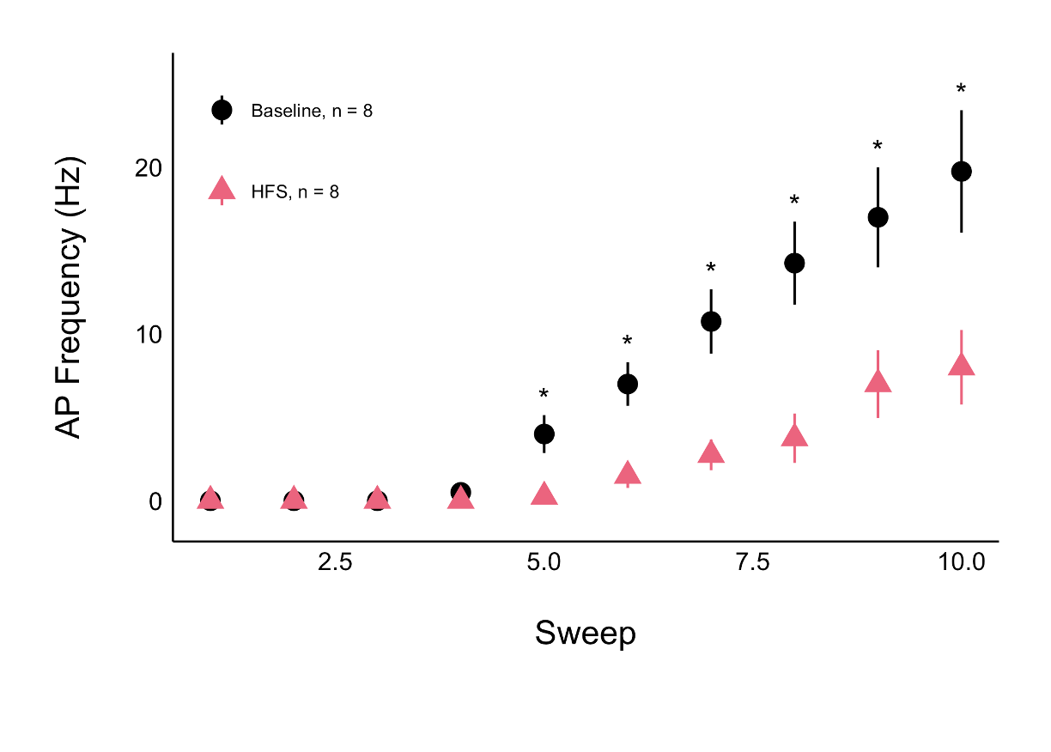
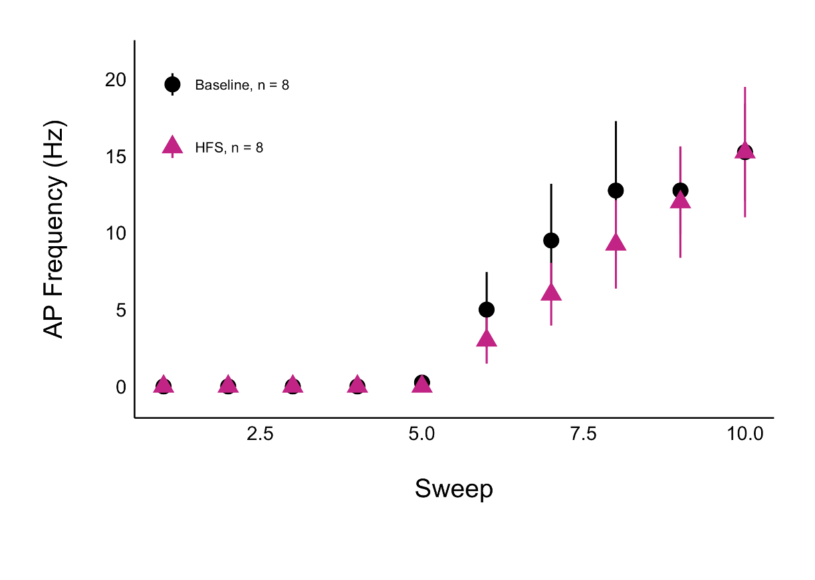
Acute Stress + Control Treatment
Acute Stress + AM251
Acute stress dectrases AP frequency after HFS depending on CB1Rs

