Slide 1
TEACHER PAGE · skipped when you present · Before you start
Happy Movember
Upper School · About 5 to 6 minutes plus the Movember video, built for an all-school meeting with three presenters · November
BEFORE YOU START
Three presenters, about five minutes, and each slide carries its own words, so nobody needs a script. Decide who tells the 20-second story, and keep suicide numbers off the mic.
EVERY STUDENT IN THE ROOM
Families and cultures differ on keeping struggles inside, and not every student has a dad, a team or a group chat to lean on; name a coach, a relative, a faith leader and a counselor as equally real places to start.
Notes:
This page is hidden and skipped when you present. The full plan, care notes and research are on the hidden pages at the end of the deck, if you want them.

Slide 2

HAPPY MOVEMBER
movember-toolbox Counseling
Notes:
PRESENTER 1, 20 SECONDS. Open with a grin: "Happy Movember. That's not a typo." If any of you are growing a mustache this month, point at it and let the room judge.

Slide 3
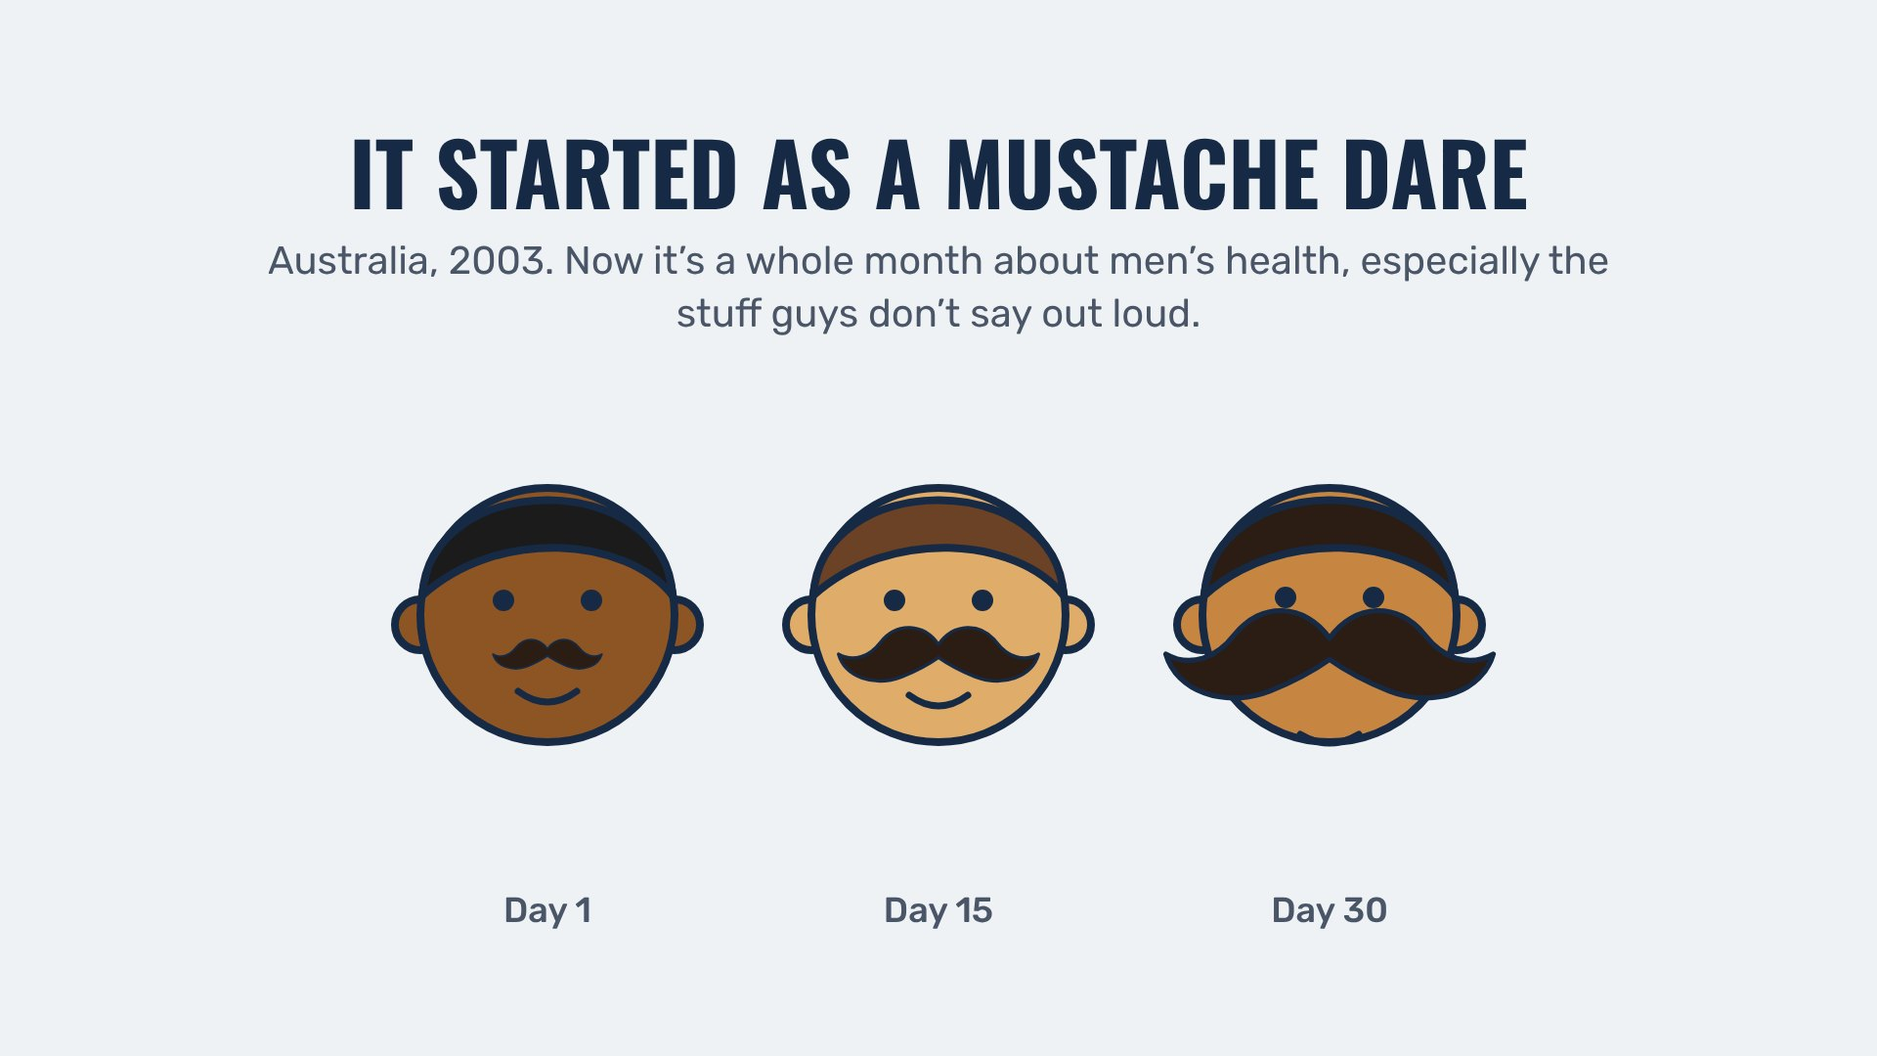
IT STARTED AS A MUSTACHE DARE
movember-toolbox Counseling
Notes:
PRESENTER 1, 30 SECONDS. Read the slide. Then: "That's why the three of us are up here. We'll keep it short."

Slide 4
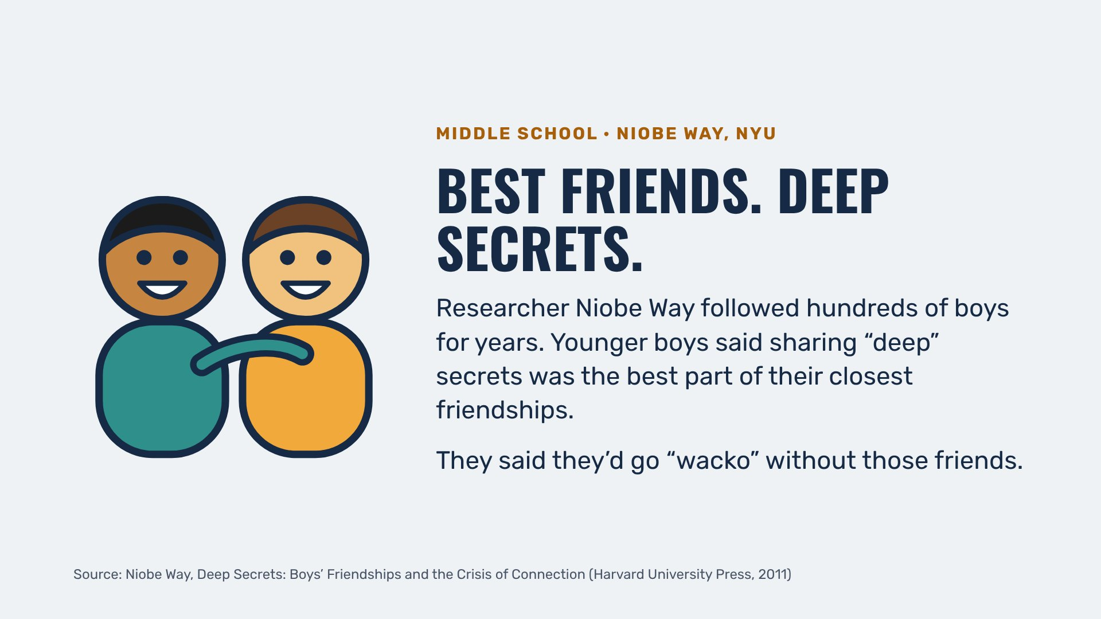
BEST FRIENDS
movember-toolbox Counseling
Notes:
PRESENTER 2, 20 SECONDS. Read it warmly. Then pause: "Here's what happened a few years later."

Slide 5
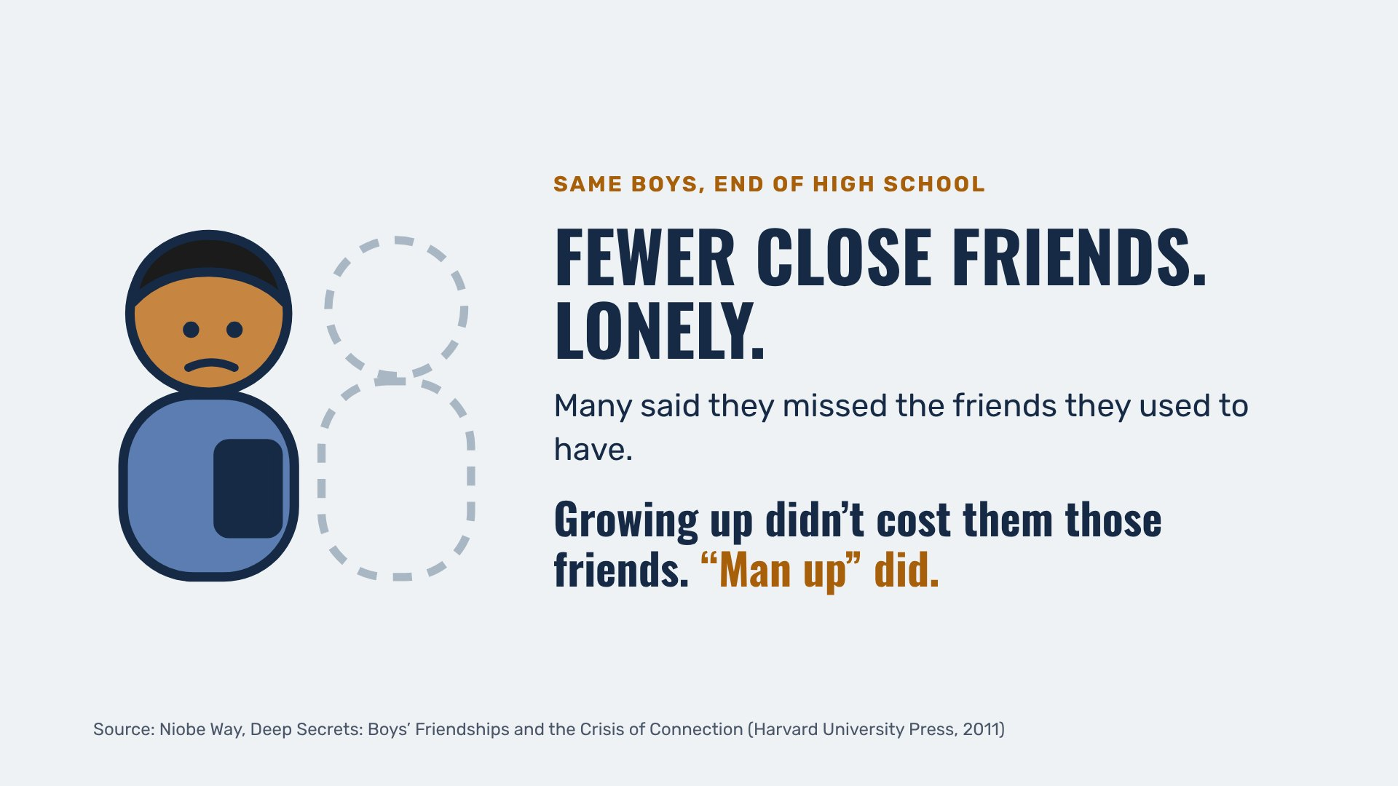
FEWER CLOSE FRIENDS
movember-toolbox Counseling
Notes:
PRESENTER 2, 20 SECONDS. Let the picture sit a second, then read the bottom line. Then: "And here's what that looks like now."

Slide 6
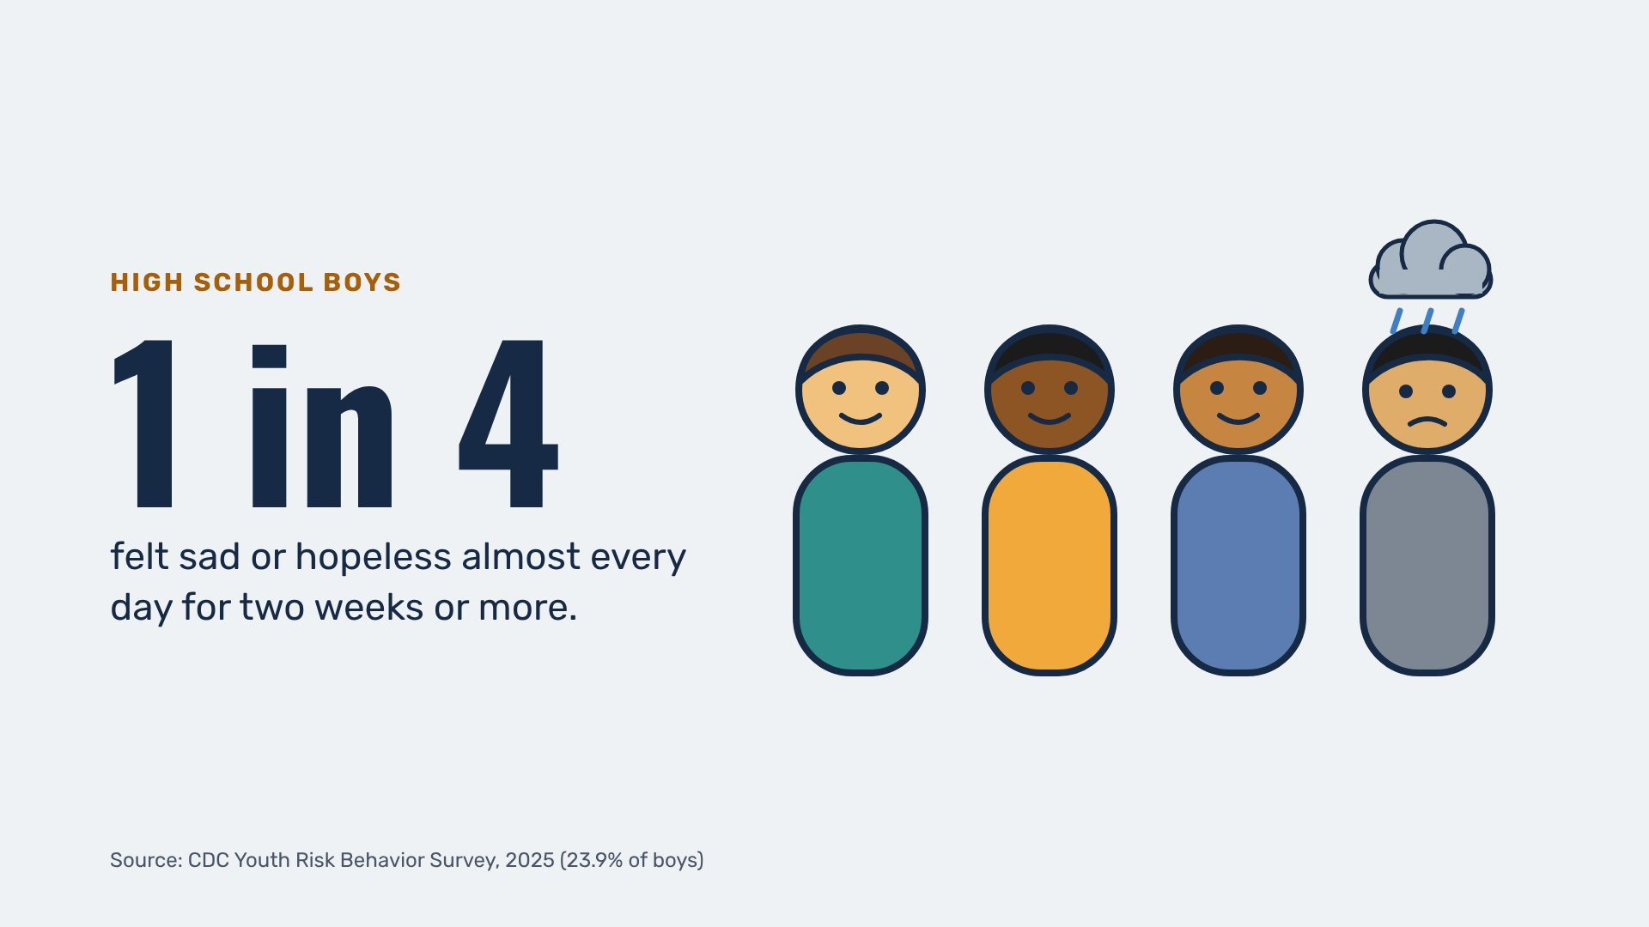
1 IN 4
movember-toolbox Counseling
Notes:
PRESENTER 2, 30 SECONDS. Read the number and the line under it. Then: "The next part surprised me."

Slide 7
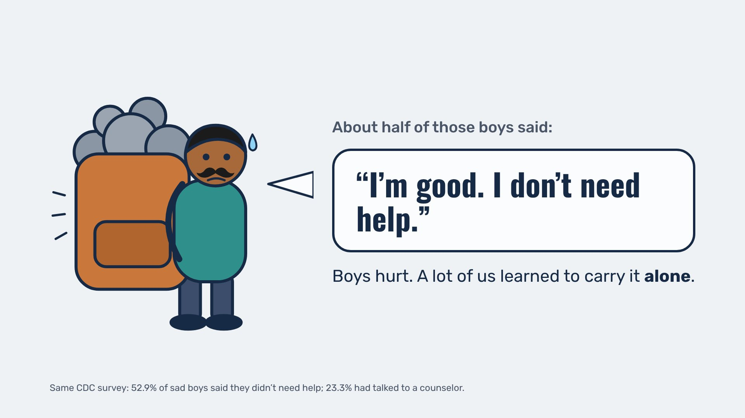
I'M GOOD
movember-toolbox Counseling
Notes:
PRESENTER 2, 30 SECONDS. Let the speech bubble land before you speak. Read: "Boys hurt. A lot of us learned to carry it alone."

Slide 8
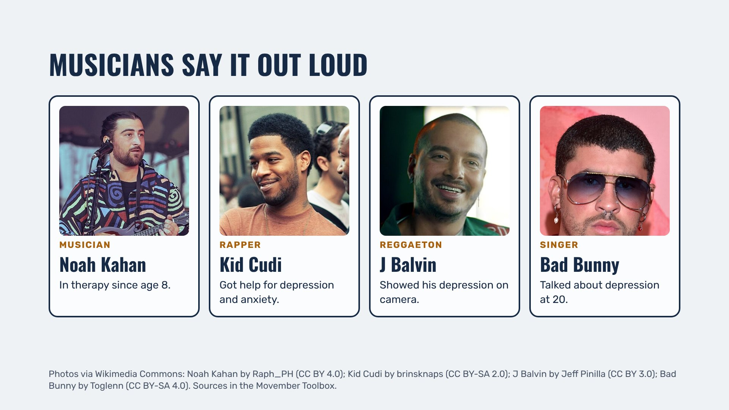
MUSICIANS SAY IT OUT LOUD
movember-toolbox Counseling
Notes:
PRESENTER 3, 20 SECONDS. Point at the names the room knows best. No need to read every card.

Slide 9
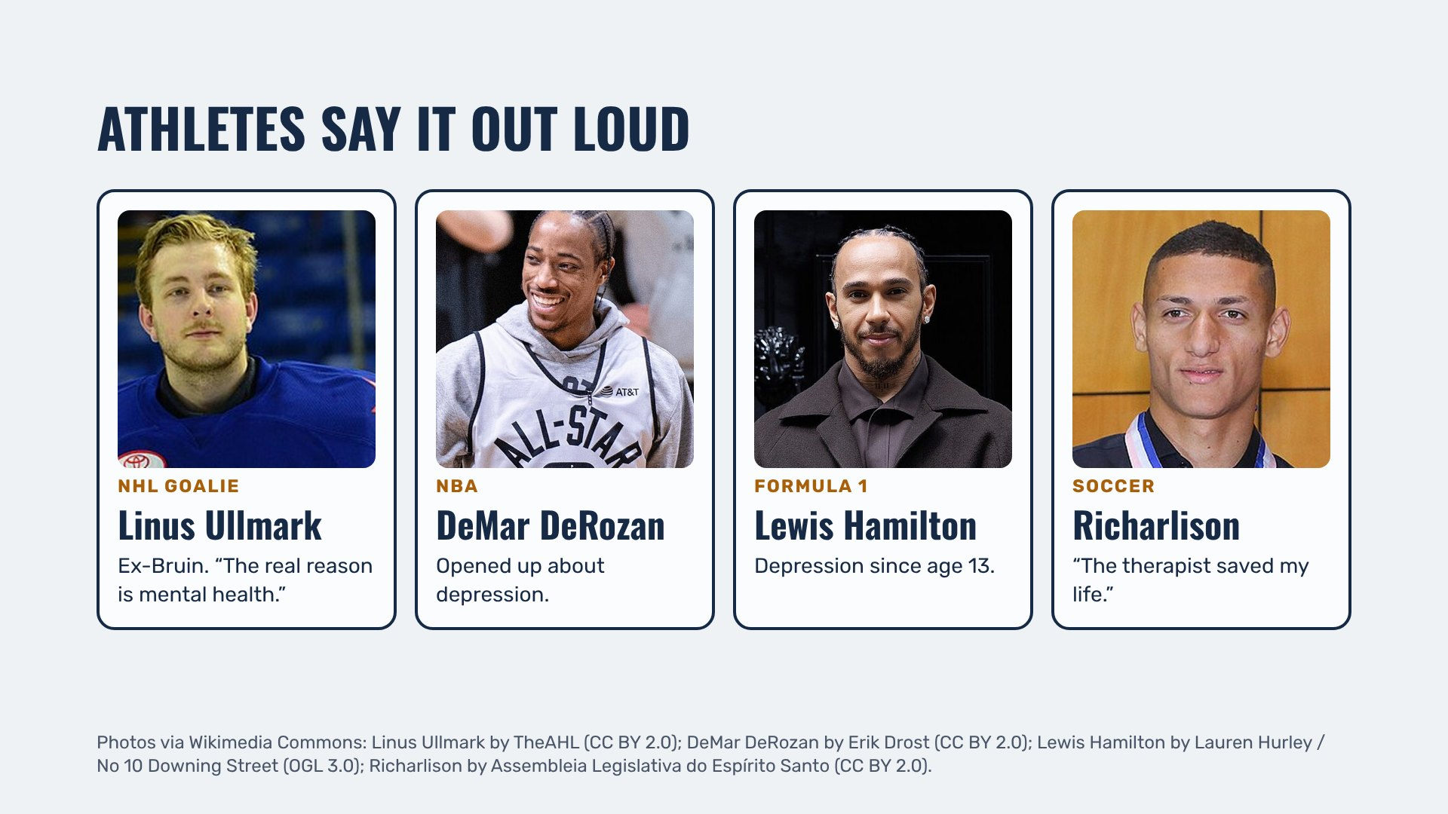
ATHLETES SAY IT OUT LOUD
movember-toolbox Counseling
Notes:
PRESENTER 3, 20 SECONDS. Same move: name one or two, especially Linus Ullmark for a hockey crowd.

Slide 10
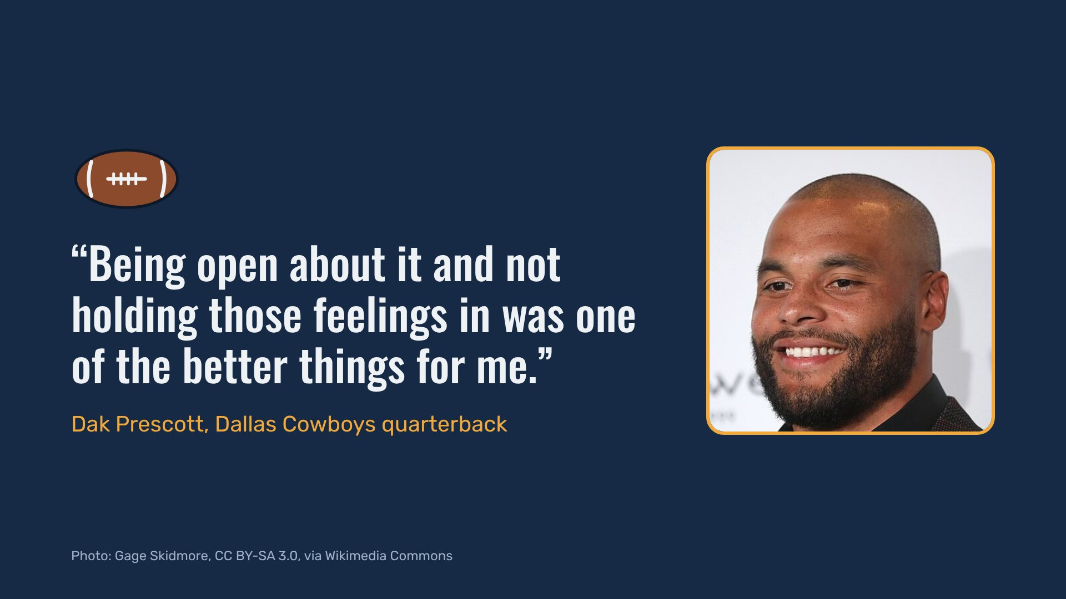
DAK PRESCOTT
movember-toolbox Counseling
Notes:
PRESENTER 3, 20 SECONDS. Read the quote, pause, move on.

Slide 11
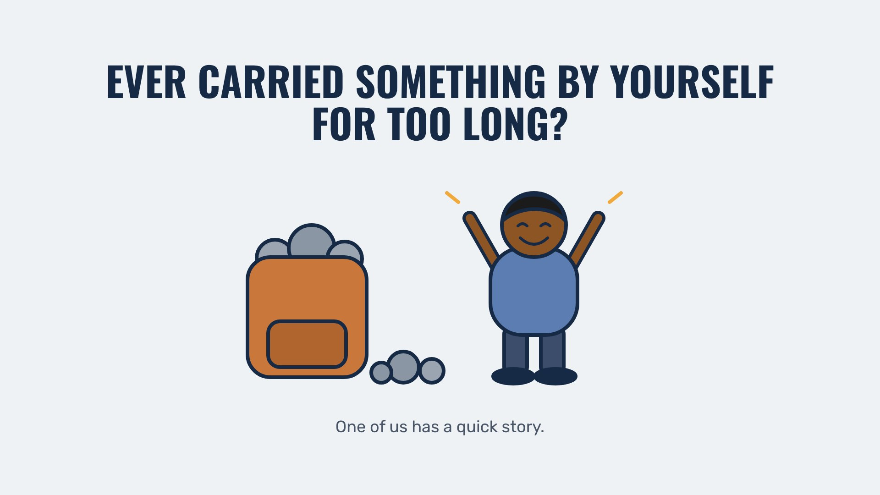
A QUICK STORY
movember-toolbox Counseling
Notes:
ANY PRESENTER, 20 SECONDS. A short true story: a time you carried something alone, and what changed when you said it out loud. Keep it light and not graphic.

Slide 12
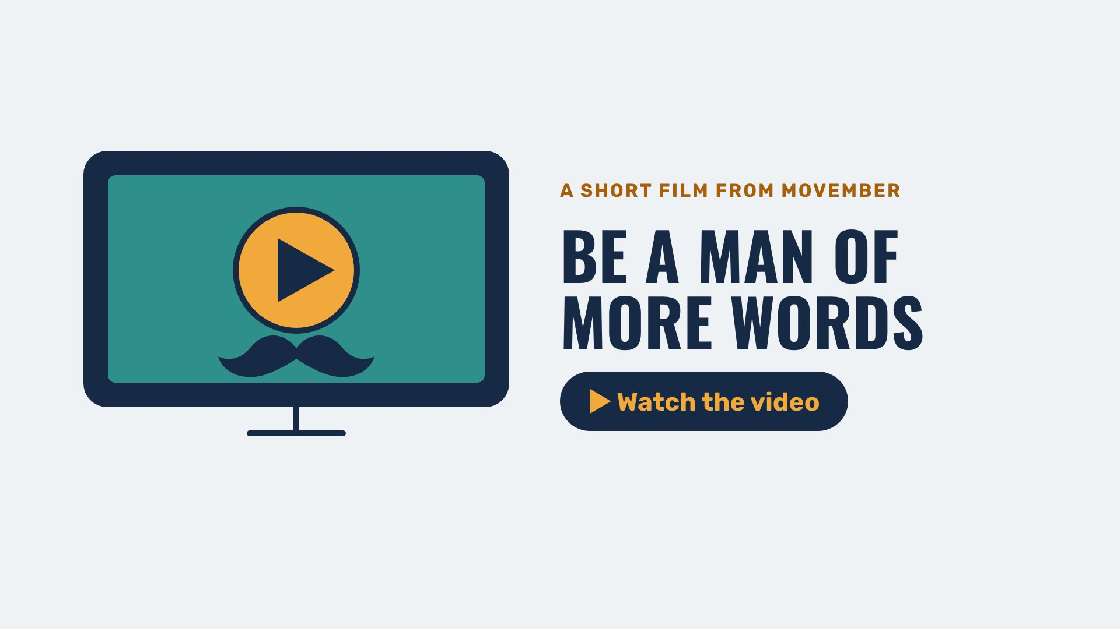
WATCH
movember-toolbox Counseling
Notes:
ANY PRESENTER. Click the slide and the video plays right here, full screen. It closes on its own at the end, or press Esc. Give it a few seconds of quiet before the next slide.

Slide 13
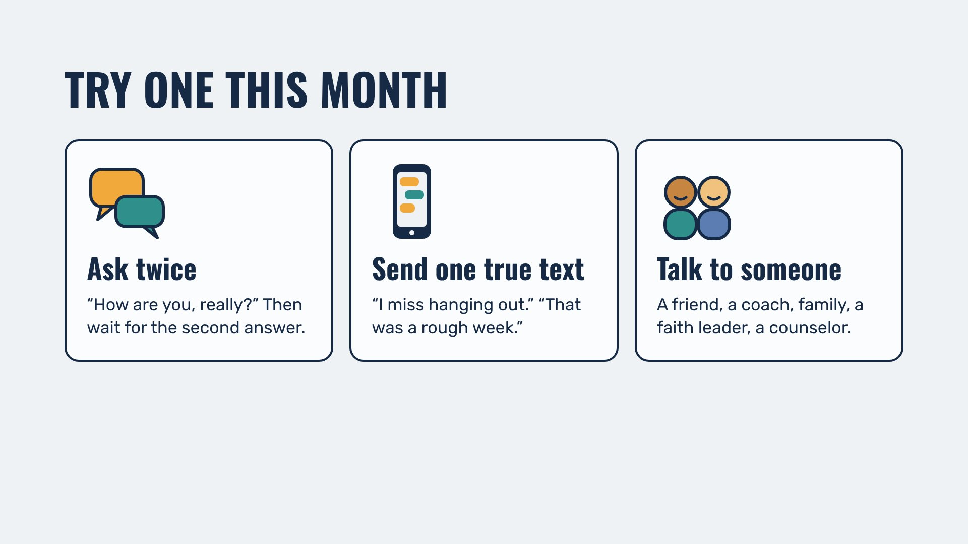
TRY ONE THIS MONTH
movember-toolbox Counseling
Notes:
PRESENTER 1, 30 SECONDS. Read the three. "Pick one, or make up your own."

Slide 14
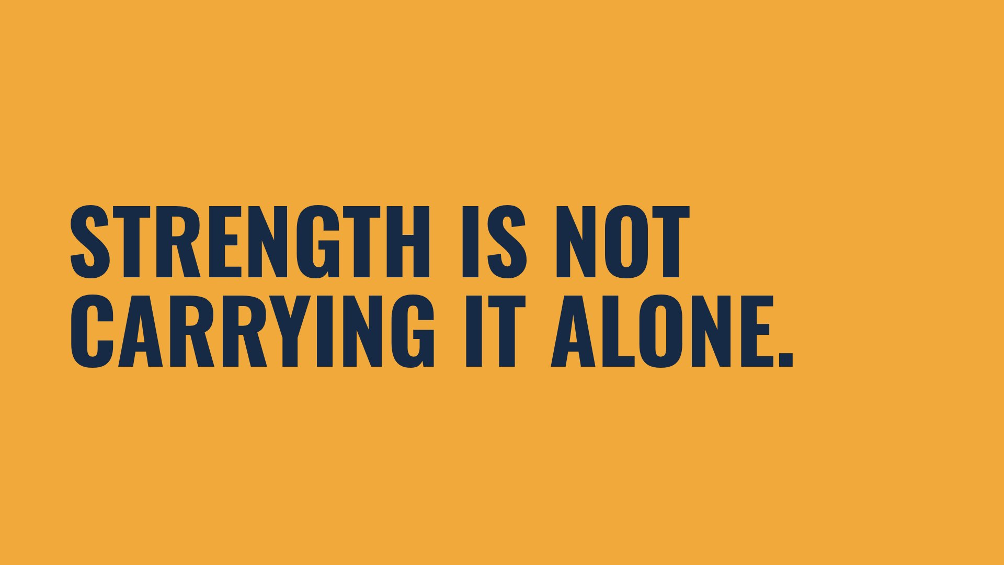
STRENGTH
movember-toolbox Counseling
Notes:
PRESENTER 1, 10 SECONDS. Say it, pause, then click to the toolbox.

Slide 15
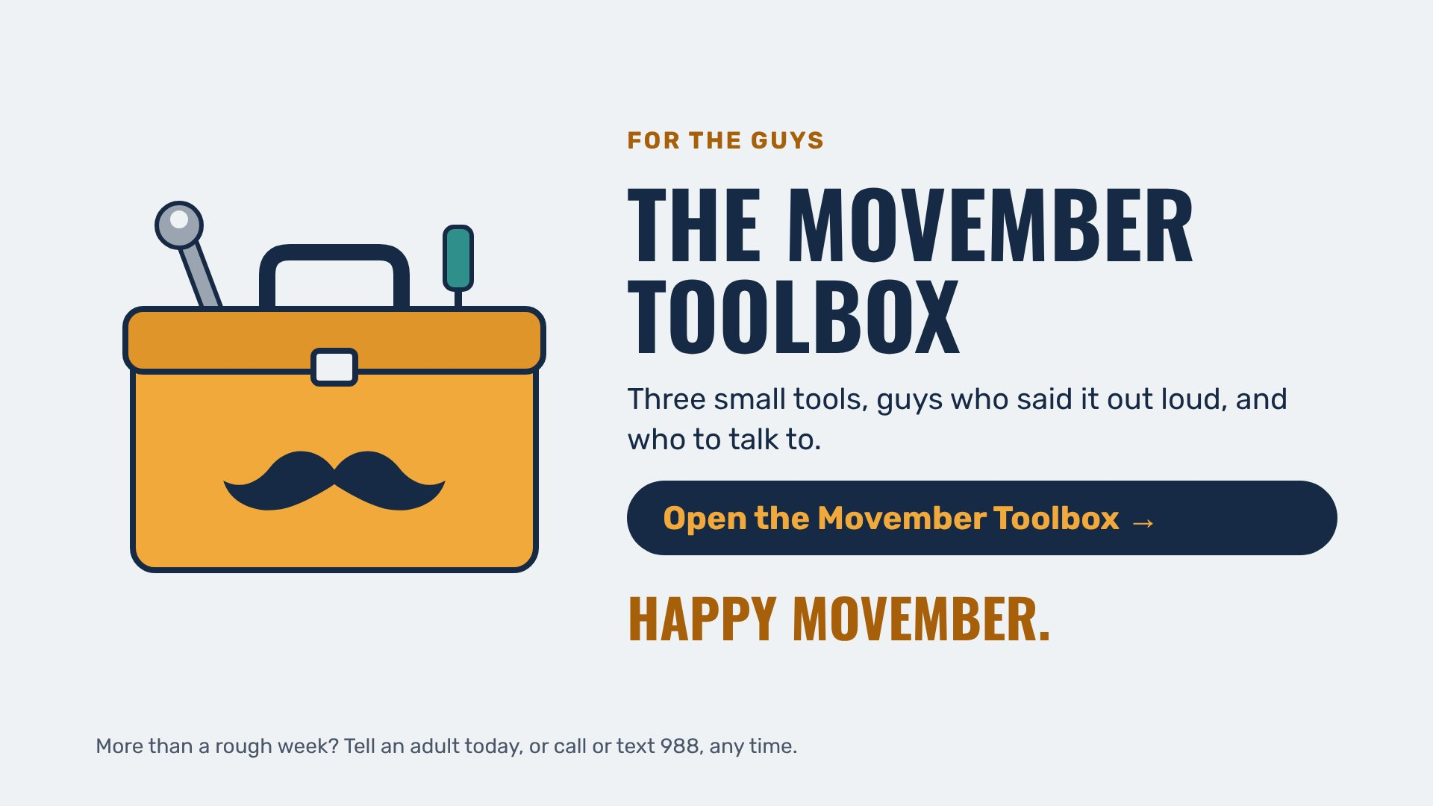
THE MOVEMBER TOOLBOX
movember-toolbox Counseling
Notes:
PRESENTER 1, 30 SECONDS. Click the slide to open the toolbox and show it to the room. Tell them the link is coming after the meeting. All three say the last line together: "Happy Movember."

Slide 16
TEACHER PAGE · skipped when you present · Lesson plan
Happy Movember
Upper School · About 5 to 6 minutes plus the Movember video, built for an all-school meeting with three presenters · November
GOAL
Students hear that a lot of guys hurt and carry it alone, see men they admire who said it out loud, and leave with one small thing to try this month and the Movember Toolbox link. Nobody is asked to share anything.
MATERIALS
Three presenters (the notes split the slides, but any split works)
The deck on the big screen, with the toolbox button on the last slide ready to click
The Movember Toolbox link to send afterward
FLOW
1 min Happy Movember, and how a mustache dare became a month
1.5 min Best friends, then fewer friends (Niobe Way); 1 in 4, and “I’m good. I don’t need help.”
1 min Guys who said it out loud: musicians, athletes, Dak Prescott
1 min + video One true 20-second story, then Movember’s short film “Be a man of more words”
1 min Try one this month, Strength is not carrying it alone, open the toolbox
SHORT ON TIME (3 MINUTES)
Cover, 1 in 4, “I’m good,” one photo slide, Strength is not carrying it alone, then click to the toolbox.
Notes:
If you want more: this page and the next three are hidden and skipped when you present.

Slide 17
TEACHER PAGE · skipped when you present · Before you teach
Before you teach
Light first, then real.
Open with the mustache joke and let the room laugh. The turn to the numbers lands harder after a grin.
Suicide numbers stay off the mic.
Men die by suicide at much higher rates than women, but stating numbers at an assembly can raise risk for a student who is struggling. The deck uses sadness and asking for help instead, following safe messaging guidance.
Your story is the strongest slide.
Twenty seconds, true, not graphic: a time you carried something alone and what changed when you said it out loud. It shows the room that adults they see every day do this too.
Everyone is in the room.
Movember centers men's health, and everyone has a guy they care about. Asking twice and sending one true text work for anyone.
Expect a few to find you.
After a talk like this, a student may stop by or a friend may share a worry. Thank them and walk them to a counselor that day.
The toolbox is the take-home.
Click the button on the last slide to show it, then send the link after the meeting.

Slide 18
TEACHER PAGE · skipped when you present · Every student in the room
Every student in the room
Culture, family, identity, ability and money: what to keep in mind for this topic.
Different families, different rules about feelings.
In many families and cultures, keeping struggles private is a form of respect or strength. Honor that, and offer talking to someone as one more kind of strength.
Faith leaders count.
For many students a pastor, imam, rabbi or youth leader is the first person they would tell. The slides name faith leaders on purpose.
The faces are chosen on purpose.
Black and Latino young men are less likely to get mental health care when they need it. Seeing Kid Cudi, J Balvin, Bad Bunny, DeMar DeRozan, Lewis Hamilton, Richarlison and Dak Prescott says this is for them too.
Not every guy is into sports or music.
The names are doors in, not a test. Invite students to think of someone they look up to who has been open.
“The guys” stays warm, never exclusive.
Trans and nonbinary students, and girls who look out for brothers and friends, belong in this too.
Cost and privacy.
Talking to a school counselor is free. Some families can't pay for outside therapy, and some students can't tell a parent yet. Point to the counselors first.

Slide 19
TEACHER PAGE · skipped when you present · Background
What the research says
In 2025, 23.9% of high school boys felt sad or hopeless almost every day for two weeks or more. Of those boys, 52.9% said they didn't need help, and 23.3% had received counseling.
CDC Youth Risk Behavior Survey 2025; Kiplagat et al., MMWR Supplement, October 2026
Following hundreds of boys over years, Niobe Way found that in early and middle adolescence boys described sharing “deep” secrets as the most important part of their closest male friendships. In late adolescence many began to lose those friendships, grew more distrustful of male peers, and spoke of loneliness and missing their former close friends. Way ties the loss to cultural pressure to “man up,” not to maturity.
Niobe Way, Deep Secrets: Boys' Friendships and the Crisis of Connection, Harvard University Press, 2011
Movember began in 2003 in Melbourne, Australia, when a group of friends dared each other to grow mustaches. It now raises money for men's mental health, suicide prevention and men's cancers worldwide.
Movember Foundation
Lacking social connection carries a mortality risk comparable to smoking up to 15 cigarettes a day.
U.S. Surgeon General's Advisory on Loneliness and Isolation, 2023 (Holt-Lunstad et al., 2010)
15% of men reported having no close friends in 2021, up from 3% in 1990.
Survey Center on American Life, American Perspectives Survey, 2021
Linus Ullmark, then with the Ottawa Senators, said of his leave last season: “The real reason is mental health.”
TSN interview, January 2026
Safe messaging guidance advises against stating suicide statistics or methods in school-wide talks and favors stories of help-seeking and hope.
Recommendations for Reporting on Suicide (reportingonsuicide.org); AFSP

