Slide 1
TEACHER PAGE · skipped when you present · Session plan
Meet the Student Toolkit
Faculty meeting · 25 minutes (15-minute version below) · Led by Dr. Wilson · Middle and Upper School faculty and advisors
GOAL
Faculty leave knowing where the toolkit lives, how a lesson works from start to finish, where every page points students for help, and with one lesson in mind to try this month.
MATERIALS
The live toolkit open in a second browser tab, in case you want to click around
A projector with internet (each screenshot slide links to the real page)
Optional: the toolkit link in the meeting invite or chat so people can follow along
FLOW
3 min Opening: a conversation you wish you'd had something for
2 min What the toolkit is
10 min A walk through one lesson, start to finish (6 screenshots)
2 min What it is and what it isn't
5 min Which would you open? (pairs)
3 min Where to begin, and one lesson this month
SHORT ON TIME (15 MINUTES)
Fifteen minutes: what it is (2), the toolkit page and the four ways in (3), open a lesson and present it (3), the student page and the help box (3), what it isn't (2), one lesson this month (2). Skip the opening and the pairs activity.
Notes:
This page and the next three are hidden. They stay in the deck for you and are skipped when you present.

Slide 2
TEACHER PAGE · skipped when you present · Before you present
Before you present
Show, don't tell.
Most of this talk is screenshots of the real pages. If the room has internet, click the button on any screenshot slide and show the live page for a moment, then come back. The pictures are there so the talk still works if the Wi-Fi doesn't.
An invitation, not an assignment.
Nobody has to use this. Say so early. Teachers who feel told to do one more thing will tune out; teachers who see a tool that saves them time on a hard conversation will come back to it.
Name the nerves.
Some faculty worry about saying the wrong thing on topics like substances, breakups or anger. The teacher side of each lesson exists for exactly that: what to say, what to watch for, and who to send a student to.
Be clear about what it isn't.
It isn't therapy, a screening tool, or something counseling watches. A student who says something worrying in a lesson gets the same response as anywhere else at Beaver: let counseling know that day.
Middle School is coming along.
Middle School student pages are there now; Middle School teacher lessons are still being written. Tell Middle School faculty they can read a student page, talk it through, and share the link, and that slides are on the way.
Leave with one.
The ask at the end is small on purpose: one lesson, one group, this month. Offer to help anyone pick.

Slide 3
TEACHER PAGE · skipped when you present · Every student in the room
Every student in the room
Culture, family, identity, ability and money: what to keep in mind for this topic.
Every lesson has a page on this.
Point out the 'Every student in the room' page in each teacher lesson. It covers culture, family, identity, ability and money for that topic, so teachers don't have to guess.
Not every family talks about these things.
Some students come from homes where mental health, dating or substances aren't discussed, or are discussed very differently. The lessons are written to respect that and to avoid assuming one kind of family.
Students who learn differently.
Student pages are short, visual and readable on a phone or on paper. Students with a learning plan can keep the page and come back to it at their own pace.
Language at home.
A student's parents may not read English comfortably. The student page is the student's to keep; if a family wants something in another language, loop in counseling.
Teachers differ too.
Faculty bring their own cultures and comfort levels. It's fine for a teacher to say 'I'm still learning about this' in front of students. That models the lesson better than a perfect script.
Privacy for everyone.
Nothing students tap or type on a page is saved or sent. Nobody, including counseling, can see what a student wrote. Say this plainly, because students and families will ask.

Slide 4
TEACHER PAGE · skipped when you present · Background
What the research says
A meta-analysis of 213 school-based social and emotional learning programs (about 270,000 students) found better social skills, attitudes and behavior, and an 11 percentile point gain in academic achievement.
Durlak et al., 2011, Child Development
Across 99 studies, warmer teacher-student relationships were linked to higher student engagement and achievement, with the strongest links for older students and students at risk.
Roorda et al., 2011, Review of Educational Research
Students who felt connected at school and at home as teens had lower odds of poor mental health, substance use and risky behavior as adults.
Steiner et al., 2019, Pediatrics
Single-session interventions for youth mental health showed small but real benefits across 50 trials. Short, well-built lessons can help; they don't replace ongoing care.
Schleider & Weisz, 2017, Journal of the American Academy of Child and Adolescent Psychiatry

Slide 5
MEET THE STUDENT TOOLKIT
Meet the Student Toolkit
Short lessons for the conversations that matter, and how to use them.
Beaver · Faculty professional development
Rick drafted this talk with help from AI, then reviewed and edited every slide.
Beaver Counseling
Notes:
Welcome everyone. Something like: "This will take about twenty-five minutes. By the end you'll know where the toolkit lives, how a lesson works, and you'll have one in mind to try. You don't have to use any of it. My hope is you'll want to."

Slide 6
TO START
Think of a conversation with a student this year you wish you'd had something for.
Just think. You don't have to share.
Beaver Counseling
Notes:
3 MINUTES. Give them thirty quiet seconds, then invite a few people to name the topic, not the student. Expect: friend drama, a breakup, vaping, anxiety before tests, a kid who stopped doing anything. Say: "Most of what you just named is in here."

Slide 7
WHAT IT IS
A short lesson, a plan for you, and a page students keep.
Written by counseling for Beaver students, grounded in research, Middle and Upper School.
Beaver Counseling
Notes:
2 MINUTES. Every topic has three parts: a teacher lesson with slides and notes, a version you can download as PowerPoint, and a student page students keep after. Upper School has teacher lessons now; Middle School has student pages, with teacher lessons on the way.

Slide 8
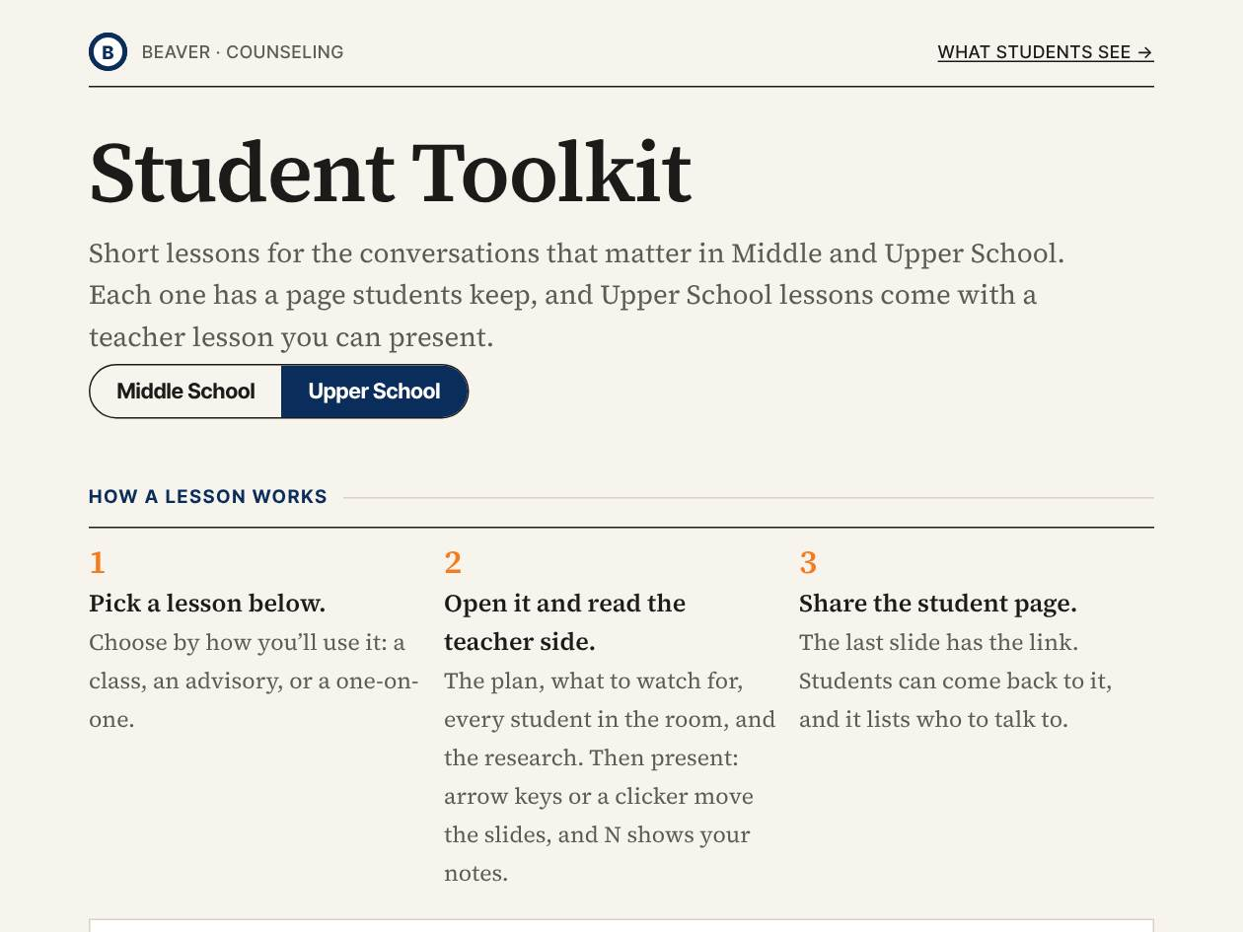
STEP 1
Start at one page.
— Bookmark it. Everything starts here.
— Switch between Middle and Upper School at the top.
— The three steps and the link key are right under the title.
Open the toolkit →
Beaver Counseling
Notes:
2 MINUTES. If you have internet, click the button and show the live page. Point to the Middle School / Upper School switch and the key that explains Open lesson, Download PowerPoint and Student page. Say: "If you remember one link from today, it's this one."

Slide 9
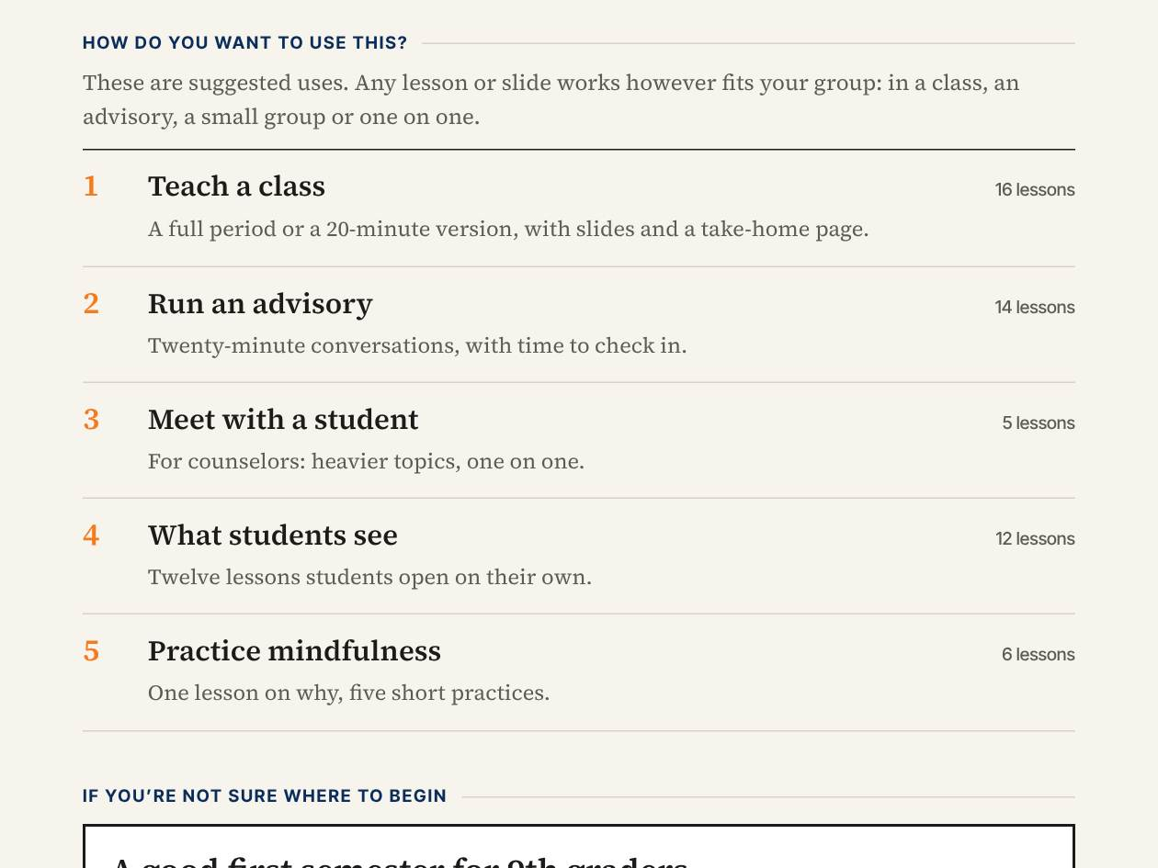
STEP 2
Pick by how you'll use it.
— Teach a class: a full period.
— Run an advisory: 20 minutes, with time to check in.
— Meet with a student: for counselors.
— Practice mindfulness: a few minutes, anywhere.
See the advisory lessons →
Beaver Counseling
Notes:
2 MINUTES. The toolkit is organized by how you'll use a lesson, not by topic. Advisors: the advisory lessons fit a 30-minute advisory with time for your own check-in, and each has a 10-minute version for short days. If you're not sure where to start, the box below this list has six lessons that work well for 9th graders in the fall.

Slide 10
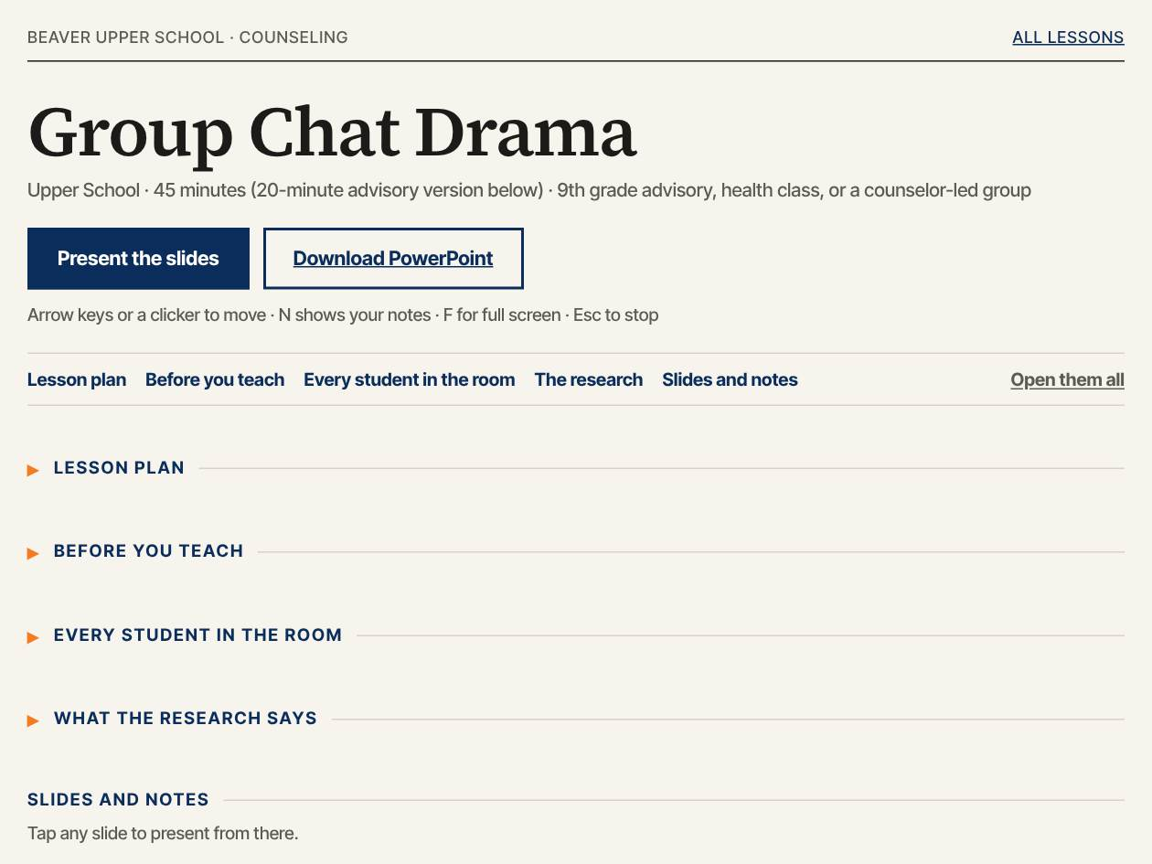
STEP 3
Open the lesson. Read the teacher side first.
— The plan and timing.
— What to watch for, and every student in the room.
— The research, so you can answer the 'says who?' question.
Open a sample lesson →
Beaver Counseling
Notes:
2 MINUTES. Click into Group Chat Drama as the example. Scroll a little: plan, before you teach, every student in the room, the research, then each slide with its notes. Ten minutes of reading the night before is plenty.

Slide 11
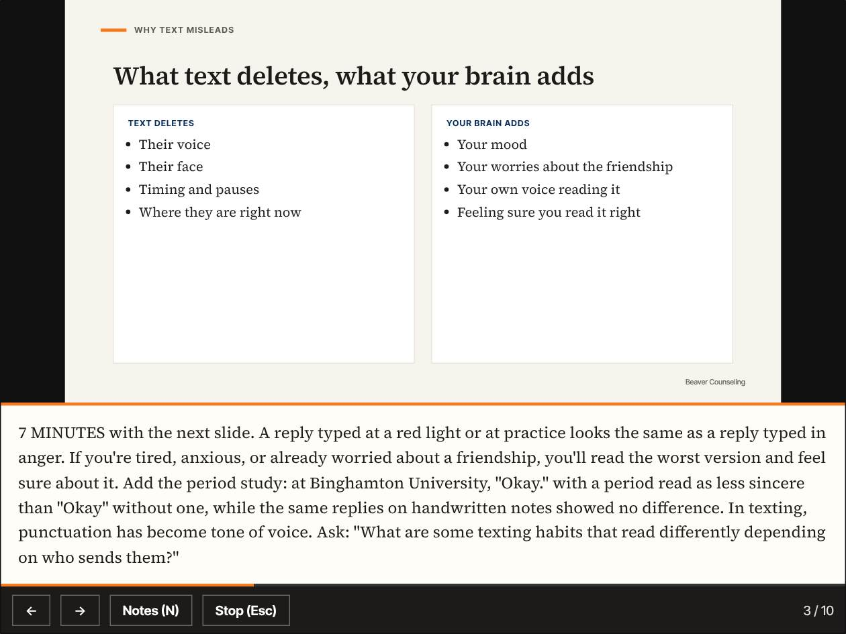
STEP 4
Present it.
— Arrow keys or a clicker move the slides.
— Press N to see your notes.
— Prefer Google Slides? Download the PowerPoint.
Try present mode →
Beaver Counseling
Notes:
2 MINUTES. If you're live, press Present the slides, then N to show the notes. The notes give timing and what to say, in plain language. Some of you will want to change the slides; that's what the PowerPoint download is for, and it opens in Google Slides.

Slide 12
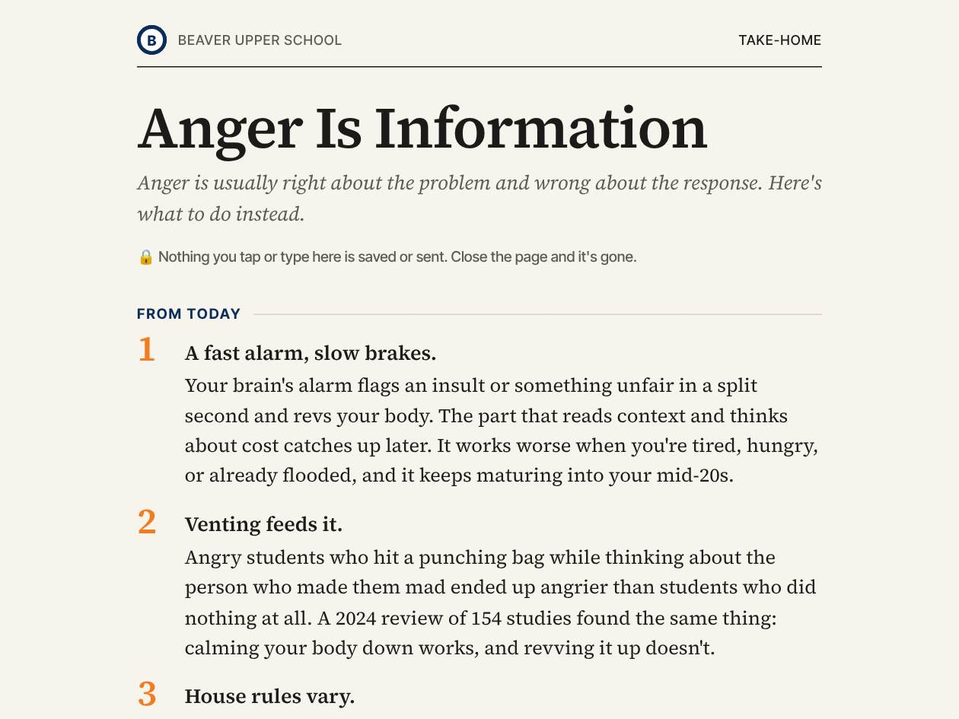
STEP 5
Share the student page.
— The last slide has the link.
— Students keep it and can come back to it.
— Nothing they tap or type is saved or sent.
See a student page →
Beaver Counseling
Notes:
1 MINUTE. Share the link after the lesson, in Canvas, email, or on the board. The page is short and works on a phone or printed. Privacy matters to students: nobody can see what they write on it, including us.

Slide 13
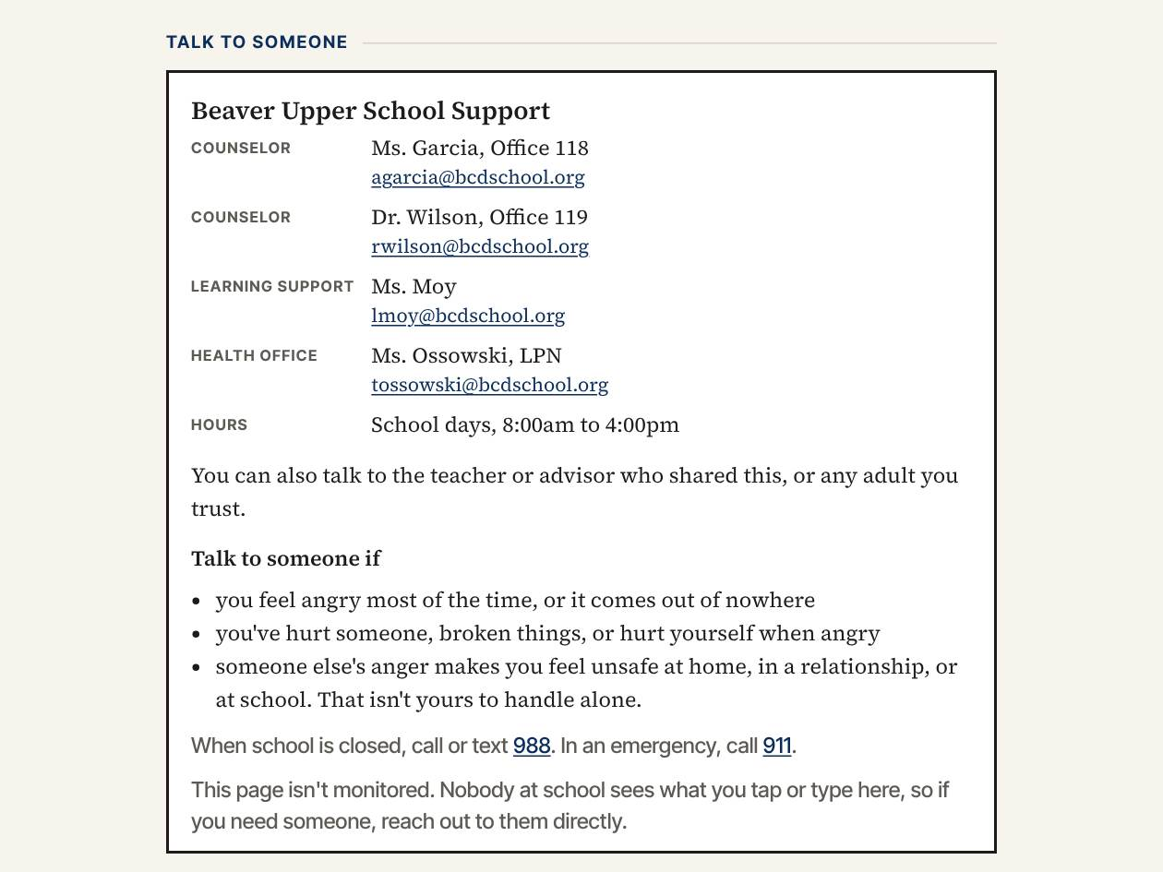
EVERY PAGE
Every page points to a person.
— Counselors first, by name and office.
— 988 and 911 for after hours.
— "This page isn't monitored."
See the help box →
Beaver Counseling
Notes:
2 MINUTES. This is the part I care most about. The toolkit supplements people; it doesn't replace them. Every student page names who to talk to, including you, and says plainly that nobody is watching the page. If a student says something in a lesson that worries you, do what you'd do anywhere at Beaver: let counseling know that day. You don't have to handle it alone.

Slide 14
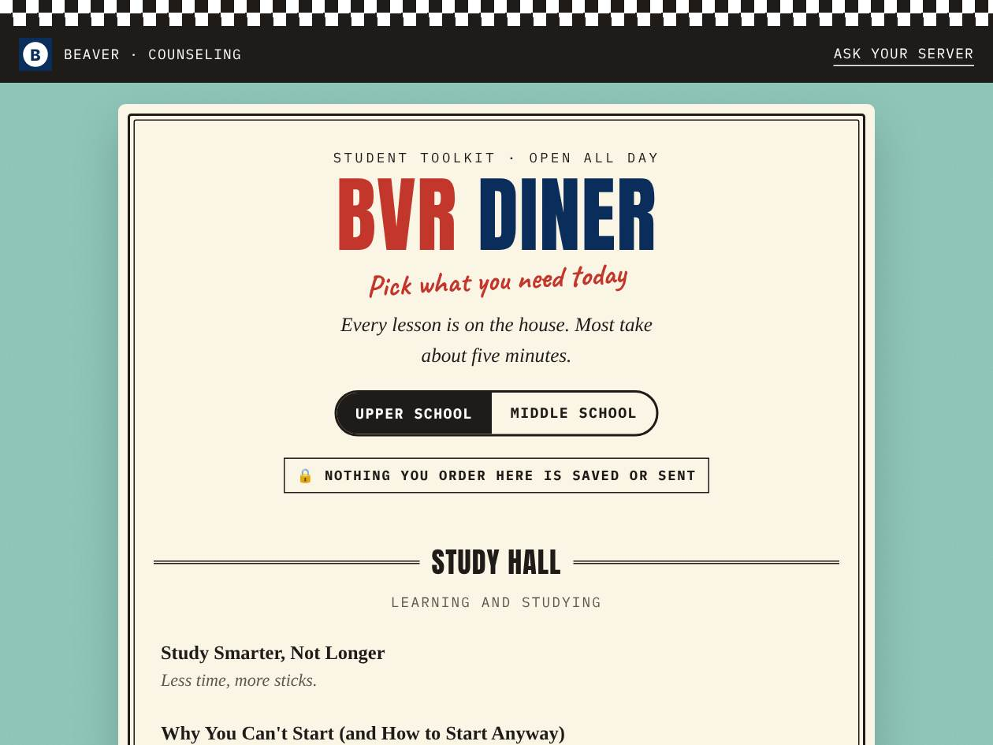
WHAT STUDENTS SEE
Twelve lessons students can open on their own.
— The BVR Diner menu: study, friends, stress and sleep.
— Teach them first if you can, especially with 9th graders.
— Then students know where to find them again.
Open the BVR Diner →
Beaver Counseling
Notes:
1 MINUTE. Most of the toolkit is adult-led. These twelve are the exception: students can open them any time from the BVR Diner. They land best after an adult has introduced them.

Slide 15
PLAINLY
What it is, and what it isn't
IT IS
IT ISN'T
A starting point for a conversation
Short, research-based lessons
A page students keep
Private: saves and sends nothing
Therapy or counseling
A screening tool
Watched by anyone
A script you have to follow
Beaver Counseling
Notes:
2 MINUTES. Say this plainly; it answers the questions people are too polite to ask. Adapt the lessons. Skip a slide. Tell a story of your own. The lessons are a scaffold, not a script.

Slide 16
TRY IT
Which would you open?
ADVISORY, TUESDAY
AFTER CLASS
HEALTH CLASS
Your 9th graders have 25 minutes, and the group chat has been ugly all week.
A student says they can't make themselves start anything and they're drowning.
Your unit on vaping starts next week.
Beaver Counseling
Notes:
5 MINUTES. Pairs, one card each, using the toolkit link if they have a laptop. Then a quick share. Likely answers: Group Chat Drama as an advisory lesson. Why You Can't Start or Study Smarter, Not Longer: share the student page, and loop in the advisor or counseling if it sounds bigger than procrastination. Vaping and Your Brain as a full class. There are no wrong picks; the point is that they found one in under a minute.

Slide 17
WHERE TO BEGIN
If you're not sure where to start
1
Try the 9th-grade fall set.
Six lessons that work well in order. Use them, mix them, or skip around.
2
Pick one advisory lesson this month.
Twenty minutes, with time to check in.
3
Ask us.
Dr. Wilson or Ms. Garcia will help you pick or co-teach the first one.
Beaver Counseling
Notes:
2 MINUTES. Offer to co-teach anyone's first lesson. That one offer tends to get more people started than anything on a slide.

Slide 18
BEFORE YOU GO
Try one this month
One lesson, one group. Tell us how it went.
THE STUDENT TOOLKIT (BOOKMARK IT)
https://rmwtoolkit.github.io/bcds-toolkit/toolkit.html
Beaver Counseling
Notes:
1 MINUTE. Invite, don't assign: "If you try one, tell me how it went, especially what didn't work." Put the link in the meeting chat or invite. Thank them.

