Slide 1
TEACHER PAGE · skipped when you present · Before you start
Gut Check
Upper School · 20 minutes (fits a 30-minute advisory) · Any grade; fits right after Who's Driving? in 10th
BEFORE YOU START
Students sort cards on their phones without being told they're values, then get the reveal. Don't say "values" until slide 4.
EVERY STUDENT IN THE ROOM
Family, faith, culture and community count as values just as much as independence or adventure; say so at the reveal, and never ask anyone which value they starred.
Notes:
This page is hidden and skipped when you present. The full plan, care notes and research are on the hidden pages at the end of the deck, if you want them.

Slide 2
GUT CHECK
Gut Check
Thirty-two cards. Go with your gut.
Beaver Upper School · Counseling
Written by Dr. Rick Wilson, with AI-assisted drafting. Every lesson is reviewed and edited by Dr. Wilson.
Beaver Counseling
Notes:
Keep it light and say as little as possible about what's coming. Something like: "Today's quick. You're going to sort some cards on your phone, on instinct. Don't overthink it."

Slide 3
WARM-UP
Who's someone you'd want in your corner?
Think of one person. What makes them that person?
Beaver Counseling
Notes:
2 MINUTES. No names needed. Take a few call-outs and write the words on the board: shows up, honest, funny, loyal, calm. Don't call them values yet. Leave the board up for the reveal.

Slide 4
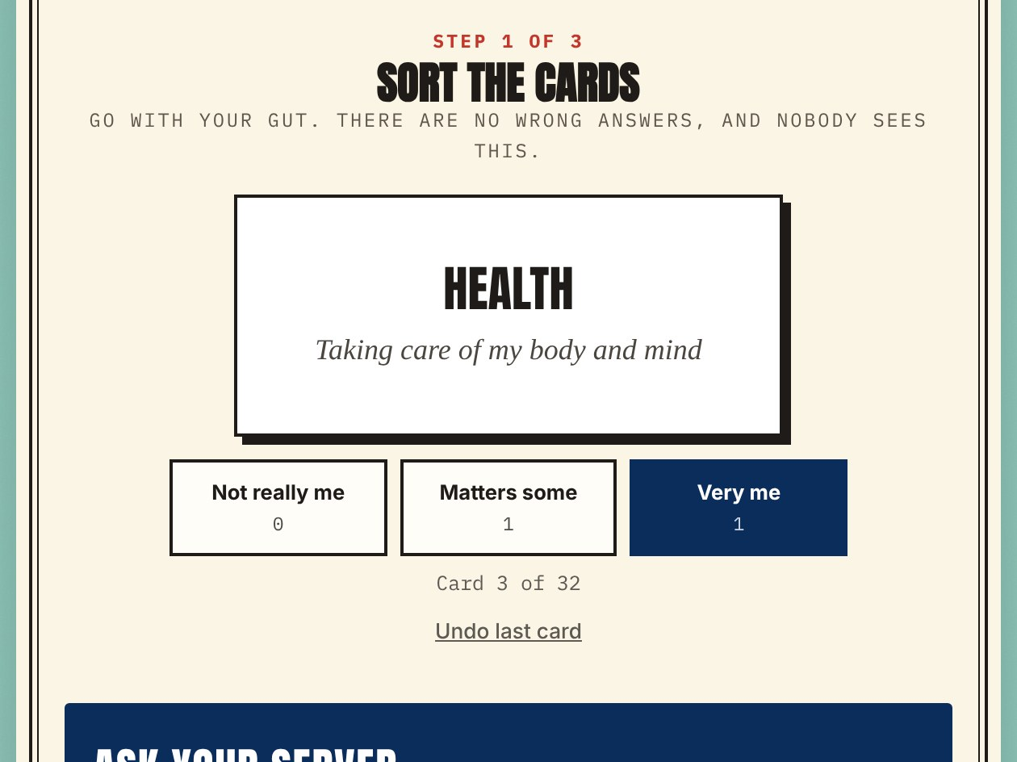
GUT CHECK
Open the Gut Check
— Tap each card: not really me, matters some, or very me.
— Keep your top five (or three).
— Star the one you'd keep if you could only keep one.
Open the Gut Check →
Beaver Counseling
Notes:
6 MINUTES. Share the link (QR, Canvas, or the chat). Quiet work, like a quiz nobody grades. Students who finish early can screenshot their card. If a student doesn't have a device, hand them the Who's Driving? values card and ask them to circle five and star one.

Slide 5
THE REVEAL
What you just sorted are your values.
What you want steering when it counts: in the group chat, at a party, when nobody's watching.
Beaver Counseling
Notes:
1 MINUTE. Point to the warm-up words on the board: "Same kind of words. You picked the people in your corner for their values, and now you've picked yours." Say that family, faith, culture and community count as much as freedom or adventure.

Slide 6
THE RESEARCH
Miller et al., 2001 · Cohen et al., 2006 · Hanselman et al., 2017 · Bryan, Yeager et al., 2016
Naming what matters helps, a little.
• Counselors use this same card sort to help people figure out what they want.
• Students who wrote about their top value before a hard stretch did a bit better in some studies.
• Bigger studies found a smaller effect. It's a nudge, not magic.
• Choices framed around your own values stick better than rules from adults.
IN CLASS
Say it straight: a few minutes of knowing what you'd stand for, and nothing more than that.
Beaver Counseling
Notes:
2 MINUTES. Cohen and colleagues (Science, 2006) had 7th graders write about their most important value; grades rose a bit, most for Black students facing stereotype threat. Larger trials found less (Borman 2016; Hanselman 2017), so don't oversell it. Bryan and Yeager (2016) found teens changed what they did when a choice was about their own independence and fairness.

Slide 7
TURN AND TALK
Your star value at work
THE GROUP CHAT
FRIDAY
THE SHORTCUT
Someone posts a screenshot to roast a classmate. Everyone's reacting with laughing faces.
You promised your family you'd be home for dinner. Everyone else is going out.
A friend offers you last year's answers to the take-home test.
Beaver Counseling
Notes:
5 MINUTES. In pairs, pick one card. Each of you: pick any value (yours or not) and say what it would do here, in one line you'd actually say. Nobody has to reveal their star. Hear a few lines. Point out that two different values can lead to the same good move.

Slide 8
TWO MINUTES, JUST FOR YOU
Why this one?
On the page or on paper: a time your star value mattered. Nobody reads it.
Beaver Counseling
Notes:
2 MINUTES. The writing box is at the bottom of their results card and is never saved. Quiet. Students who'd rather not write can just think.

Slide 9
BEFORE YOU GO
You picked yours.
Keep the screenshot. Values shift as you grow, so try it again next year.
GUT CHECK PAGE
https://rmwtoolkit.github.io/bcds-toolkit/gut-check-high-school.html
Beaver Counseling
Notes:
2 MINUTES. Close with: "Nobody can tell you what your values are, and no quiz can either. You just noticed them. Use them." If anything heavy came up, thank the student and let a counselor know that day.

Slide 10
TEACHER PAGE · skipped when you present · Lesson plan
Gut Check
Upper School · 20 minutes (fits a 30-minute advisory) · Any grade; fits right after Who's Driving? in 10th
GOAL
Students sort 32 cards on instinct, keep five, star one, and only then learn that what they sorted are their values. They see one way their star value could steer a real moment, and write privately about why it matters. Nobody shares their list.
MATERIALS
A phone or laptop per student, or one per pair (students without one can circle five on the Who's Driving? values card)
A board for the warm-up words
The Gut Check link (slide 3) to share
FLOW
2 min Warm-up: someone you'd want in your corner
6 min The Gut Check, quietly on phones
3 min The reveal, and what the research says
5 min Turn and talk: your star value at work
2 min Two minutes, just for you
2 min Close
SHORT ON TIME (20-MINUTE ADVISORY)
Warm-up (1), the Gut Check (5), the reveal (2), one turn-and-talk card (2). Students write on their own later.
Notes:
If you want more: this page and the next three are hidden and skipped when you present.

Slide 11
TEACHER PAGE · skipped when you present · Before you teach
Before you teach
Keep the reveal.
The point is that students pick on instinct before the word "values" shows up and they start choosing what sounds good. If someone asks, say "you'll see at the end."
Nobody shares their list.
Turn-and-talk is about what a value would do in a moment, not which one you starred. Students can talk about any value, theirs or not.
When values pull against home.
A student whose star is independence may live in a family that prizes making them proud, or the other way around. Both can be true at once. If it seems to weigh on someone, mention that counselors are good to talk to about exactly that.

Slide 12
TEACHER PAGE · skipped when you present · Every student in the room
Every student in the room
Culture, family, identity, ability and money: what to keep in mind for this topic.
Values come from many places.
For some students, values come from their family, faith or community more than from themselves. The cards include family, faith, culture and heritage, making my family proud, and community on purpose. Treat those as their own choices, not someone else driving.
Faith, and no faith.
Faith is one card among 32. Students who aren't religious skip it; students who are can star it. Neither needs explaining.
Devices and reading.
Students can work in pairs on one phone, use the paper card, or have the cards read aloud. The page works with a screen reader and keyboard.

Slide 13
TEACHER PAGE · skipped when you present · Background
What the research says
The Personal Values Card Sort, used in motivational interviewing, has people sort value cards into piles by how important each is, then rank the top ones. It is in the public domain.
Miller, C'de Baca, Matthews & Wilbourne, University of New Mexico, 2001
Seventh graders who wrote for a few minutes about their most important value early in the year earned somewhat better grades, with the largest effect for Black students facing stereotype threat.
Cohen, Garcia, Apfel & Master, Science, 2006
In a larger trial across many schools, the effect was smaller, and a large replication found little overall effect.
Borman et al., 2016; Hanselman et al., Journal of Educational Psychology, 2017
Teens changed their choices for months when a choice was framed around their own values, like independence and fairness, rather than adult rules.
Bryan, Yeager et al., PNAS, 2016

