Slide 1
TEACHER PAGE · skipped when you present · Before you start
The Drinking Game
Upper School · 45 minutes (20-minute advisory version below) · Health class, advisory, or a counselor-led group
BEFORE YOU START
Students learn the order alcohol affects the brain, why the last drink isn't the peak, and the signs that mean call 911. Bring paper for the exit card, keep it about Theo rather than anyone in the room, and if a student shares worry about their own or a family member's drinking, walk them to a counselor that day.
EVERY STUDENT IN THE ROOM
Families and faiths handle alcohol very differently, from never to wine at dinner, and some students live with an adult who drinks too much; respect every one of those homes and keep the focus on what alcohol does.
SHORT ON TIME (20-MINUTE ADVISORY)
The guess (3), four stops (6), Theo's Friday, stops 3 and 4 only (7), signs and the call (4). Share the take-home link so students get the rest.
Notes:
This page is hidden and skipped when you present. The full plan, care notes and research are on the hidden pages at the end of the deck, if you want them.

Slide 2
THE DRINKING GAME
The Drinking Game
What alcohol actually does, how the night usually goes, and what to do when it goes wrong.
Beaver Upper School · Counseling
Written by Dr. Rick Wilson, with AI-assisted drafting. Every lesson is reviewed and edited by Dr. Wilson.
Beaver Counseling
Notes:
Open plainly. Something like: "Everybody has an opinion about drinking. Today is about how the game actually plays out, and the mechanism, because knowing it can keep someone alive." Say up front that nobody will be asked about their own drinking.

Slide 3
QUICK GUESS
Out of 100 tenth graders, how many didn't drink at all last year?
Write a number. No names.
Beaver Counseling
Notes:
5 MINUTES. Students write a guess on scrap paper. Ask for a few out loud or a quick show of fingers by tens. Most guess low. The answer: 76 out of 100 tenth graders and 59 out of 100 seniors didn't drink at all in the past year (Monitoring the Future, 2025). Say: "Not drinking is the normal choice in your grade. The guess most people carry around is wrong, and that wrong guess pushes people to do things they don't want to."

Slide 4
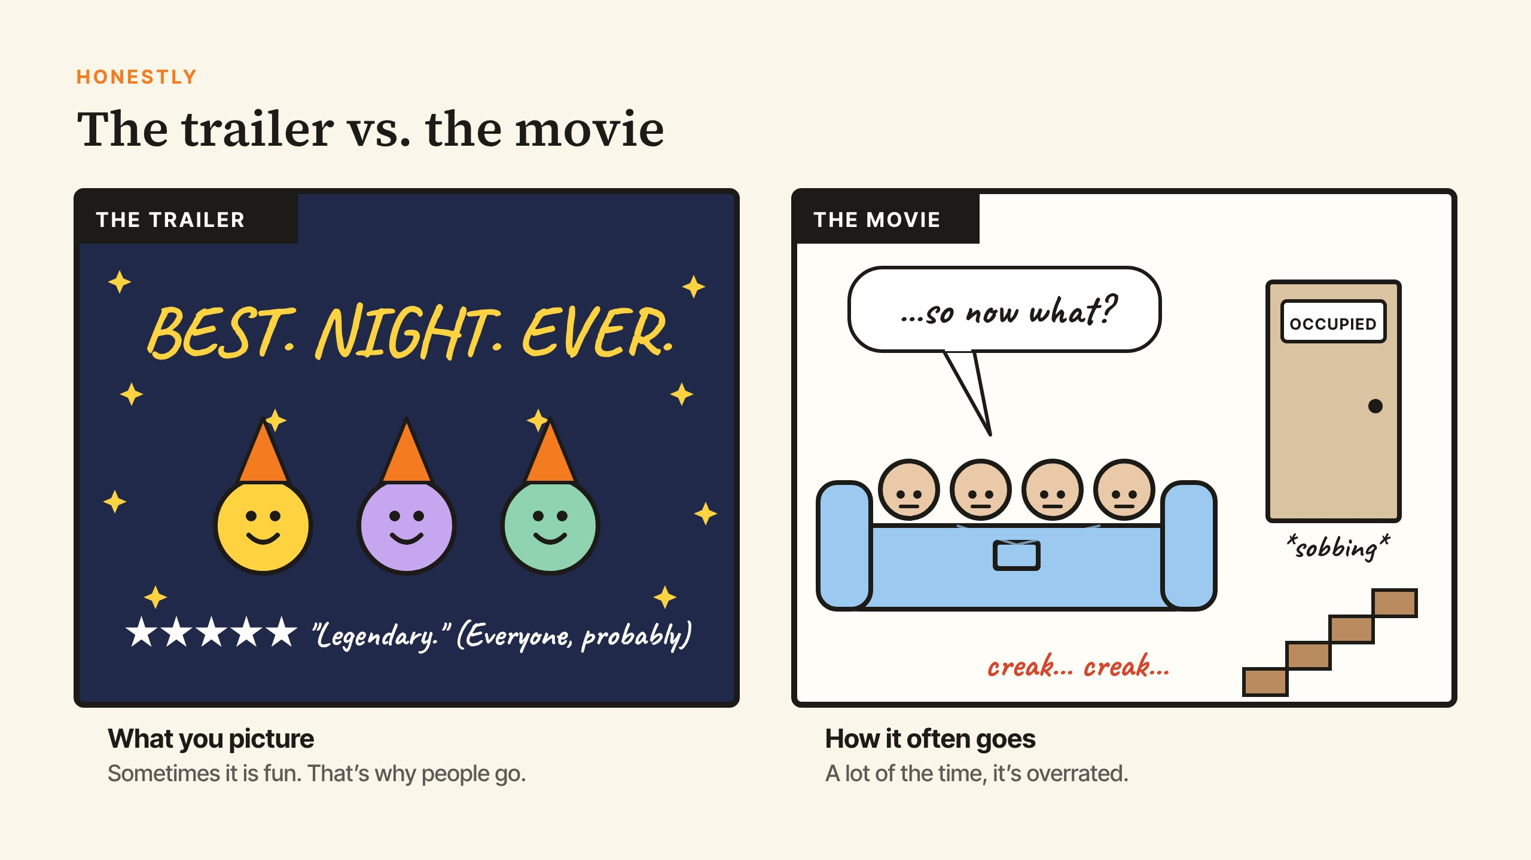
HONESTLY
Beaver Counseling
Notes:
3 MINUTES. Be honest, because they'll know if you aren't: sometimes it is fun, and that's why people go. A lot of the time it's overrated. Ask: "What's in the trailer that isn't in the movie?" Let them laugh, then: "Today is about the parts the trailer leaves out."

Slide 5
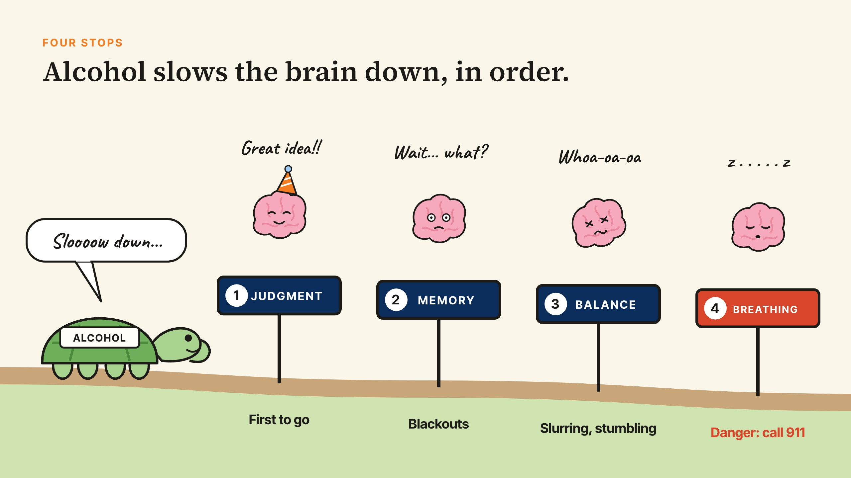
FOUR STOPS
Beaver Counseling
Notes:
8 MINUTES. Walk the turtle across the four signs. Talking points. 1, Judgment: alcohol boosts GABA, the brain's brake signal. The prefrontal cortex, which weighs consequences, feels it first, so the dare or the drive home sounds fine before anyone feels drunk. It's also why someone who's drunk can't give consent: the part of the brain that weighs a yes is the first one offline. 2, Memory: the hippocampus stops saving new memories while the person is still awake, talking and choosing. That's a blackout, which is different from passing out. 3, Balance: the cerebellum slows, so slurring and stumbling show up. 4, Breathing: the brainstem runs breathing, heart rate and the gag reflex. When it slows, that's alcohol poisoning. Ask: "Which stop do people feel last?" (Judgment, because the part that would notice is the part already affected.)

Slide 6
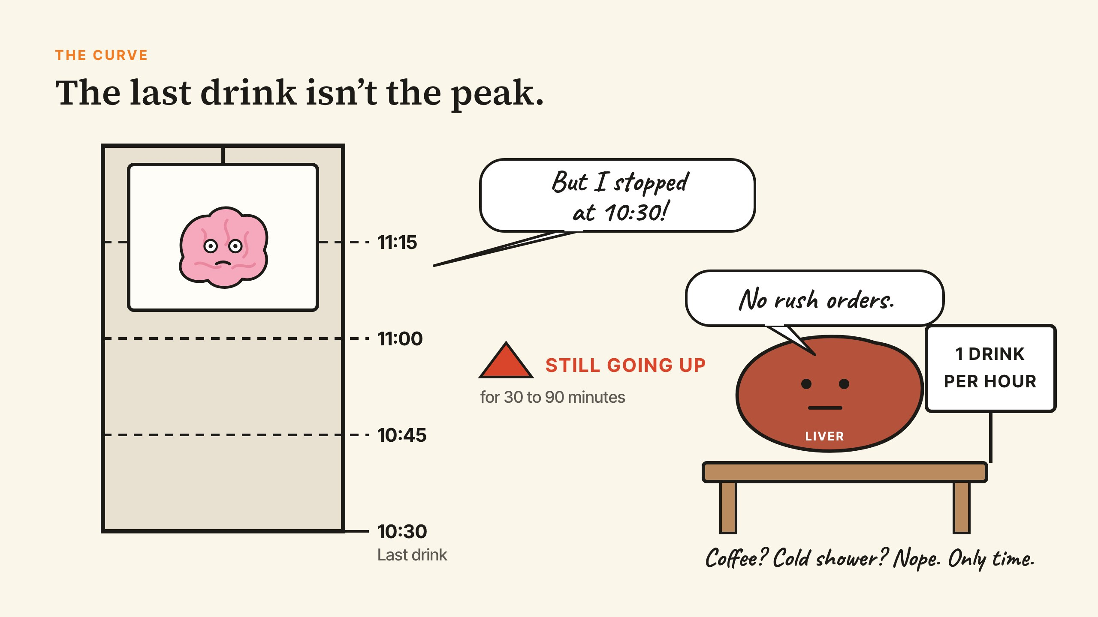
THE CURVE
Beaver Counseling
Notes:
4 MINUTES. Point to the elevator: it keeps rising after the last drink. Say: "Someone who seems fine at 10:30 can be in danger at 11:15." Coffee, a cold shower and throwing up don't speed up the liver. A mixed drink in a party cup is often two or more standard drinks. Add the teen piece: teens feel fewer of the sleepy, wobbly warning signs adults get (Spear, 2018), so the body's own stop signal is quieter.

Slide 7
LOTS OF WAYS IN
Where the bottle usually comes from
1
A parent's cabinet, without them knowing.
"They'll never notice. I'll add water."
2
An older friend or sibling buys it.
Or someone has a fake ID.
3
A party, a sleepover, a trip.
Whoever brought it, it ends up in a cup.
4
An adult who says "better here than out there."
It's illegal for an adult to let other people's kids drink at their place. They can be charged, and sued if someone gets hurt.
Beaver Counseling
Notes:
2 MINUTES. Read the list quickly; this is a map of how it happens, not a debate about any one path. Most students drinking for the first time get alcohol from home or from friends, not from a store. Be clear on the last one, because some students have heard it framed as the safe option: in Massachusetts, an adult who supplies alcohol to, or knowingly lets someone else's child under 21 drink on property they own or control can be fined up to $2,000, jailed up to a year, or both (c.138 §34), and hosts can also be sued if a guest is hurt afterward. Parents supplying alcohol also hasn't been shown to make teens safer; one six-year study found those teens were more likely to get it from other sources too (Mattick, 2018). A parent serving their own child at a family dinner is a different situation, and that comes up later. Ask: "Does where it came from change what it does in your body?" (No.)

Slide 8
THEO'S FRIDAY
Vote 1, 2 or 3 with your fingers.
1
9:00. Five friends hanging out at Maya's.
Someone pulls out a bottle of vodka and passes it around.
2
10:00. Someone starts a drinking game.
Theo loses four rounds in twenty minutes. "I feel nothing."
3
11:00. Theo is slurring and has thrown up.
He wants to lie down alone on the couch in the corner.
4
11:20. Theo won't wake up.
Long pauses in his breathing. "Don't call. We'll all get in trouble."
Beaver Counseling
Notes:
8 MINUTES. Read each stop, then give three options and have everyone vote with fingers before anyone talks. Stop 1: (1) take one, nobody will know; (2) "I'm good" and grab a soda; (3) take one and nurse it. Stop 2: (1) believe him; (2) get him water, get him out of the game, and stay close for the next hour; (3) tell him to slow down and walk away. Answer 2: drinking games are built for fast drinking, and those rounds haven't fully hit yet. Stop 3: (1) let him sleep it off; (2) go with him, keep him on his side, stay; (3) check on him in an hour. Answer 2: never leave someone alone to sleep it off. Stop 4: (1) wait and see; (2) call 911, and get an adult if one is home; (3) drive him home. Make this completely clear: call 911, every time. Getting in trouble is temporary. Ask: "At which stop was the right move hardest? What made it hard?" Keep it about Theo.

Slide 9
WHEN TO CALL
Any one of these: call 911
THE SIGNS
WHAT YOU DO
Can't be woken up
Vomiting while passed out
Slow or gappy breathing
Cold, pale or bluish skin, or a seizure
Call 911
Roll them on their side, top knee bent
Stay with them
Poison Control: 1-800-222-1222
Beaver Counseling
Notes:
5 MINUTES. Have students stand and practice the recovery position on a partner's description, or demonstrate it yourself on the floor if that fits your room. "Let them sleep it off" is how people choke. Be honest about the law: Massachusetts' Good Samaritan law covers drug overdose calls and doesn't specifically cover underage drinking. Tell students to call anyway. Some students worry about police because of immigration status or how their community is treated. Acknowledge it, then repeat that a medical emergency is a 911 call.

Slide 10
THREE MOMENTS
What would you do?
JAE
AMARA
A FAMILY DINNER
Your ride home had two beers three hours ago. He's 18, says he feels fine, and everyone else has left.
Your friend laughs about blacking out last weekend. It's the third time this semester.
An uncle pours you a small glass of wine. Your parents are fine with it.
Beaver Counseling
Notes:
3 MINUTES IN PAIRS, THEN SHARE. Jae: call your exit-plan person and offer Jae a ride too. In Massachusetts a driver under 21 at 0.02 or above loses their license on the spot, and every 0.02 rise more than doubled young drivers' crash death risk. Amara: bring it up later, privately, when she's sober; three blackouts is a pattern worth a counselor's help. Family dinner: this is the family's call and the student's. Some families do this; one six-year study found parents supplying alcohol wasn't protective, and students can pass without making a scene. Respect every family's answer.

Slide 11
YOUR PLAN
Set it up before you go
1
Pick your exit-plan person.
Someone you can text a code word to, no questions.
2
Not drinking is normal.
Most of your grade made that choice.
3
If alcohol is there, protect the basics.
Eat first, go slow, own cup, never mix.
4
Never ride with a driver who drank.
Call your person instead.
Beaver Counseling
Notes:
5 MINUTES. Private reflection: ask students to write the name of their exit-plan person on the back of their exit card (they keep that part). Families handle this differently: some will pick up with no questions that night, and some won't. A parent, older sibling, cousin, aunt or family friend all work. Never mixing with weed or pills matters because both slow breathing too.

Slide 12
BEFORE YOU GO
Exit card
Theo's friend says "let him sleep it off." What do you say back?
STUDENT PAGE
https://rmwtoolkit.github.io/bcds-toolkit/alcohol-and-your-brain-high-school.html
Beaver Counseling
Notes:
5 MINUTES. Collect anonymously. Share the take-home link on the slide. It has the four stops, the signs, the exit plan, and who to talk to, including SAMHSA's free helpline at 1-800-662-4357. Remind students counselors handle questions about their own drinking, a friend's or someone's at home.

Slide 13
TEACHER PAGE · skipped when you present · Lesson plan
The Drinking Game
Upper School · 45 minutes (20-minute advisory version below) · Health class, advisory, or a counselor-led group
GOAL
Students can explain the order alcohol affects the brain (judgment, memory, balance, breathing), why the last drink isn't the peak, and exactly what to do when someone shows signs of alcohol poisoning. Not drinking gets named as the normal choice it is. Nobody in the room should feel judged for their family's habits.
MATERIALS
Paper and pens for the exit card
Nothing to draw: the four stops and the curve are cartoons on the slides
The take-home link (last slide) to share after class
FLOW
3 min Quick guess: how many of your grade drink?
3 min Honestly: the trailer vs. the movie
8 min Four stops: what alcohol does, in order
4 min The curve: why the last drink isn't the peak
2 min Lots of ways in: where the bottle comes from
8 min Theo's Friday (four votes)
8 min When to call, and three moments (pairs)
4 min Your plan (private)
5 min Exit card and take-home link
SHORT ON TIME (20-MINUTE ADVISORY)
The guess (3), four stops (6), Theo's Friday, stops 3 and 4 only (7), signs and the call (4). Share the take-home link so students get the rest.
Notes:
If you want more: this page and the next three are hidden and skipped when you present.

Slide 14
TEACHER PAGE · skipped when you present · Before you teach
Before you teach
Assume every kind of home is in the room.
Students who never drink, students who drink at parties, students whose family serves wine at holidays, students whose faith forbids it, and students living with an adult who drinks heavily. Talk to all of them. No show of hands about anyone's drinking.
Lead with the numbers.
Most of their grade isn't drinking. Teens overestimate how many peers drink, and that guess shapes what they do. Saying the real number out loud does real work.
Make the 911 message impossible to miss.
If someone can't be woken, is breathing slowly or with long pauses, or is vomiting while passed out, the answer is 911. Say it more than once. Fear of getting in trouble is the main reason people wait.
Be honest about the law.
Massachusetts' Good Samaritan law covers drug overdose calls and doesn't specifically cover underage drinking. Don't promise students immunity. Tell them to call anyway, because trouble is temporary.
If a student mentions drinking at home.
Some students are worried about a parent. Thank them quietly, don't probe in front of the class, and walk them to a counselor that day.
If a student says they black out.
Stay calm and private. Blackouts mean a lot of alcohol, fast. Tell them you're glad they said something and connect them with a counselor that day.

Slide 15
TEACHER PAGE · skipped when you present · Every student in the room
Every student in the room
Culture, family, identity, ability and money: what to keep in mind for this topic.
Faith and culture.
For some students alcohol is forbidden; for others wine is part of a holiday table. Present facts about the brain and leave the values to the student and their family.
Family drinking.
"Parent" can mean a grandparent, aunt, foster parent or older sibling, and some of those adults drink too much. Never make a drinking parent sound foolish. A student may be protecting them.
Who they call.
The exit-plan person might be a parent, an older sibling, a cousin or a family friend. Some families will pick up with no questions; some won't. Let students choose their own person.
Fear of police.
For some students, calling 911 brings real worries about immigration status or how police treat their community. Name that calmly. For a medical emergency like alcohol poisoning, 911 is still the call.
Mixed examples.
Use names and situations from many backgrounds, and include LGBTQ+ students in the party stories without making identity the reason anyone drinks.
Money and parties.
Some students hang out in basements where a parent buys or allows the drinks; others never get invited anywhere. Keep the scenarios about choices, not about who has the house or the money.

Slide 16
TEACHER PAGE · skipped when you present · Background
What the research says
76% of U.S. 10th graders and 59% of 12th graders didn't drink at all in the past year. Teen drinking is near the lowest level the survey has recorded.
Monitoring the Future, 2025
Teens feel fewer of alcohol's sedating, wobbly effects than adults do, so they get fewer natural stop signals.
Spear, Nature Reviews Neuroscience, 2018
134 young people were scanned repeatedly between ages 12 and 24. Those who became heavy drinkers lost gray matter faster in frontal and temporal areas. This shows a link, not proof of cause.
Squeglia et al., American Journal of Psychiatry, 2015
483 teens scanned before they ever drank showed the same frontal pattern after heavy drinking began.
Pfefferbaum et al., American Journal of Psychiatry, 2018
51% of college students who drank reported at least one blackout.
White et al., Journal of American College Health, 2002
47% of people who started drinking before 14 became dependent at some point, compared with 9% of those who waited until 21 or older.
Hingson et al., Archives of Pediatrics and Adolescent Medicine, 2006
For young drivers, each 0.02 rise in blood alcohol more than doubled the risk of dying in a crash.
Zador et al., Journal of Studies on Alcohol, 2000
A six-year study of about 1,900 Australian teens found no protective effect from parents supplying alcohol; those teens were more likely to get it from other sources too. One study, and families decide this for many reasons.
Mattick et al., The Lancet Public Health, 2018
In Massachusetts, an adult who supplies alcohol to, or knowingly allows drinking by, someone else's child under 21 on property they own or control can be fined up to $2,000, jailed up to a year, or both. Hosts can also be sued if a guest is hurt.
Massachusetts General Laws c.138 §34

