Slide 1
TEACHER PAGE · skipped when you present · Before you start
Who's Driving?
Upper School · 45 minutes, built for a 10th-grade meeting (20-minute advisory version below) · 10th grade, first weeks of school
BEFORE YOU START
Students see where a 16-year-old brain is (adult-level reasoning when calm, brakes still building under pressure) and pick the values they want steering. Print a values card per student, and keep the driving talk general: not everyone drives or has a car, and nobody shares what they've done.
EVERY STUDENT IN THE ROOM
Family, faith, loyalty and community count as values at the wheel just as much as independence; say so when students pick five.
SHORT ON TIME (20-MINUTE ADVISORY)
Quick vote (2), the road-work and two-speeds cartoons (5), one turn-and-talk (5), pick five (4), one if-then plan (4). Share the student page for the rest.
Notes:
This page is hidden and skipped when you present. The full plan, care notes and research are on the hidden pages at the end of the deck, if you want them.

Slide 2
WHO'S DRIVING?
Who's Driving?
Your brain at 16, your values, and who's really at the wheel.
Beaver Upper School · Counseling
Written by Dr. Rick Wilson, with AI-assisted drafting. Every lesson is reviewed and edited by Dr. Wilson.
Beaver Counseling
Notes:
Open plainly. Something like: "This is your year for licenses, later nights and bigger choices. Today is about where your brain actually is right now, and what you want steering when it counts. Nobody will be asked what they've done."

Slide 3
QUICK VOTE
At what age is your brain done?
1
16
2
18
3
21
4
25
5
It's never done
Beaver Counseling
Notes:
2 MINUTES. Hands up for each. Most will say 25; they've heard it. Then: "Brains keep changing your whole life, so 5 is closest. But one part finishes a lot earlier than you've been told, and that's good news for you."

Slide 4
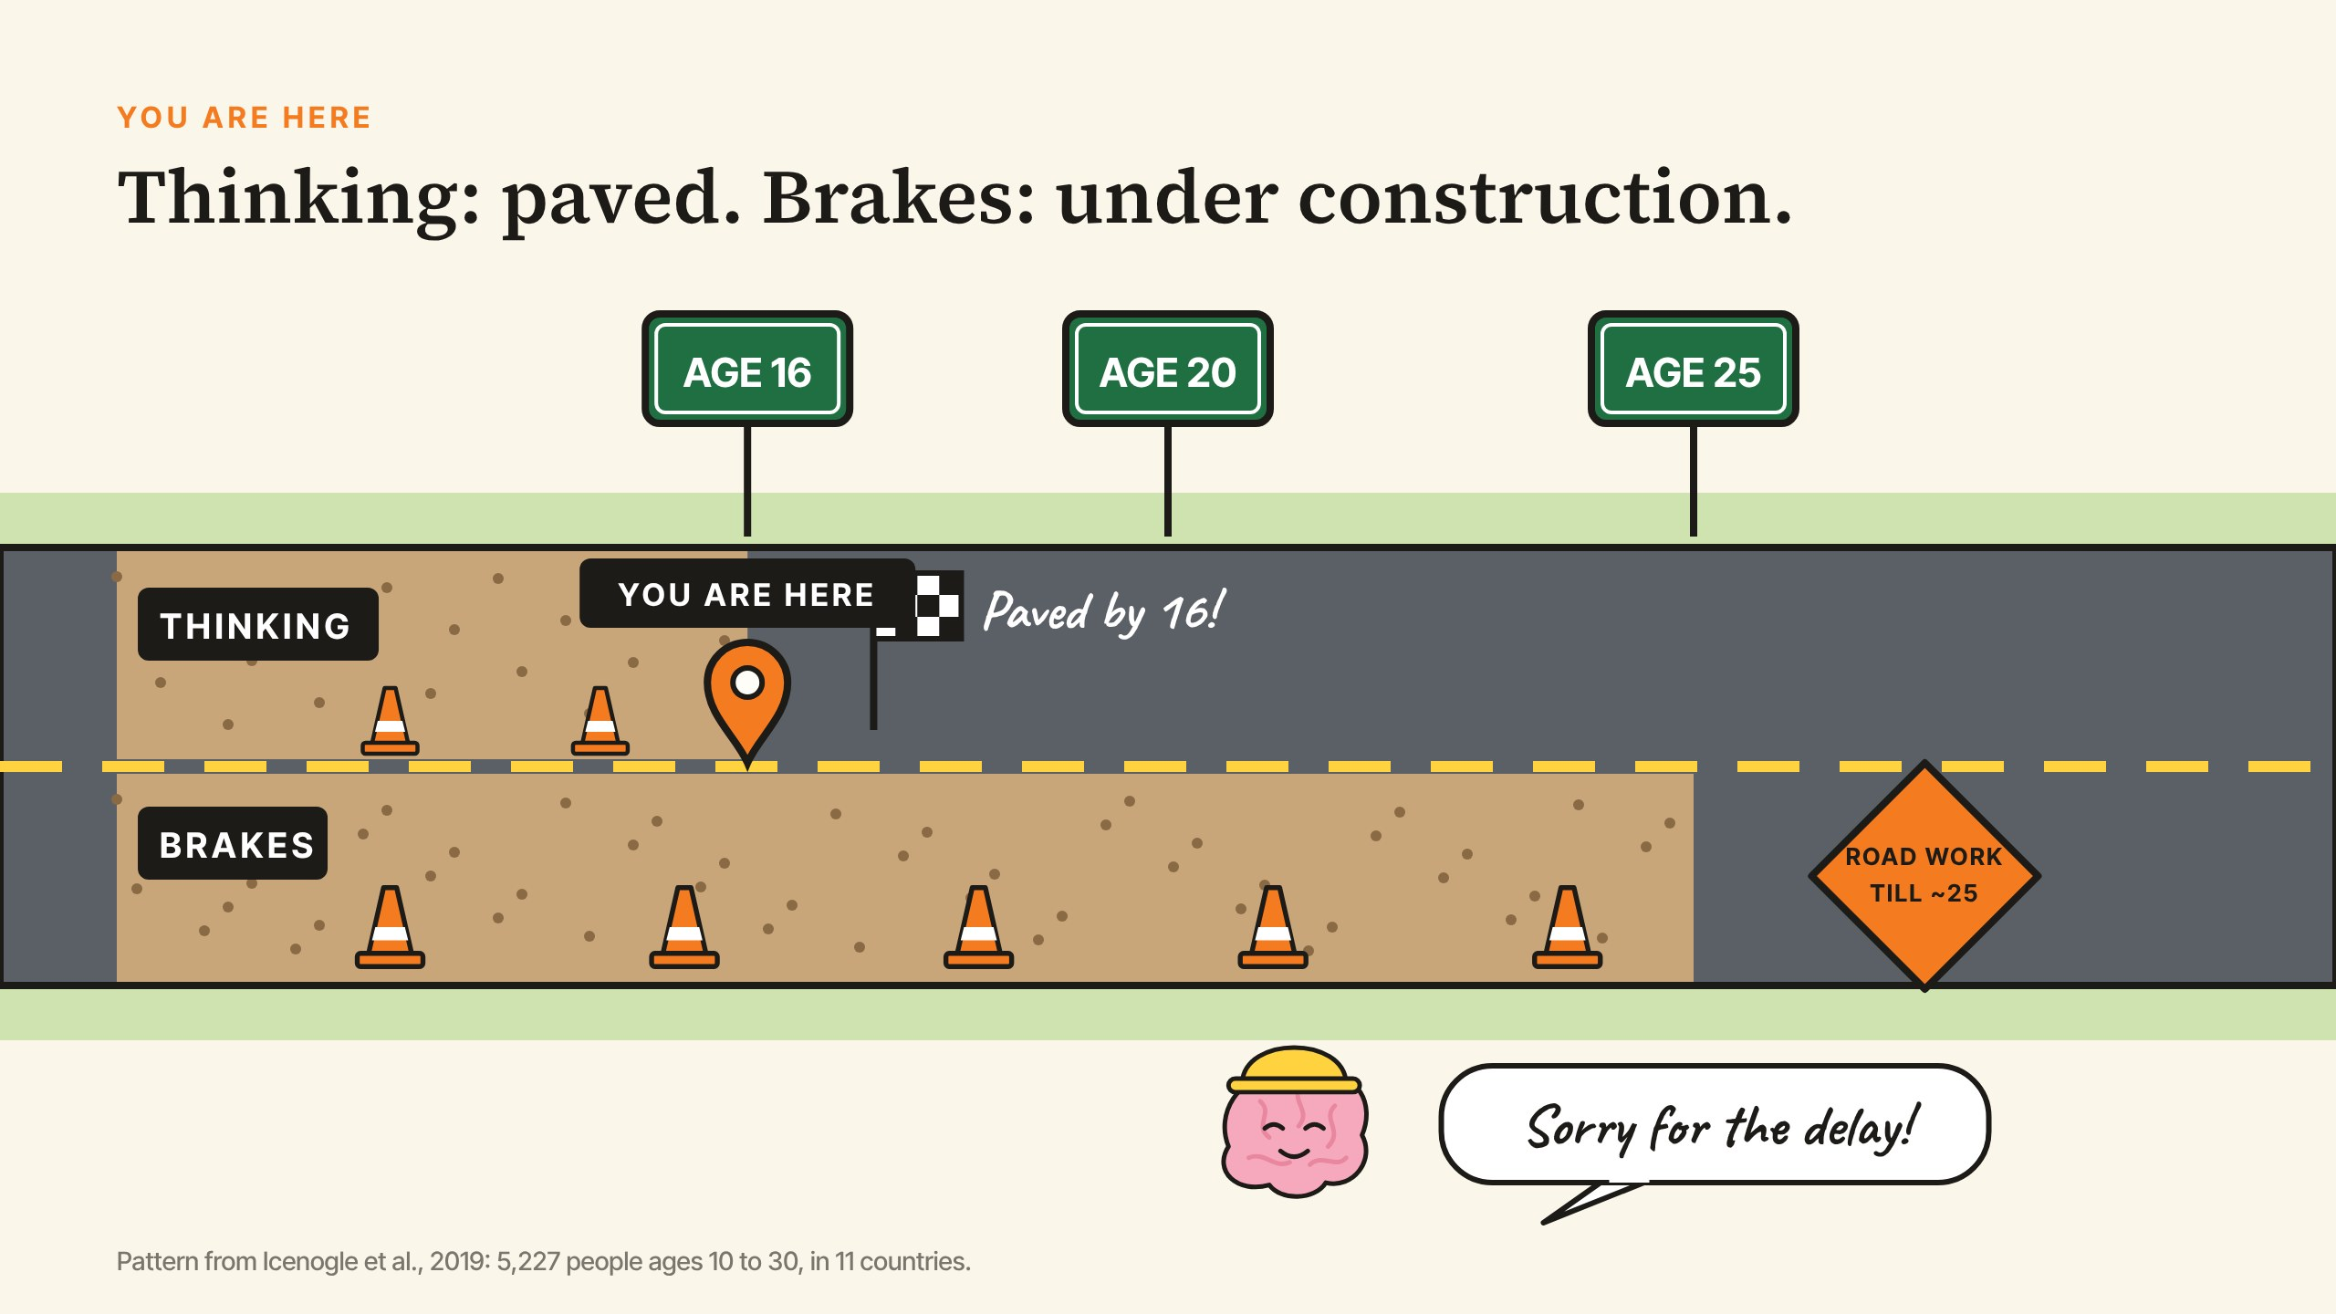
YOU ARE HERE
Beaver Counseling
Notes:
4 MINUTES. Like that poster of the galaxy with the tiny "you are here" arrow. Two lanes. Thinking it through (planning, reasoning, weighing pros and cons) is paved by about 16. A big study of more than 5,000 people in 11 countries found the same thing everywhere. Brakes under pressure (holding back when you're excited, angry, or being watched) is still under construction into your 20s. Point at the pin: "You're right here. Great thinking, brakes still being built. That's normal, not a flaw." Point at the hard hat: "Sorry for the delay."

Slide 5
A TRUE STORY
A Tuesday promise and a Saturday night
Your presenter's story, from when they were about your age.
Beaver Counseling
Notes:
3 MINUTES. Tell a short, true story of your own: a plan you made calmly that fell apart in the moment with friends around. Keep it light and a little embarrassing, not dangerous or graphic. End on what you wish you'd decided ahead of time. Students remember a real story from the person in front of them far longer than a statistic.

Slide 6
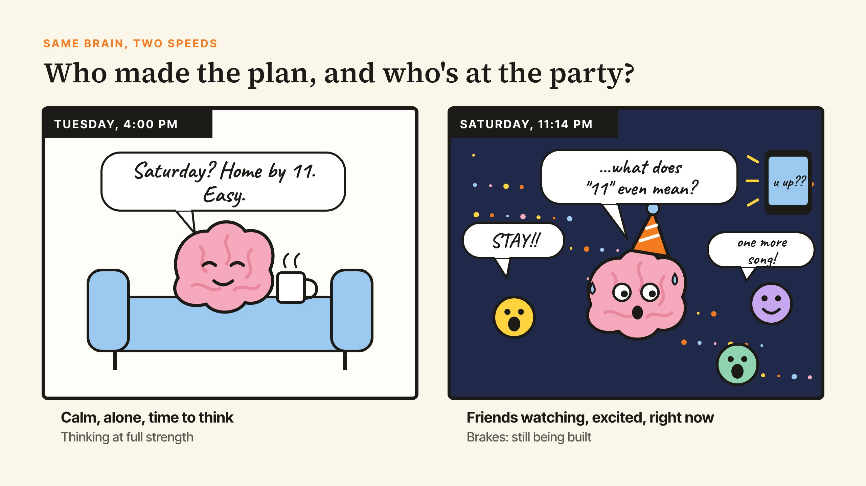
SAME BRAIN, TWO SPEEDS
Beaver Counseling
Notes:
3 MINUTES. Read the two bubbles out loud; let them laugh. Say: "Same brain. On Tuesday, the thinking lane is driving. On Saturday, with friends watching and the clock ticking, the brakes get tested." Ask for hands: "Who's ever made a Tuesday plan that didn't survive Saturday?" Hands only, no stories.

Slide 7
THE DRIVING GAME
With friends watching, teens took more risks. Adults didn't.
Alone, everyone drove about the same. It's one reason new Massachusetts drivers can't carry friends for six months.
Beaver Counseling
Notes:
3 MINUTES. The study: teens, college students and adults played a driving game, alone or with two friends watching. Only the teens changed, and brain scans later showed their reward system lighting up when friends watched. Ask first: "Why do you think the passenger rule exists?" Then: "It isn't about you being reckless. Friends in the car turn up every 16-year-old's reward system."

Slide 8
TURN AND TALK
What would you do?
THE RIDE HOME
11:14
Jordan got their license two weeks ago. After the big win, Jordan offers you and three friends a ride. Everyone's hyped, the music's up.
Your curfew is 11:30. Your ride says they're staying till 1. The party just got good.
Beaver Counseling
Notes:
5 MINUTES. Turn to the person next to you and pick one. Two questions: what would make it hard to say something, and what could you actually say or do? Give them three minutes, then take two or three answers from the room. Listen for real-sounding lines ("I'll text my mom, she'll come"), and say them back. No one has to share their own story.

Slide 9
THE GOOD NEWS
The same boost works for good risks.
Trying out, speaking up, sitting with someone new. Friends watching makes those easier too.
Beaver Counseling
Notes:
2 MINUTES. In one study, teens gave more to a group when peers were watching (van Hoorn et al., 2016). Say: "Your friends aren't the problem. The volume on the reward system is turned up at your age. You get to choose what it rewards."

Slide 10
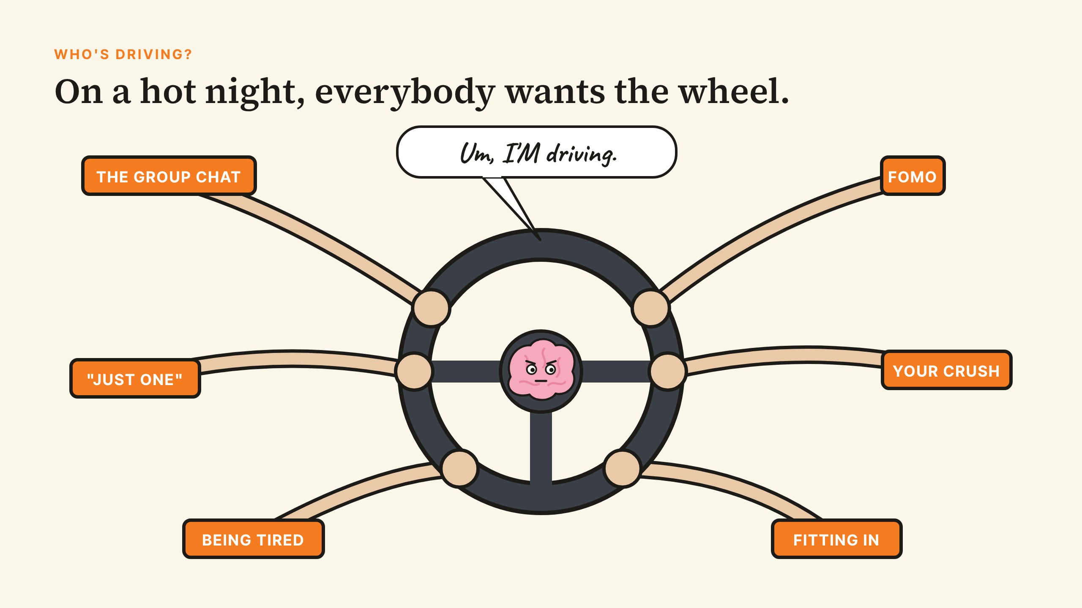
WHO'S DRIVING?
Beaver Counseling
Notes:
3 MINUTES. Read the hands out loud. Ask: "What else grabs the wheel?" Take a few call-outs. Then: "All of those are real, and none of them is you. So what do you want steering instead?"

Slide 11
A REAL STORY
Tokyo, 2021. The whole world watching.
Simone Biles stopped in the middle of the Olympic team final to protect her safety and her mental health. A week later she came back and won bronze on the beam.
Beaver Counseling
Notes:
3 MINUTES. The hottest moment there is: Olympic final, teammates counting on her, millions watching. She had the "twisties," losing track of herself in the air, which is dangerous. She steered by what she valued (her safety, her health, her team getting the best lineup) even though people criticized her. Ask: "What made that so hard? What did she have to know about herself first?"

Slide 12
THE RESEARCH
Teens tune out warnings. They don't like being played.
When 8th graders learned how junk-food ads try to manipulate teens, they chose fewer junk snacks, for months. Health warnings didn't do that.
Beaver Counseling
Notes:
2 MINUTES. Bryan, Yeager and colleagues, 2016 and 2019. Say it with a smile: "So we're not going to give you rules. We're going to ask what you care about."

Slide 13
PICK FIVE
What do you want at the wheel?
Circle five on your card. Star the one you'd keep if you could only keep one.
Beaver Counseling
Notes:
4 MINUTES. Hand out the values cards. The 24 values: Family, Loyalty, Honesty, Faith, Health, Freedom, Being trusted, Fun, Respect, Kindness, Fairness, Courage, Achievement, Adventure, Friendship, Community, Culture and heritage, Independence, Humor, Creativity, Calm, Making my family proud, Standing up for others, Being myself. Two quiet minutes. Say that family, faith and community are values at the wheel, not someone else driving.

Slide 14
TURN AND TALK
Your star value takes the wheel.
THE VAPE
THE DARE
JUST ONE
At a party, someone holds one out to you. "Everyone's watching, just hit it."
The group chat is planning to TP a teacher's house at midnight. "You in?"
Before the game, an older friend offers you a drink. "It's one. Relax."
Beaver Counseling
Notes:
6 MINUTES. With your partner, pick one. Each of you: what would your star value do here, and what's the exact line you'd say? Three minutes, then hear a few lines. Celebrate the funny, realistic ones ("Can't, my mom tracks my phone like the FBI"). Point out that blaming a parent, a game tomorrow, or a curfew are all real moves.

Slide 15
DECIDE COLD, USE HOT
Make the call before you're in the car.
IF…
…THEN I'LL
the driver has been drinking or smoking
someone hands me a vape
the group wants to go where I don't
it's 11:14 and I want out
text my code word for a pickup
say "I'm good, I've got practice"
blame my parents: "I have to be home"
call the person I'd call first
Beaver Counseling
Notes:
3 MINUTES. If-then plans work because the hot moment only has to remember one line (Gollwitzer & Sheeran, 2006). A code word works best when the adult on the other end has agreed to it ahead of time: tonight is a good night to set one up.

Slide 16
YOUR PLAN
On the back of your card: If ___, then I'll ___.
Keep it. Nobody collects it.
Beaver Counseling
Notes:
2 MINUTES. Suggest a wallet, phone case or car visor. Say: "You made that plan in a cold moment. That's the version of you who should be driving."

Slide 17
THIS YEAR
Who's driving? You are.
Next in advisory: Under Construction and Saying No. In October: The Drinking Game.
STUDENT PAGE
https://rmwtoolkit.github.io/bcds-toolkit/whos-driving-high-school.html
Beaver Counseling
Notes:
1 MINUTE. Share the student page link. Close with: "Thinking: paved. Brakes: under construction. Decide in the calm moments, and let that drive." Advisors: the follow-up lessons use the values card, so ask students to keep it.

Slide 18
TEACHER PAGE · skipped when you present · Lesson plan
Who's Driving?
Upper School · 45 minutes, built for a 10th-grade meeting (20-minute advisory version below) · 10th grade, first weeks of school
GOAL
Students can say where a 16-year-old brain is (adult-level reasoning when things are calm, brakes for heated moments still being built), explain why friends watching changes teen choices, name the five values they want steering, and write one if-then plan made in a calm moment for a heated one. Nobody is asked what they've done.
MATERIALS
A values card for every student: 24 values on the front, "If ___, then I'll ___" on the back (list in the notes for slide 12)
Pens or pencils
The student page link (last slide) to share afterward
FLOW
2 min Quick vote: when is a brain done?
7 min You are here (cartoon), then your own true story
6 min Two speeds, and the driving game
5 min Turn and talk: the ride home, or 11:14
5 min Good risks, and who's grabbing the wheel
5 min A real story (Simone Biles) and what the research says about values
4 min Pick five
6 min Turn and talk: your star value takes the wheel
5 min If-then plans, your plan, and what's next
SHORT ON TIME (20-MINUTE ADVISORY)
Quick vote (2), the road-work and two-speeds cartoons (5), one turn-and-talk (5), pick five (4), one if-then plan (4). Share the student page for the rest.
Notes:
If you want more: this page and the next three are hidden and skipped when you present.

Slide 19
TEACHER PAGE · skipped when you present · Before you teach
Before you teach
Skip "your brain is broken."
Teens hear "your brain isn't done until 25" as an insult or an excuse. The research gives better news: when it's calm, a 16-year-old reasons as well as an adult. Keep coming back to that.
The 25 number is softer than it sounds.
It comes from scan studies where change slowed in the mid-20s. Brains keep changing for life. Say "into your mid-20s," not "done at 25."
Keep it in the car on the slide.
The car at 11:14 is made up. Don't ask who has been in that car or what happened there.
Not everyone drives.
Some students won't get a license this year for money, family or other reasons. The passenger seat counts. The driver's seat in this talk means who decides.
Big room, small moves.
In a grade meeting, keep participation low-risk: hands, cards, standing up. Nobody talks into a microphone about themselves.
If someone tells you something.
If a student mentions riding with an impaired driver, or anything worse, thank them and follow up one on one that day.

Slide 20
TEACHER PAGE · skipped when you present · Every student in the room
Every student in the room
Culture, family, identity, ability and money: what to keep in mind for this topic.
Values aren't only individual.
Many students come from families and cultures where duty, family honor, faith and community come first. Those are values at the wheel, not someone else driving.
Independence means different things.
The research framed healthy choices as not being manipulated by people selling you something. That's different from going against your family. Say so out loud.
A license costs money.
Driver's ed, a car and insurance aren't equally available. Use the car as a picture of who decides, and never as a status marker.
Police and the 911 call.
Some students fear what police contact could mean for them or their family. A code word, a trusted adult's pickup, or a friend's parent are full options, not the backup plan.
Brains differ.
ADHD and other differences change how the brakes feel. Impulsivity isn't a character flaw. Avoid "just think first."
Every gender, every friend group.
Pressure isn't only boys daring boys. It shows up in group chats, on teams, in quiet friend groups. Use varied names and examples.

Slide 21
TEACHER PAGE · skipped when you present · Background
What the research says
Across 5,227 people ages 10 to 30 in 11 countries, reasoning and planning (cognitive capacity) leveled off at adult levels around 16. The ability to hold back when excited or pressured (psychosocial maturity) kept developing past 18 and into the 20s. The authors call the difference a "maturity gap."
Icenogle et al., Law and Human Behavior, 2019
Teens, college students and adults played a driving game alone or with two friends watching. Alone, the groups drove much the same. With friends watching, teens took more risks, college students somewhat more, and adults no more than alone.
Gardner & Steinberg, Developmental Psychology, 2005
In brain scans during the same kind of driving game, reward regions were more active in teens when they knew friends were watching. Adults showed no such change.
Chein, Albert, O'Brien, Uckert & Steinberg, Developmental Science, 2011
Peers push the other way too: 12- to 16-year-olds gave more to a group in a public goods game when same-age peers were watching, and more again when peers approved of giving.
van Hoorn et al., Social Cognitive and Affective Neuroscience, 2016
In a randomized study of 536 eighth graders, standard health lessons did little. A lesson exposing how food marketers try to manipulate teens, framed around independence and fairness, led students to choose fewer sugary snacks and drinks. A follow-up found boys cut junk-food purchases by about a third for the rest of the semester.
Bryan, Yeager et al., PNAS, 2016; Bryan et al., Nature Human Behaviour, 2019
Across 94 studies, people who made if-then plans ("If X happens, I'll do Y") followed through on goals much more often than people who only set the goal.
Gollwitzer & Sheeran, Advances in Experimental Social Psychology, 2006
At the Tokyo Olympics (held in 2021), Simone Biles withdrew from the women's team final after one vault, citing the "twisties" and her mental health, and later withdrew from other finals. She returned to win bronze on the balance beam.
Widely reported, July and August 2021
In Massachusetts, a junior operator can't drive with passengers under 18 (other than immediate family) for the first six months, or drive between 12:30 and 5 a.m. without a parent.
Massachusetts General Laws c.90 §8; mass.gov Teen Drivers

