Slide 1
TEACHER PAGE · skipped when you present · Before you start
Everything Connects
Opening talk for the year · About 30 minutes (15-minute version below) · Given by Ms. Garcia, Dr. Wilson or another adult to any grade; advisories follow up with the conversation guide
BEFORE YOU START
Each slide carries its own point, so you can talk with the room instead of reading notes. Nobody has to share their own circles or what’s in their backpack. Keep the turn-and-talk open: for you, or for people you know.
EVERY STUDENT IN THE ROOM
Every student carries something, in every skin tone and every kind of family. Money, being the only one, adult jobs at home and long commutes are often invisible at an independent school; name them plainly and move on so nobody feels spotted.
Notes:
This page is hidden and skipped when you present. The full plan, care notes and research are on the hidden pages at the end of the deck, if you want them.

Slide 2
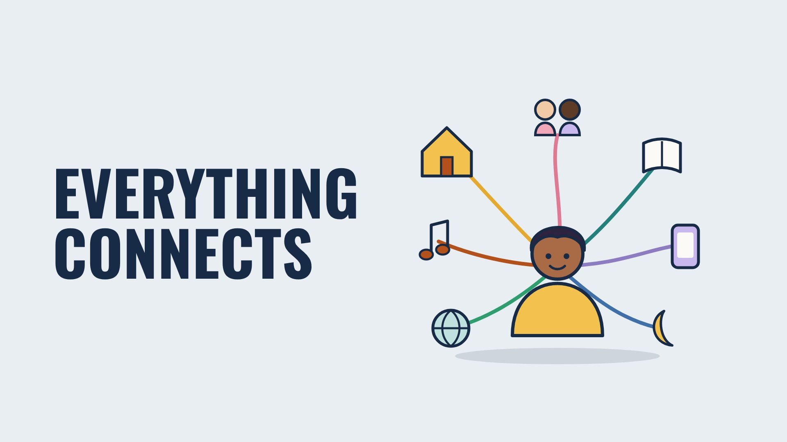
EVERYTHING CONNECTS
Beaver Counseling
Notes:
1 MINUTE. Open warm: “Today is about why this toolkit exists. Short version: your life doesn’t come in separate pieces.”

Slide 3
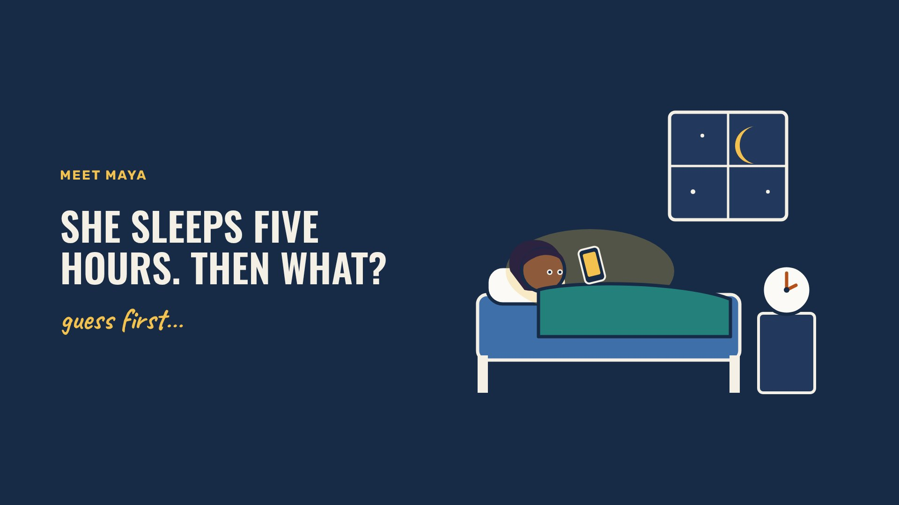
MEET MAYA
Beaver Counseling
Notes:
1 MINUTE. Ask the room: “Maya gets five hours of sleep. What happens to the rest of her day?” Take two or three guesses, then click on.

Slide 4
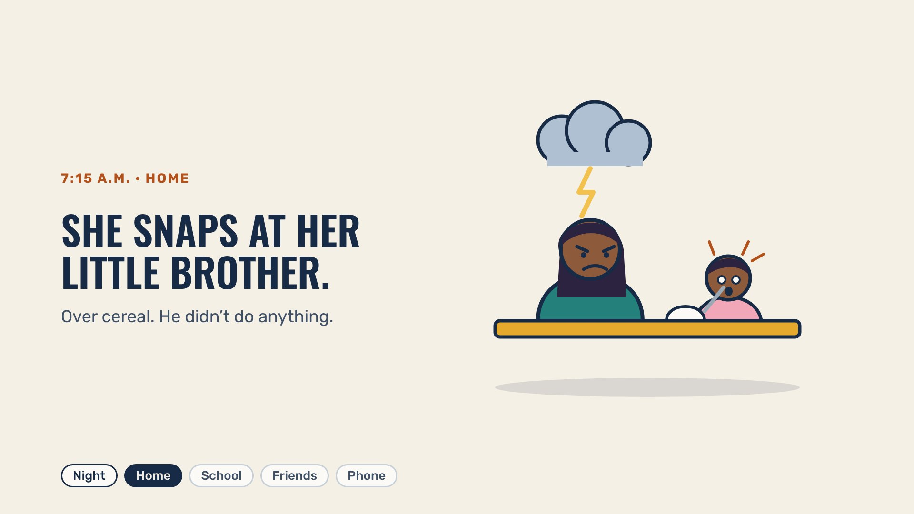
7:15 A.M. · HOME
Beaver Counseling
Notes:
1 MINUTE. Tired brains run short on patience first. Ask: “Ever been mean to someone who didn’t deserve it, just because you were wiped?”

Slide 5
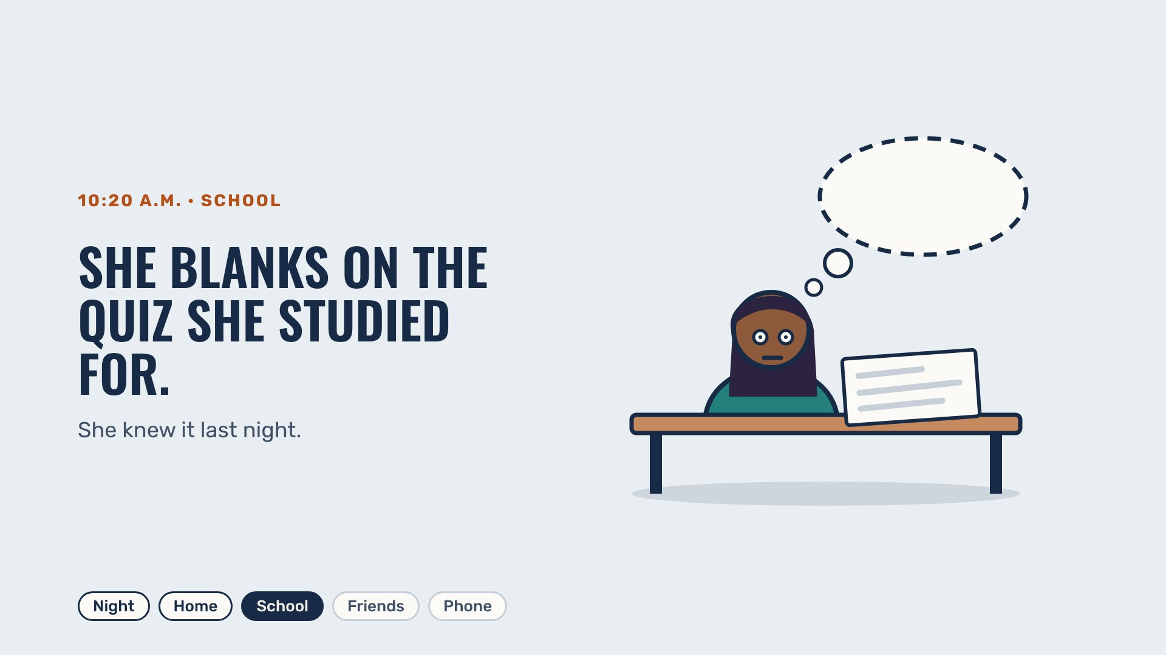
10:20 A.M. · SCHOOL
Beaver Counseling
Notes:
1 MINUTE. Sleep is when the brain files what you learned. Less sleep, messier filing.

Slide 6
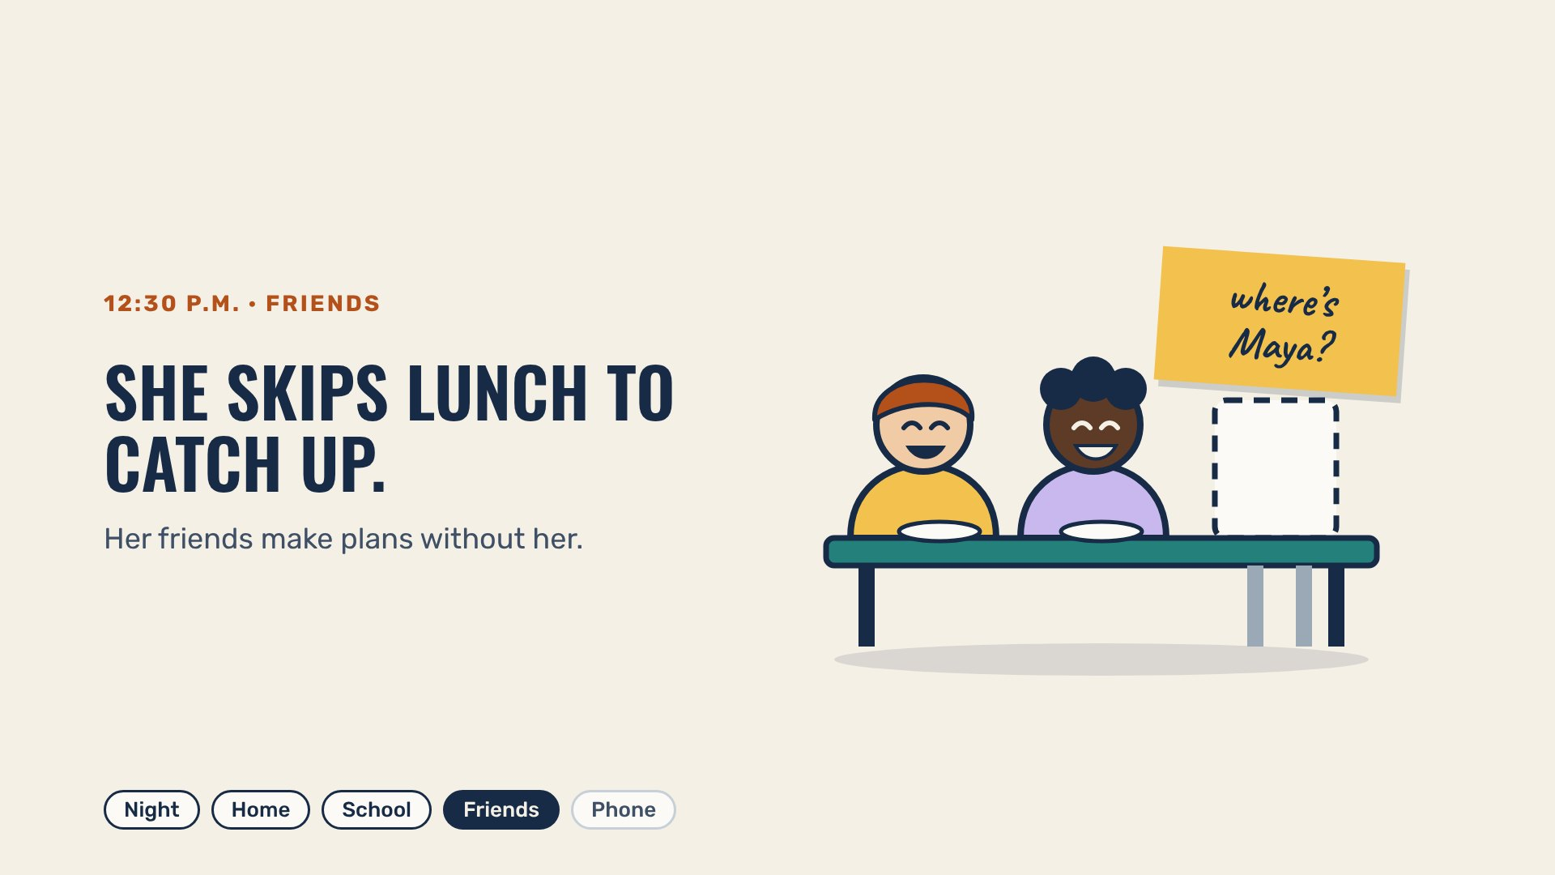
12:30 P.M. · FRIENDS
Beaver Counseling
Notes:
1 MINUTE. One rough morning starts costing her people. Nobody did anything wrong here.

Slide 7
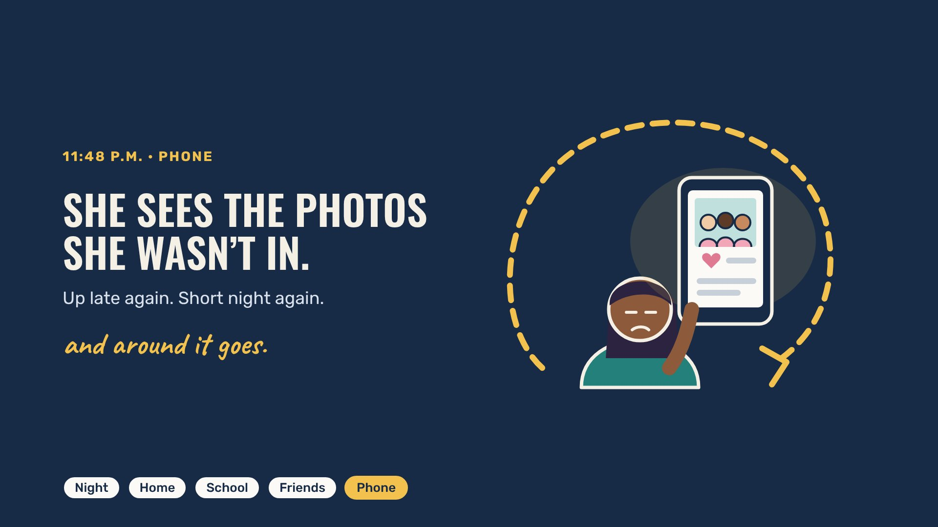
11:48 P.M. · PHONE
Beaver Counseling
Notes:
2 MINUTES. Point at the loop: one short night touched home, school, friends and her phone, then made the next night short too. Ask: “Where could the loop break?” Any answer counts.

Slide 8
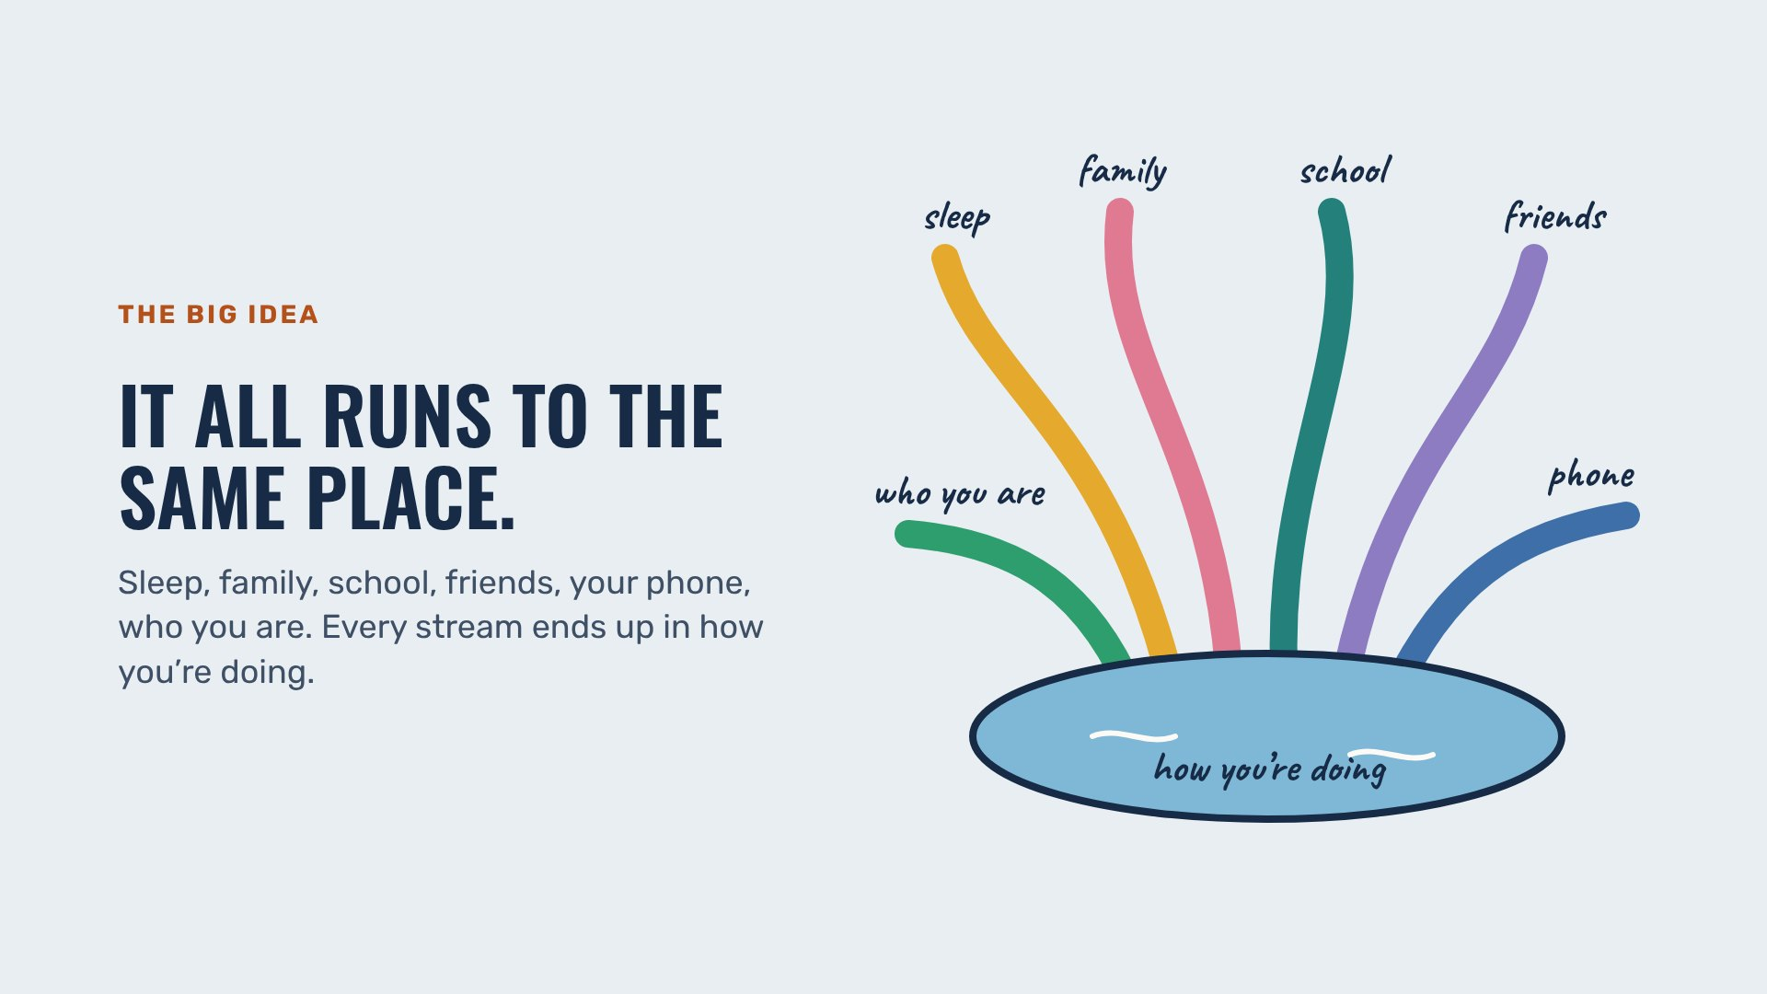
THE BIG IDEA
Beaver Counseling
Notes:
2 MINUTES. Trace one stream with your hand into the lake. Ask: “Which stream has the most water in it for people your age right now?”

Slide 9
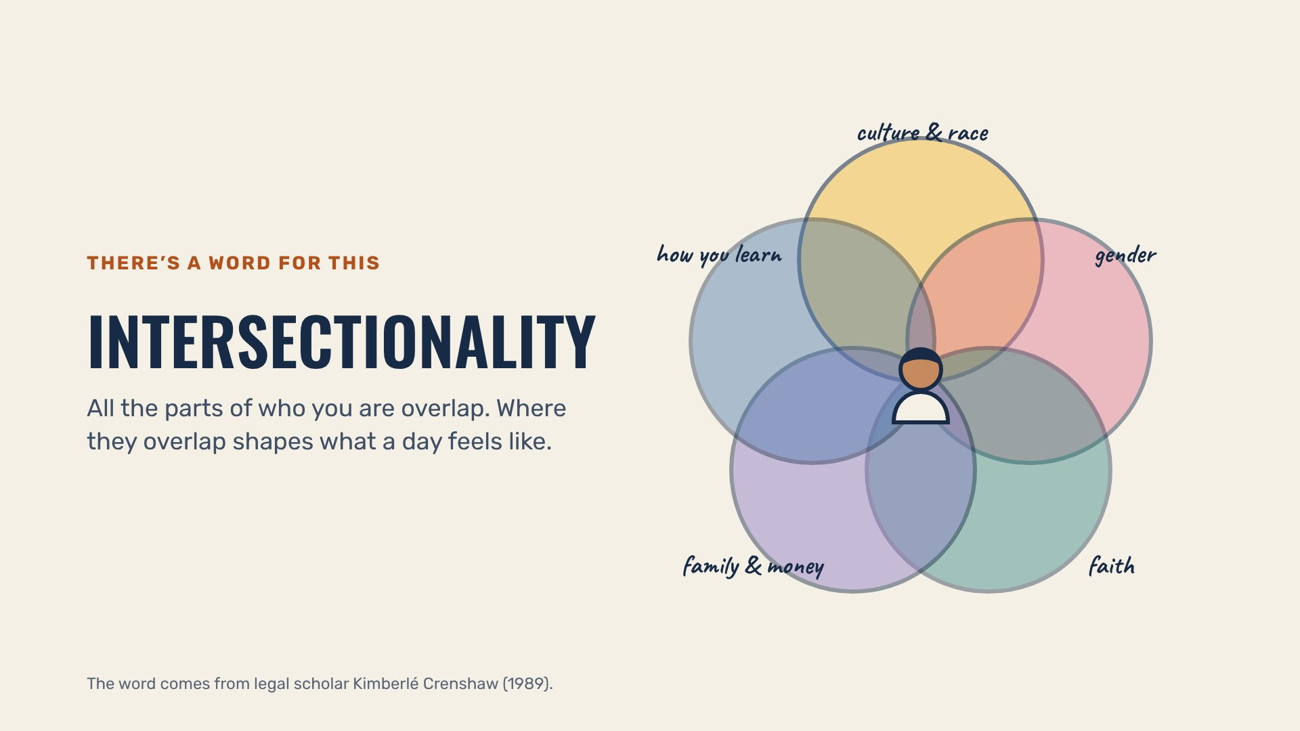
THERE’S A WORD FOR THIS
Beaver Counseling
Notes:
2 MINUTES. Keep it simple: “You’re never just one thing. A Tuesday feels different depending on all of it at once.” No one has to share their own circles.

Slide 10
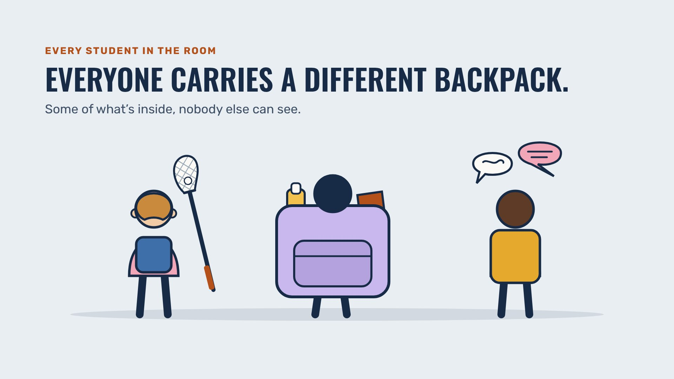
EVERY STUDENT IN THE ROOM
Beaver Counseling
Notes:
2 MINUTES. Don’t ask anyone what’s in their backpack. Say: “You can’t tell from the outside, and that’s the point.”

Slide 11
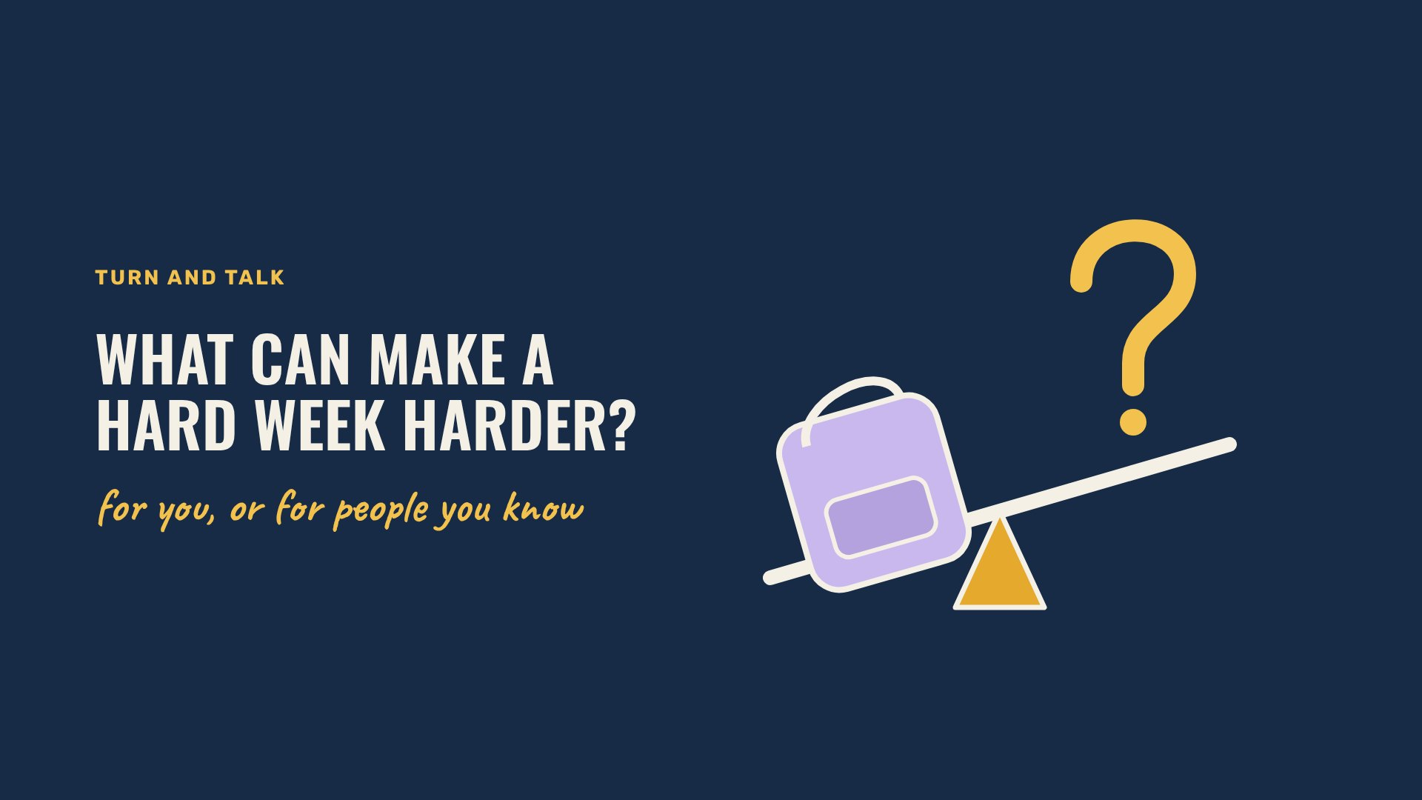
TURN AND TALK
Beaver Counseling
Notes:
4 MINUTES. Turn and talk, then take a few answers. The next four slides show one each; click after the room has had a go.

Slide 12
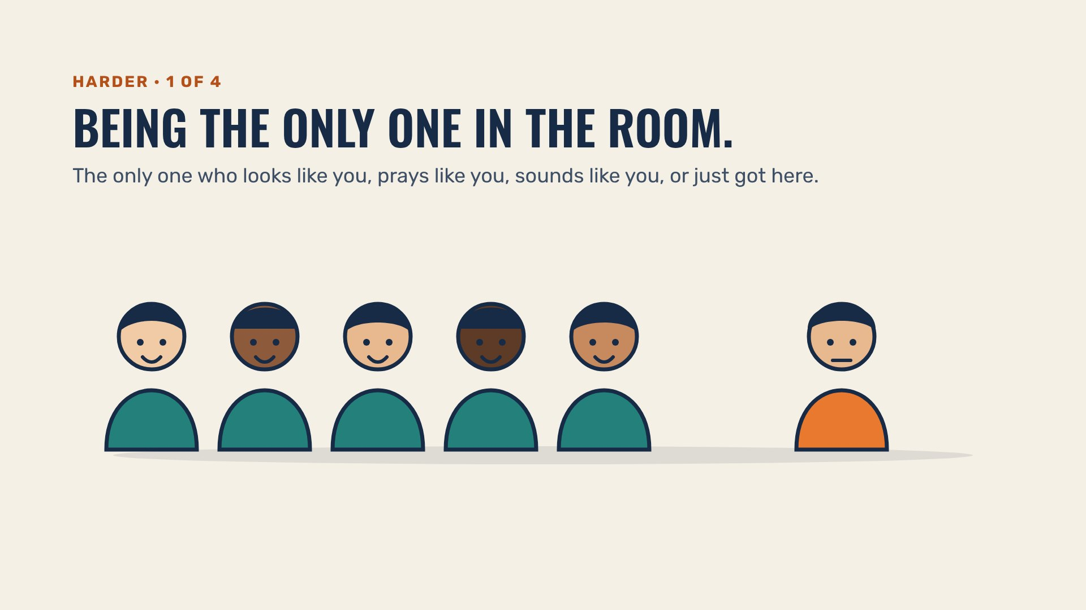
HARDER · 1 OF 4
Beaver Counseling
Notes:
1 MINUTE. Name it plainly. Being “the only one” takes energy most people never notice spending.

Slide 13
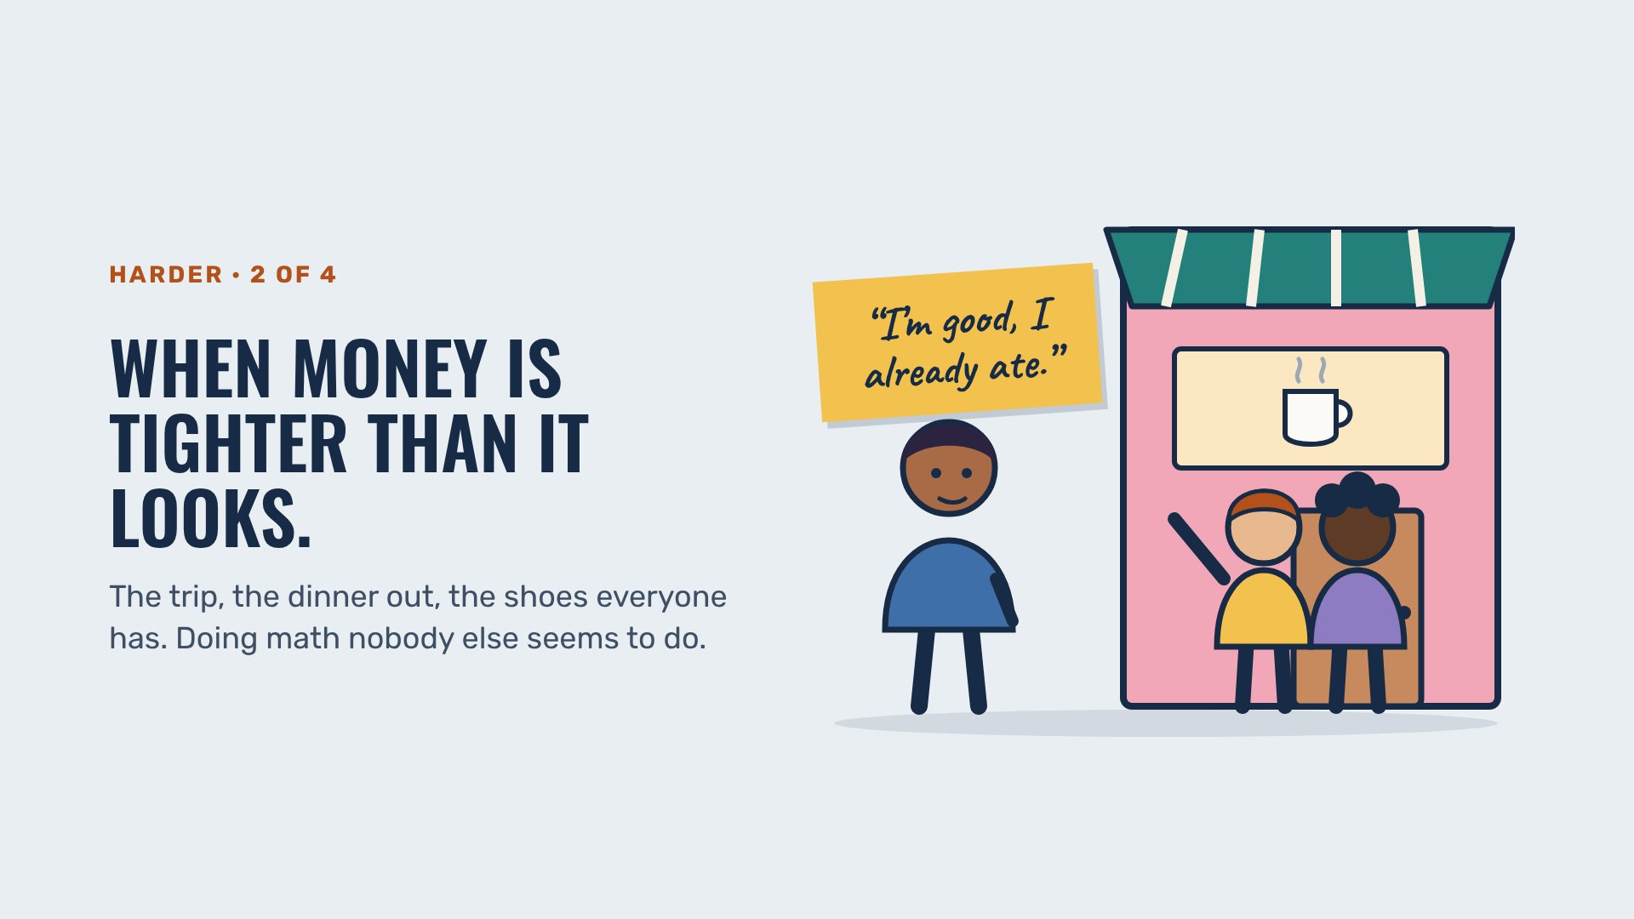
HARDER · 2 OF 4
Beaver Counseling
Notes:
1 MINUTE. Say it plainly and move on; nobody should feel spotted. Money shapes plans, friendships and stress, and it’s often invisible at a school like ours.

Slide 14
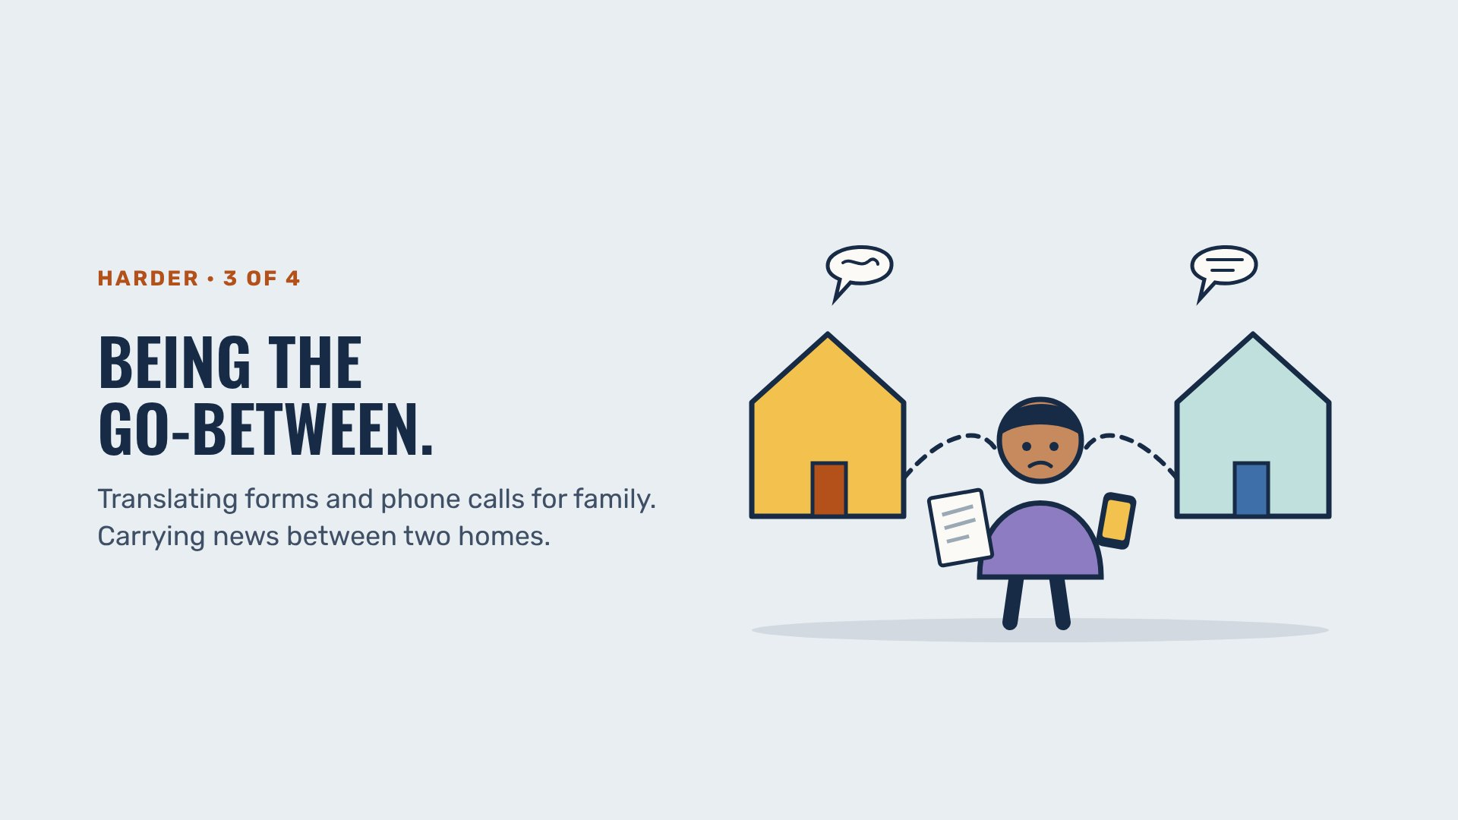
HARDER · 3 OF 4
Beaver Counseling
Notes:
1 MINUTE. Lots of students carry adult jobs at home. It can be a source of pride and a real load on the same day.

Slide 15
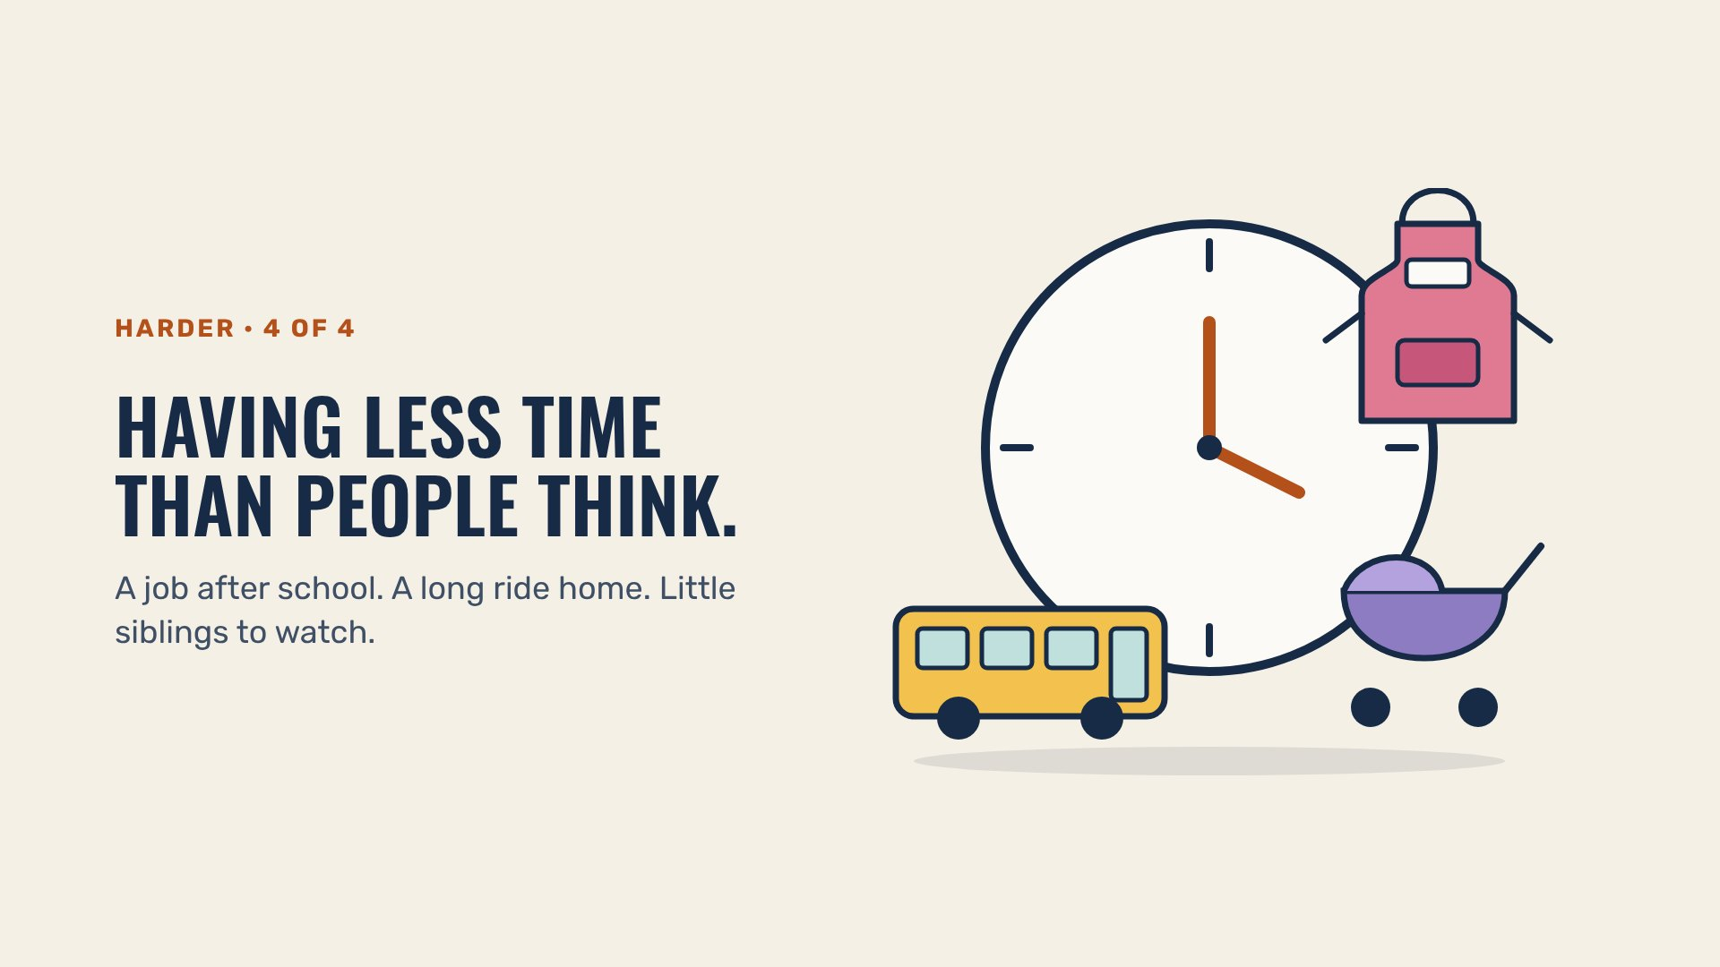
HARDER · 4 OF 4
Beaver Counseling
Notes:
1 MINUTE. When someone seems checked out, sometimes they’re just out of hours.

Slide 16
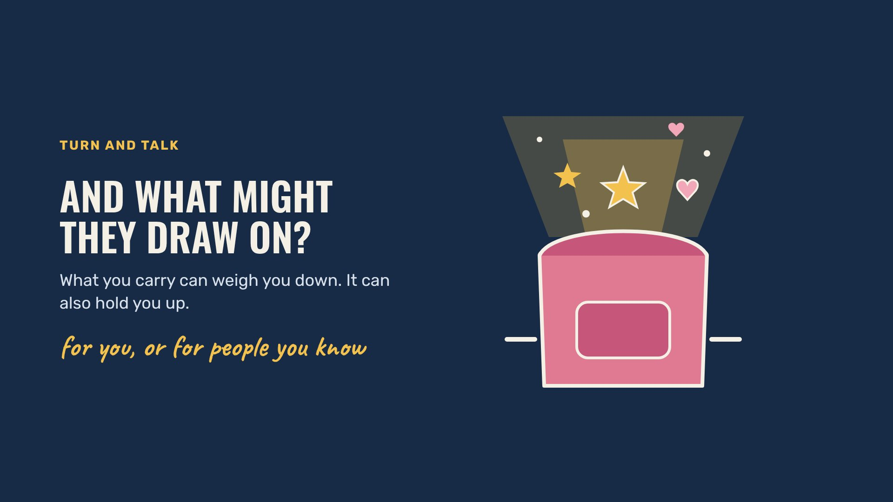
TURN AND TALK
Beaver Counseling
Notes:
4 MINUTES. Same turn and talk, the other direction. This is the half people forget: identity is a source of strength, too. Three examples follow, one per slide.

Slide 17
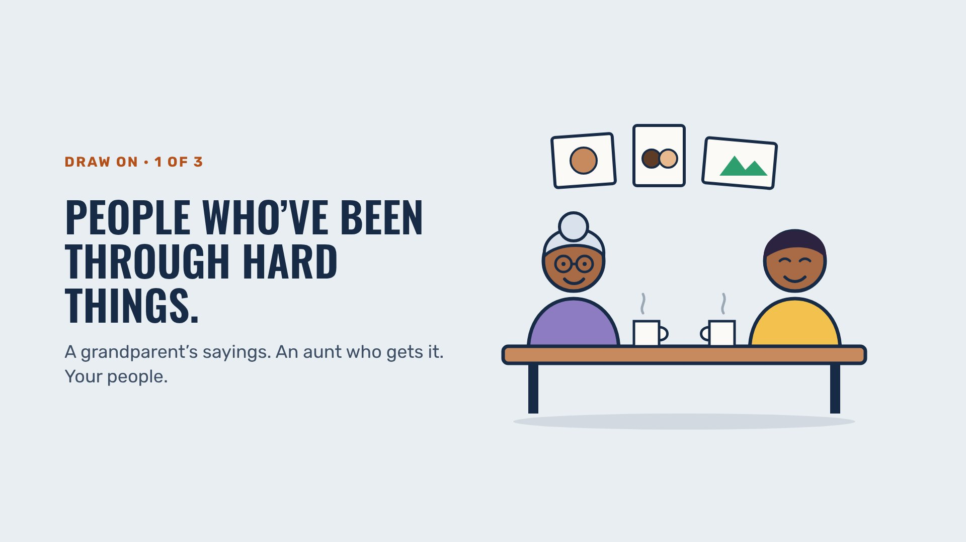
DRAW ON · 1 OF 3
Beaver Counseling
Notes:
1 MINUTE. Ask: “Who’s someone in your life who has been through something hard and came out okay?” No need to share out loud.

Slide 18
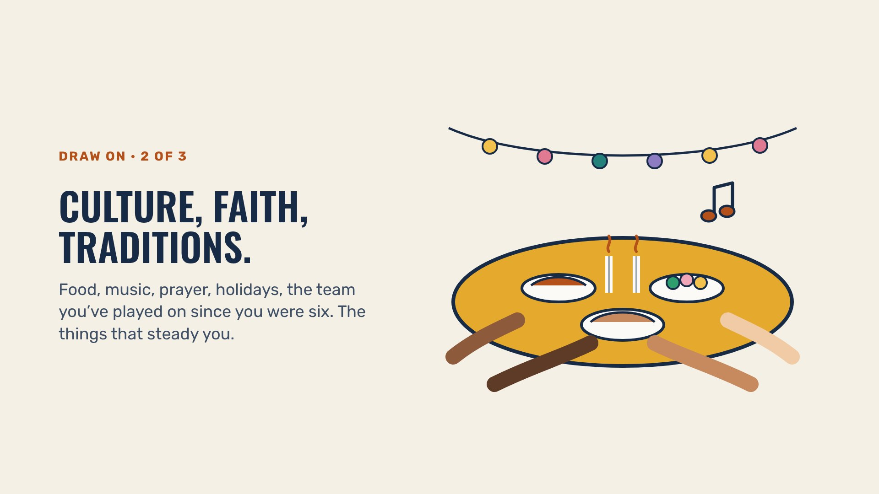
DRAW ON · 2 OF 3
Beaver Counseling
Notes:
1 MINUTE. Keep it wide on purpose: some students’ steadying thing is a faith, some a grandmother’s cooking, some a team. All count.

Slide 19
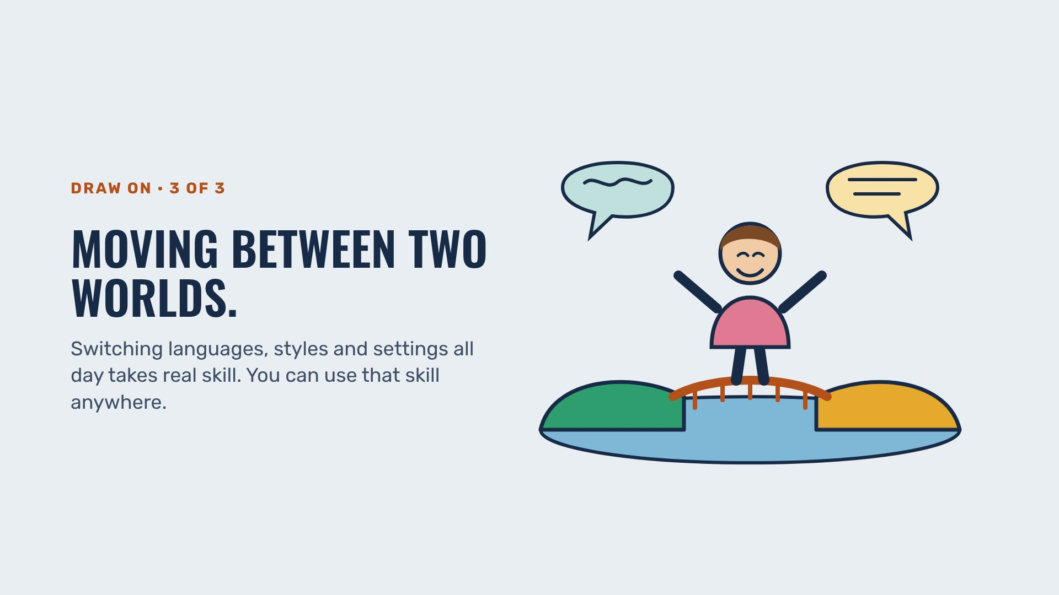
DRAW ON · 3 OF 3
Beaver Counseling
Notes:
1 MINUTE. Code-switching is tiring, and it’s also a skill most adults wish they had. Both are true.

Slide 20
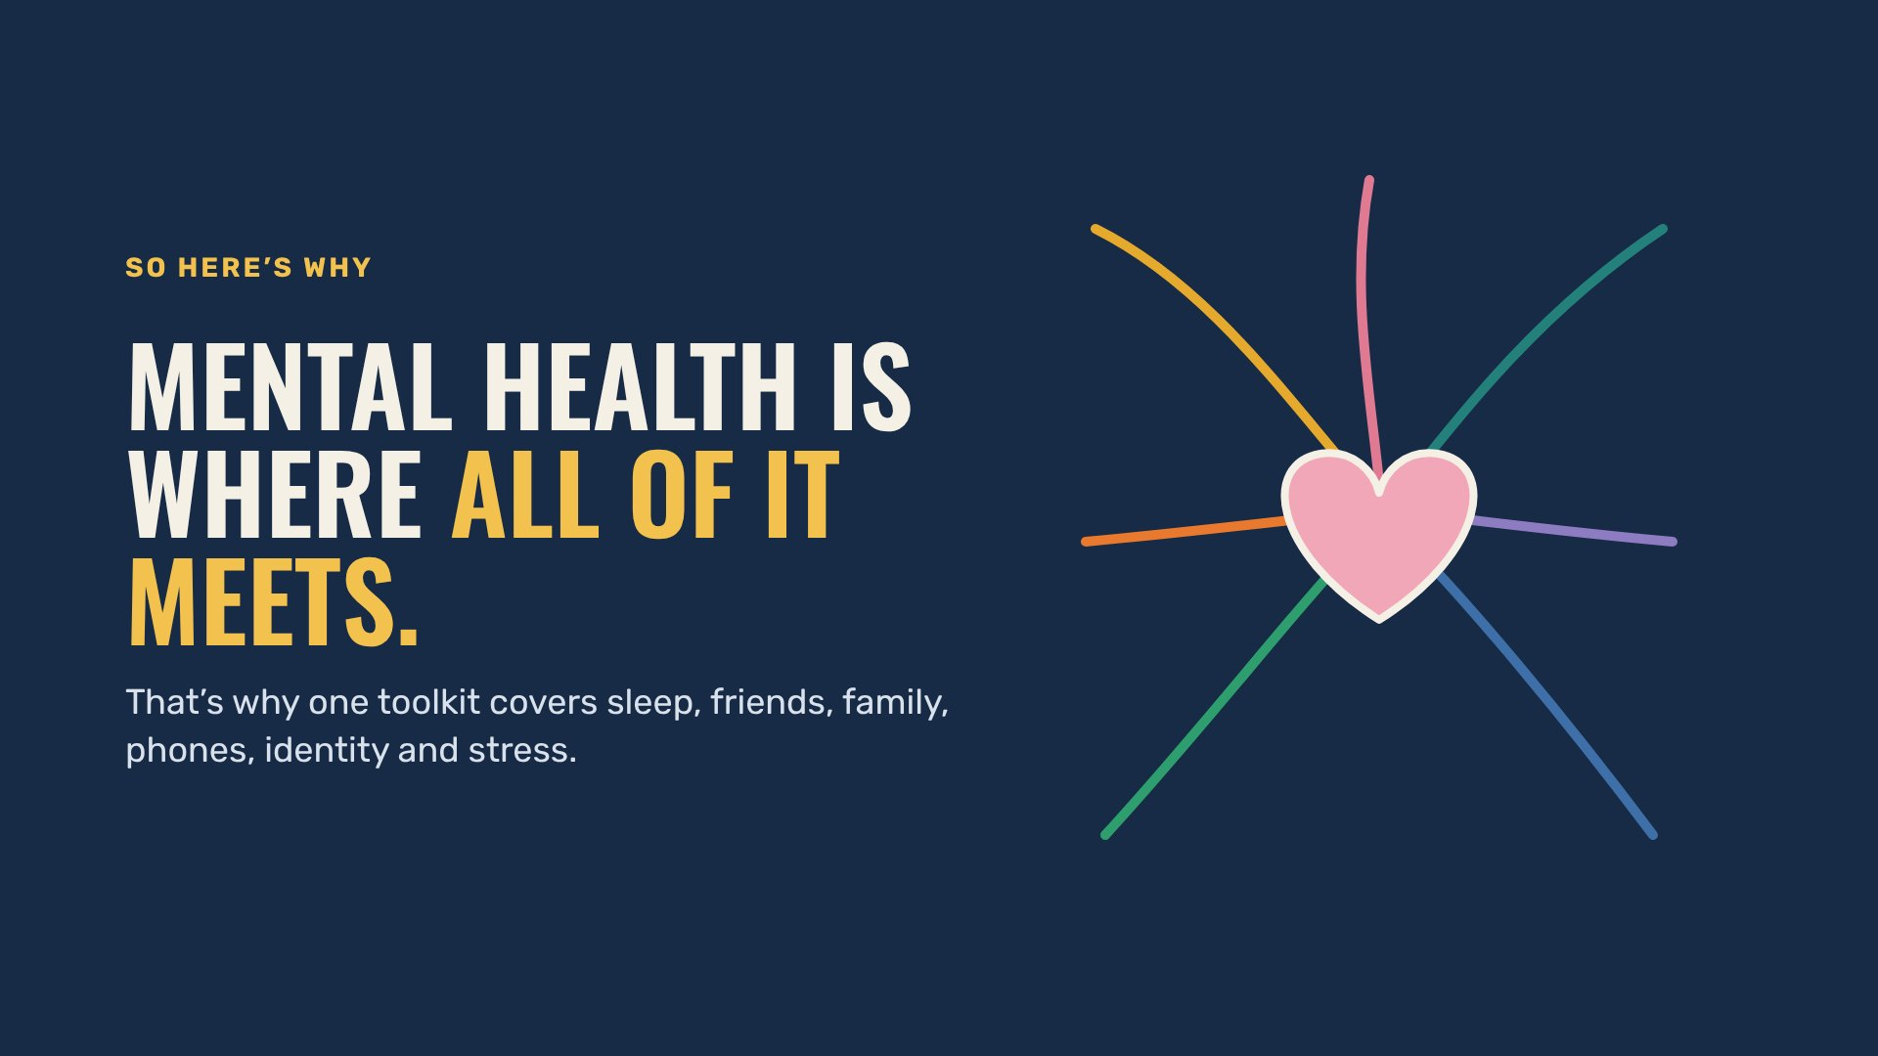
SO HERE’S WHY
Beaver Counseling
Notes:
1 MINUTE. Let the line sit. This is the whole reason the toolkit exists.

Slide 21
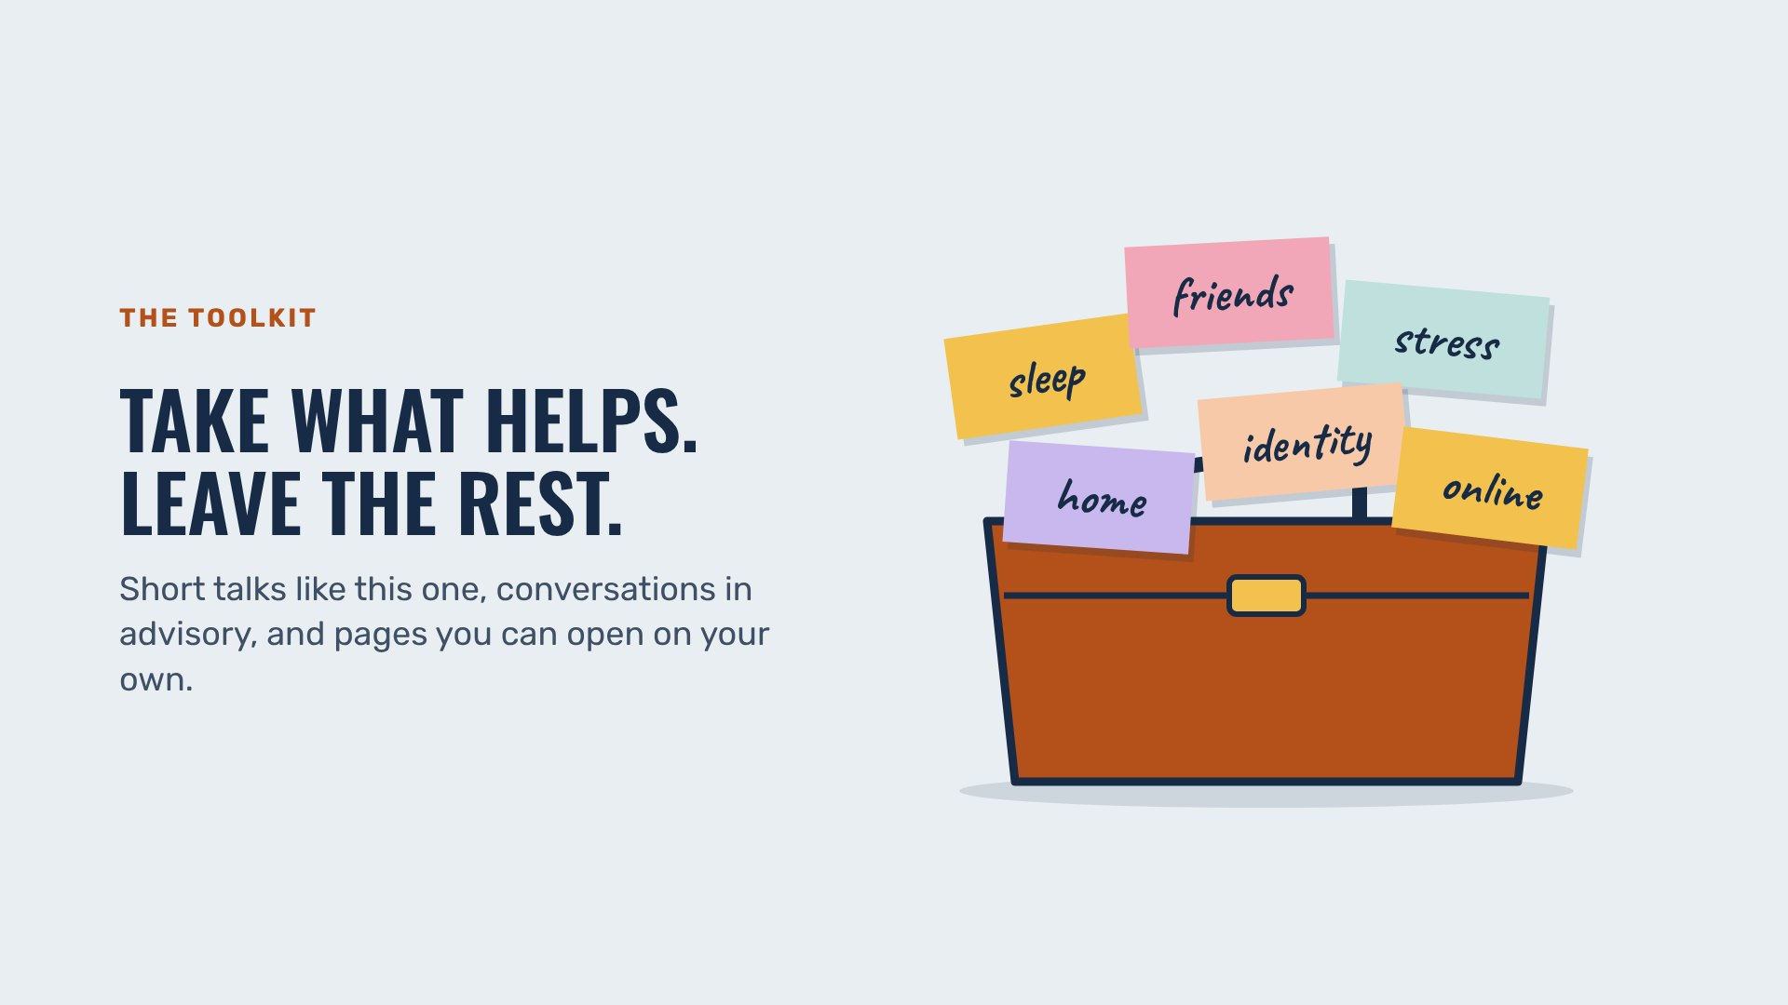
THE TOOLKIT
Beaver Counseling
Notes:
1 MINUTE. Agency matters here: nobody has to use any of it. Use what helps, skip what doesn’t.

Slide 22
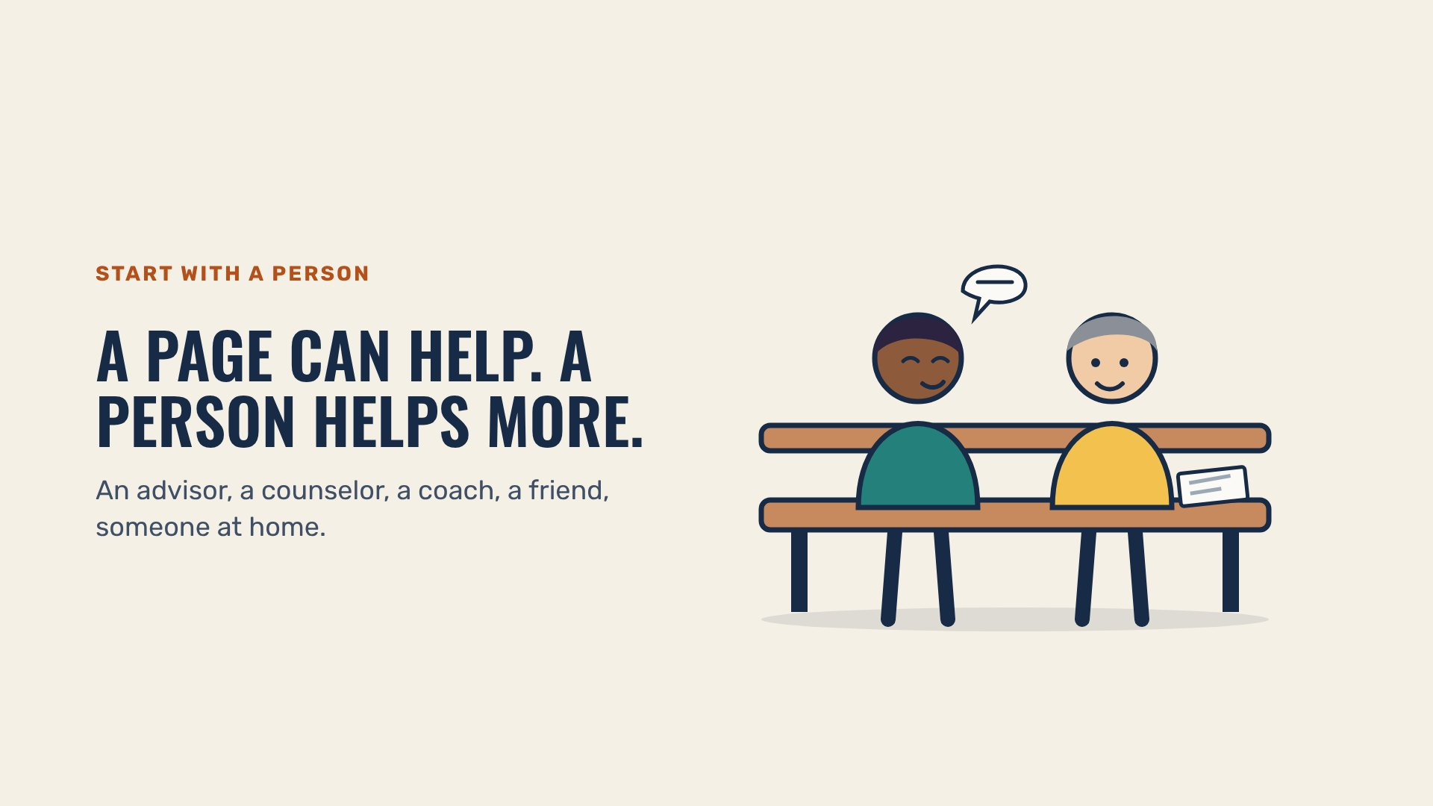
START WITH A PERSON
Beaver Counseling
Notes:
1 MINUTE. Name the real people: “Ms. Garcia, Dr. Wilson, your advisor. Our doors are open.”

Slide 23
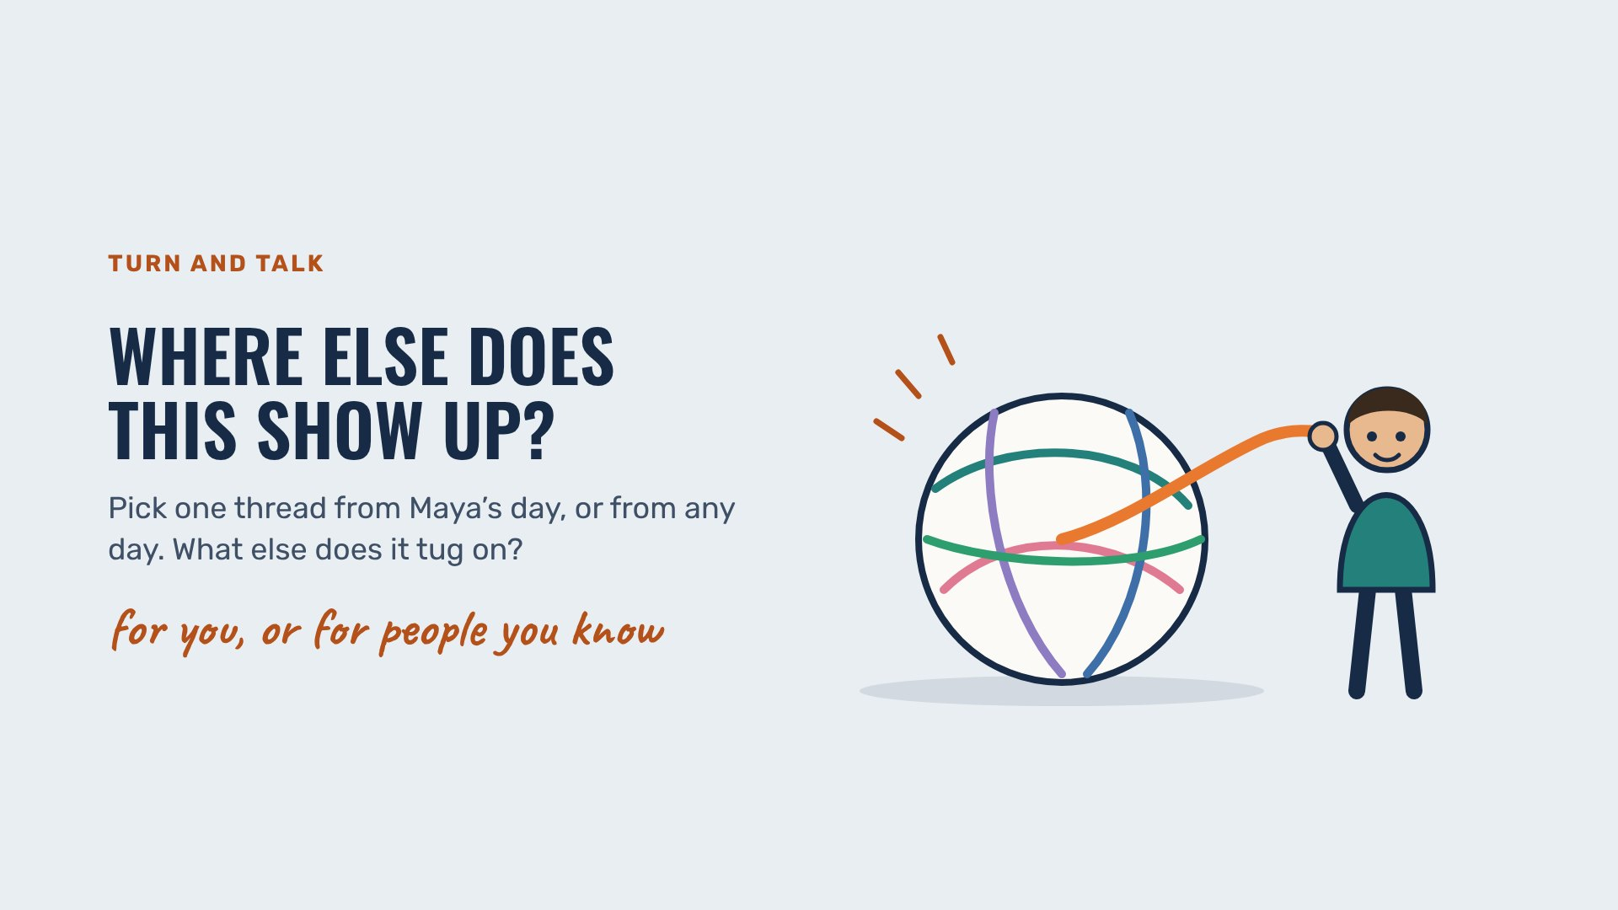
TURN AND TALK
Beaver Counseling
Notes:
4 MINUTES. Take a few answers; any connection counts.

Slide 24

BEFORE YOU GO
Beaver Counseling
Notes:
1 MINUTE. Close warm. Point out where to find the toolkit and that every page lists a person first.

Slide 25
TEACHER PAGE · skipped when you present · Lesson plan
Everything Connects
Opening talk for the year · About 30 minutes (15-minute version below) · Given by Ms. Garcia, Dr. Wilson or another adult to any grade; advisories follow up with the conversation guide
GOAL
Students see that sleep, family, school, friends, phones and who they are all run into the same place: how they’re doing. They hear the word intersectionality, notice that every student carries something others can’t see, and that what they carry can also hold them up. They leave knowing the toolkit is there to take what helps, and that a person comes first.
MATERIALS
The deck on the big screen. Each slide carries its own point, so no script is needed.
The Student Toolkit link to share after the talk
FLOW
5 min Maya’s day: one short night, one slide per link, and the loop
5 min It all runs to the same place, and the word for it: intersectionality
8 min Everyone carries a different backpack: what makes a hard week harder, one answer per slide
6 min What people draw on, one answer per slide
6 min Mental health is where it all meets, take what helps, start with a person, turn and talk, close
SHORT ON TIME (15 MINUTES)
Maya’s night and the loop slide, it all runs to the same place, intersectionality, the backpack slide, one harder and one draw-on answer, then mental health is where it all meets and the closing slide.
Notes:
If you want more: this page and the next three are hidden and skipped when you present.

Slide 26
TEACHER PAGE · skipped when you present · Before you teach
Before you teach
Nobody speaks for a group.
Invite answers about “you, or people you know.” Never ask a student to explain their culture, faith or family to the room.
Name the load and the strength.
The harder slides and the draw-on slides belong together. Identity can make a week harder and can also be what holds someone up.
Money is real here.
Say it plainly once and keep going. The “I’m good, I already ate” slide works because it doesn’t point at anyone.
If something heavy comes up.
Thank the student, keep it short in the room, and connect them with a counselor that day.

Slide 27
TEACHER PAGE · skipped when you present · Every student in the room
Every student in the room
Culture, family, identity, ability and money: what to keep in mind for this topic.
Everyone carries something.
Show the range on purpose: students of every skin tone, family shape and income carry things others can’t see.
Families draw on different things.
Faith, food, music, elders, a team, a language. Treat each as a real strength, never as a curiosity.
Money shapes friendships.
Trips, dinners out and the right shoes cost money. Students with less often do quiet math nobody sees.
Two worlds is a skill.
Students who switch languages or settings all day are tired and skilled at once. Both are true.

Slide 28
TEACHER PAGE · skipped when you present · Background
What the research says
The term intersectionality comes from legal scholar Kimberlé Crenshaw, who used it to describe how race and sex together shaped Black women’s experiences in ways neither one alone explains.
Crenshaw, 1989, University of Chicago Legal Forum
Teens aged 13 to 18 need 8 to 10 hours of sleep a night for health, learning, mood and attention.
American Academy of Sleep Medicine consensus statement (Paruthi et al., 2016, Journal of Clinical Sleep Medicine)
Across many studies, a positive sense of ethnic-racial identity is linked to better well-being and fewer depressive symptoms in young people.
Rivas-Drake et al., 2014, Child Development
Teens who felt connected at school had lower risks of emotional distress, suicidal thoughts and substance use as adults.
Steiner et al., 2019, JAMA Pediatrics

