Slide 1


BANK RECONCILIATION
=
ALLPPT.com _ Free PowerPoint Templates, Diagrams and Charts

Slide 2
Intended Learning Outcomes
At the end of the discussion, we will be able to:
Understand the need for a bank reconciliation
Understand the reconciling items affecting the cash in bank per ledger
Know the reconciling items affecting the cash in bank per bank statement
Prepare a bank reconciliation
Prepare the necessary adjusting entries to reconcile the cash in bank per ledger with the cash in bank per bank statements

Slide 3
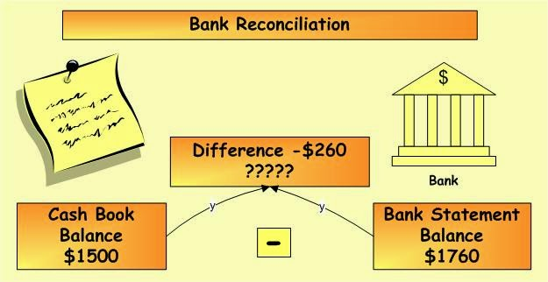
Bank Reconciliation
It is a statement which brings into agreements the cash balance per book and the cash balance per bank
Necessary only for demand deposit or checking account
Usually prepared monthly

Slide 4
Bank Statement
A monthly report of the bank to the depositor showing:
Cash balance per bank at the beginning
Deposits made by the depositor and acknowledge by the bank
Checks drawn by the depositor and paid by the bank
Daily cash balance per bank during the month

Slide 5
Reconciling Items
Book Reconciling items:
Credit Memos
these are additions (bank credits) made by the bank to the entity’s bank account but not yet recorded by the entity
Debit Memos
these are deductions (bank debits) made by the
bank to the entity’s bank account not yet
recorded by the entity
Errors

Slide 6
Credit Memos
Notes Receivable collected by Bank
Proceeds of loan credited to the account of the depositor
Matured time deposits transferred by the bank to the current account of the depositor

Slide 7
Debit Memos
No Sufficient Fund Checks (NSF)
Technically Defective Checks
Bank Service Charge
Payment of Loan
Automatic debits

Slide 8
2. Bank Reconciling Items
Deposits in Transit
Outstanding Checks
Errors

Slide 9
Deposits in Transit
Collections already forwarded to the bank for deposit but too
late to appear in the bank statement
Undeposited collections or those still in the hands of the
depositor

Slide 10
Outstanding Checks
Checks drawn and already given to payees but not yet presented for payment
Certified Checks are excluded from outstanding checks

Slide 11
Errors
Errors can either be book or bank reconciling items

Slide 12
Forms of Bank Reconciliation
Adjusted balance Method
Book to Bank Method
3. Bank to Book Method

Slide 13
Proforma Reconciliation for Adjusted Balance Method
Book Balance xx
Add: Credit Memos xx
Errors xx
------
Total xx
Less: Debit memos xx
Errors xx
------
Adjusted Book Balance xx
═══

Slide 14
Proforma Reconciliation for Adjusted Balance Method
Bank Balance xx
Add: Deposits in Transit xx
Errors xx
------
Total xx
Less: Outstanding Checks xx
Errors xx
------
Adjusted Bank Balance xx
═══

Slide 15
Sample Problem
Kate company reported a cash account balance per ledger of P1, 652,000 on December 31. The bank statement showed a balance of P2,090,000 at the same date. The reconciling items consisted of a bank service charge (interest) of P2,000, outstanding checks totaling P590,000 and a deposit in transit P150,000. Prepare the adjusting journal entries and compute the adjusted book and bank balances on December 31.

Slide 16
Solution
Book Balance P1,090,000
Add: Credit Memo 0
------------------
Total P1,652,000
Less: Debit memo
Bank Service Charge 2,000
------------------
Adjusted Bank Balance P1,650,000
═════════

Slide 17
Solution
Bank Balance P2,090,000
Add: Deposits in Transit 150,000
------------------
Total P2,240,000
Less: Outstanding Checks 590,000
------------------
Adjusted Bank Balance P1,650,000
═════════

Slide 18
Adjusting Journal Entries
Book Reconciling Item:
To record the bank service charge (interest) in the entity’s book
Interest Expense P2,000.00
Cash in Bank P2,000.00

Slide 19
Summary
Bank Reconciliation is necessary for demand deposit and usually prepared monthly to explain the difference between cash recorded on bank statement and cash balance on entity’s books.
Debit and credit memos are book reconciling items.
Deposits in Transit and Outstanding checks are bank reconciling items.
Errors can either be bank or book reconciling items depending on its nature.

Slide 20
Summary
Bank Reconciliation is necessary for demand deposit and usually prepared monthly to explain the difference between cash recorded on bank statement and cash balance on entity’s books.
Debit and credit memos are book reconciling items.
Deposits in Transit and Outstanding checks are bank reconciling items.
Errors can either be bank or book reconciling items depending on its nature.

Slide 21
Summary
Bank Reconciliation is necessary for demand deposit and usually prepared monthly to explain the difference between cash recorded on bank statement and cash balance on entity’s books.
Debit and credit memos are book reconciling items.
Deposits in Transit and Outstanding checks are bank reconciling items.
Errors can either be bank or book reconciling items depending on its nature.

Slide 22
Assignment
Grass Company provided the following information for the month of July 31, 2017:
Balance per Bank Statement P1,240,000
Balance per Ledger 750, 000
Deposit of July 30 not recorded by bank 280, 000
Debit memo-service Charges 10, 000
Credit memo-collection of note 300, 000
Outstanding Checks 550, 000
An analysis of the canceled checks returned with the bank statement revealed the following:
Check for purchase of supplies was drawn for P60,000 but was recorded as P90,000.
The manager wrote a checks for traveling expenses of P10,000 while out of town. The checks was not recorded.

Slide 23
Requirement
In a one (1) whole sheet of yellow paper, compute the adjusted book and bank balances of the problem presented. Prepare the adjusting entries needed for the book reconciling items.

Slide 24
THANK YOU ROCK & ROLL MGA LODI KONG PETMALU

