Slide 1
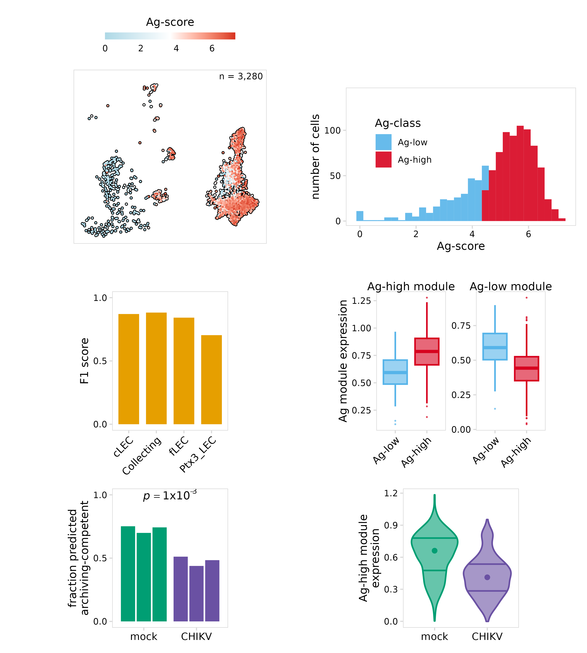
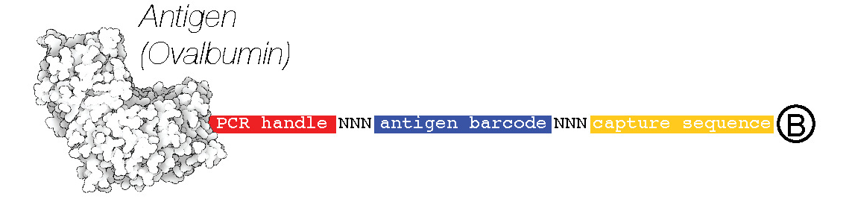
Using machine learning to predict antigen archiving
a
b
Antigen-DNA conjugate
1. Identify Ag-high cells
Inject mouse with Ag-tag
Harvest draining lymph node
Perform scRNA-seq
2. Train model
c
d
Split cells into training/testing groups
Train random forest
classifier
Test model
e
f
3. Predict archiving-competent cells
Datasets that did not receive an Ag-tag
Predict treatments/perturbations that impair archiving
Design new experiments and verify

