Slide 1
Predicting Antigen Archiving
Ryan Sheridan
RNA Bioscience Initiative

Slide 2
Intro: What is Ag Archiving?
Introduce Beth’s previous work

Slide 3
Intro: LEC subsets

Slide 4
Objectives
Identify cells that archive antigen
Characterize pathways that promote and regulate Ag archiving during vaccination

Slide 5
Tracking Ag using scRNA-seq
Sort for CD45- and CD45+ cells

Slide 6
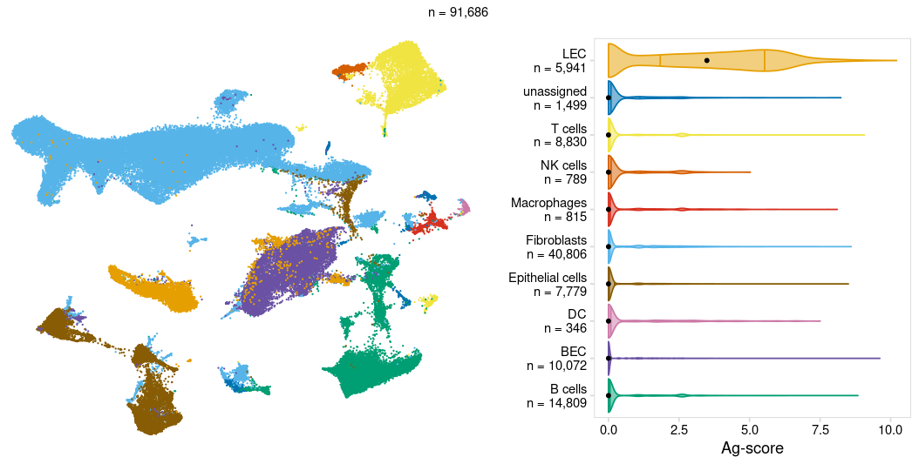
LECs show strongest Ag signal

Slide 7
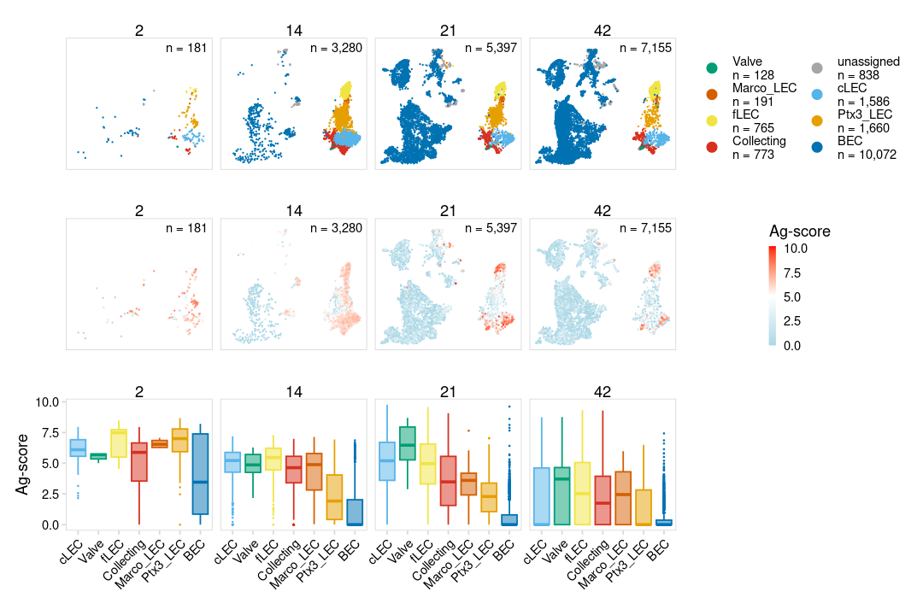
Discrete LEC subsets archive Ag

Slide 8
Discrete LEC subsets archive Ag

Slide 9
Tracking Ag over time

Slide 10
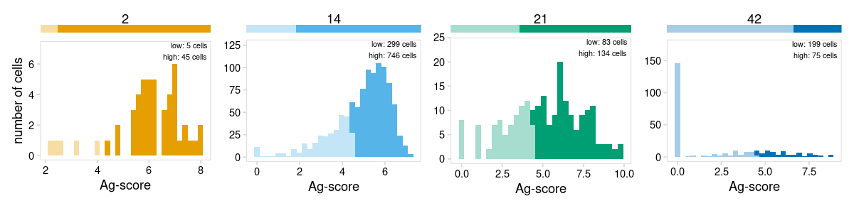
Some cells are more proficient at archiving

Slide 11
Is archiving ability a cell-intrinsic property?
Show hypothesis and predictions

Slide 12
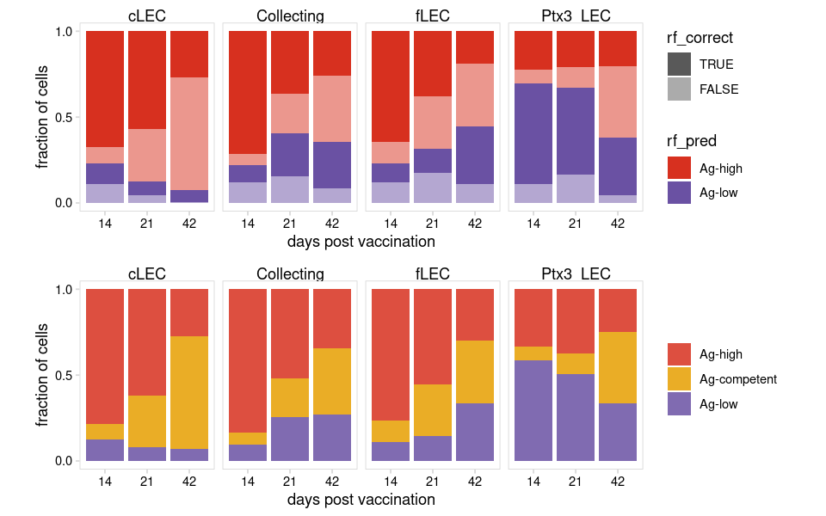
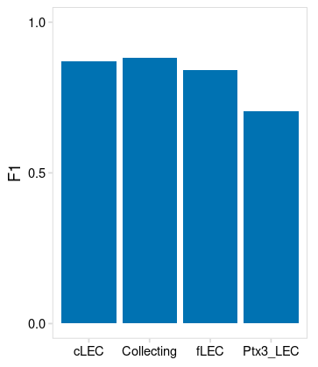
Using machine learning to identify gene expression patterns

Slide 13
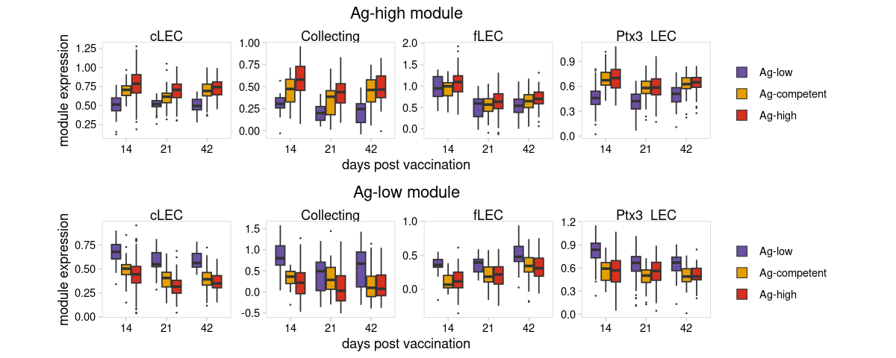
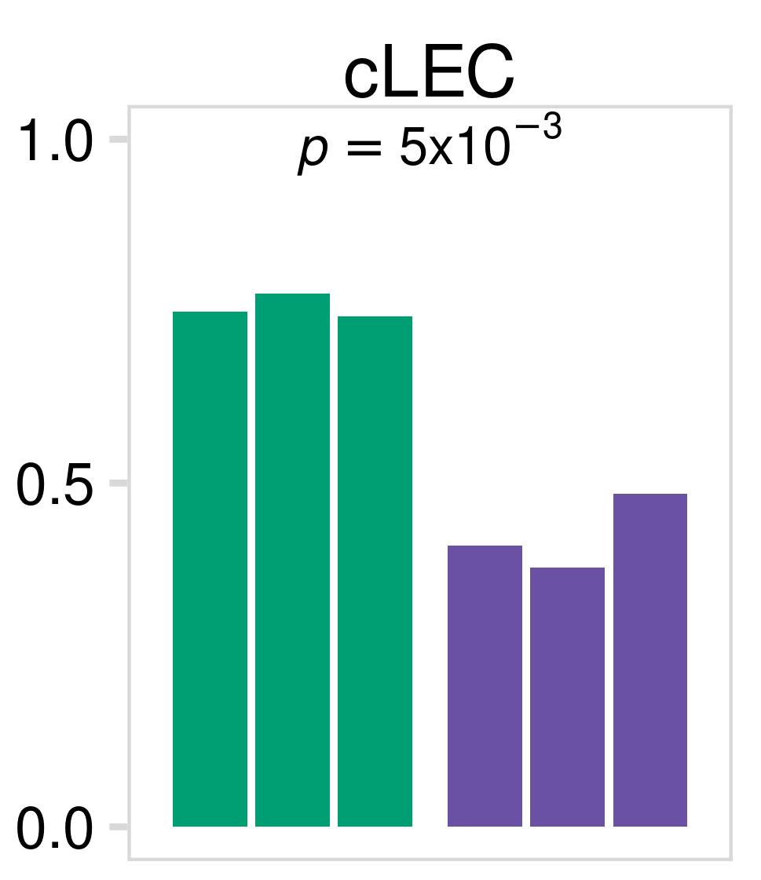
Using machine learning to predict antigen archiving
Identify Ag-high cells
Ag-tag cartoon
Split cells into
training/testing groups
Train random forest
classifier
Test model
Predict archiving capacity
during CHIKV infection

Slide 14
Model accuracy

Slide 15
Ag module expression

Slide 16
Ag module expression

Slide 17
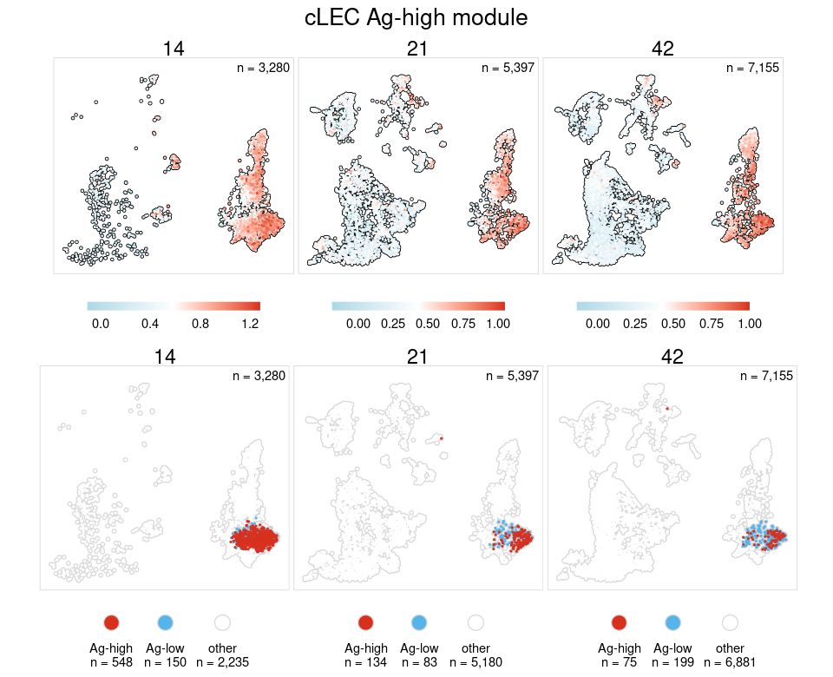
UMAPs module signal

Slide 18
GO terms for Ag module

Slide 19
Predicting archiving competent cells during CHIKV infection
Show flow chart illustrating approach

Slide 20
Ag module expression in Ag-competent cells

Slide 21
Ag module is broadly downregulated during CHIKV infection

Slide 22
Conclusions
We can identify a gene expression program expressed in LECs from naive mice that is predictive of a cells ability to archive antigen
LECs that show highest expression of this Ag module retain Ag for longer periods of time
We can predict archiving competent LECs in CHIKV datasets
Our Ag module is broadly downregulated during CHIKV infection

Slide 23
Impact
Using this approach we can predict archiving capacity in samples that did not receive an Ag-tag
We can mine existing data sets to identify treatments/perturbations that are predicted to influence archiving
Using this information we can design experiments to further investigate mechanisms underlying Ag archiving

