Slide 1
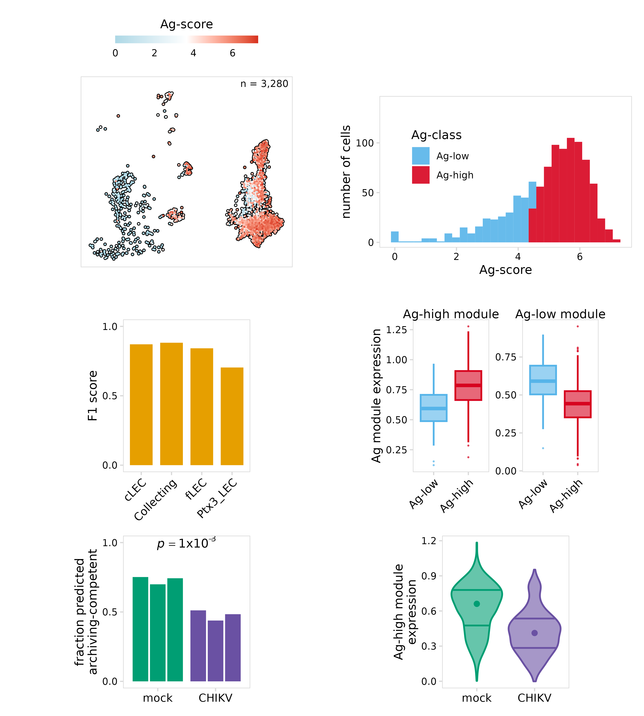
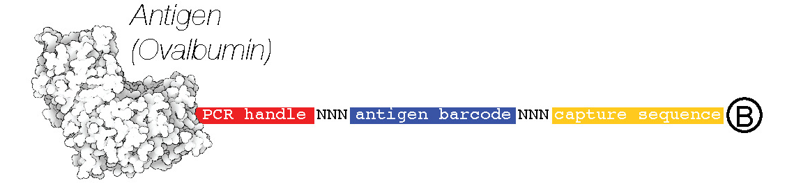
Using machine learning to predict antigen archiving
Question
Antigen-DNA conjugate
a
b
Can we identify cells that
archive antigen for samples that
did not receive an Ag-tag?
1. Identify Ag-high cells
Inject mouse with Ag-tag
Harvest draining lymph node
Perform scRNA-seq
c
d
2. Train model
Split cells into training/testing groups
Train random forest
classifier
Test model
e
f
3. Predict archiving-competent cells
Predict treatments/perturbations that impair archiving
Design new experiments and verify

