Slide 1
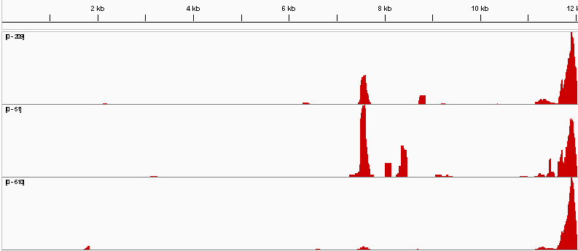
R1
R2
R3

