Slide 1
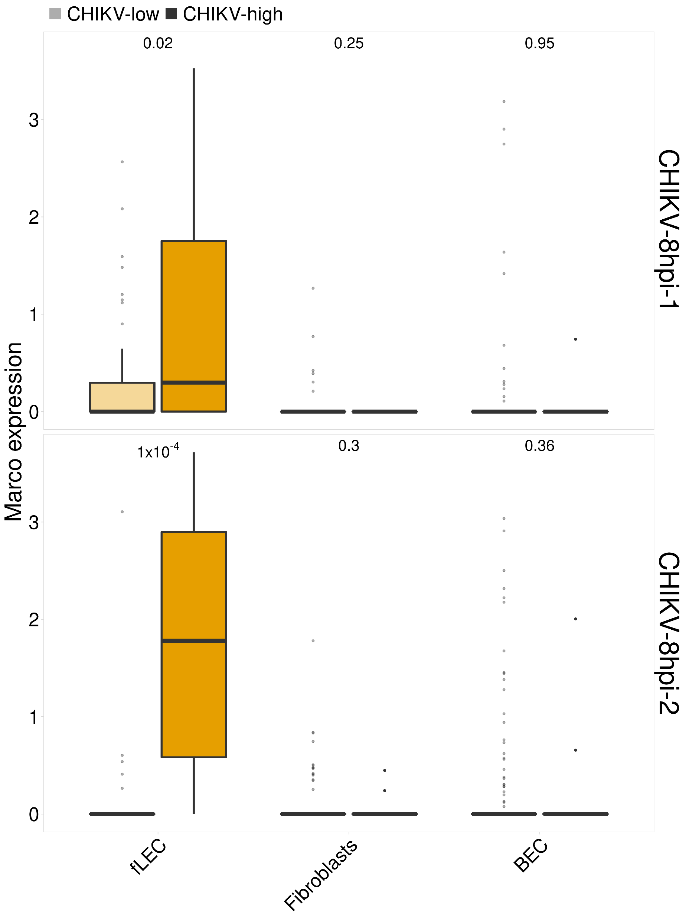
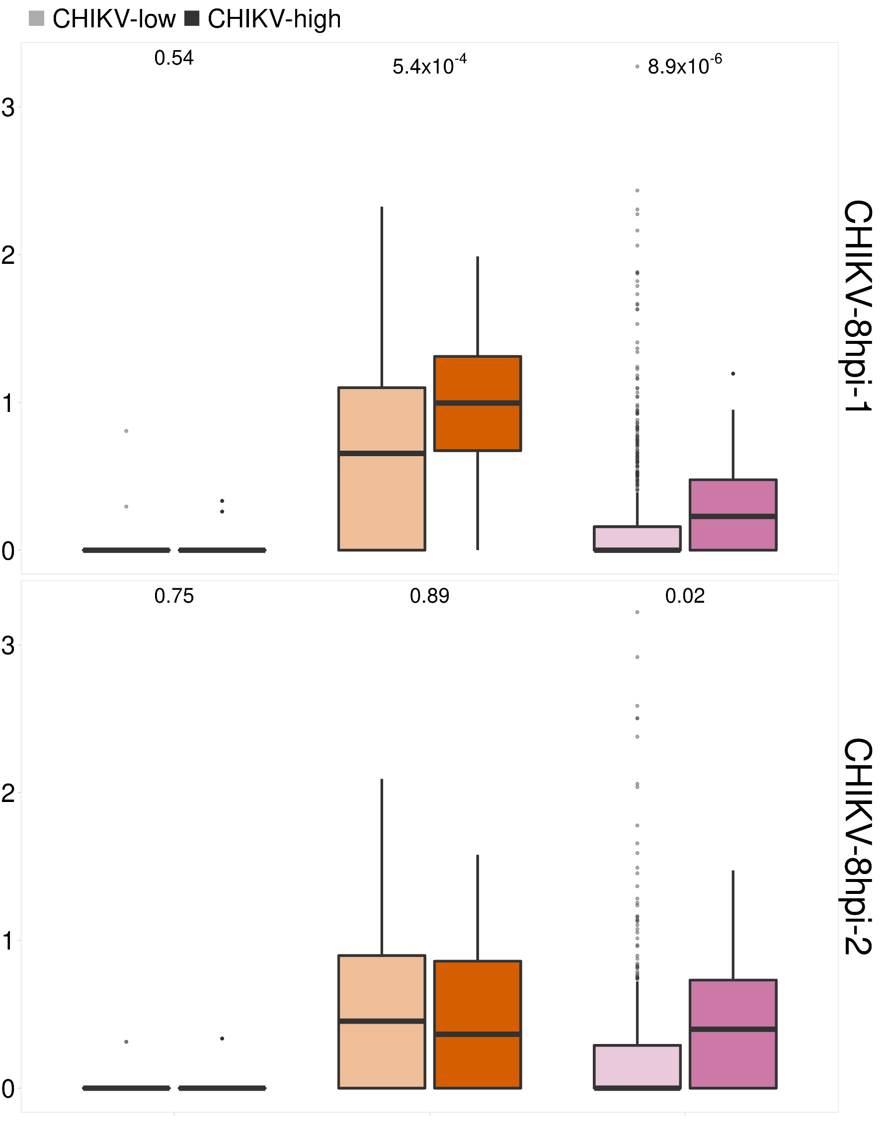
CHIKV-high fLECs express Marco
Marco expression
Mxra8 expression
fLEC
Fibroblasts
BEC
fLEC
Fibroblasts
BEC
Notes:
1

