Slide 1

NEW YORK JOB VACANCY ANALYSIS & BIOMETRIC ANALYSIS USING CLOUD
A PROJECT REPORT
Submitted in partial fulfilment of the
requirement for the award of the degree
of
BACHELOR OF TECHNOLOGY (B.Tech)
in
Computer Science & Engineering
By
Romil Nagar
169105154
Department of Computer Science & Engineering,
School of Computing and IT,
MANIPAL UNIVERSITY JAIPUR
JAIPUR-303007
RAJASTHAN, INDIA
May/2020

Slide 2
TOPICS TO BE COVERED
Abstract
Motivation
Introduction
Methodology
Results
Conclusion & Future Scope

Slide 3
ABOUT THE PROJECT
Big Data
Reports Based On analysis
Heterogeneous Sources i.e. operational data (Flat files)
Data warehouse (MySQL and Hadoop)
EXTRACT TRANSFORM LOAD

Slide 4
ABSTRACT
Getting familiarized with the existing methods and overall structure of the project.
Accordingly symmetrizing the data flow and the methods to collect data for analysis.
Cleaning the raw accumulated data.
Query analysis on the data helps us to draw insights .
Visualize the data and to understand the occurrence of outcome.
Visualized data was understood.
Used to ﬁnd the vacancies in different sectors.
Display the preferred skills & job description which can be used to fetch the required skills for a particular job
First Part
Second Part
Third Part
New York Job Vacancy Analysis

Slide 5
Job Vacancy Analysis using Big-Data
INTRODUCTION
Biometric Analysis using Google Cloud
Big Data refers to all the data that is being generated across the globe at an unprecedented rate. This data could be either structured or unstructured. Today’s business enterprises owe a huge part of their success to an economy that is firmly knowledge-oriented.
Better data leads to better decision making and an improved way to strategize for organizations regardless of their size, geography, market share, customer segmentation and such other categorizations.
Gait is a behavioral biometric which can be perceived from a distance. It can be acquired without personal contact and cooperation. Iris and face biometrics have similar advantages but they need high resolution images and frontal view.
Human gait analysis can be used as a useful tool in a variety of applications. One such promising application is medical diagnostics of diseases that affect voluntary muscle activity such as walking Gait can also be used to generate early warning for law enforcement agencies by detecting suspicious motion activity in airports or subway stations.

Slide 6
MOTIVATION
The computing revolution that began more than 2 decades ago has led to large amounts of digital data being amassed by corporations. Advances in digital sensors; proliferation of communication systems, especially mobile platforms and devices; massive scale logging of system events; and rapid movement toward paperless organizations have led to a massive collection of data resources within organizations and the increasing dependence of businesses on technology ensures that the data will continue to grow at an even faster rate.
Having the ability to drill down through huge amounts of data to find the really powerful metrics and nuggets of information is the core purpose of big data and is also a key tool for employees to be able to track their progress. The success of ‘increasing website visitors’ or ‘increasing revenue’ comes from the success of the elements that make up the larger goals, which are in turn made from smaller metrics. Being able to accurately track these at a macro level gives genuine goals that can be achieved daily, creating almost a gamification model and further increasing motivation to meet long term, larger goals

Slide 7
PRE-PROCESSING OF DATA
For Spark, we used “@” delimiter because “|” separated each character and raised problem in creation of DataFrame.
1
Different line separator that is “|” is used to separate fields
2
After loading the data into hive, we have replaced blank columns/fields with NA and follow the approach of not deleting the entire column as we do not tamper the dataset provided by the client
3

Slide 8
METHODOLOGY AND BACKGROUND MATERIAL
Generating two files consisting of '|' and '@' as delimiters to separate fields
Replace the null values with 'NA' in fields.
Data was imported from MySQL into Hadoop using SQOOP
Database project and table nyc_job was created in MySQL and data was loaded in it.
To save time, we used Spark as an alternative for MapReduce job
Perform queries in spark using sqlContext.sql() which would reflect in hive table.

Slide 9
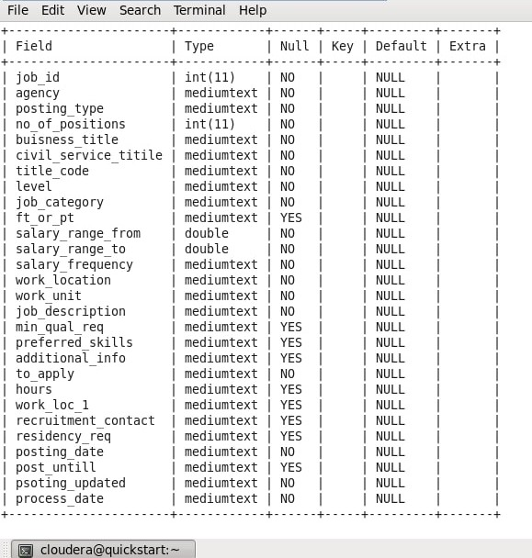
SCHEMA OF nyc_job TABLE
The project has a single table schema approach.
It consists of 27 fields.

Slide 10

RESULTS & ANALYSIS
10

Slide 11
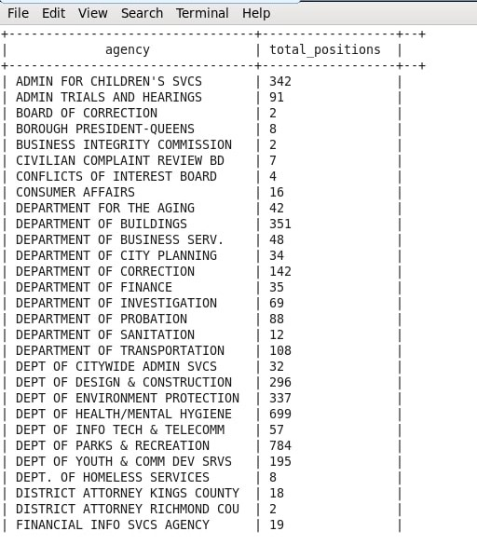
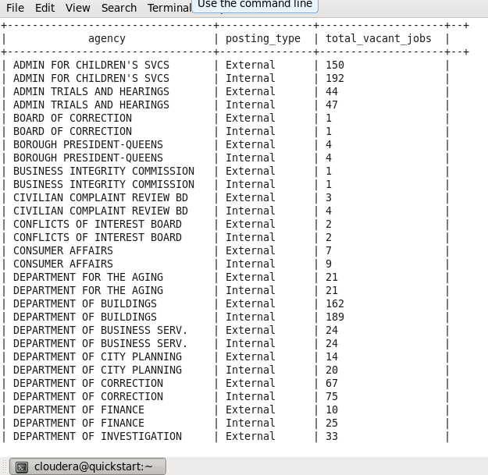
Jobs with highest demand in each agency
External and internal jobs in each agency

Slide 12
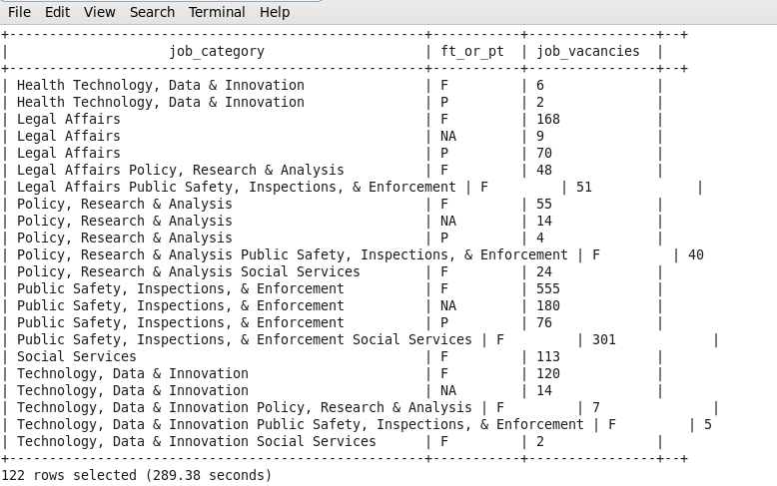
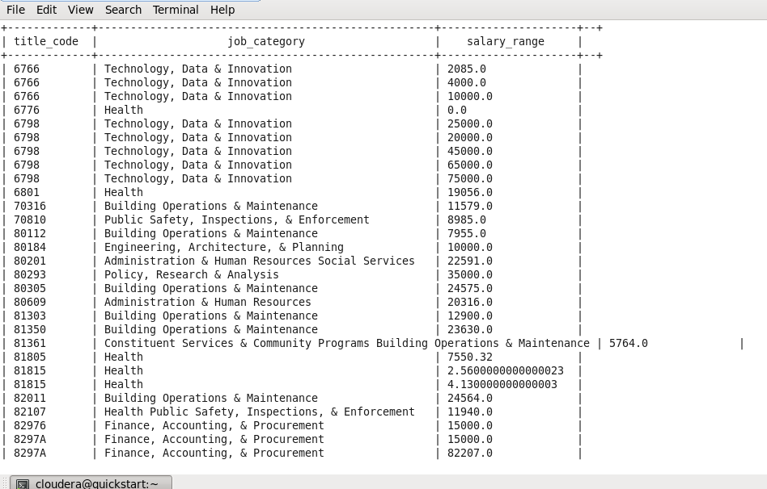
Number of part time and full time jobs vacancies in different job categories.
Display different jobs with salary ranges (0 indicates that salary is fixed and there is no increment).

Slide 13
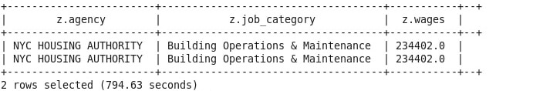
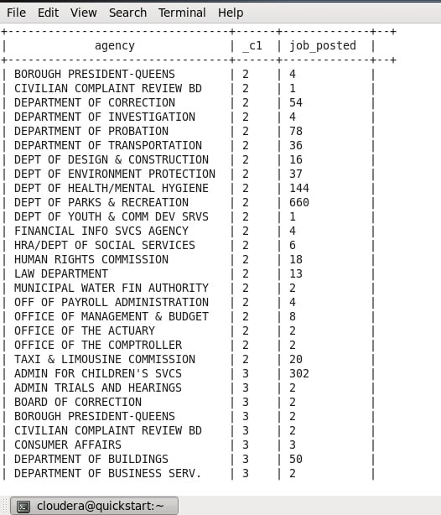
Agency and Job Category having Highest paying jobs
Month wise number of job posted in all agencies
select z.agency,z.job_category,z.wages from (select agency,job_category, case when salary_frequency in ('Hourly') then salary_range_to*9*269 when salary_frequency in ('Daily') then salary_range_to*269
else salary_range_to
end as wages from nyc_job)z where z.wages in
(select max(u.wages) from (select agency,job_category,
case when salary_frequency in ('Hourly') then salary_range_to*9*269 when salary_frequency in ('Daily') then salary_range_to*269
else salary_range_to
end as wages from nyc_job)u)

Slide 14
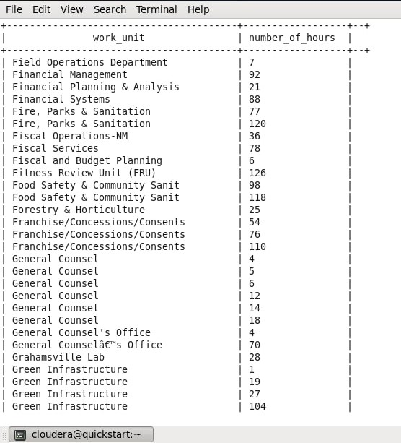
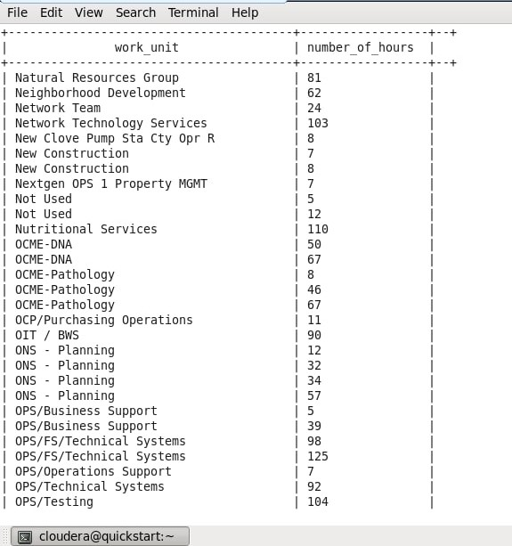
Days taken in job application for each work unit
Number of job positions in each work unit

Slide 15
Conclusion & Future Scope !
From this project we can conclude that with right tools like Big Data tools we can infer some great things from a big dataset which cannot be processed using old technologies
Conclusion
Through these big data technologies we can integrate with machine learning technologies to find some depth analytics that cannot be inferred using simple query methods.
We can use machine learning methods to help job seekers find vacancies in any particular organization.
Future
Scope
Use better questionnaire to find some more important trends and perform Better modelling of the data.

Slide 16
METHODOLOGY FOR GAIT ANALYSIS
Image Extraction from Database.
Converting to threshold images.
Building GEIVnet.
Extracting Region of Interest and combining all images to form Gait Energy Images(GEI).
Passing the GEI and training them.
Building 3 different networks and checking accuracy through CMC Curve.

Slide 17
RESULTS AND ANALYSIS
We conclude that the accuracy at image size of 32*32 is best achieved at 99.69%. and when the image size was 120*120 it was 99.81.
Input Size | Learning Rate | Model | EER(%) | Rank1 ACC
32*32 | 1e-5 | V3 | 0.40 | 99.63%
32*32 | 1e-4|1e-5 | V6 | 0.18 | 99.69%
120*120 | 1e-4|1e-5 | v4+LRN | 0.97 | 99.81%

Slide 18
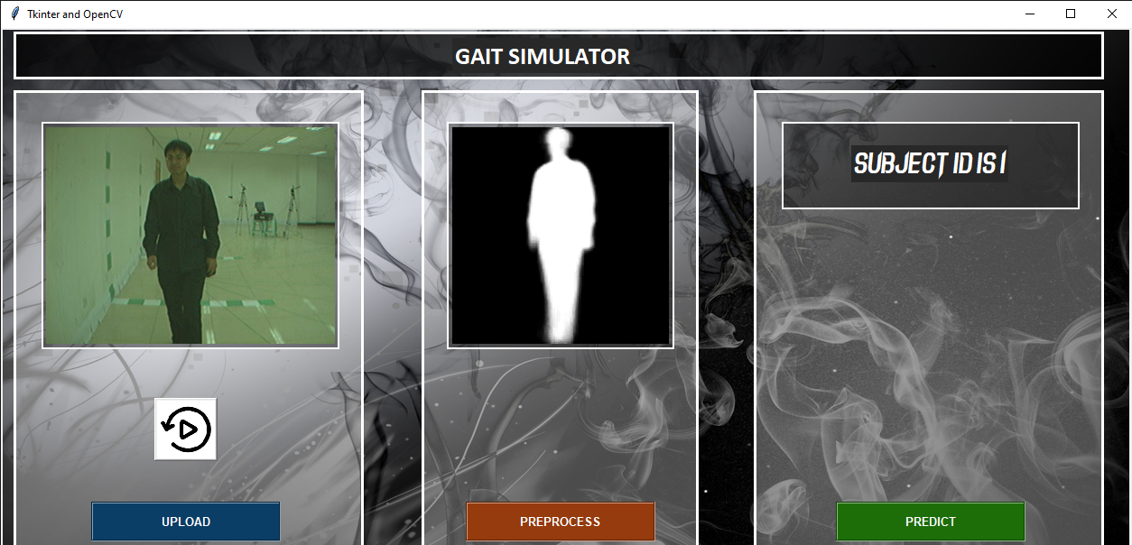
GAIT SIMULATOR USER INTERFACE

Slide 19
CONCLUSION AND FUTURE SCOPE FOR GAIT ANALYSIS
The main work encompassed gait identification and gait analysis of individuals. First, a novel approach for identifying individuals was proposed. This identification method achieved very high accuracy in a data sample with very similar subjects. Then, a solution was provided to the question: which of these features should be extracted to represent gait and why. A novel gait cycle and its corresponding phases were defined. The influence of gait features from the gait phases was investigated
In addition, the relationship between gait and attractiveness was analyzed and a predictable model for gait attractiveness was built. The similarity and dissimilarity between the left and right sides of the body in gait were investigated. This research showed the most asymmetric body parts in each subjects’ in gait and revealed the common similarities and asymmetric appearances in gait among different subjects.
Prominent future research domain demands on the effective fusion of gait with other biometrics so as to accomplish a comprehensive surveillance system in environments that are characterized by “special interest”, high traffic, much transient in nature such as airports. Encompassing the GRS as a part, in launching a comprehensive multi model Automated Human Recognition System is to be experimented in depth and to be optimistically realized in the near future

Slide 20
Thank You!
ANY QUESTIONS?

