Slide 1




Verifying a C implementation of Derecho’s coordination mechanism using VST and Coq
Ramana Nagasamudram* ¹
Lennart Beringer* ²
Ken Birman ³
Mae Milano ²
David Naumann* ¹
¹
²
³
6/4 NFM 2024
* Partially supported by Siemens, lead by Charif Mahmoudi
¹ Stevens Institute of Technology
² Princeton University
³ Cornell University

Slide 2
Introduction
Safety critical applications: sensitive to inconsistencies in data
Want data replication with strong consistency guarantees
Formally verified for high assurance
Highest possible levels of performance to be useful
Derecho: a C++ library for state machine replication, Paxos-style
Offers strong consistency guarantees while being highly performant
Optimal protocols phrased monotonically + CPU-bypass technologies

Slide 3
What we do
Isolate the key data structure of Derecho, the shared-state table as a separate code unit in C, with a simplified API
Verify this implementation: specifications refer to abstract model of data structure operations and distributed communication
Build a library of reasoning principles and sample applications
Verified Software Toolchain (VST)
Concurrent separation logic for C in Coq, machine-checked proof of soundness with respect to semantics formalized by CompCert

Slide 4
The shared-state table (SST)
Row corresponding to replica R in replica P’s SST
Communication via syncs
Each replica pushes its own
row to other replicas
Each row in an SST has a
single writer
Derecho: syncs use RDMA
P | 5
Q | 7
R | 2
P | 3
Q | 8
R | 3
P | 5
Q | 8
R | 5
9
9
Replica P
Replica Q
Replica R
Replica R knows maximum value of counter is at least 9
Relies on actions being monotonic
Node of a distributed system
Replicas are registered with actions
An action consists of a predicate and a trigger
if predicate holds on SST { update own row using trigger }

Slide 5

Modeling data structures in VST and Coq
Representation predicate
pred
predicate
trigger
private state
Action_rep Act a
SST_rep SST p
trig
Pointer a points to a
data structure that
represents the Coq action Act
Pointer p points to a
data structure that
represents the Coq value SST
C
An SST is a struct with:
2-D array of integers
Index to own row
Coq
Record with:
tbl : list (list Z)
id : Z
+ constraints on dim. of tbl
C
bool (predicate_t *) (sst *, priv_state *p)
void (trigger_t *) (sst *, priv_state *p)
An action is a struct with:
private state (app-specific)
func. ptrs. for pred, trig
Coq
Type of private states: priv
Predicate := SST * priv $→$ bool * priv
Trigger := SST * priv $→$ SST * priv
Action := Predicate * Trigger * priv
Replica: An SST paired with a list of actions
System state: A collection of replicas

Slide 6







Operations on SSTs and specifications
The sync operation
Copy own row of an SST to the corresponding row of another
The run action operation
Update the own row of an SST by running an action
PRE: SST_rep FROM s1 $∗$ SST_rep TO s2
PRE: SST_rep SST s $∗$ Action_rep Act act
$$∗$$
$$∗$$
predicate
trigger
private state
pred
trig
sync_sst(sst* s1, sst* s2)
run_action(sst* s, action* act)
$$∗$$
$$∗$$
predicate
trigger
private state
pred
Coq function
trig
POST: SST_rep FROM s1 $∗$
SST_rep (sync_sst FROM TO) s2
POST: SST_rep (run_action SST Act) s *
Action_rep (upd_priv SST Act) act

Slide 7
An example client
Transitive closure of a graph
find: One insertion of resumptive Floyd-Warshall
copy: Learns from other replicas
Steps:
Create replicas
Install actions
Call run
In Derecho:
each replica concurrently runs its actions and syncs with the others
Our implementation:
sequential, round-robin exec
Details hidden from clients
sys* st = new_replicas(gph)
for (int i=0; i<numreps(st); ++i)
{ install_action(st, i, find);
install_action(st, i, copy); }
st = run(st)

Slide 8

The specification of run
In sch, each replica has performed each of its actions NUM_ROUNDS many times
PRE: We have a system st
,
,
,
…
,
run(st, NUM_ROUNDS)
POST: There exists a schedule sch such that the state of st is run(st, sch)
$∃$ sch.
(
)
run
,
,
,
…
,
, sch
A schedule: sequence of events, where an event is either
a sync from one replica to another
a replica performing an action, updating its own row

Slide 9
An example client
After the call to run:
System state is described by
run(st, sch) for schedule sch
sch is a sequence of:
Syncs between replicas
Replicas running find and copy
If run reaches a fixpoint for find on a given replica, that replica has computed the transitive closure
Eventually, each replica knows the transitive closure

Slide 10

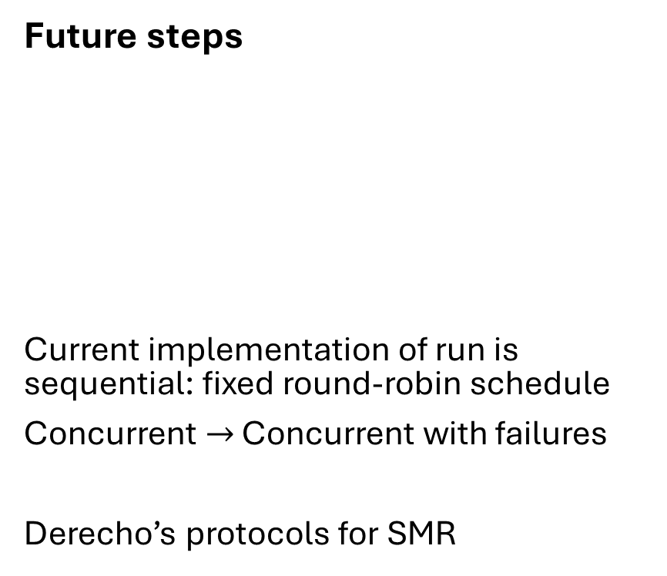
Conclusion
What we’ve done so far
Verified an implementation of Derecho’s core coordination mechanism
Verified two small applications
Identified as first steps by developers
Formalized notions of monotonicity and knowledge at the model level
A library of reasoning principles
Future steps
Current implementation of run is sequential: fixed round-robin schedule
Concurrent $→$ Concurrent with failures
Derecho’s protocols for SMR
,
,
…
,
,
(
run(st, NUM_ROUNDS)
)
,
,
…
$∃$ sch.
run
,
,
, sch

Slide 11

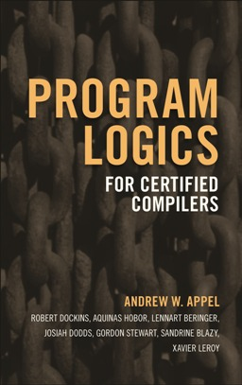
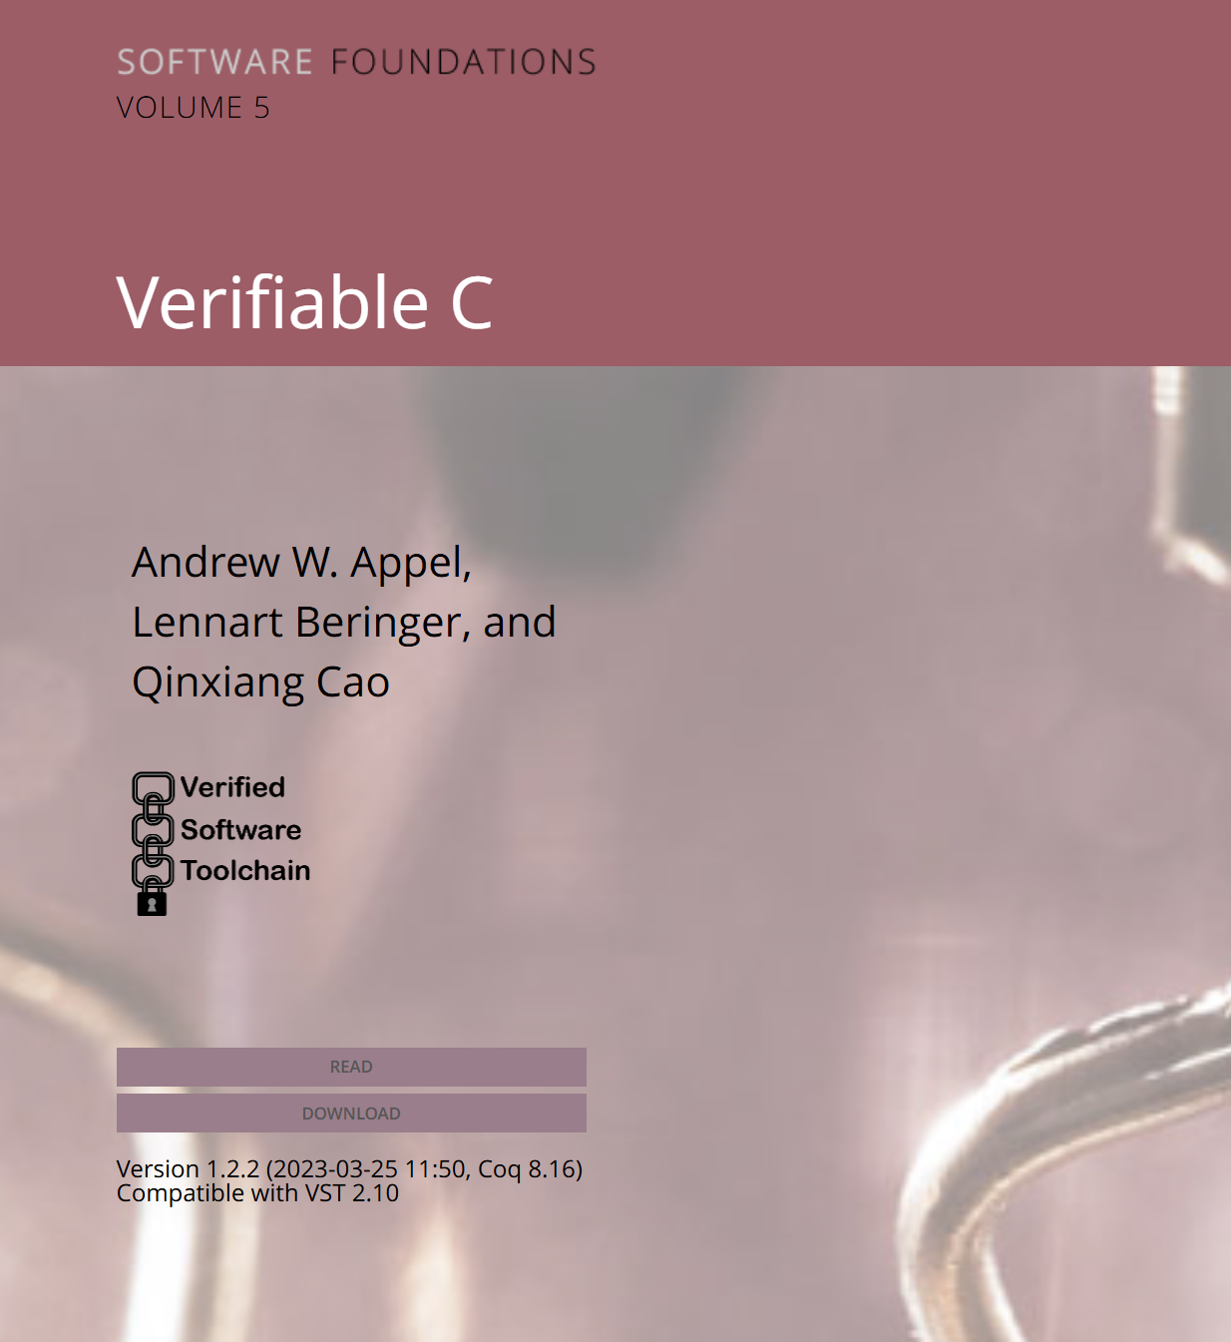
References
Derecho
https://derecho-project.github.io/
Applications
Automated herd-management for large dairies, real-time diagnosis of skin infections in dairy cows, robotic coordination tasks, product inspections in factory floors, ...
Developed at Cornell by Ken Birman’s group
Mae Milano helped develop our formal model
SSS 2023 invited paper: Monotonicity and Opportunistically-Batched Actions in Derecho, K. Birman et al.
Verified Software Toolchain
Verified C applications
Malloc/free, concurrent search templates, HTTP server, packet error-correction, Crypto HMAC, …
Homepage: https://vst.cs.princeton.edu/
See Software Foundations Vol. 5
Please reach out! rnagasam@stevens.edu

Slide 13
Appendix

Slide 14
Stability detection
Towards two-phase commit
Actions: multicast and acknowledge
High-level properties in terms of knowledge (epistemic):
A replica knows P if P holds in all worlds indistinguishable from the current world
We show replicas know lower bound on message counts
Crucially relies on monotonicity
multicast
acknowledge
multicast

