Slide 1
Air Miles
Interoperability

Slide 2





Actors
Airline Passengers
Airline Operators
Airline Alliance
Rating Agency
Other Vendors

Slide 3
Interaction maps
Service delivery
Dispute resolution
ratings
governance
Existing

Slide 4

Interaction maps
Service delivery
Proposed

Slide 5
Existing pain points
Limited Inter-operability
Expiry of unused miles
Non-transparency
Cost of onboarding and maintenance
Unrealized cost of airline marketing campaigns
Limited redemption options
Facts
Around 9.7 trillion frequent flier miles going unredeemed every year.
80% of frequent flyer members never actually earn enough miles to redeem a flight

Slide 6
Proposed solution – Right Miles
Tokenize miles
Increased Inter-operability
Tokens do not expire
Contracts In blockchain and have full Transparency
Operators share cost of onboarding and maintenance using
More redemption options
Dynamic exchange rate determination.

Slide 7
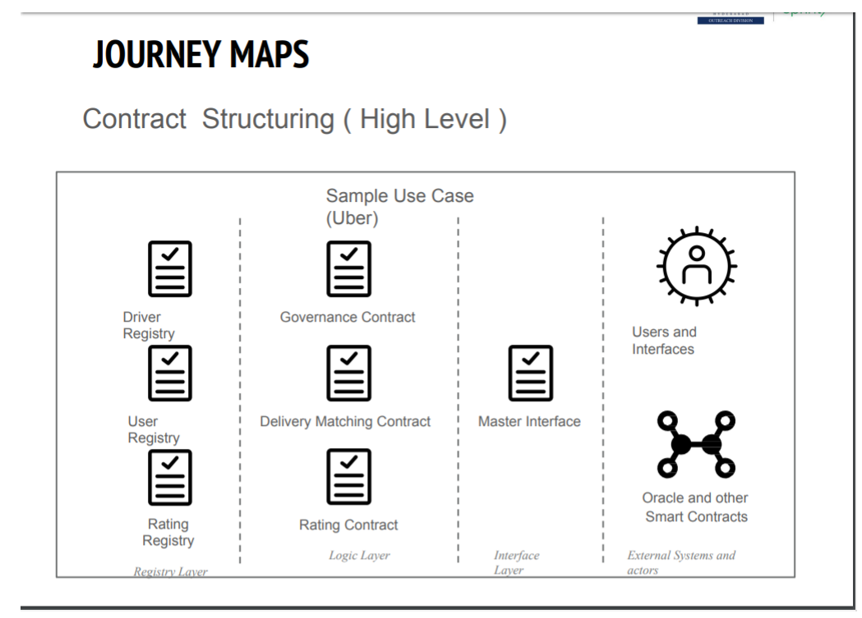
TODO: Journey Maps

