Slide 1
Customer360 Navigator Enterprise Suite
Suite-Wide Executive Rollup

Slide 2
Suite KPI Overview
BPs in suite: 8
BP1-BP7 with completed Gate 7: 7 of 7
Recommended for production: 5
Disparate-impact flagged: 1
Total pytest passed (suite): 157 (n=2 BPs)
Total decision/gold records: 1,048,575 (n=1 BPs)

Slide 3
BP1-BP4 Status
BP | Champion | Tier | Disparate Impact
BP1 | logistic_regression | RECOMMENDED FOR PRODUCTION | structurally_no_check
BP2 | xgboost | RECOMMENDED FOR PRODUCTION | structurally_no_check
BP3 | xgboost | CONDITIONAL - GOVERNANCE REVIEW REQUIRED | flagged
BP4 | polars_lazy_streaming | RECOMMENDED FOR PRODUCTION | structurally_no_check

Slide 4
BP5-BP7 Status
BP | Champion | Tier | Disparate Impact
BP5 | — (not in manifest) | Recommended for Decision-Support Use, With Monitoring | not_applicable
BP6 | taxonomy_bucket_match | RECOMMENDED FOR PRODUCTION | not_applicable
BP7 | correlation_aware_plus_lr_diagnostic | RECOMMENDED FOR PRODUCTION | not_flagged

Slide 5
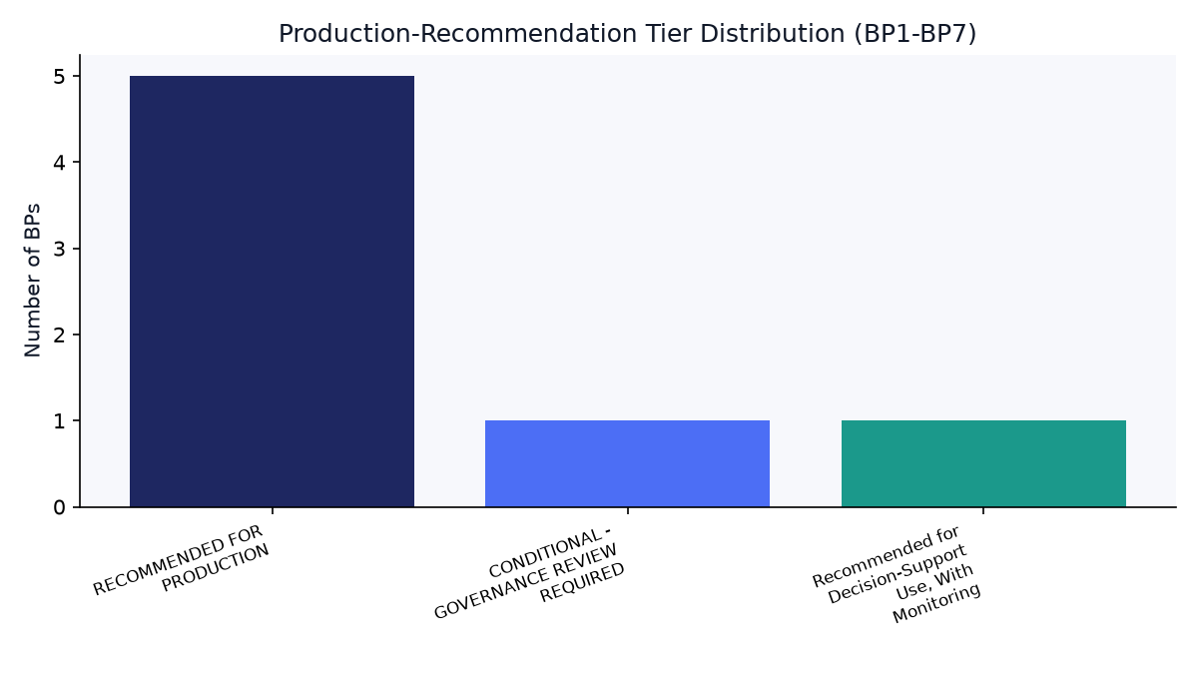
Production-Recommendation Tier Distribution

Slide 6
BP8 -- Executive Product Analytics
Gate 1: confirmed
Gate 2: None KPI categories ready, None Gold tables written
Gate 3: real-run confirmed

Slide 7
Smart Suggestions (Rule-Based)
BP1: No blocking action. Re-validate at the next scheduled re-run, consistent with this suite's standing monitoring cadence.
BP2: No blocking action. Re-validate at the next scheduled re-run, consistent with this suite's standing monitoring cadence.
BP3: Complete the governance review this BP's own Gate 7 rollup calls for before moving to production; re-check after review.
BP4: No blocking action. Re-validate at the next scheduled re-run, consistent with this suite's standing monitoring cadence.
BP5: Proceed under this BP's own stated qualification -- "Recommended for Decision-Support Use, With Monitoring" -- rather than treating it as an unconditional production-ready result; keep the monitoring it calls for active.
BP6: No blocking action. Re-validate at the next scheduled re-run, consistent with this suite's standing monitoring cadence.
BP7: No blocking action. Re-validate at the next scheduled re-run, consistent with this suite's standing monitoring cadence.
BP8: All 3 of BP8's real gates are confirmed. Remaining step is the human, Power BI Desktop (.pbix) build over these Gold tables (Master Plan Section 19).

Slide 8
Closing Note
The suite's final decision layer is a human-built Power BI Desktop (.pbix) file, per Master Plan Section 19 -- out of scope for any notebook to build.

