Slide 1
BP1 Customer Intent Classification
Executive Rollup — Customer360 Navigator Enterprise Suite
Champion model: logistic_regression | Held-out accuracy: 82.24% (real) | Generated 2026-09-24
Recommended for Production: RECOMMENDED FOR PRODUCTION

Slide 2
Executive Summary — Real KPIs
logistic_regression
Champion Model
82.24%
Held-out Accuracy
0.8221
Held-out F1-macro
0.9933
ROC-AUC (OvR)
3,080
Decision Records
4.9%
Reason-code Coverage
52 passed
pytest
1 near-random / 2 high-var
Gate 3 Open Anomalies

Slide 3
Gate 1 — Business Understanding & Policy (real)
• Primary target: category (BANKING77's real 77-class fine-grained customer intent label, attached to the `text` field it was collected with.)
• Secondary target: common_taxonomy_bucket (The 9-bucket common taxonomy from Gate 2 (configs/taxonomy_mapping.yaml), used only for coarser reporting and for cross-dataset comparability with CFPB's bucket-tagged rows in BP8 - never trained on directly in place of the real 77-class label.)
• Feature variable: text | Split: BANKING77's own provided train/test split (banking77_train.csv / banking77_test.csv) - used as-is, never re-randomized or re-merged.
• Compliance touchpoint: Data-minimization & purpose-limitation statement (GLBA/GDPR-aligned)
• Live check — shared CFPB/BANKING77 columns: 0
• Live check — train/test exact-text overlap rows: 0
• 77-class imbalance ratio: 5.34x (min 35 / max 187)
• 9-bucket imbalance ratio: 3.85x (min 460 / max 1770)

Slide 4
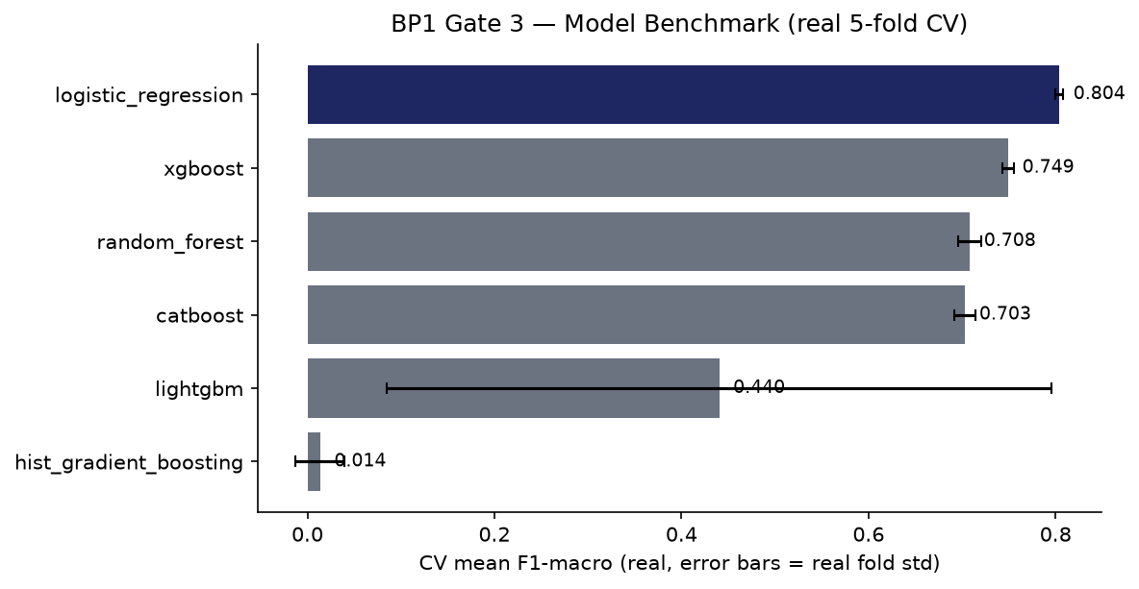
Model Benchmark — Gate 3 (real 5-fold CV)

Slide 5
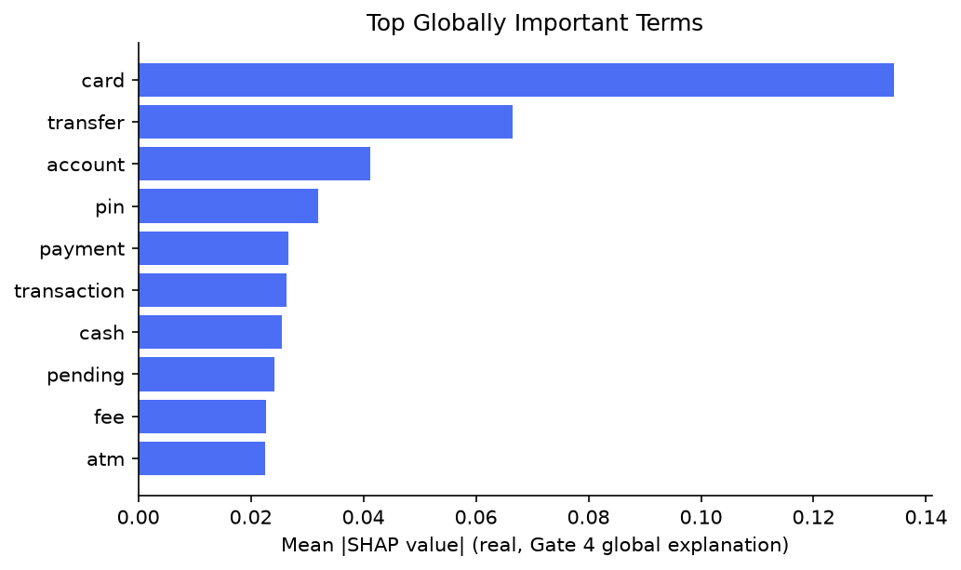
Explainability — Gate 4 (real SHAP)

Slide 6
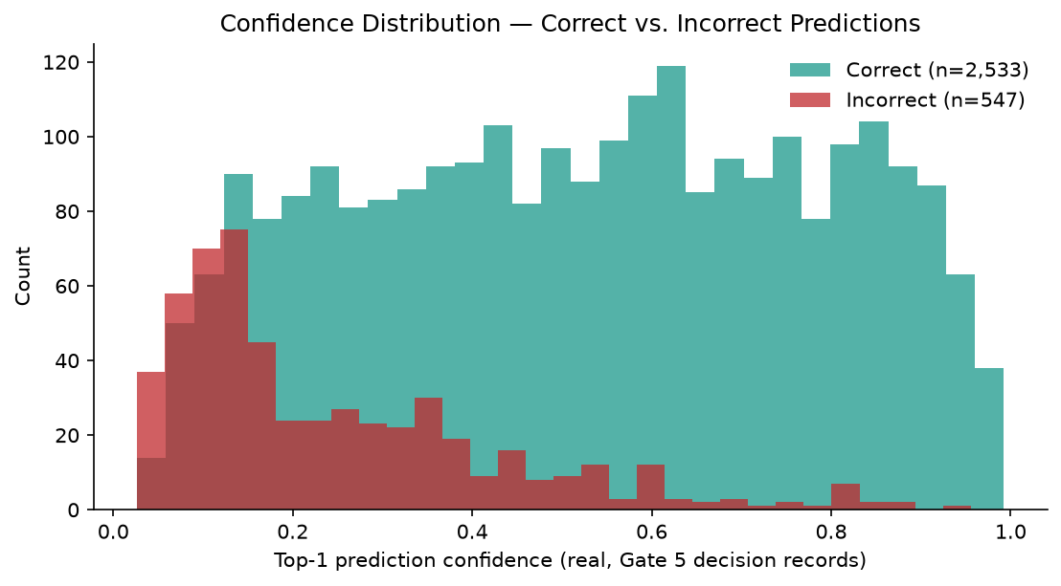
Decision Layer — Gate 5 (real)

Slide 7
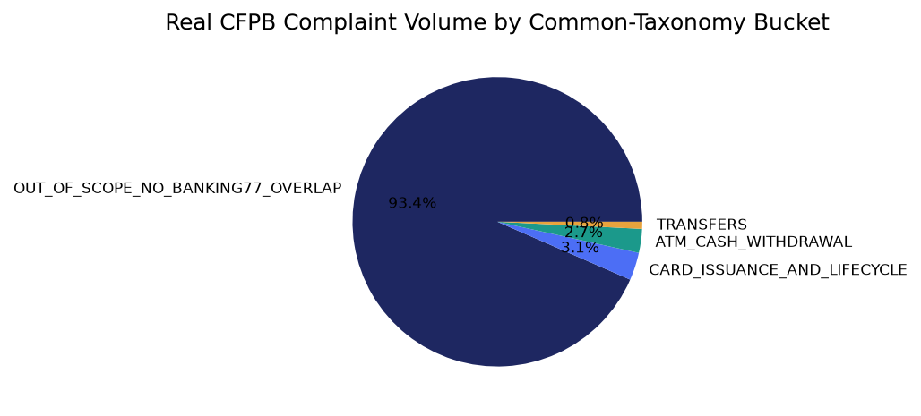
Taxonomy Coverage — Gate 2 (real)

Slide 8
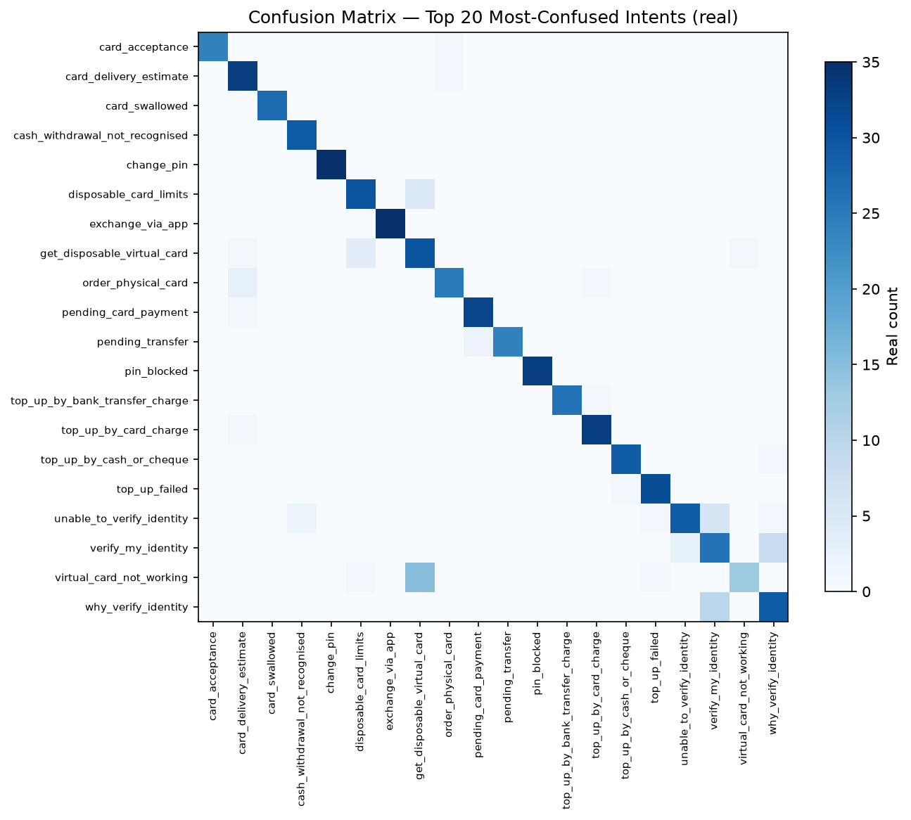
Confusion Analysis — Gate 3 (real)

Slide 9
SMART Suggestions
Root-cause hist_gradient_boosting's near-random CV score
hist_gradient_boosting scored a real CV mean F1-macro of 0.0137 (near the 77-class random baseline of ~0.0130) while consuming 1731s of real CV wall-clock time - by far the most expensive candidate for the worst result. Target: Target: either a mean F1-macro above the weakest currently-passing candidate (0.440) after the fix, or a documented decision to drop this candidate from future benchmarks.
Stabilize lightgbm's fold-to-fold variance
lightgbm's real CV fold std (0.3554) is 0.8x its mean (0.4403) - too unstable to trust for production without investigation. Target: Target: std/mean ratio below 0.3 after tuning (hyperparameters, class weighting, or a fixed early-stopping schedule).
Increase SHAP sample size for more stable global explanations
Gate 4 and Gate 5 independently computed SHAP importance from two different 150-row samples of real held-out data, and only 4/10 top terms overlapped. Target: Target: overlap of 7/10 or higher at a larger, fixed sample size (re-run both gates with an increased SHAP_SAMPLE_SIZE and compare).
Monitor per-intent recall for the weakest-performing classes in production
Overall held-out test accuracy is real and strong (82.24% across 77 classes), but per-class performance is uneven by construction of a 77-class problem - track the bottom-decile intents (see the Known Limitations / worst-performing intents table) once in production. Target: Target: no individual intent's real production F1-score drifting more than 10 percentage points below its Gate 3 held-out test value without an alert.
Expand grounded reason-code coverage beyond the current SHAP sample bound
Only 150 of 3,080 real decision records (4.9%) currently carry a grounded per-instance reason code, bounded by the 150-row SHAP sample size for laptop safety. Target: Target: 100% reason-code coverage once compute budget allows removing the sample bound, or a documented, deliberate sampling policy if full coverage is not pursued.

Slide 10
Gate 6 — Governance & Known Limitations (real)
• pytest suite: 52 passed / 0 failed
• Notebook syntax audit: 8/8 passed
• Open item: 1 near-random + 2 high-variance Gate 3 candidate anomaly(ies), not yet root-caused
• Model card: reports\bp1_customer_intent_classification\MODEL_CARD.md
• Changelog: reports\bp1_customer_intent_classification\CHANGELOG.md
• Gate 3 candidates evaluated: logistic_regression, random_forest, hist_gradient_boosting, xgboost, lightgbm, catboost
• BP1 governance gates complete: 6/6

Slide 11
Recommended for Production Status
RECOMMENDED FOR PRODUCTION
• All 6 BP1 gates are real-run confirmed and every structural integrity check passed (pytest 52 passed / 0 failed, notebook syntax audit all passed). Tier 2 (CONDITIONAL - GOVERNANCE REVIEW REQUIRED) is structurally unreachable for BP1: this BP's real Gate 1-6 artifacts carry no ECOA/Reg B disparate-impact check (introduced starting with BP3), so BP1 cannot ever be flagged into Tier 2.

