Slide 1
BP2 Customer Friction Classification
Executive Rollup — Customer360 Navigator Enterprise Suite
Champion model: xgboost | Held-out accuracy: 75.58% (real) | Generated 2026-09-24
Recommended for Production: RECOMMENDED FOR PRODUCTION

Slide 2
Executive Summary — Real KPIs
xgboost
Champion Model
75.58%
Held-out Accuracy
0.4559
Held-out F1-macro
0.8857
ROC-AUC (OvR)
152.0:1
Class Imbalance Ratio
163,344
Decision Records
105 passed
pytest
0 near-random / 0 high-var / 0 failed
Gate 3 Open Items

Slide 3
Gate 1 — Business Understanding & Policy (real)
• Primary target: friction_severity_class
• Sentiment-proxy signal — scoped OUT: NOT built as literally named in the Master Plan - no narrative/complaint-text column exists in the real CFPB extract (RAW_DATA_MANIFEST.md F...
• Repeat-contact signal — scoped OUT: NOT built - the real CFPB schema (verified live in Section 4) has no persistent customer/consumer identifier, only `Complaint ID` (identifie...
• Feature variable candidates: Structured CFPB fields only (Product, Sub-product, Issue, Sub-issue, State, Submitted via) plus the Gate-2/BP1 `common_taxonomy_bucket` (con...
• Compliance touchpoint: UDAAP (Unfair, Deceptive, or Abusive Acts or Practices) framing
• Live check — real CFPB row count: 1,048,575
• Live check — Company public response null rows: 570,861

Slide 4
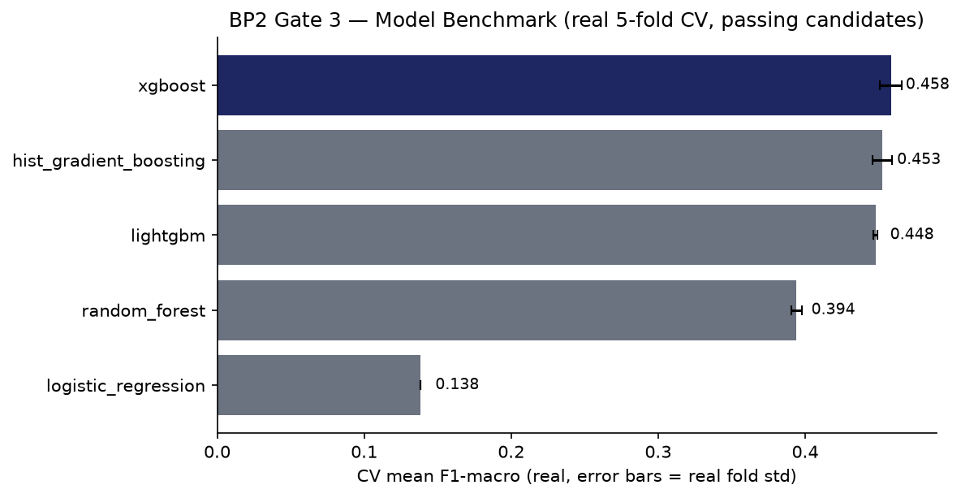
Model Benchmark — Gate 3 (real 5-fold CV)

Slide 5
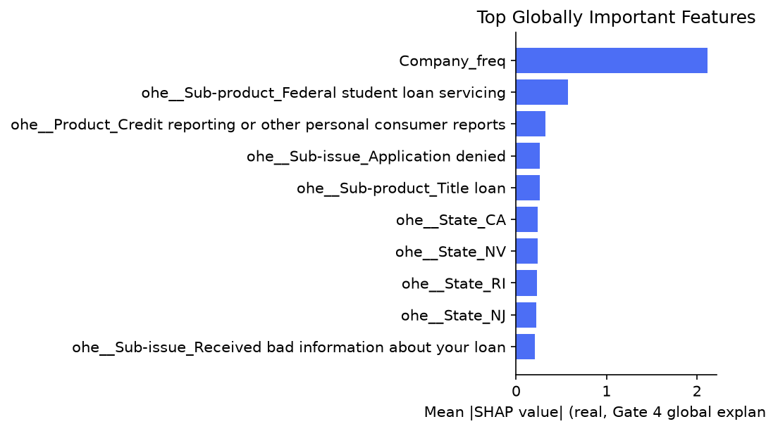
Explainability — Gate 4 (real SHAP)

Slide 6
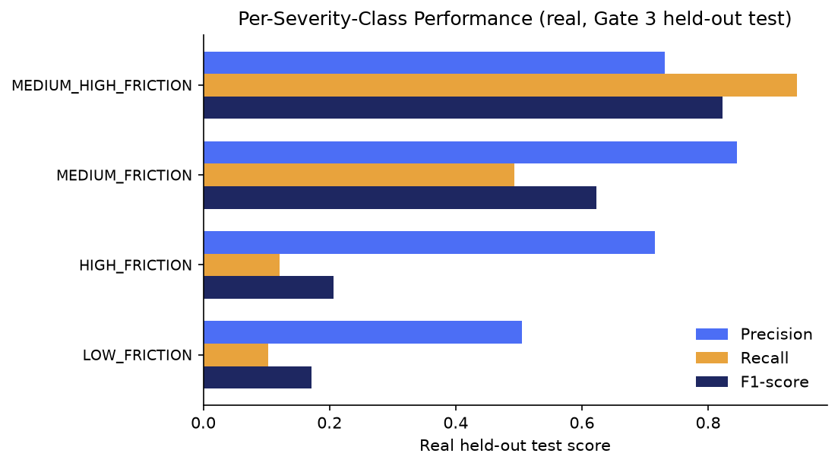
Per-Severity-Class Performance — Gate 3 (real)

Slide 7
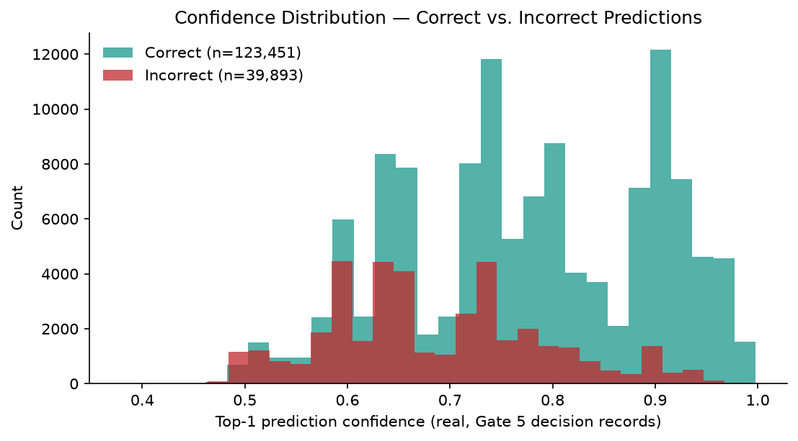
Decision Layer — Gate 5 (real)

Slide 8
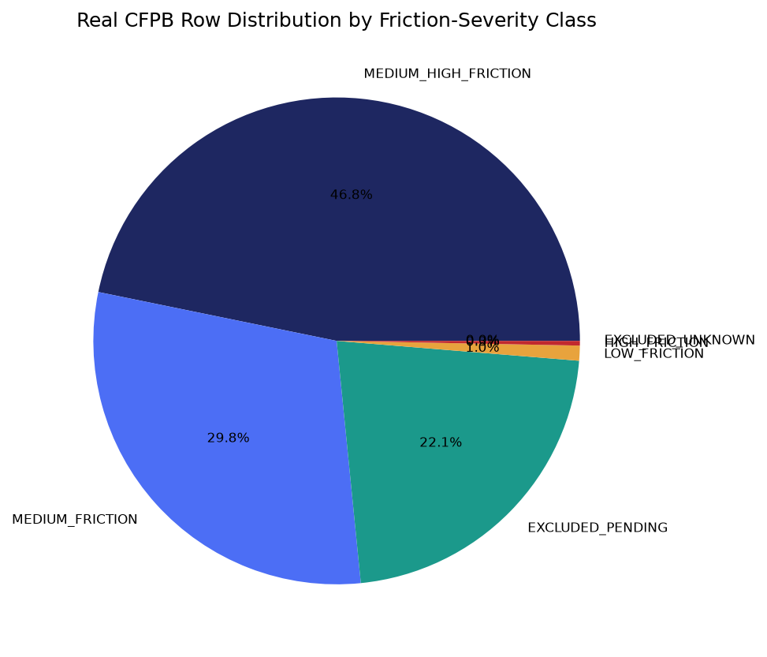
Severity Distribution — Gate 2 (real)

Slide 9
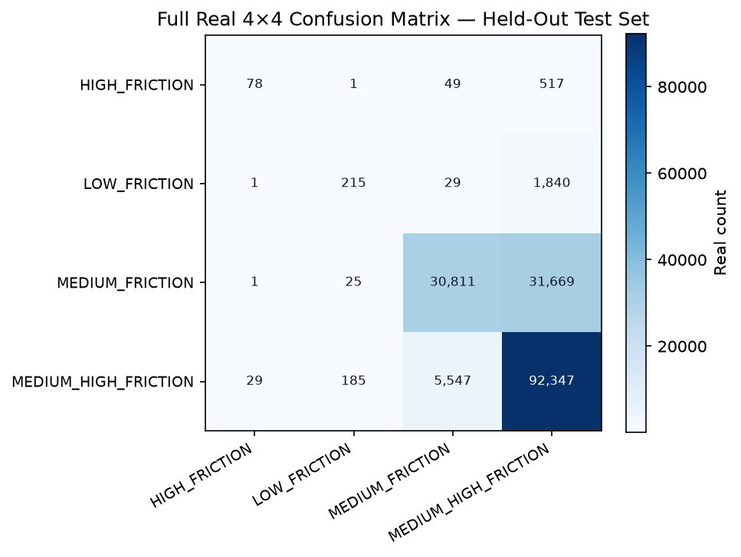
Confusion Analysis — Gate 3 (real, full 4×4 matrix)

Slide 10
SMART Suggestions
Close the minority-class recall gap on the two smallest severity classes
Despite reasonably strong real precision, the two lowest-support real severity classes show much weaker real recall on the held-out test set: HIGH_FRICTION (precision 71.6%, recall 12.1%, support 645); LOW_FRICTION (precision 50.5%, recall 10.3%, support 2,085). With a real 152:1 class-imbalance ratio (majority/minority), the champion under-predicts these classes far more than the headline 75.6% accuracy suggests. Target: Target: real recall above 30% for both LOW_FRICTION and HIGH_FRICTION at the next Gate 3 re-benchmark (e.g. via class weighting adjustments, threshold tuning, or a resampling strategy), without materially reducing macro-F1 on the majority classes.
Increase SHAP sample size for more stable global explanations
Gate 4 and Gate 5 independently computed SHAP importance from two different 150-row samples of real held-out data, and only 2/10 top terms overlapped — lower than BP1's equivalent 4/10 overlap, consistent with a structured-feature space having many more near-tied low-signal one-hot columns than BP1's TF-IDF vocabulary. Target: Target: overlap of 6/10 or higher at a larger, fixed sample size (re-run both gates with an increased SHAP_SAMPLE_SIZE and compare).
Run the deferred Company public response leakage/predictive-value ablation
`Company public response` (~54% null, real, live-checked at Gate 1) was deliberately excluded from Gate 3's feature set as an open item, never tested for leakage against the target or for genuine predictive value. Target: Target: a documented ablation run (with vs. without the field) reporting the real macro-F1 delta and a leakage-risk verdict, before it is ever added to the production feature set.
Expand grounded reason-code coverage beyond the current SHAP sample bound
Only 150 of 163,344 real decision records (0.09%) currently carry a grounded per-instance reason code, bounded by the 150-row SHAP sample size for laptop safety — a much thinner relative real coverage than BP1's 150/3,080 (4.9%) on the same sample-size bound, simply because BP2's real held-out test set (163,344 rows) is ~53x larger. Target: Target: 100% reason-code coverage once compute budget allows removing the sample bound, or a documented, deliberate sampling policy (e.g. stratified by severity class) if full coverage is not pursued.

Slide 11
Gate 6 — Governance & Known Limitations (real)
• pytest suite: 105 passed / 0 failed
• Notebook syntax audit: 19/19 passed
• Open item: 0 near-random + 0 high-variance + 0 failed Gate 3 candidate(s)
• Real failure detail: none
• Model card: reports\bp2_customer_friction_classification\MODEL_CARD.md
• Changelog: reports\bp2_customer_friction_classification\CHANGELOG.md
• Gate 3 candidates evaluated: logistic_regression, random_forest, hist_gradient_boosting, xgboost, lightgbm
• BP2 governance gates complete: 6/6

Slide 12
Recommended for Production Status
RECOMMENDED FOR PRODUCTION
• All 6 BP2 gates are real-run confirmed and every structural integrity check passed (pytest 105 passed / 0 failed, notebook syntax audit all passed, 0 Gate 3 failed candidates — CatBoost was removed from the real Gate 3 candidate set entirely, not left as a failed candidate). Tier 2 (CONDITIONAL - GOVERNANCE REVIEW REQUIRED) is structurally unreachable for BP2: this BP's real Gate 1-6 artifacts carry no ECOA/Reg B disparate-impact check (introduced starting with BP3), so BP2 cannot ever be flagged into Tier 2.

