Slide 1
BP3 Complaint Escalation / Intervention Prediction
Executive Rollup — Customer360 Navigator Enterprise Suite
Champion model: xgboost | Held-out PR-AUC: 0.3496 (real) | Generated 2026-09-23
Recommended for Production: CONDITIONAL - GOVERNANCE REVIEW REQUIRED

Slide 2
Executive Summary — Real KPIs
xgboost
Champion Model
0.3496
Held-out PR-AUC
94.24%
Held-out Recall @0.5
15.10%
Held-out Precision @0.5
1.29%
Positive-class Ratio
0.139 (FLAGGED)
Disparate-impact Ratio
163,091
Decision Records
189 passed
pytest

Slide 3
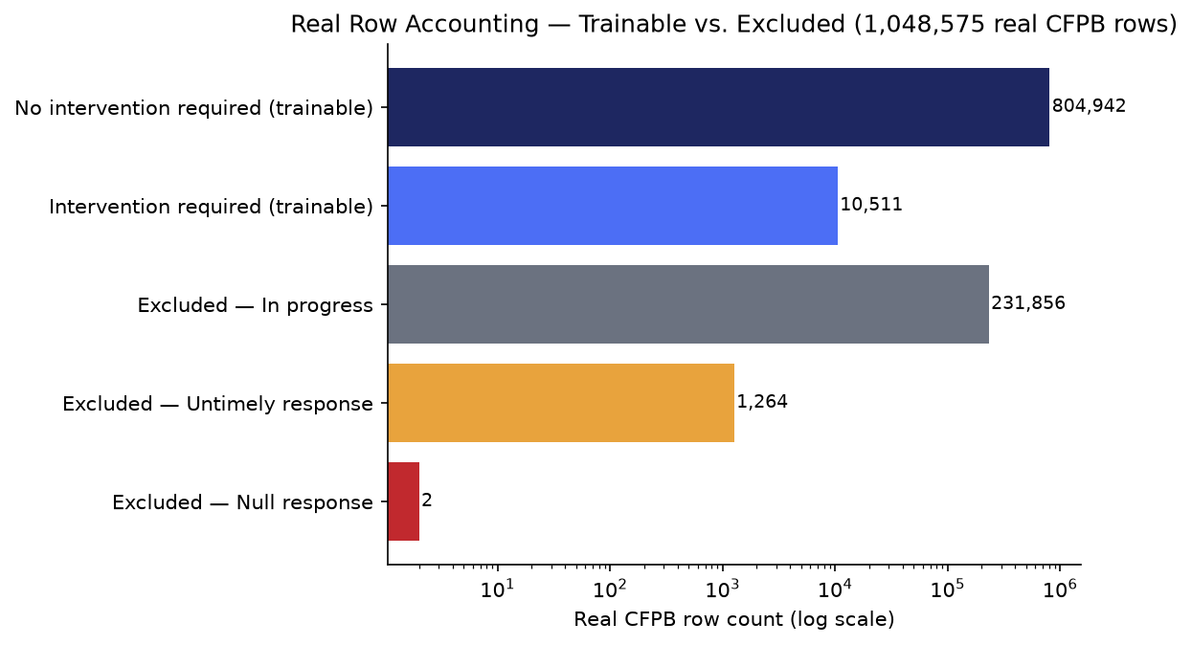
Gate 1 — Business Understanding & Policy (real)
• Primary target: intervention_required
• Real positive-class ratio of trainable rows: 1.29%
• Feature variable candidates: Structured CFPB fields only: Product, Sub-product, Issue, Sub-issue, State, Submitted via, Company (frequency-encoded, HYPER-reusing BP2's o...
• Compliance touchpoint: ECOA / Regulation B - Fair Lending & Adverse Action (Master Plan Section 9; BP3 is one of the four BPs this section explicitly maps to ECOA/Reg B)
• Live check — real CFPB row count: 1,048,575
• Real trainable / excluded rows: 815,453 / 233,122

Slide 4
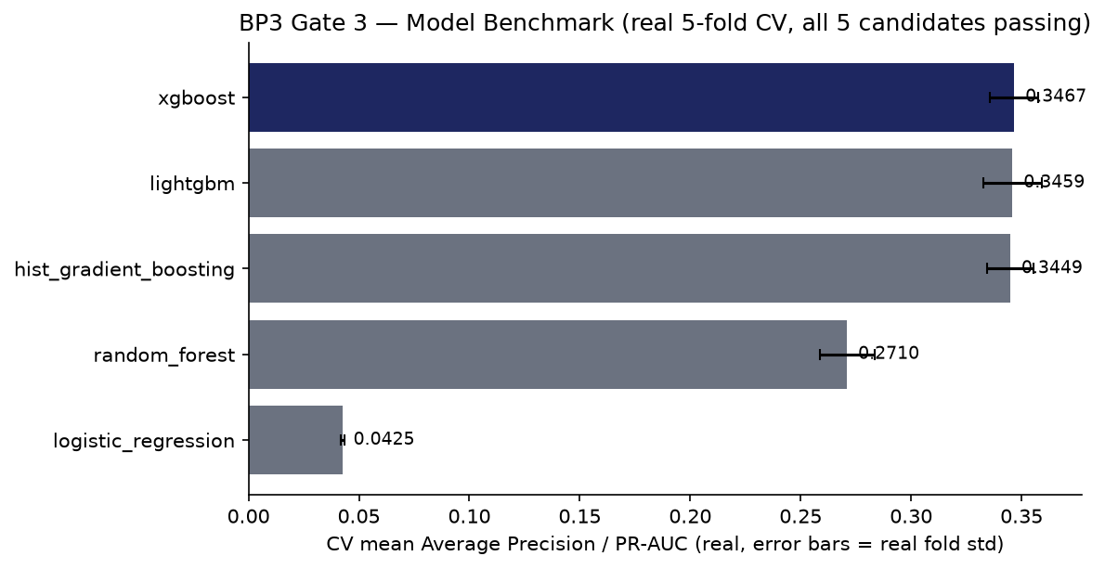
Model Benchmark — Gate 3 (real 5-fold CV, PR-AUC-selected)

Slide 5
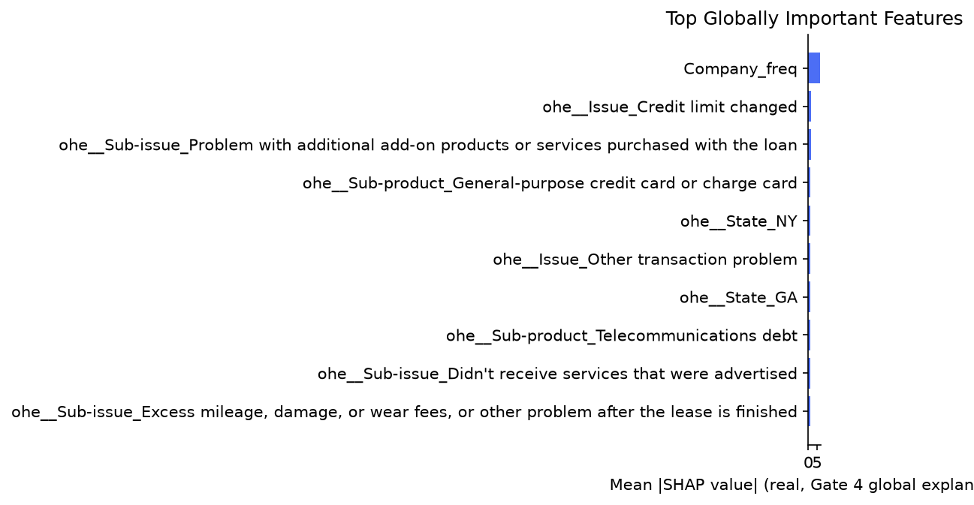
Explainability — Gate 4 (real SHAP)

Slide 6
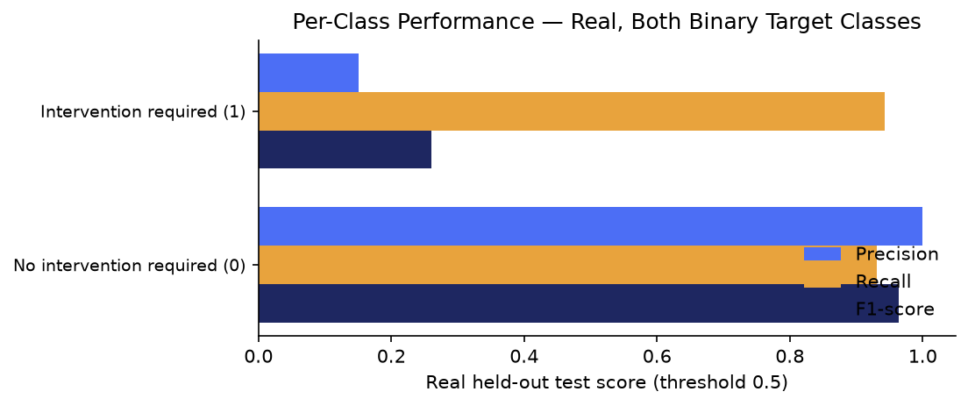
Per-Class Performance — Gate 3 (real, both binary classes)

Slide 7
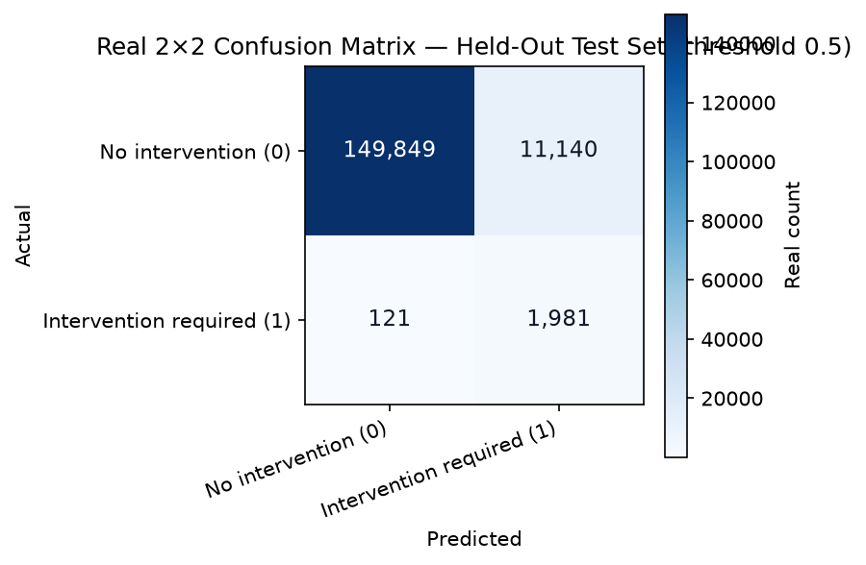
Confusion Analysis — Gate 3 (real, full 2×2 matrix)

Slide 8
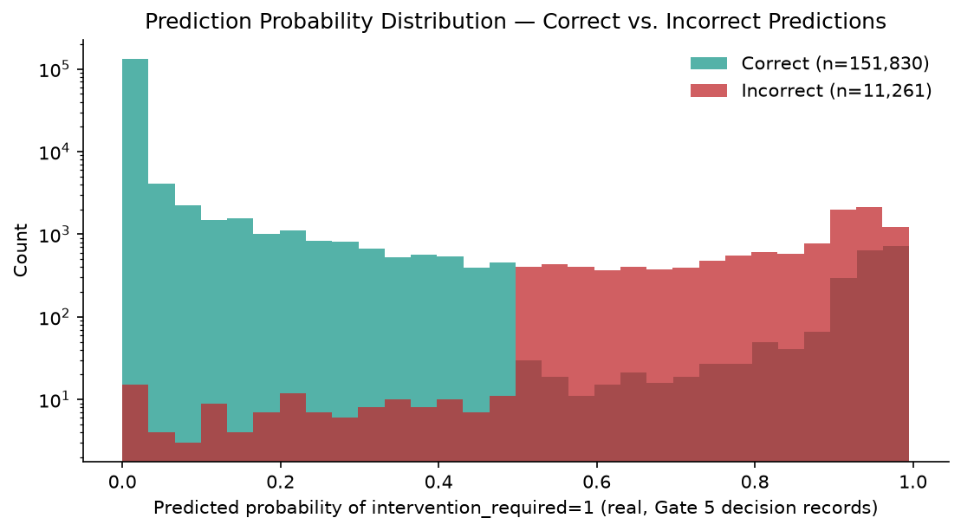
Decision Layer — Gate 5 (real)

Slide 9
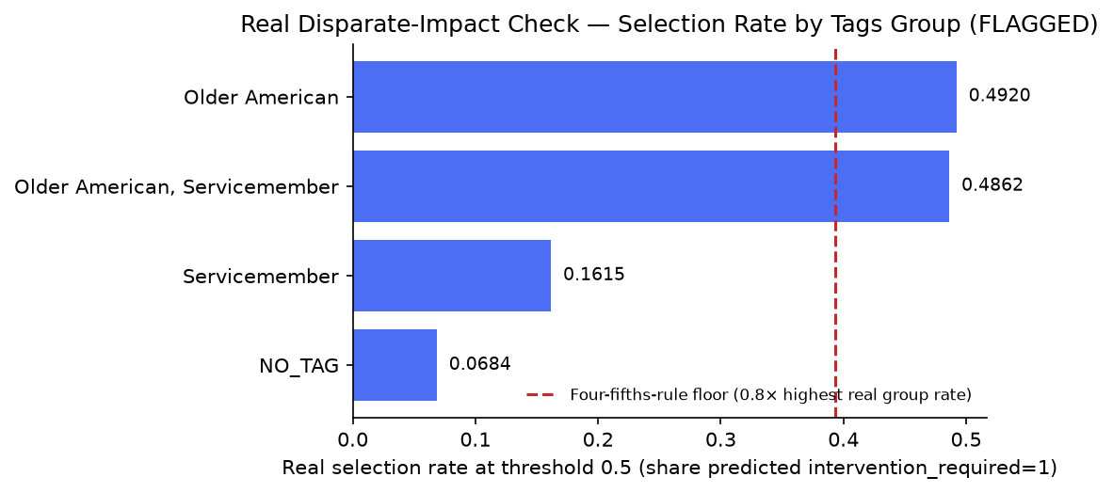
Disparate-Impact Check — ECOA/Reg B (real, FLAGGED)
Adverse-impact ratio 0.139 — lowest real selection rate: NO_TAG (0.0684); highest: Older American (0.492).

Slide 10
SMART Suggestions
Root-cause the 2 real near-zero-recall Gate 3 candidates
Despite passing PR-AUC and ROC-AUC, 2 of the 5 real Gate 3 candidates show near-zero real recall at the default 0.5 threshold: `logistic_regression` (recall 0.0000, PR-AUC 0.0425, ROC-AUC 0.8620) and `hist_gradient_boost... Target: Target: a documented root cause for both candidates' real threshold/recall behavior, or a documented decision that PR-AU...
Governance sign-off required on the real FLAGGED disparate-impact finding
The real, independently-recomputed disparate-impact ratio on the `Tags` field is 0.139 (Gate 4) / 0.139 (Gate 5 recompute, diff=2.4e-05) — below the four-fifths-rule convention threshold of 0.8. Notably in the opposite d... Target: Target: a documented human governance review of this real finding (per Master Plan Section 9's ECOA/Reg B mapping) befor...
Increase SHAP sample size — real overlap is unusually low
Gate 4 and Gate 5 independently computed SHAP importance from two different 150-row samples of real held-out data, and only 1/10 top terms overlapped (`Company_freq`) — markedly lower than BP2's equivalent 4/10 overlap o... Target: Target: overlap of 5/10 or higher at a larger, fixed sample size (re-run both gates with an increased SHAP_SAMPLE_SIZE a...
Decide the real production operating threshold — 0.5 vs. Gate 4's F1-maximizing 0.9
At the default 0.5 threshold, the real held-out recall is 94.24% but real precision is only 15.10% — roughly 85 real false positives for every 15 true positives flagged. Gate 4's own 9-point threshold grid found real F1 ... Target: Target: a documented decision on the real production operating threshold, grounded in the real operational cost of a fal...
Expand grounded reason-code coverage beyond the current SHAP sample bound
Only 150 of 163,091 real decision records (0.092%) currently carry a grounded per-instance reason code, bounded by the 150-row SHAP sample size for laptop safety — a much thinner relative real coverage than BP2's, simply... Target: Target: 100% reason-code coverage once compute budget allows removing the sample bound, or a documented, deliberate samp...

Slide 11
Gate 6 — Governance & Known Limitations (real)
• pytest suite: 189 passed / 0 failed
• Notebook syntax audit: 27/27 passed
• Open item: 0 near-random-PR-AUC + 2 near-zero-recall + 0 failed Gate 3 candidate(s)
• Disparate-impact ratio carried forward: 0.139 (FLAGGED)
• Model card: reports\bp3_complaint_escalation_prediction\MODEL_CARD.md
• Changelog: reports\bp3_complaint_escalation_prediction\CHANGELOG.md
• Gate 3 candidates evaluated: logistic_regression, random_forest, hist_gradient_boosting, xgboost, lightgbm
• BP3 governance gates complete: 6/6

Slide 12
Recommended for Production Status
CONDITIONAL - GOVERNANCE REVIEW REQUIRED
• All 6 BP3 gates are real-run confirmed and every structural integrity check passed (pytest 189 passed / 0 failed, notebook syntax audit all passed, 0 Gate 3 failed candidates). However, the real, independently-recomputed disparate-impact ratio on the `Tags` field is 0.139 — below the four-fifths-rule convention threshold of 0.8. This is a monitoring signal for a human reviewer, not a legal determination of ECOA/Reg B compliance, and is never treated as a hard block — but production use requires explicit governance sign-off first.

