Slide 1
BP4 Customer Journey Analytics
Executive Rollup — Customer360 Navigator Enterprise Suite
Champion pipeline: polars_lazy_streaming | Real speedup: 29.51x | Generated 2026-09-23
Recommended for Production: RECOMMENDED FOR PRODUCTION

Slide 2
Executive Summary — Real KPIs
polars_lazy_streaming
Champion Pipeline
29.51x
Real Speedup
1,048,575
Real Journey Rows
37,160
Real Issue Clusters
41.85%
Recurring-Cluster Rate
0.4652
Mean Response Lag (days)
6.55%
BANKING77 Coverage
219 passed
pytest

Slide 3
Gate 1 — Business Understanding & Policy (real)
• BP4 is event/issue journey analytics, never customer/longitudinal journey analytics - stated in every BP4 deliverable from Gate 1 forward, per Master Plan Section 5.1/7's own explicit instruction for BP4.
• Real CFPB row count (live check): 1,048,575
• Real recurring-cluster rate: 41.85%
• BANKING77-derived coverage: 6.55% of rows
• Compliance touchpoint: CFPB supervisory & complaint-handling standards (Master Plan Section 9; governs all 8 BPs, primarily BP1-BP4)

Slide 4
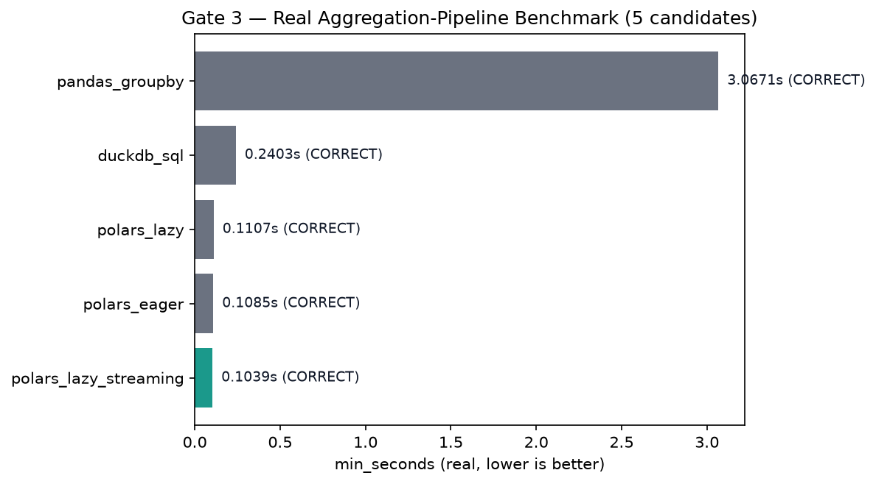
Aggregation-Pipeline Benchmark — Gate 3 (real, speed-selected)

Slide 5
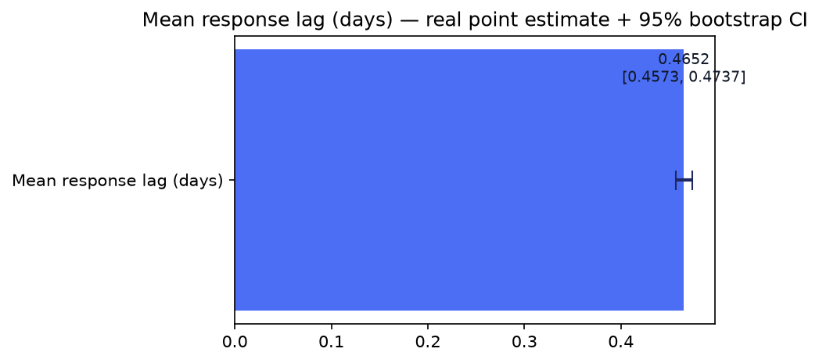
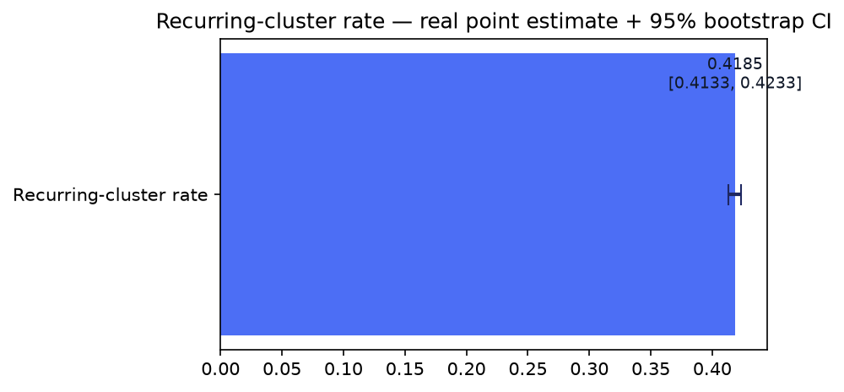
Statistical Validation — Gate 4 (real, bootstrap CI)

Slide 6
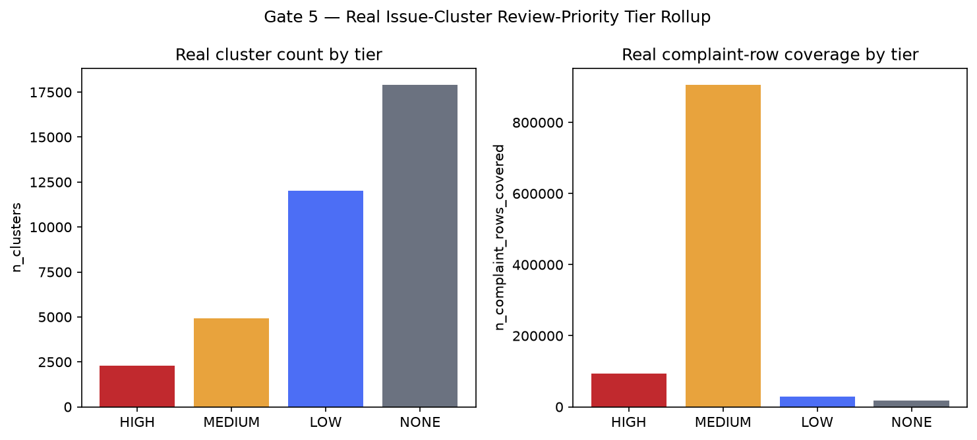
Issue-Cluster Review-Priority Tier Rollup — Gate 5 (real)

Slide 7
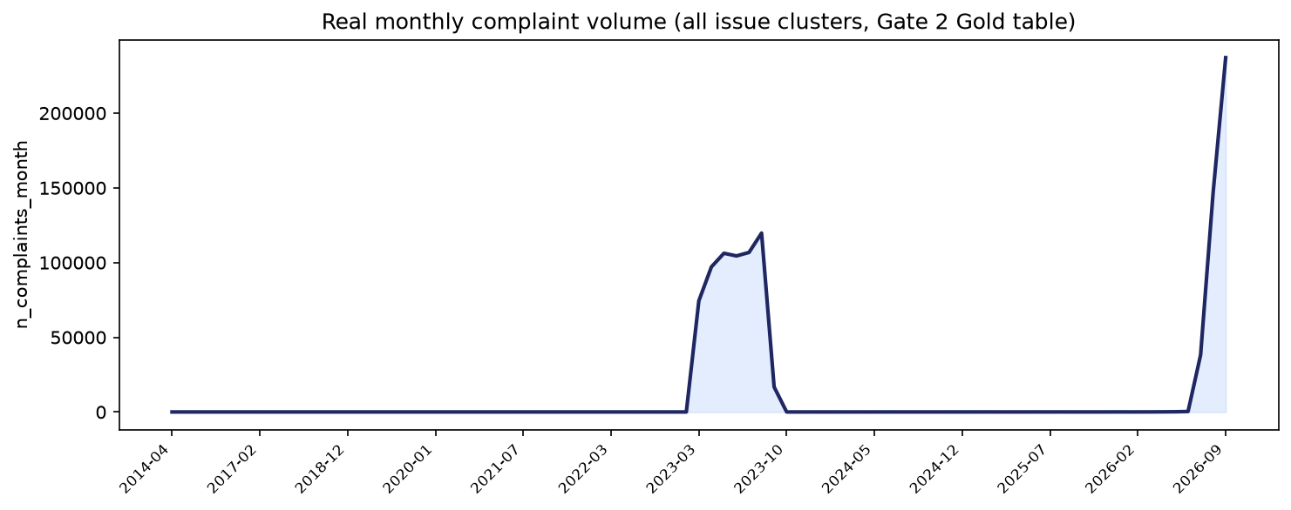
Monthly Complaint-Volume Trend (real, live-aggregated)

Slide 8
SMART Suggestions
Prioritize real HIGH-tier issue clusters for human review first
2,284 real issue clusters carry a HIGH review-priority tier (recurring + elevated-lag + high-volume flags all triggered), covering 94,410 real complaint rows — the smallest cluster count of the four tiers but the one car... Target: 2,284 clusters / 94,410 rows (real Gate 5 tier rollup)....
Reconcile Gate 3's real champion with Gate 2's production pipeline
Gate 3's real full-scale benchmark champion is 'polars_lazy_streaming' (min_seconds=0.103927), which differs from Gate 2's own already-confirmed production implementation 'polars_lazy' (champion_matches_current_productio... Target: Real speedup if adopted: 29.51x over the baseline (pandas_groupby, 3.067079s)....
Expand BANKING77-derived taxonomy coverage beyond its current 6.55%
The Gold-layer common_taxonomy_bucket overlay real-covers only 68,710 of 1,048,575 real rows (6.55%), limiting how much of BP4's real issue-cluster population can be cross-referenced against BANKING77 intent categories i... Target: Raise real in-scope coverage above 6.55% without changing BANKING77's own 77-class scope....
Feed Gate 5's review_priority_score/tier into BP7's cross-BP decision engine as one real input
Gate 5's own compliance note (bp7_decision_engine_boundary) states this BP4-local reporting flag may become one real input BP7's cross-BP priority + intervention-risk decision engine later combines with BP1-BP5's own out... Target: 19,237 of 37,160 real clusters carry grounded reason codes, ready to be combined....
Re-benchmark the real slow-but-correct Gate 3 candidates against future data growth
pandas_groupby, duckdb_sql passed correctness but real min_seconds exceeded 2.0x the champion's own real min_seconds (0.103927s) — expected variation across execution-engine designs at this row count, not a defect, but w... Target: 2 real candidate(s) flagged this run....

Slide 9
Gate 6 — Governance & Known Limitations (real)
• pytest suite: 219 passed / 0 failed
• Notebook syntax audit: 34/34 passed
• Open items: 0 failed + 2 slow-but-correct Gate 3 candidate(s)
• Model inventory (SR 11-7): NOT_APPLICABLE - BP4 registers no trained model
• Model card: reports\bp4_customer_journey_analytics\MODEL_CARD.md
• BP4 governance gates complete: 6/6

Slide 10
Recommended for Production Status
RECOMMENDED FOR PRODUCTION
• All 6 gates real-run confirmed; every structural integrity check across all 6 gates passed (pytest 219 passed/0 failed, notebook-syntax audit all passed, 0 failed Gate 3 candidates, champion pipeline 'polars_lazy_streaming' consistent across Gate 3/Gate 4/Gate 6, real cluster count and row coverage consistent across Gate 1/2/5). Tier 2 (CONDITIONAL - GOVERNANCE REVIEW REQUIRED) is structurally unreachable for BP4: Gate 4's real ecoa_disparate_impact_applicability is NOT_APPLICABLE (BP4's issue-cluster key contains no ECOA/Reg B barred column and Master Plan Section 9 does not map ECOA/Reg B to BP4), so BP4 carries no disparate-impact check that could ever trigger Tier 2 — this differs from BP3, which does run that check and can land in Tier 2.

