Slide 1
BP5 — Root-Cause & Driver Analytics
Executive Rollup | Recommended for Decision-Support Use, With Monitoring | Generated 2026-09-24T11:23:26.431529+00:00

Slide 2
Executive KPIs
• Top field — Outcome 1: Sub-issue (Cramer's V=0.4156)
• Top field — Outcome 2: Sub-product (Cramer's V=0.1645)
• Held-out ROC-AUC — Outcome 1: 0.9705
• Held-out ROC-AUC — Outcome 2: 0.9526
• UDAAP language check: PASSED
• Negligible-strength fields detected: 2
• Near-zero-precision outcomes detected: 1
• ECOA/Reg B disparate-impact applicability: NOT_APPLICABLE

Slide 3
Gate 1 — Business Understanding & Policy
• Master Plan Section 6 (Integration Architecture) names 'CFPB outcome fields' (plural) feeding BP3/BP5 - BP5 draws on that same real CFPB outcome-field family BP3's Gate 1 already defined and used, not a different data source. BP5 tests real product/issue/process fields for statistical association against TWO real, distinct outcome fields (below), not one - grounded live in Section 6's outcome-fiel

Slide 4
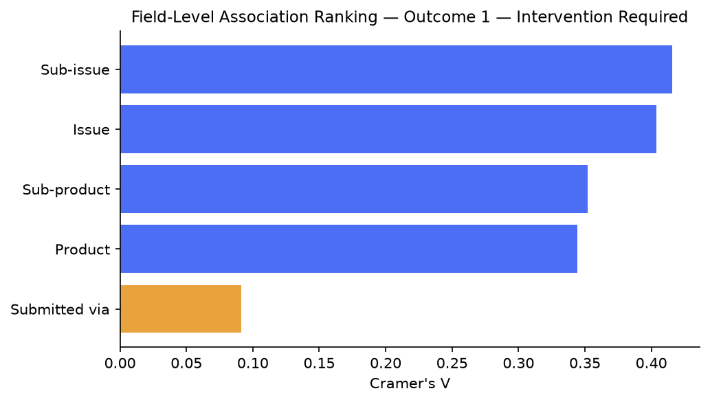
Field-Level Association — Outcome 1 — Intervention Required

Slide 5
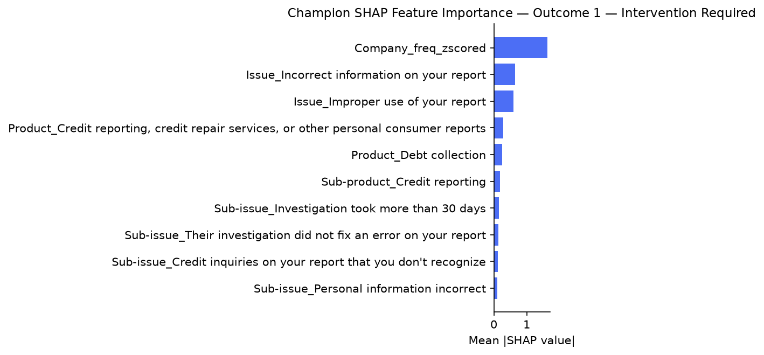
SHAP Feature Importance — Outcome 1 — Intervention Required

Slide 6
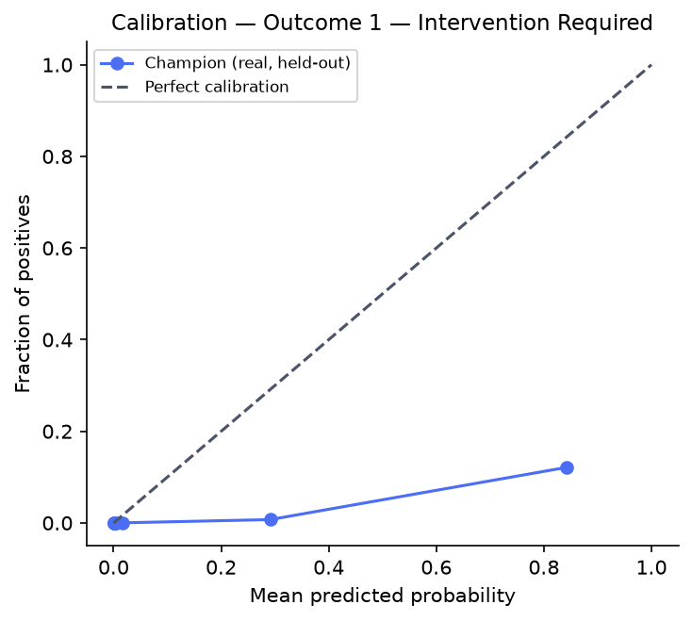
Calibration — Outcome 1 — Intervention Required

Slide 7
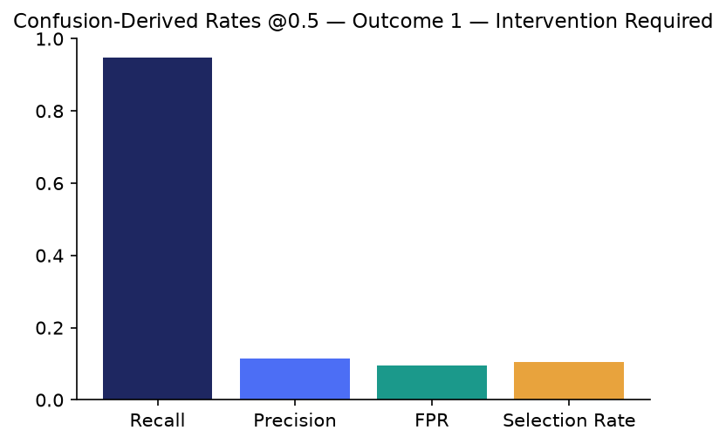
Confusion-Derived Rates @0.5 — Outcome 1 — Intervention Required

Slide 8
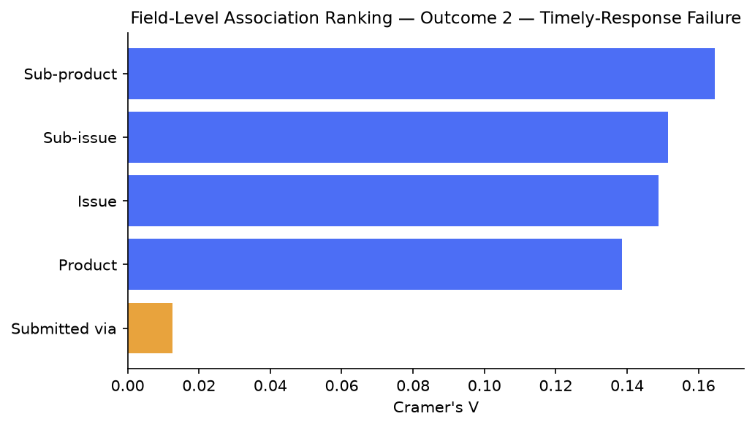
Field-Level Association — Outcome 2 — Timely-Response Failure

Slide 9
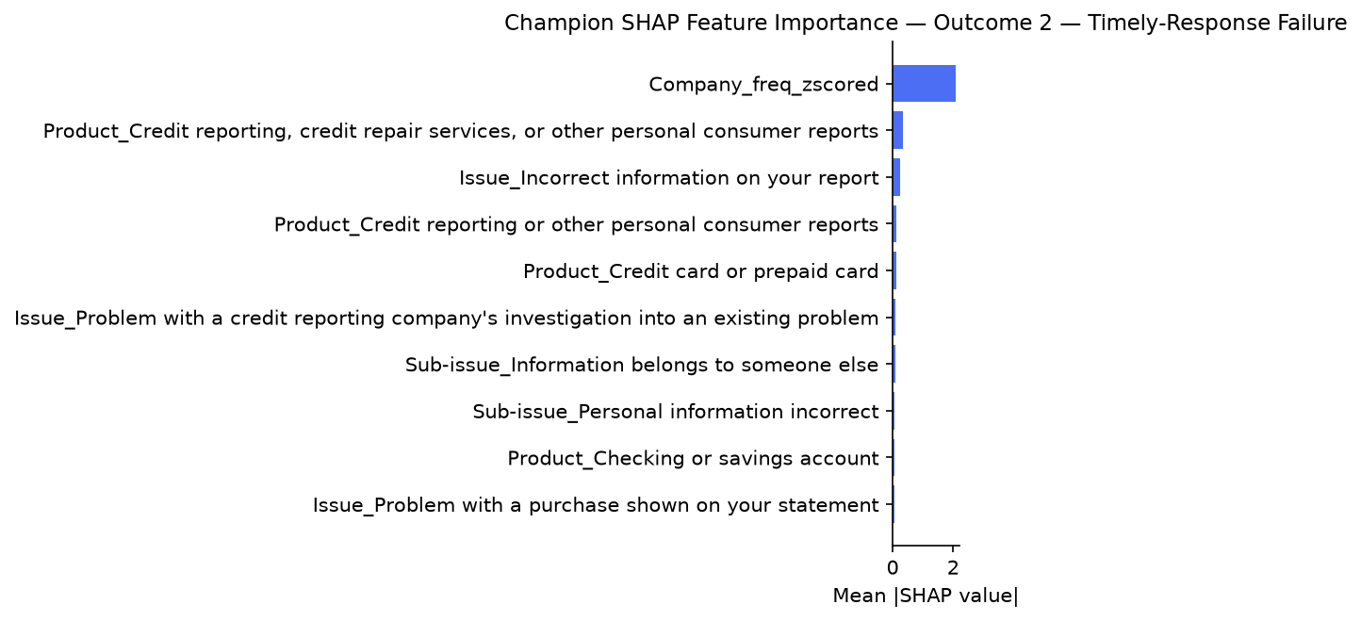
SHAP Feature Importance — Outcome 2 — Timely-Response Failure

Slide 10
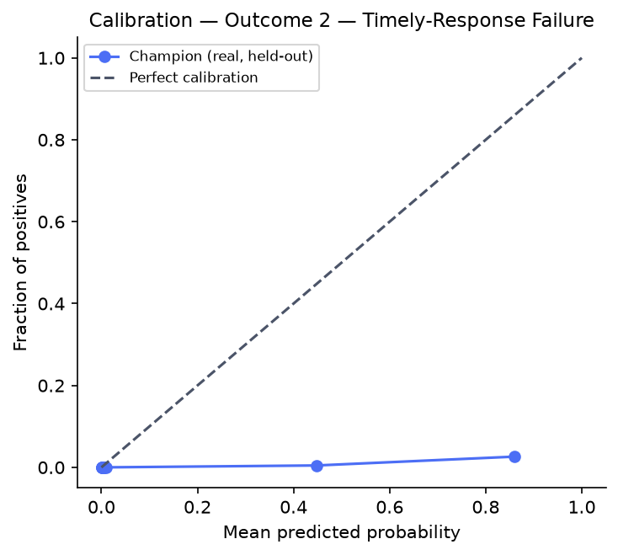
Calibration — Outcome 2 — Timely-Response Failure

Slide 11
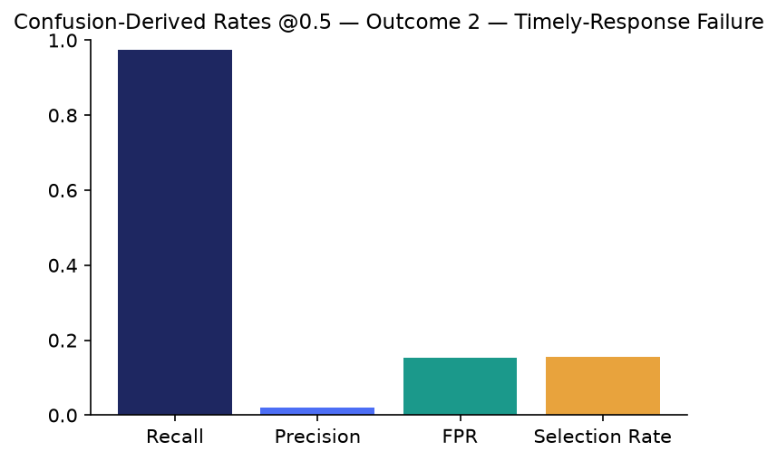
Confusion-Derived Rates @0.5 — Outcome 2 — Timely-Response Failure

Slide 12
Gate 6 — Governance & Known Limitations
• pytest: ================ 325 passed, 3 skipped, 182 warnings in 9.51s =================
• Notebook syntax check: 51 passed / 0 failed
• Barred-fields bar relaxed: False

Slide 13
SMART Suggestions
• Review the two real negligible-association candidate fields
• Review outcome_2's near-zero precision at the default 0.5 threshold
• Maintain the mechanical UDAAP language review cadence
• Formal governance review of the 3 barred candidate fields' real diagnostics
• Deep-dive the Company (frequency-encoded) driver - the strongest SHAP feature for both outcomes

Slide 14
Recommendation: Recommended for Decision-Support Use, With Monitoring
• All structural checks passed. 3 real open item(s) were live-detected by Gate 6 (2 negligible-association candidate field(s), 0 near-random PR-AUC outcome(s), 1 near-zero-precision-at-0.5 outcome(s)) - none of these block use, but each is a real, disclosed monitoring item a human reviewer should be aware of before acting on this report's findings. This is a monitoring signal, never a legal or compliance determination.

