Slide 1
BP6 — GenAI Resolution Assistant
Executive Rollup | RECOMMENDED FOR PRODUCTION | Generated 2026-09-24T17:09:51.901460+00:00

Slide 2
Executive KPIs
• Champion retrieval strategy: taxonomy_bucket_match (coverage=0.3333)
• Bootstrap 95% CI: [0.0000, 0.6667]
• PII rows screened / flagged: 13,083 / 0
• Citations used / available: 4 / 28
• NIST AI RMF risk category: MEDIUM
• Approval status: PENDING_HUMAN_REVIEW (auto_applied=False)
• Gate 6 FastAPI self-test identical: True
• ECOA/Reg B disparate-impact applicability: NOT_APPLICABLE

Slide 3
Gate 1 — Business Understanding & Policy
• Retrieve structured evidence from BP1-BP5's real outputs, summarize it, and recommend a next action with a citation/evidence field on every claim, per Master Plan Section 5.1/7 - human-in-the-loop approval required before any recommendation is treated as final.

Slide 4
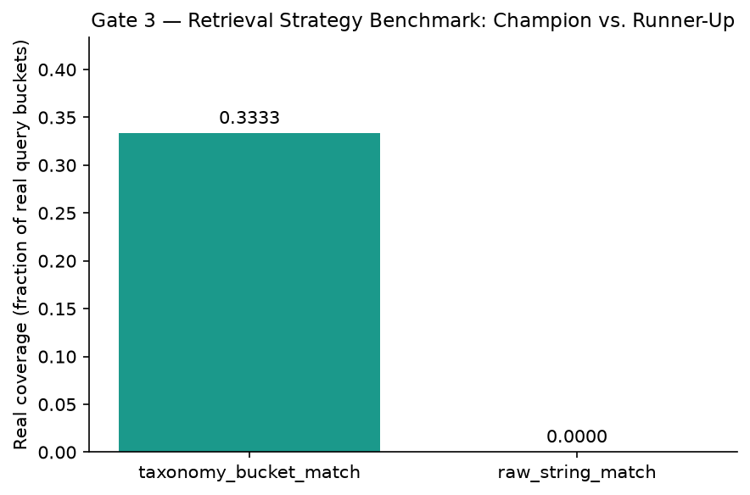
Gate 3 — Retrieval Strategy Benchmark

Slide 5
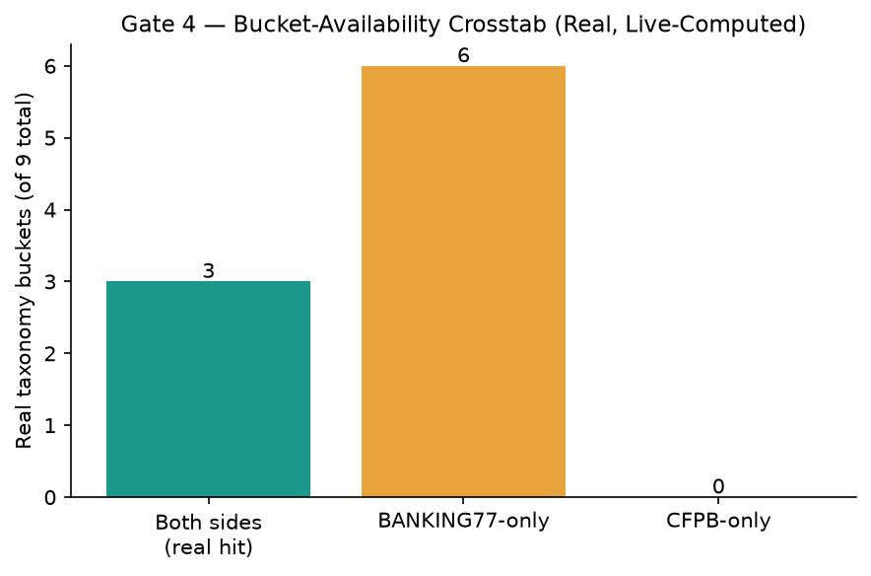
Gate 4 — Bucket-Availability Crosstab

Slide 6
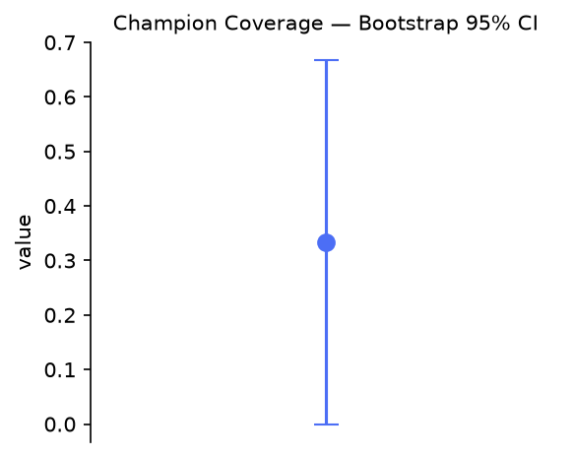
Gate 4 — Bootstrap CI on Champion Coverage

Slide 7
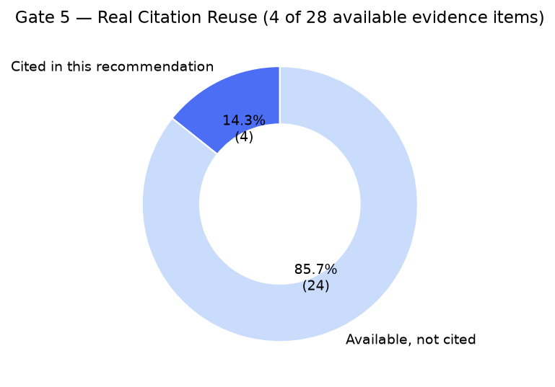
Gate 5 — Real Citation Reuse

Slide 8
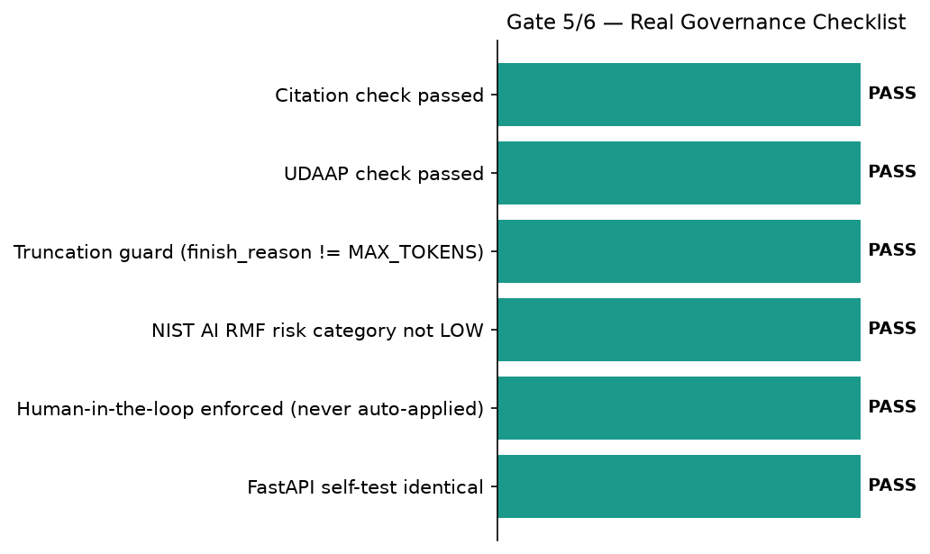
Gate 5/6 — Real Governance Checklist

Slide 9
Gate 5 — GenAI Recommendation (quoted verbatim)
• “To address this unrecognized withdrawal report, we should review BP4, which utilizes a polars_lazy_streaming champion pipeline [EV-BP4-1] and is currently recommended for the production tier [EV-BP4-2]. Additionally, we should note that BP4 represents two slow but correct candidates from gate 3 [EV-BP4-5] and embeds 7,204 high and medium tier clusters [EV-BP4-6]. Please verify these system specifications before initiating the standard investigation process for the customer's transaction.”

Slide 10
Gate 6 — Governance & Known Limitations
• pytest: ================ 363 passed, 6 skipped, 182 warnings in 21.06s ================
• Notebook syntax audit returncode: 0
• FastAPI self-test identical: True
• Open item — low citation-reuse ratio detected: True
• Open item — model drift vs. Gate 5 saved artifact: True

Slide 11
SMART Suggestions
• Expand taxonomy-bucket coverage beyond the 3 real cross-corpus hits
• Review the low real citation-reuse ratio as a governance signal
• Monitor the real Gemini model-drift disclosure between Gate 5 and Gate 6
• Maintain the mechanical UDAAP + citation-grounding review cadence
• Keep the human-in-the-loop approval gate mandatory as BP6 scales

Slide 12
Recommendation: RECOMMENDED FOR PRODUCTION
• All 6 gates real-run confirmed (each gate's own config marker block present with a real generated_at_utc timestamp); every real structural/governance check passed (pytest 363 passed/0 failed, notebook-syntax audit all passed, retrieval champion 'taxonomy_bucket_match' agrees across Gate 3/Gate 4, coverage independently reproduces exactly, leakage reconfirmed, citation/UDAAP checks passed, finish_reason='FinishReason.STOP' (never truncated), NIST AI RMF risk category 'MEDIUM' (never LOW), human-in-the-loop enforced (approval_status=PENDING_HUMAN_REVIEW, auto_applied=False), and Gate 6's own real FastAPI self-test reported identical=True). Tier 2 (CONDITIONAL - GOVERNANCE REVIEW REQUIRED) is structurally unreachable for BP6: Gate 4's real ecoa_reg_b_status is NOT_APPLICABLE (BP6's real inputs - BANKING77's text/category columns and the real common_taxonomy_bucket join field - carry no ECOA/Reg B protected-class or demographic-adjacent field), so BP6 carries no disparate-impact check that could ever trigger Tier 2 - this differs from BP3, which does run that check and can land in Tier 2, and matches BP4's own precedent exactly.

