Slide 1
BP7 — Customer Navigator Decision Engine
Executive Rollup | RECOMMENDED FOR PRODUCTION | Generated 2026-09-25T07:45:22.492499+00:00

Slide 2
Executive KPIs
• Champion rule scheme: correlation_aware_plus_lr_diagnostic
• Champion weights (BP2/BP3/BP4): 0.2227 / 0.1708 / 0.6065
• Real intervention_flag rate: 0.7684 [0.7676, 0.7692]
• Gate 4 reproduction bit-exact: True
• Exact contribution reconstruction: True (max_abs_error=0.0)
• ECOA/Reg B disparate-impact ratio: 0.908127 (flagged=False)
• Real decision records scored: 1,048,575 (100.0%)
• Gate 6 FastAPI self-test all checks passed: True
• GenAI API used (any gate): False

Slide 3
Gate 1 — Business Understanding & Policy
• NOT a single trained ML target. Per Master Plan Section 5.1/7, BP7 is a transparent, auditable decision-rule layer that combines BP1-BP5's own already-computed prediction fields into three output fields per in-scope complaint: priority_score, intervention_flag, and recommended_action - every row also carrying reason_codes and the exact thresholds applied. See this notebook's markdown cell 'The transparent-scoring-vs-model tension, resolved' for the full reasoning.

Slide 4
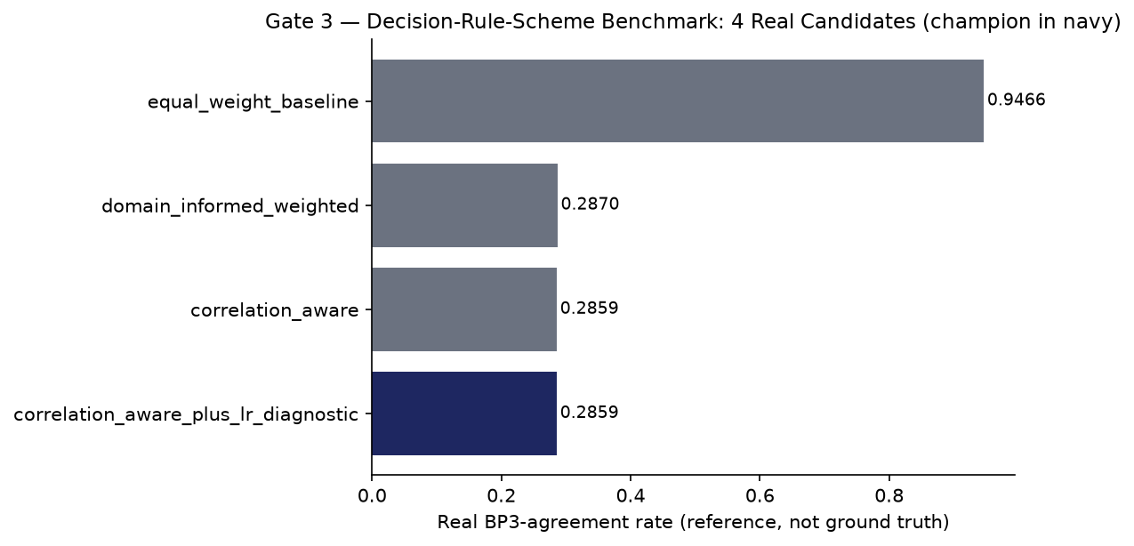
Gate 3 — Decision-Rule-Scheme Benchmark & Champion Selection

Slide 5
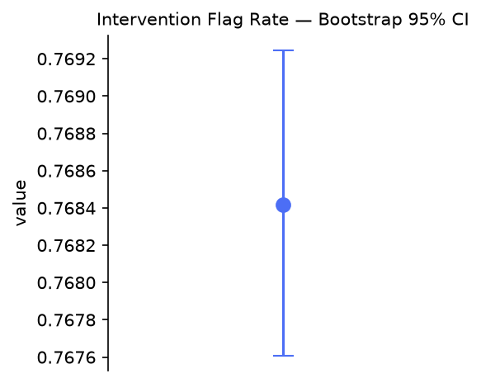
Gate 4 — Bootstrap 95% CI: intervention_flag Rate

Slide 6
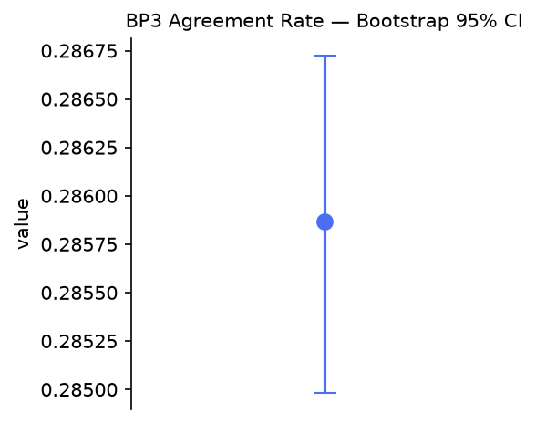
Gate 4 — Bootstrap 95% CI: BP3-Agreement Rate

Slide 7
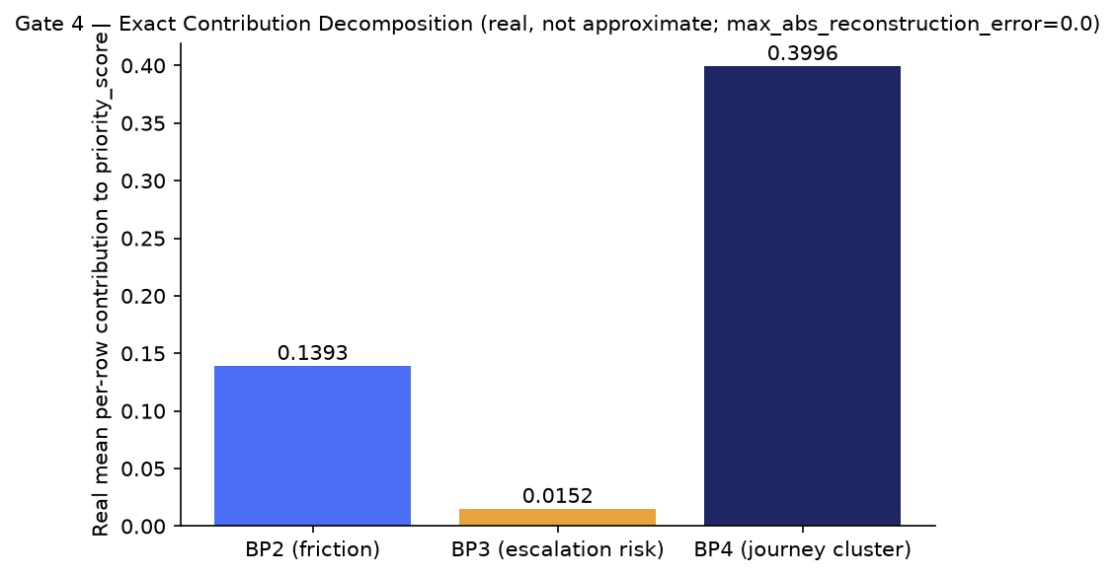
Gate 4 — Exact Contribution Decomposition (BP7's transparent stand-in for SHAP)

Slide 8
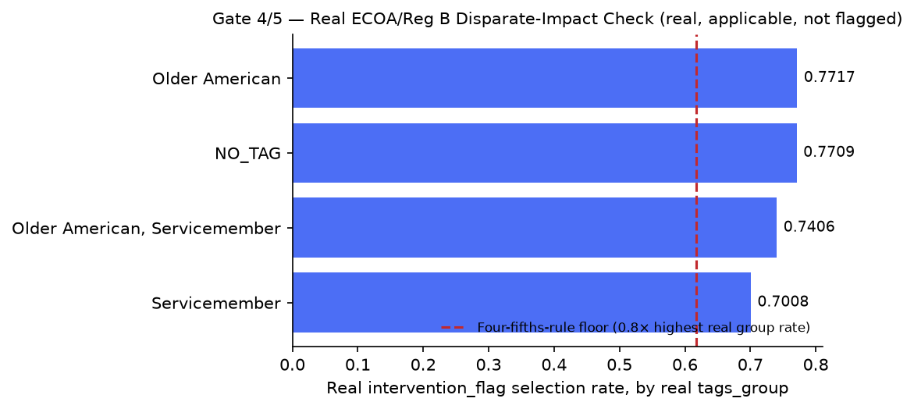
Gate 4/5 — Real ECOA/Reg B Disparate-Impact Audit

Slide 9
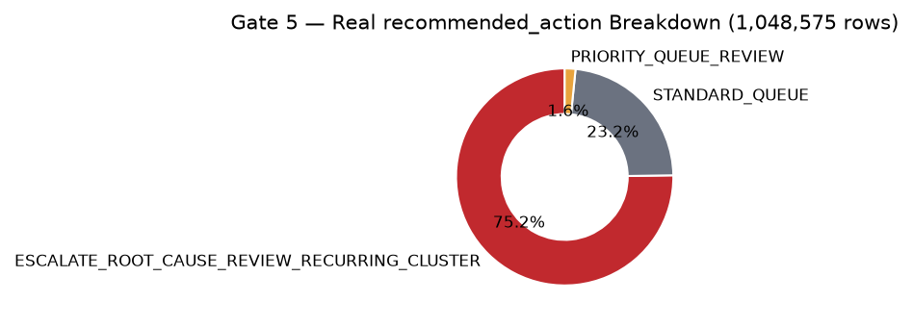
Gate 5 — Real recommended_action Breakdown

Slide 10
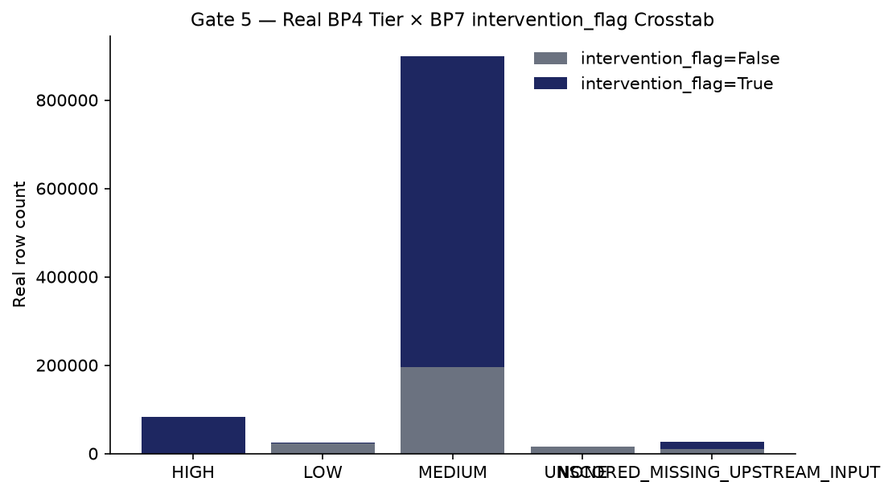
Gate 5 — Real BP4 Tier × Intervention Crosstab

Slide 11
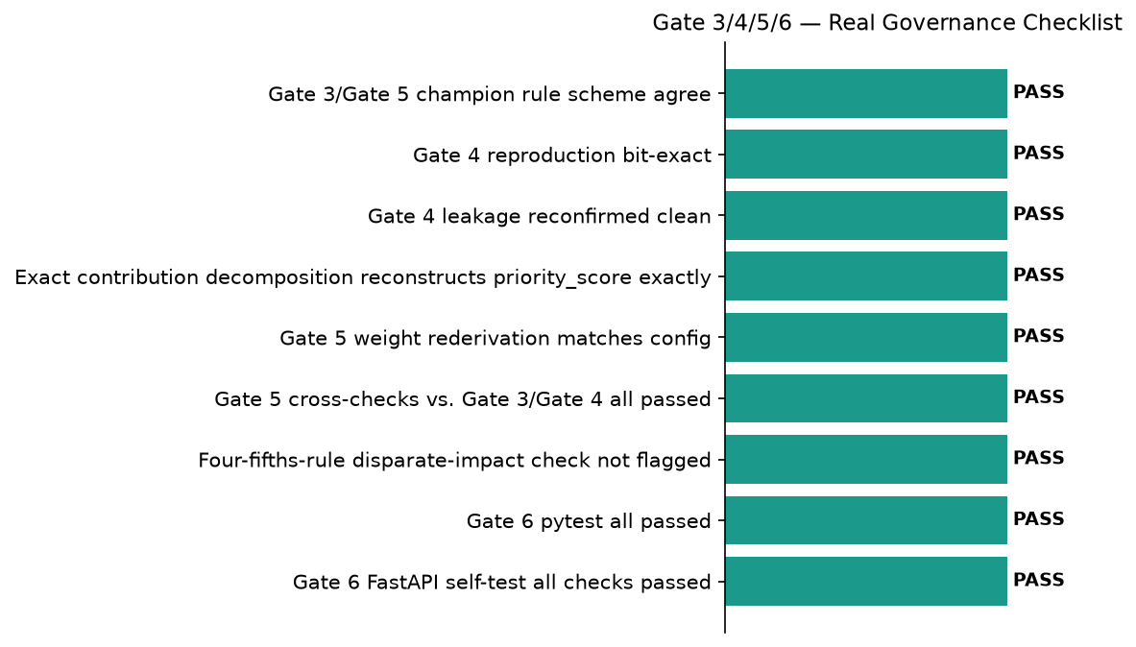
Gate 3/4/5/6 — Real Governance Checklist

Slide 12
Gate 6 — Governance & Known Limitations
• pytest: ================ 410 passed, 3 skipped, 182 warnings in 13.74s ================
• Notebook syntax audit returncode: 0
• FastAPI self-test all checks passed: True
• Open item — BP4 unscored rate detected: True (rate=0.024632)
• Open item — low BP3-agreement rate detected: True (rate=0.285865)

Slide 13
SMART Suggestions
• Resolve the real 2.46% BP4-unscored rate before wider rollout
• Review the real, low BP3-agreement rate as a governance/interpretability signal
• Expand real BP1 optional-context coverage beyond the current 6.55%
• Maintain the real four-fifths-rule disparate-impact monitoring cadence
• Integrate BP5's real driver-association output once it clears its own Gate 1

Slide 14
Recommendation: RECOMMENDED FOR PRODUCTION
• All 6 gates real-run confirmed (each gate's own config marker block present, combined with a real confirming generated_at_utc timestamp - Gates 2-4 checked against their own artifact JSON's timestamp per this BP's real flat-config shape, Gates 5-6 checked against the config's own gate5_generated_at_utc/gate6_generated_at_utc fields); every real structural/governance check passed (pytest 410 passed/0 failed, notebook-syntax audit all passed, Gate 3/Gate 5 champion rule scheme 'correlation_aware_plus_lr_diagnostic' agrees, Gate 4's independent reproduction of Gate 3's entire champion-selection pipeline is bit-exact, leakage reconfirmed clean, the exact contribution decomposition reconstructs priority_score exactly (max_abs_reconstruction_error=0.0), Gate 5's weight rederivation matches the config and all 4 Gate 3/Gate 4 cross-checks passed, and Gate 6's own real FastAPI self-test reported all_checks_passed=True); and the real, independently re-derived-at-Gate-5 four-fifths-rule disparate-impact check is NOT flagged (adverse_impact_ratio=0.908127, above the 0.8 four-fifths-rule convention threshold). Tier 2 (CONDITIONAL - GOVERNANCE REVIEW REQUIRED) is genuinely reachable for BP7 - unlike BP4's/BP6's own NOT_APPLICABLE ECOA/Reg B finding, BP7 DOES run a real disparate-impact check (resolved at Gate 4 after an honest Gate 3 deferral) - it is simply not triggered on this real run's own numbers.

