Slide 1
Fraud Detection Platform
Executive Rollup — Real Results, NB1–NB9
Prepared by Nandagopal | 2026-09-13 | Zero-fabrication policy

Slide 2
Executive Summary
Every figure below is loaded verbatim from NB1–NB9's real on-disk outputs
• Champion model: CatBoost (CV PR-AUC 0.8482, temporal-split 0.7692)
• Savings vs. no model: EUR 199,995.35 (approx. USD 231,834.61) | vs. naive threshold: EUR 7,865.08 (approx. USD 9,117.20)
• Model tier: Tier 2 — Moderate materiality -- proportionate, standard oversight (composite 5/9)
• BCBS 239 data-quality gate: 6/6 checks passed on 284,807 real rows
• Governance sign-off readiness: 21/30 checks Pass (5 outside pipeline scope)
• Real local API latency: p99 5.10 ms

Slide 3
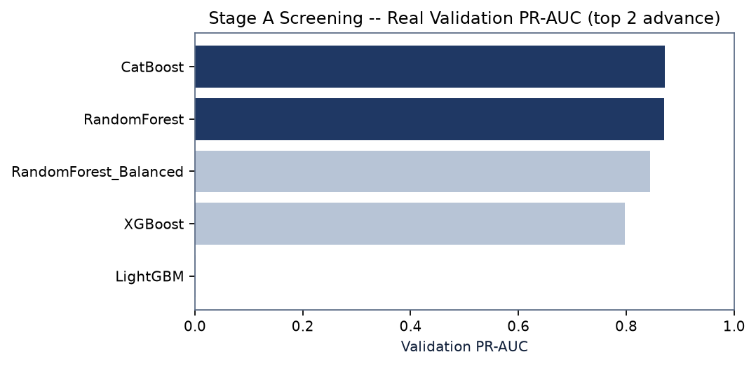
Model Screening & Validation
NB1 — 5 real candidates screened, champion selected by 5-fold CV
• Champion: CatBoost vs. runner-up RandomForest
• Temporal PR-AUC 0.7692 vs. CV 0.8482 — real, disclosed gap
• Benchmark investigate_flag: True (precision gap -23.82%)

Slide 4
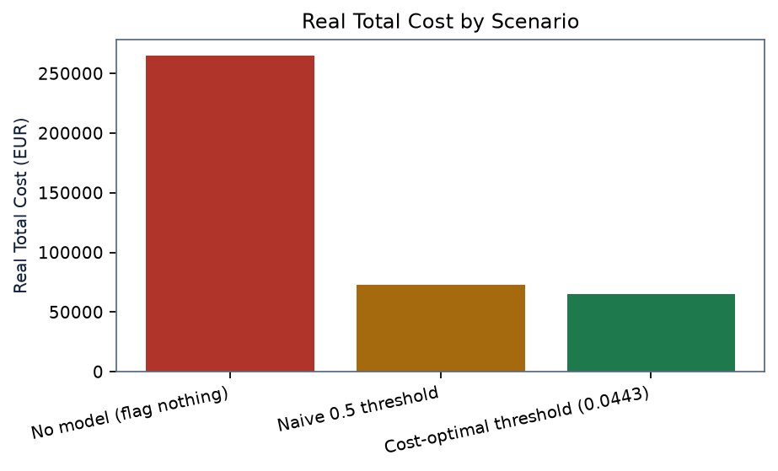
Cost-Optimal Threshold & Financial Impact
NB1 real measured totals
• No model (flag nothing): EUR 265,164.35 (approx. USD 307,378.51)
• Naive 0.5 threshold: EUR 73,034.07 (approx. USD 84,661.10)
• Cost-optimal threshold (0.0443): EUR 65,169.00 (approx. USD 75,543.90)

Slide 5
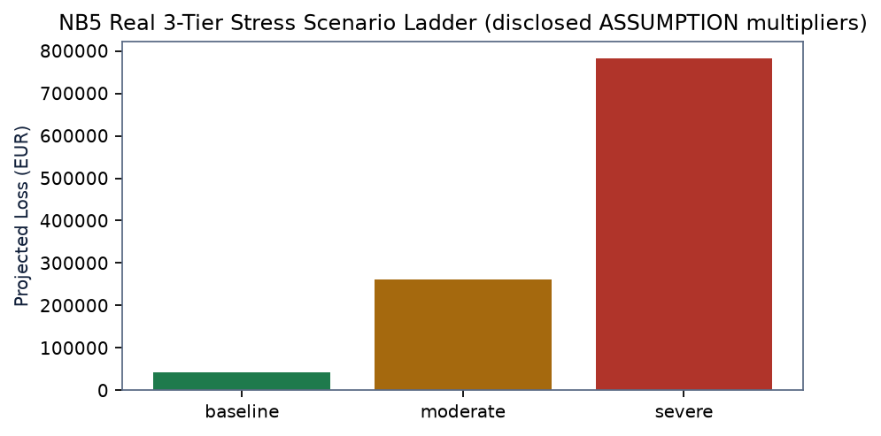
Deepened Stress Testing
NB5 real 3-tier ladder + 105-combo grid sweep
• Worst of 105 swept combinations: volume x4.0, fraud-rate x8.0 -> EUR 1,390,976.41 (approx. USD 1,612,419.85)
• Reverse stress: 3.00x fraud-rate needed to double today's real cost

Slide 6
Governance Sign-Off Readiness
NB9 real evidence-populated 4-tier dry-run — no decision fabricated
Tier | Pass | Conditional | Outside Scope
1 — Technical Lead | 10/12 | 2 | 0
2 — Model Risk Manager | 7/7 | 0 | 0
3 — CCO | 2/5 | 1 | 2
4 — Business Owner | 2/6 | 1 | 3
• Every Approve/Conditional/Reject checkbox and Name/Date/Signature field is left exactly blank — this package assembles real evidence, it does not fabricate a human decision.

Slide 7
SMART Decisions by Role
Auto-derived from real flags across NB1–NB9
CEO / Board — Approve continued investment in the fraud-detection program
Real basis: Measured savings vs. no model: EUR 199,995.35 (approx. USD 231,834.61) over the real 284,807-transaction sampled window. Classified Moderate materiality -- proportionate, standard oversight (Tier 2, composite score 5/9).
Conditional — 4 of 30 governance sign-off checks (NB9) are marked outside this pipeline's scope -- real organizational facts, not model gaps. (Source: NB1, NB6, NB9)
CFO — Book projected fraud-loss savings into the budget
Real basis: Real total cost by scenario -- no model EUR 265,164.35 (approx. USD 307,378.51), naive threshold EUR 73,034.07 (approx. USD 84,661.10), cost-optimal EUR 65,169.00 (approx. USD 75,543.90).
Conditional — Figures are real totals over the sampled ~48-hour window, not annualized -- NB6 explicitly disclosed that annualizing would require a representativeness assumption this project has not sourced. (Source: NB1, NB6)

Slide 8
SMART Decisions by Role
Auto-derived from real flags across NB1–NB9
Chief Risk Officer (CRO) — Accept the model into risk appetite at Tier 2
Real basis: Worst-case NB5 stress-grid loss is 21.3x today's real cost (EUR 65,169.00 (approx. USD 75,543.90) -> EUR 1,390,976.41 (approx. USD 1,612,419.85)). 2 open regulatory-scrutiny flags.
Conditional — NB2 real drift monitoring any_alert=True (worst real feature PSI 1.4298) -- resolve before treating Tier 2 as steady-state. (Source: NB2, NB5, NB6)
Chief Compliance Officer (CCO) — Sign off on the regulatory applicability assessment
Real basis: 4 real frameworks mapped (BSA/SAR, Reg E, GLBA Safeguards, PSD2 SCA). BCBS 239 data-quality gate: 6/6 checks passed on 284,807 real rows.
Conditional — Data architecture, Completeness remain limitation-disclosed, not evidenced. (Source: NB7, NB8)

Slide 9
SMART Decisions by Role
Auto-derived from real flags across NB1–NB9
CTO / Head of Data & Analytics — Approve production deployment of the real-time scoring service
Real basis: Real local API: p99 client latency 5.10 ms. Training/serving consistency check: max abs diff 0.0 over 500 real rows.
Go — Health check and train/serve consistency both real-verified PASS; latency is a local signal only, not yet a reachable production deployment. (Source: NB4)
Head of Fraud Operations — Adopt the cost-optimal decision threshold operationally
Real basis: Threshold 0.0443 -> real precision 69.51%, real recall 82.93%. Human-review band (ASSUMPTION +/-0.02): 51 of 284,807 real transactions routed for manual review.
Go — Threshold is real and vectorized-search-verified (NB1); review band is a disclosed ASSUMPTION, not a measured optimum. (Source: NB1, NB8)

Slide 10
SMART Decisions by Role
Auto-derived from real flags across NB1–NB9
Model Risk Manager — Complete Tier 2 (second-line) model-risk documentation
Real basis: NB9 real evidence: Tier 2 checks 7/7 Pass (methodology, environment pinning, RANDOM_SEED=42 consistency, fairness-scope disclosure, known limitations, challenger model, model card).
Go — All 7 Tier 2 checks pass on real evidence (NB9) -- ready for a real human Model Risk Manager signature. (Source: NB9)
Technical Lead / Data Science — Resolve the open external-benchmark investigate flag
Real basis: investigate_flag=True, precision_gap=-23.82% vs. external reference (your precision 69.51% vs. reference 93.33%).
Conditional — Large positive gaps may indicate leakage; large negative gaps may indicate a bug — investigate before trusting either. (Source: NB1)

