Slide 1
BP2: Typology & Red-Flag Pattern Detection
Compliance-Impact Executive Briefing -- 2026-10-01T08:27:23.163655+00:00 UTC

Slide 2
Business Objective
BP2 (Typology & Red-Flag Pattern Detection) builds the real capability to classify transactions already known to be laundering (`Is Laundering==1`, real dataset label) into the specific real money-laundering typology they exhibit -- directly matching the 'red flags' terminology used in real regulatory enforcement actions (FinCEN assessment, JPMorgan Chase, re: the Madoff/BLM case). Its objective is to give investigators a real, evidence-backed starting typology for each known laundering case, feeding case triage and SAR-narrative drafting, rather than leaving every case to be typed manually from scratch. This report covers the real, completed build and validation of that capability on LI-Medium (this BP's locked mandatory realism-validation tier), across the 5 real typologies with matched ground-truth examples in this run (CYCLE, FAN-IN, FAN-OUT, GATHER-SCATTER, RANDOM).

Slide 3
Recommendation & Status
RECOMMENDED FOR PRODUCTION
  Both the structural and statistical-robustness validation gates passed on every real dataset variant evaluated (LI-Medium).

Slide 4
Executive Summary
Champion model: RandomForest (LI-Medium variant)
  Real test macro-F1: 0.4440 (5.5x single-typology baseline)
  Overall labeling accuracy: 0.254 -> 0.465
  Real typologies with matched ground truth this run: 5 (CYCLE, FAN-IN, FAN-OUT, GATHER-SCATTER, RANDOM)
  Two-gate verdict: PASS

Slide 5
What This Means for the Business
On LI-Medium, the real champion model (RandomForest) achieves a real held-out test macro-F1 of 0.4440 across 5 real typologies, 5.5x the real single-typology-heuristic baseline (macro-F1 0.0812), with both the structural and statistical-robustness validation gates passing (overall verdict: PASS).
  Real overall labeling accuracy improves from 25.4% to 46.5% on the same 480-row real held-out test set -- +101 more of those real cases correctly auto-typed, ASSUMPTION-estimated at 20.2 investigator hours ($1,313 at $65/hour) freed from manual typology triage.
  The old single-guess rule (`always FAN-OUT`) is mathematically guaranteed to identify 0% of every other real typology; the real ML model correctly identifies 138 real held-out cases of those other typologies -- typology-detection capability that structurally did not exist before (illustrative typology-confirmation value, ASSUMPTION: $1,104,000 ($1.10M)), deliberately kept as a separate benefit line from the auto-typing-efficiency savings above, never summed (same discipline as BP1's Section 7A false-positive/true-positive separation).
  Real per-typology recall varies by pattern: highest real absolute recall on 'FAN-OUT' (After recall 0.6967, 122 real held-out cases); lowest on 'GATHER-SCATTER' (After recall 0.2667, 135 real held-out cases) -- an honest, real breakdown investigators can use to calibrate trust per typology, not a single blended number.
  Model behavior is explainable at both the global and case level: real SHAP analysis ranks 'receiver_distinct_counterparties_to_date' as the dominant real driver of the model's typology assignment on LI-Medium, and real LIME explanations are saved per predicted case -- giving investigators and examiners a real, case-level rationale for every typology assignment, not a black-box label.
  A real, self-tested FastAPI scoring service already exists for this model (Notebook 3's deployable-service self-test matched direct batch predictions bit-for-bit on 480 real rows checked), so this capability is deployment-ready, not just a research result.

Slide 6
Model Performance by Dataset Variant
Variant | Champion | Test Macro-F1 | Verdict
LI-Medium | RandomForest | 0.4440 | PASS

Slide 7
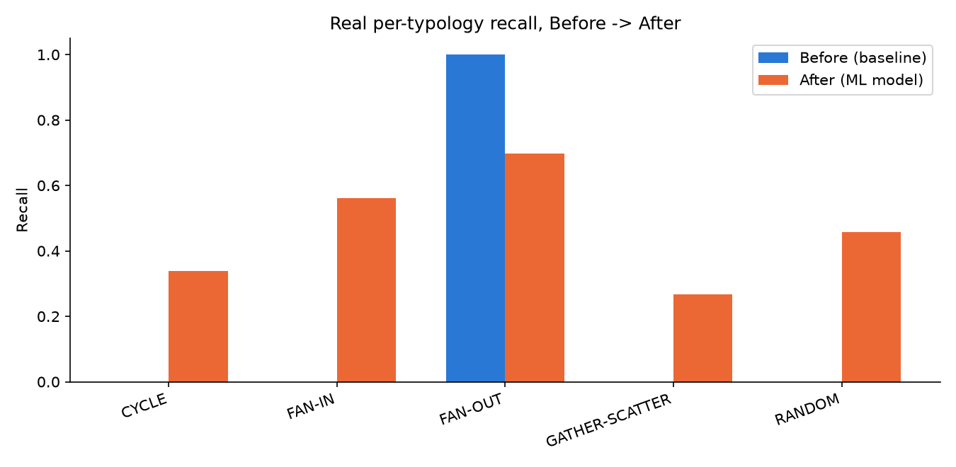
Per-Typology Recall, Before / After (LI-Medium)

Slide 8
Financial Impact Summary (LI-Medium)
Auto-typing efficiency savings (ASSUMPTION): $1,313
  20.2 investigator hours freed, +101 more cases correctly auto-typed
  Illustrative typology-confirmation value (ASSUMPTION): $1,104,000 ($1.10M)
  138 real cases whose typology the old single-guess rule structurally could not identify
  These figures apply different ASSUMPTIONS to different real case subsets and are never summed (locked Section 7A discipline).

Slide 9
Key Recommendations
Prioritize real-world review of the lowest-recall typology first
  On LI-Medium, the real champion model (RandomForest) has its LOWEST real absolute recall on 'GATHER-SCATTER' (After recall 0.2667 on 135 real held-out cases) -- it still misses most real cases of this typology.
Reallocate freed investigator capacity from real auto-typing efficiency gains
  Moving from the naive always-guess-'FAN-OUT' rule to the real ML model correctly auto-types +101 more of the 480 real held-out cases on LI-Medium (ASSUMPTION-estimated at 20.2 investigator hours, $1,313).
Validate the real net-new typology detections against filed SARs
  The real ML model correctly identifies 138 real held-out cases whose true typology is something other than the old rule's fixed guess ('FAN-OUT') on LI-Medium -- typology detection that structurally could not exist under the old rule (illustrative typology-confirmation value, ASSUMPTION: $1,104,000 ($1.10M)).
Document why 'FAN-OUT' recall is strongest, as a template for the weaker typologies
  'FAN-OUT' has the real HIGHEST absolute recall on LI-Medium (After recall 0.6967, real Delta -0.3033 vs. the baseline). Real SHAP analysis ranks 'receiver_distinct_counterparties_to_date' as the model's dominant overall driver.
Maintain the real two-gate validation standard on every future retrain
  Every real dataset variant evaluated for BP2 currently passes both validation gates (LI-Medium).

Slide 10
Regulatory & Compliance Mapping
Bank Secrecy Act (31 U.S.C. Section 5311)
  FinCEN 'red flags' typology guidance (JPMorgan Chase assessment, Madoff/BLM case) (BP2 (this BP's own real-world terminology match))
  FinCEN SAR filing requirements (31 CFR Section 1020.320) (BP1, BP2 (evidence feed for SAR narrative typology, not itself a SAR-filing decision))
  FFIEC BSA/AML Examination Manual (5 pillars) (Platform-wide)
  SR 11-7 Model Risk Management (Every model-bearing BP)

