Slide 1
BP3: Transaction Network & Graph Intelligence
Compliance-Impact Executive Briefing -- 2026-10-01T09:19:30.566344+00:00 UTC

Slide 2
Business Objective
BP3 (Transaction Network & Graph Intelligence) builds the real capability to flag accounts using directly-interpretable graph-structural signals -- real degree, real PageRank, and real network proximity to already-flagged accounts -- computed from the real account-to-account transaction structure, no ground-truth label required to construct them. Its objective is to give investigators a real, evidence-backed structural starting point for which accounts' surrounding networks deserve review next, and to surface a real bounded 2-hop ego-network around each flagged account rather than leaving every case to single-account review. This report covers the real, completed build and validation of that capability on LI-Medium (this BP's locked mandatory realism-validation tier) -- 2,032,095 real distinct (Bank, Account) nodes, 4,363,197 real distinct directed edges.

Slide 3
Recommendation & Status
RECOMMENDED FOR PRODUCTION
  Both the structural and statistical-robustness validation gates passed on every real dataset variant evaluated (LI-Medium).

Slide 4
Executive Summary
Champion structural signal: 2-hop proximity to a TRAIN-flagged account (LI-Medium variant)
  Real network-lift ratio: 3.19x (bootstrap 95% CI [3.16x, 3.22x])
  Real graph: 2,032,095 nodes, 4,363,197 distinct edges, base rate 1.16%
  Two-gate verdict: PASS -- No trained ML model (structural rule only)

Slide 5
What This Means for the Business
On LI-Medium, the real champion structural signal ('2-hop proximity to a TRAIN-flagged account') achieves a real held-out test network-lift ratio of 3.19x over the real base rate of 1.1570% (real bootstrap 95% CI [3.16x, 3.22x], 2,000 resamples, 0 invalid), with both the structural and statistical-robustness validation gates passing (overall verdict: PASS).
  Real bounded 2-hop ego-network review surfaces materially more real account context per flagged case than single-account review: NB3's 3 real illustrative examples show real network sizes of 181,831, 15,360, 15,174 accounts before the locked 2,000-node cap is applied -- a real volume-scale KPI, never dollarized (no sourced per-account investigation-cost basis exists for this BP, and none is invented).
  BP3 has no trained ML model -- every candidate (real degree, real PageRank, real network proximity) is a directly-interpretable structural signal, ranked purely by real network-lift ratio on a real held-out test set of accounts, never a black-box score.
  The real champion signal differs between real dataset scales (HI-Small Stage A screening selected 'In-degree (top decile)', LI-Medium mandatory validation selects '2-hop proximity to a TRAIN-flagged account') -- per this platform's locked policy, the real LI-Medium result is authoritative and is never silently overridden by the smaller-scale prior.
  A real, self-tested FastAPI scoring service already exists for this champion RULE (Notebook 3's deployable-service self-test matched direct batch computation bit-for-bit on 2,000 real rows checked, 0 mismatches), so this capability is deployment-ready, not just a research result.

Slide 6
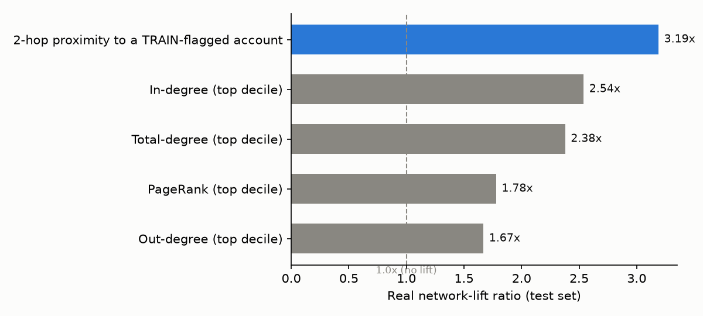
Candidate Structural Signals -- Real Network-Lift Ranking

Slide 7
Model Performance by Dataset Variant
Variant | Champion Signal | Real Lift Ratio | CI95 | Verdict
LI-Medium | 2-hop proximity to a TRAIN-flagged account | 3.19x | [3.16x, 3.22x] | PASS

Slide 8
Before / After Impact (LI-Medium)
Before: single-account review -- zero real network visibility
  After: real bounded 2-hop ego-network around the same account (capped at 2,000 nodes)
  Reported as a real volume-scale KPI -- never dollarized (no sourced per-account cost basis exists for this BP)
  3 real illustrative examples -- not a population-wide average

Slide 9
Key Recommendations
Re-validate the champion structural signal on a fixed cadence
  The champion signal on LI-Medium (2-hop proximity to a TRAIN-flagged account) achieves a real network-lift ratio of 3.19x (real bootstrap 95% CI [3.16x, 3.22x], 2,000 resamples, 0 invalid).
Scale investigator review capacity to the real bounded ego-network volume, not account count
  Before = single-account review (zero real network visibility). After = the real bounded 2-hop ego-network around the same flagged account -- NB3's 3 real illustrative examples show real network sizes 181,831, 15,360, 15,174 accounts before the locked 2,000-node cap is applied.
Investigate the real champion divergence between HI-Small and LI-Medium
  The real Stage A (HI-Small) screening champion ('In-degree (top decile)') and the real LI-Medium mandatory-validation-tier champion ('2-hop proximity to a TRAIN-flagged account') are DIFFERENT signals. Per this platform's locked rule, the real LI-Medium result is authoritative and is never silently overridden by the smaller-scale prior -- but the divergence itself is worth understanding.
Keep the 'no trained model' framing explicit in every downstream use of this rule
  BP3 has no trained ML model -- every candidate is a directly-interpretable structural signal; SHAP/LIME are N/A, not attempted. The real deployable artifact is a RULE (near_train_flagged (set-membership test)), never a pickled classifier -- confirmed by the real self-tested FastAPI service (2,000 real rows checked, 0 mismatches).
Maintain the real two-gate validation standard on every future retrain
  Every real dataset variant evaluated for BP3 currently passes both validation gates (LI-Medium).

Slide 10
Regulatory & Compliance Mapping
Bank Secrecy Act (31 U.S.C. Section 5311)
  FFIEC BSA/AML Examination Manual (5 pillars -- link analysis / relationship mapping is a recognized investigative technique) (BP3 (real-world terminology match not independently confirmed against a primary enforcement document, disclosed honestly per Notebook 1 Section 3))
  FinCEN SAR filing requirements (31 CFR Section 1020.320) (BP3 (evidence feed for SAR narrative network context, not itself a SAR-filing decision))
  SR 11-7 Model Risk Management (Every model/rule-bearing BP -- applied here to a RULE artifact, not a trained model)

