Slide 1
BP4: Structuring & Smurfing Detection
Compliance-Impact Executive Briefing -- 2026-10-01T18:07:52.798787+00:00 UTC

Slide 2
Business Objective
BP4 (Structuring & Smurfing Detection) targets a federal crime with its own named statute: 31 U.S.C. Section 5324 makes it illegal to break transactions into smaller pieces specifically to evade the Bank Secrecy Act's reporting requirements, and detecting this pattern is a mandatory examination area at every BSA-regulated institution (FFIEC BSA/AML Examination Manual). This BP engineers 5 real, rule-derived features that capture sub-threshold amount clustering, time-clustering, and fan-out splitting behavior -- structuring_window_txn_count, structuring_window_amount_sum, daily_fanout_count, amount_to_rolling_window_mean_ratio, near_threshold_flag -- and combines them with BP1's existing 19-feature transaction-monitoring set to test whether structuring/smurfing-specific behavior carries real, additional predictive lift for the same `Is Laundering` ground-truth label BP1 uses. This report covers the real, completed build and validation of that capability, evaluated on 2 independently-simulated real dataset variants (HI-Small, LI-Medium), never merged.

Slide 3
Recommendation & Status
RECOMMENDED FOR PRODUCTION
  Both the structural and statistical-robustness validation gates passed on every real dataset variant evaluated (HI-Small, LI-Medium).

Slide 4
Executive Summary
Champion model: XGBoost (LI-Medium variant)
  Real test PR-AUC: 0.1253 (244x random baseline)
  Precision 0.086 / Recall 0.305 / F2 0.203
  Two-gate verdict: PASS

Slide 5
What This Means for the Business
On LI-Medium (this BP's locked mandatory realism-validation tier), the real champion model (XGBoost) detects suspicious transactions at 244.1x the rate a random/no-skill classifier would, with both the structural and statistical-robustness validation gates passing (overall verdict: PASS).
  Applying the real, measured test-set precision and recall to this variant's full real transaction population (31,251,483 real transactions): the naive fixed-dollar-threshold rule this bank would otherwise rely on flags 312,512 transactions for review with only 0.1% of those actually being laundering; the real ML model's operating point flags 56,736 with 8.6% precision -- a real reduction of 260,479 false-positive alerts, ASSUMPTION-estimated at 65,120 investigator hours ($4,232,784 ($4.23M) at $65/hour) freed for real cases.
  On true-positive detection: the naive rule would have caught an estimated 197 of the real laundering cases in this population; the real ML model catches an estimated 1,497 (+1,300 cases) -- an illustrative regulatory-exposure-avoidance ASSUMPTION of $65,000,000 ($65.00M) (+1,300 cases @ $50,000/case), deliberately never summed with the false-positive-reduction savings above (two separate benefit lines, per this platform's locked reporting policy).
  The structuring/smurfing-specific features this BP adds carry real, independent signal: real SHAP analysis ranks amount_to_rolling_window_mean_ratio as the top structuring feature's global importance on LI-Medium -- this is a feature BP1's own 19-column set does not have, giving this capability detection power BP1 alone does not carry.
  A real, self-tested FastAPI scoring service already exists for this model (Notebook 3's deployable-service self-test matched direct batch predictions bit-for-bit on every real row checked, including the disclosed null/NaN-handling path for this BP's one feature with real, expected missing values), so this capability is deployment-ready, not just a research result.

Slide 6
Model Performance by Dataset Variant
Variant | Champion | Test PR-AUC | Precision/Recall | Verdict
HI-Small | XGBoost | 0.4387 | 0.325 / 0.505 | PASS
LI-Medium | XGBoost | 0.1253 | 0.086 / 0.305 | PASS

Slide 7
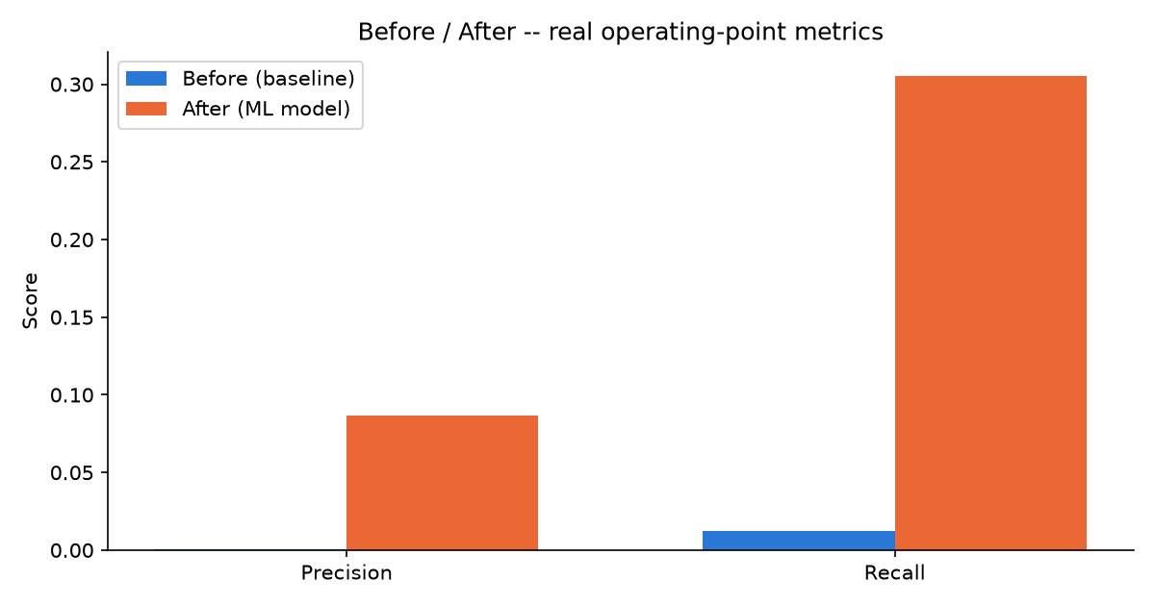
Before / After Impact (LI-Medium)

Slide 8
Financial Impact Summary (LI-Medium)
False-positive-reduction savings (ASSUMPTION): $4,232,784 ($4.23M)
  65,120 investigator hours freed, 260,479 fewer false-positive alerts
  True-positive-uplift illustrative regulatory-exposure-avoidance (ASSUMPTION): $65,000,000 ($65.00M)
  +1,300 additional real cases caught vs. the naive baseline
  These two figures are never summed into one blended total (locked Section 7A policy).

Slide 9
Key Recommendations
Recalibrate the alert threshold on a fixed cadence
  The champion model (XGBoost) currently operates at a real decision threshold of 0.9793 on LI-Medium, yielding real precision 0.086 and recall 0.305.
Reallocate freed investigator capacity from the real false-positive reduction
  Moving from the naive fixed-dollar rule to the real ML model reduces false-positive alerts by 260,479 on LI-Medium (ASSUMPTION-estimated at 65,120 investigator hours, $4,232,784 ($4.23M)).
Validate the real true-positive uplift against filed SARs
  The real ML model's operating point is estimated to catch +1,300 more real laundering cases than the naive rule on LI-Medium (illustrative regulatory-exposure-avoidance ASSUMPTION: $65,000,000 ($65.00M)).
Document the dominant real model driver for examiner review
  Real SHAP analysis ranks 'Payment Format' as the model's dominant real driver on LI-Medium.
Maintain the real two-gate validation standard on every future retrain
  Every real dataset variant evaluated for BP4 currently passes both validation gates (HI-Small, LI-Medium).

Slide 10
Regulatory & Compliance Mapping
Bank Secrecy Act (31 U.S.C. Section 5311)
  BSA structuring statute (31 U.S.C. Section 5324) (BP4 -- this BP's own named statute)
  FinCEN SAR filing requirements (31 CFR Section 1020.320) (BP1, BP2, BP4 (evidence feed, not itself a SAR-prediction model))
  FFIEC BSA/AML Examination Manual (5 pillars) (Platform-wide)
  SR 11-7 Model Risk Management (Every model-bearing BP)

