Slide 1
CS554 – Operating Systems Programming Project
Spring Semester 2017

Slide 2
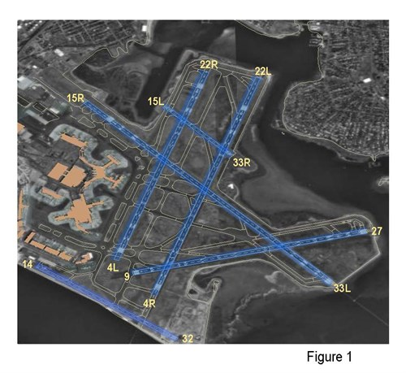
Logan Airport Runway Diagram

Slide 3
Rules
Our airport simulation uses six runways labeled 4L, 4R, 9, 14, 15L, & 15R*
Runway 4L may be used simultaneously with 4R
Runway 9 may be used simultaneously with 15L
Runway 14 may be used simultaneously with any other runway
Runway 15L may be used simultaneously with 15R
Runway 9 may not be used simultaneously with 4R or 15R
Runways 15L or 15R may not be used simultaneously with 4L or 4R
Only one airplane at a time may occupy a given runway
Due to restrictions of Air Traffic Control, only six requests for landing may be active simultaneously
Seven airplanes are continuously attempting to land at the airport
Each airplane requests a randomly selected runway on which to land
The simulator determines whether a given landing request can be fulfilled, based on the usage of the requested runway and other runways
If any of the restrictions listed in Rule 1 would be violated, the airplane must “go into a holding pattern” (sleep) until the restriction(s) are lifted
Once permission to land on the selected runway is granted, the airplane is assumed to land immediately, but will occupy the runway for a random amount of time while taxiing
Shortly after the airplane leaves the runway, that airplane magically is in the air again ☺, and requests another landing
You must add Java Semaphores to the AirportRunwayServer code in order to enforce synchronization and mutual exclusion on the use of the runways
The simulation must permit simultaneous use of runways whenever allowed by Rules 1 and 2

Slide 4
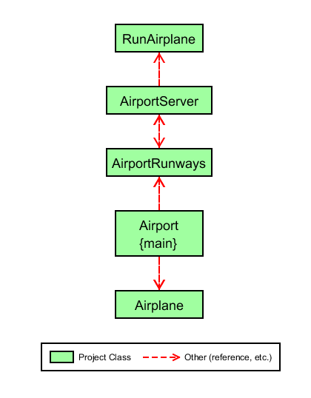
UML Diagram

Slide 5
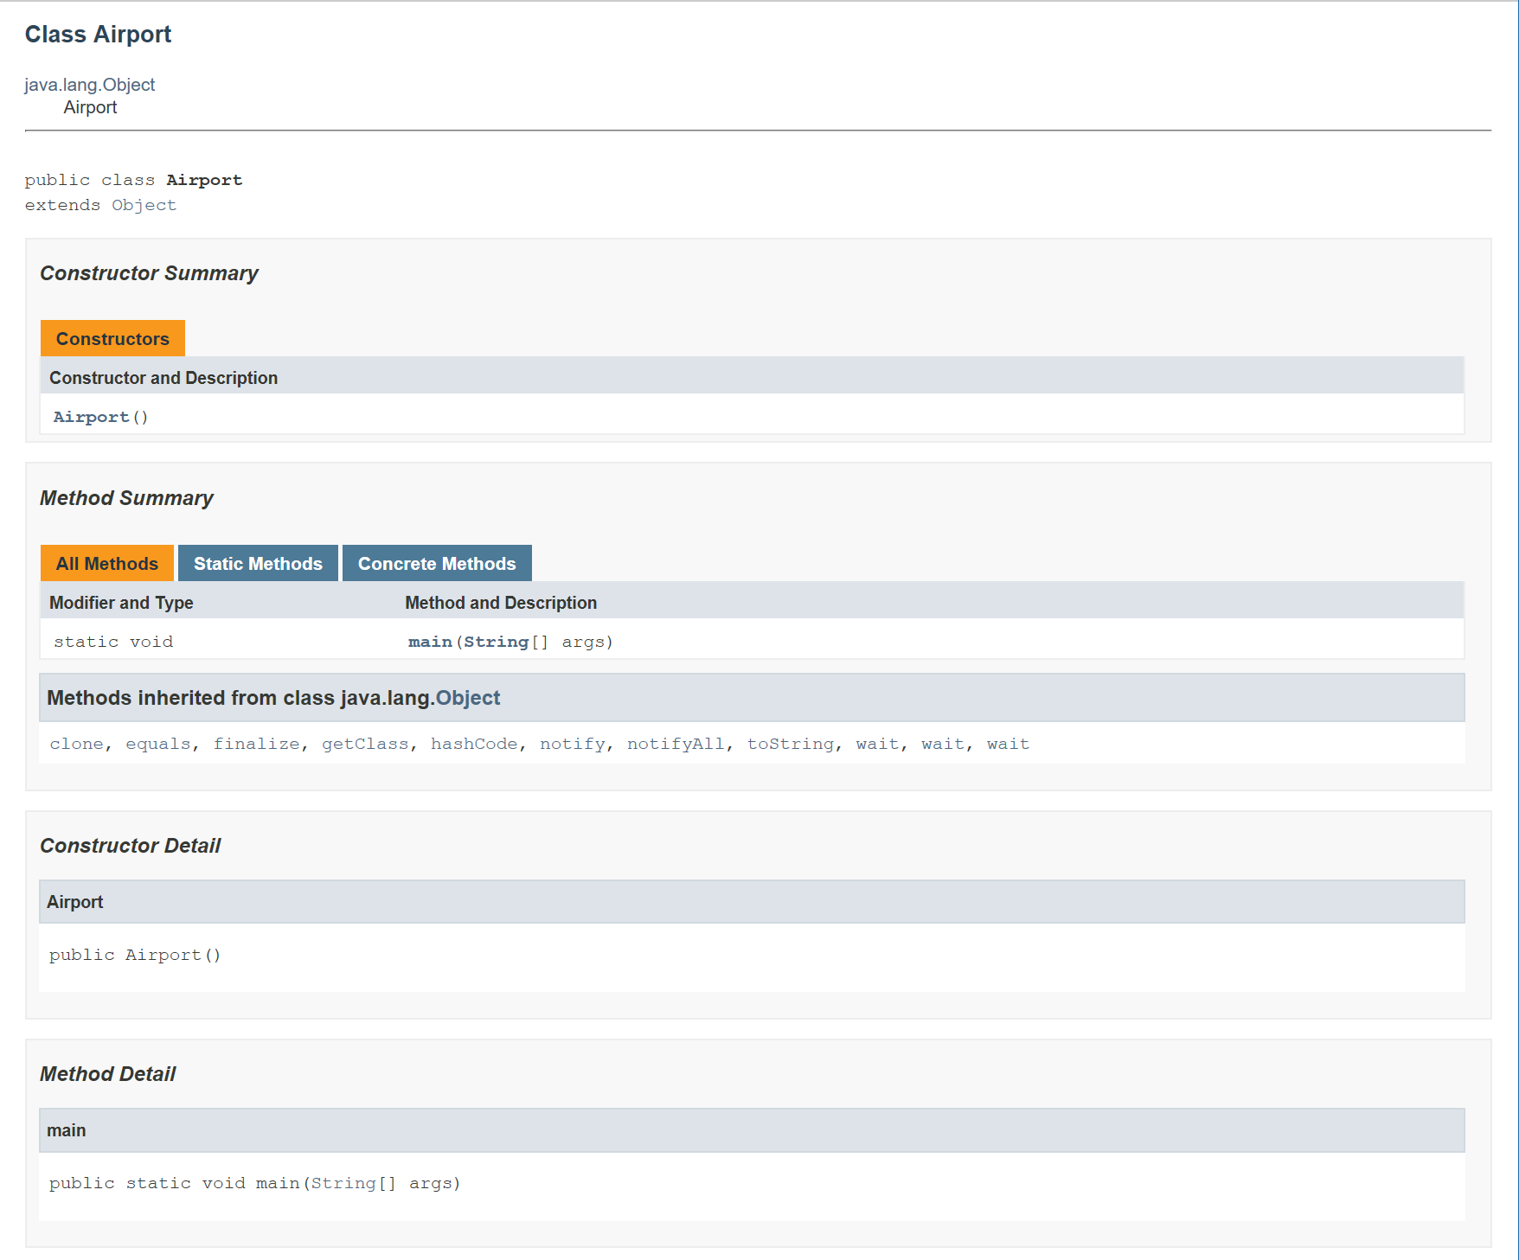
JavaDoc—Class Airport

Slide 6
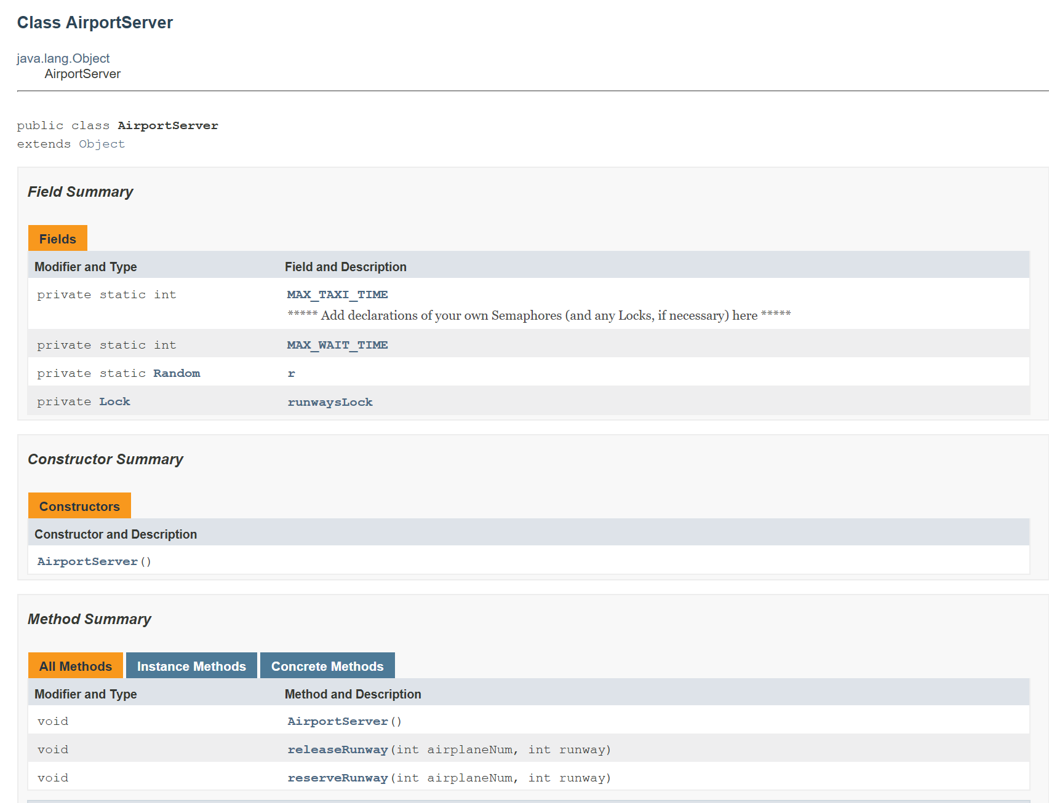
JavaDoc—Class AirportServer

Slide 7
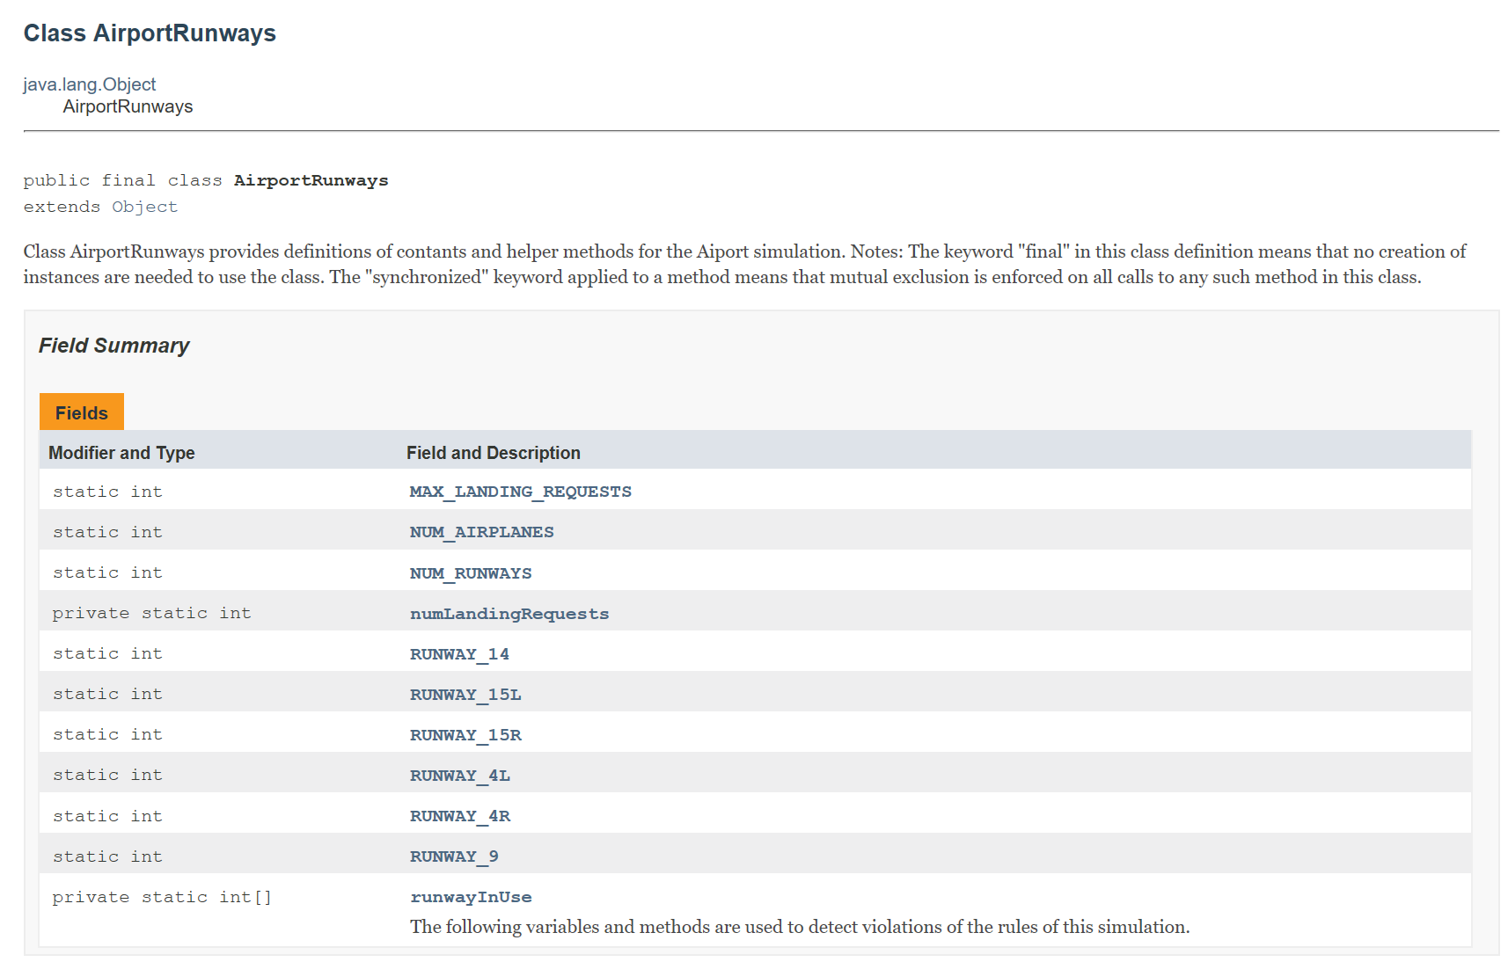
JavaDoc—Class AirportRunways (1 of 2)

Slide 8
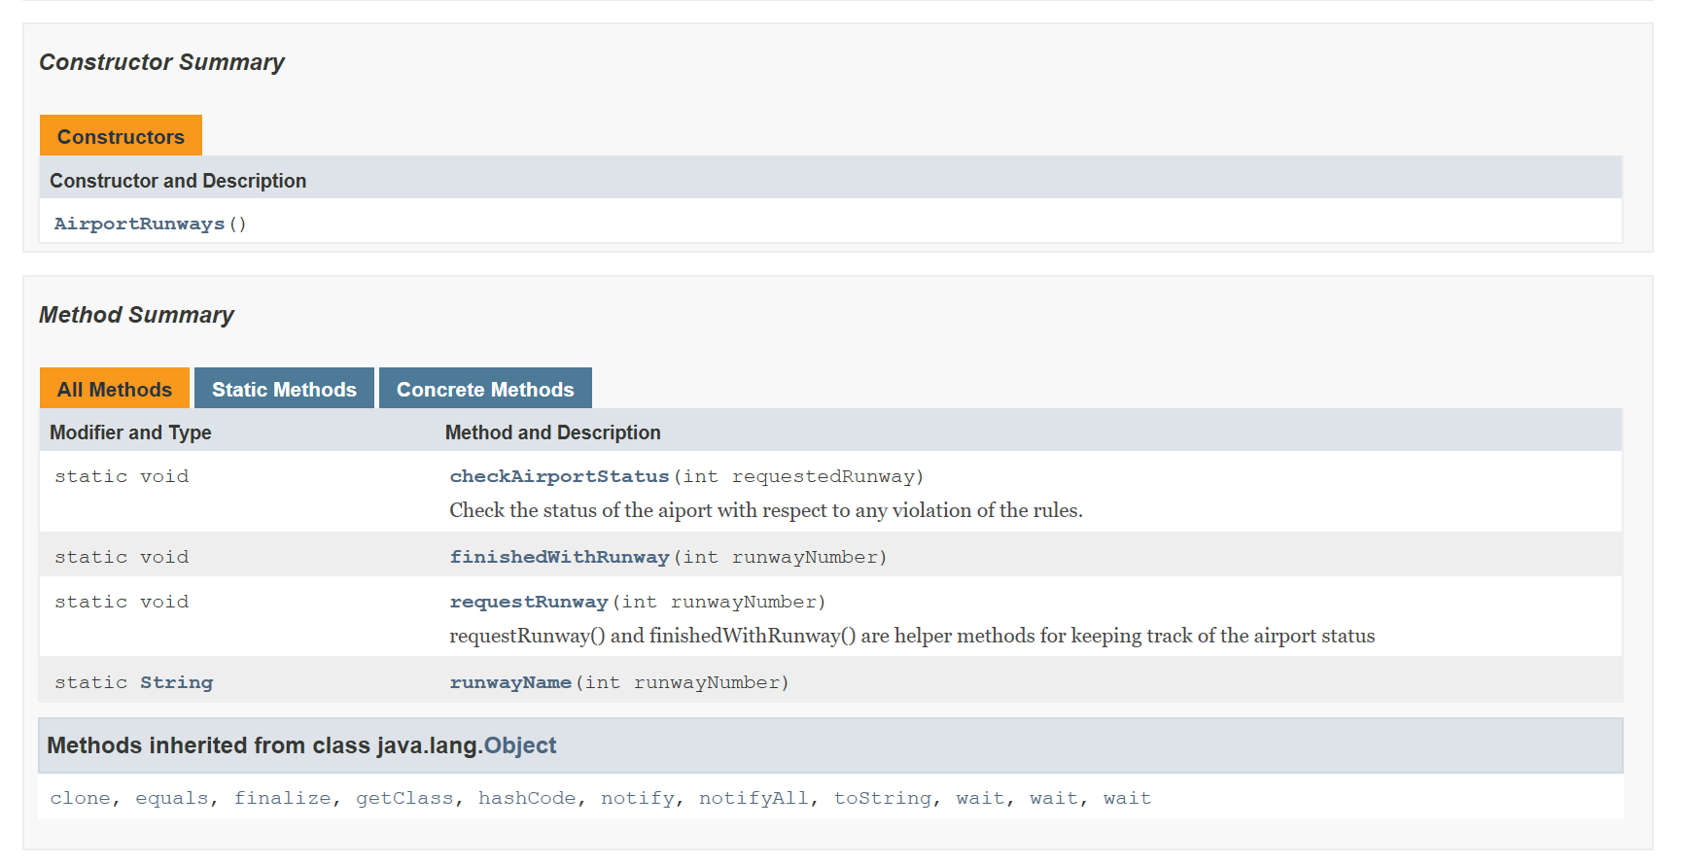
JavaDoc—Class AirportRunways (2 of 2)

Slide 9
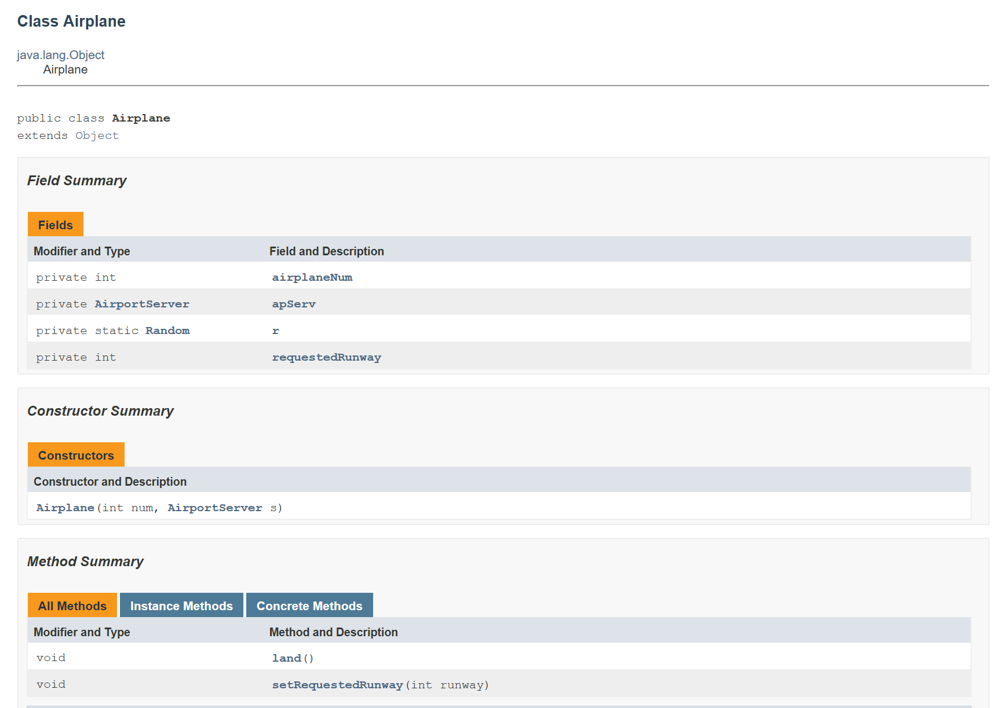
JavaDoc—Class Airplane

Slide 10
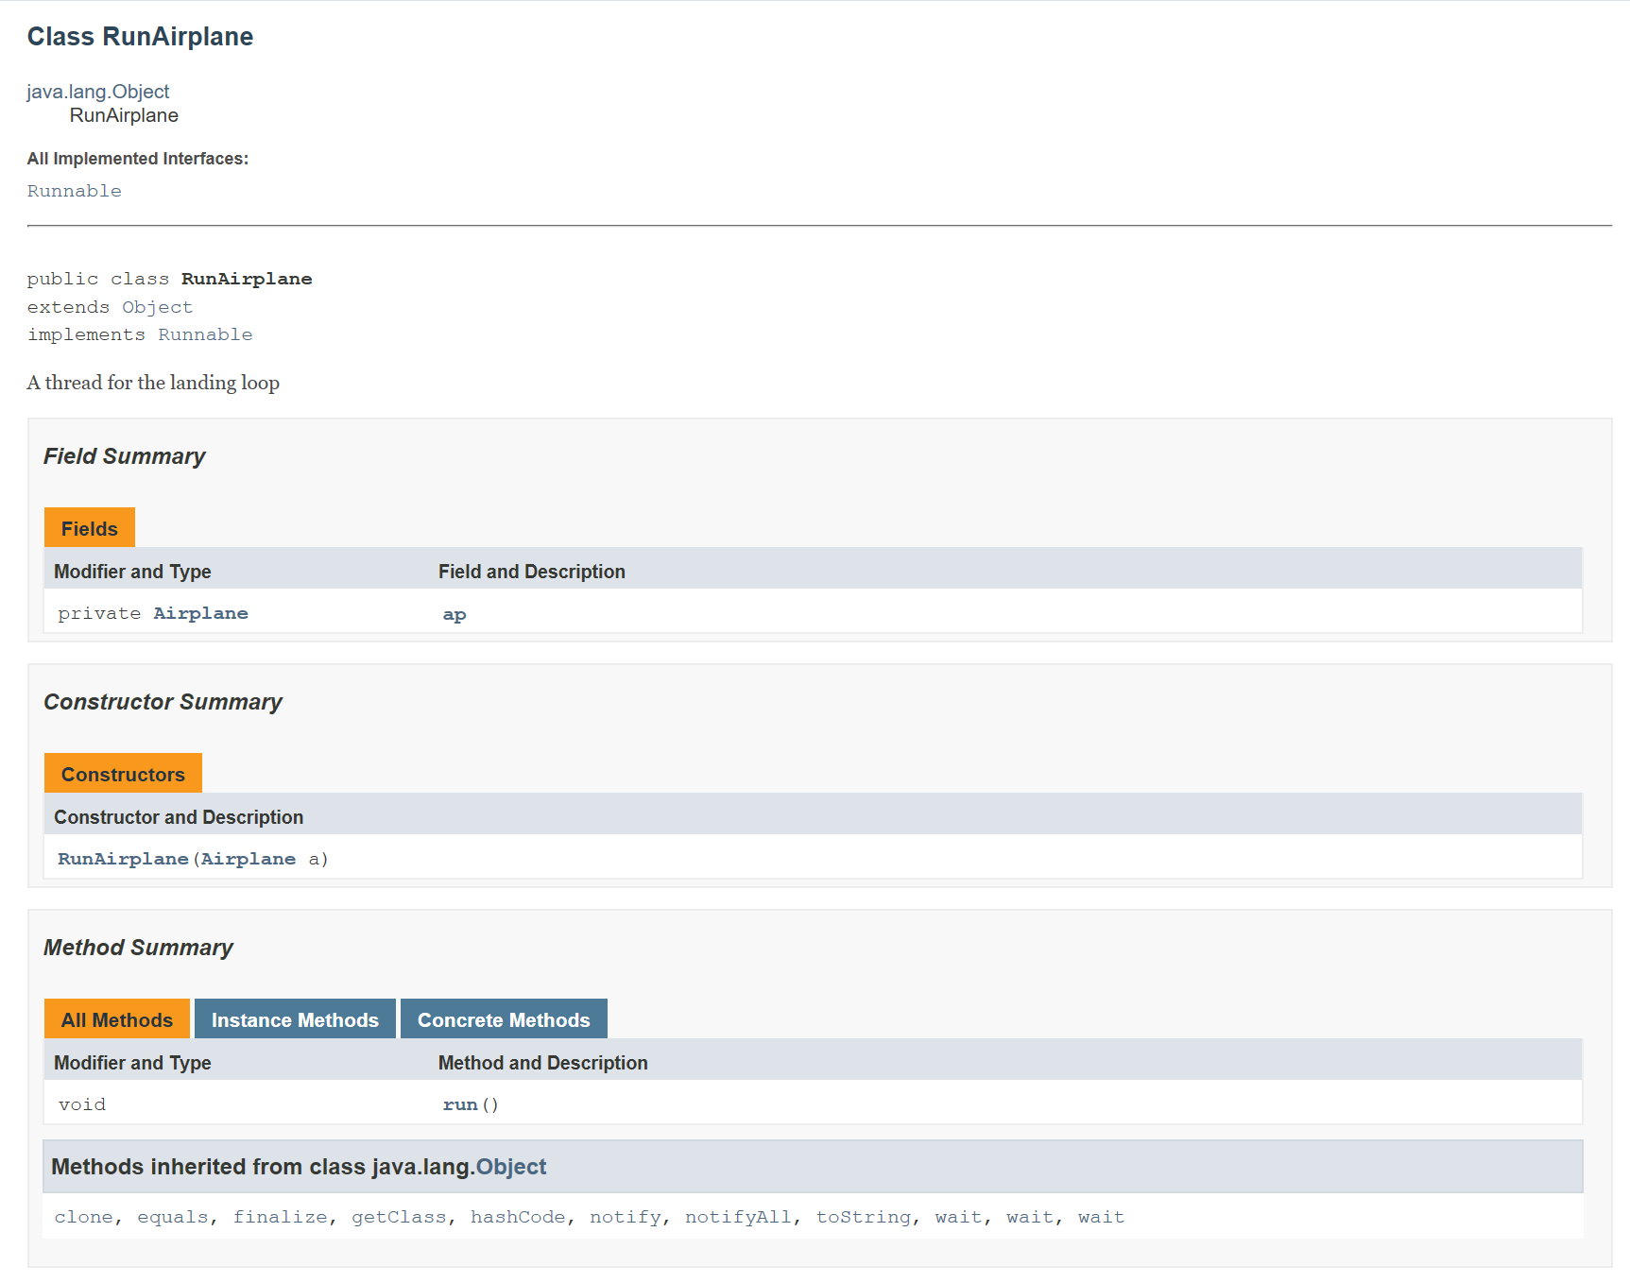
JavaDoc—Class RunAirplane

