Slide 1


GenAI-Based Data Profiling for Regulatory Reporting
LLM-Legends
Ravindra Reddy Nandyala
Mahan Kaleswararao
Siva Kumar Bestha
Sai Teja Vavintaparthi
Prashanth

Slide 2
Problem Statement & Challenges
LLM-Legends
Regulatory reporting requires accurate data profiling.
Manual rule definition is time-consuming and error-prone.
Existing methods lack adaptive risk scoring.
Compliance teams need automated remediation suggestions.

Slide 3
Solution Overview
LLM-Legends
Leverage’s Generative AI(LLMs) to extract data profiling rules from regulatory documents.
Validates transactions against the extracted rules.
Detects violations and provides actionable insights.

Slide 4
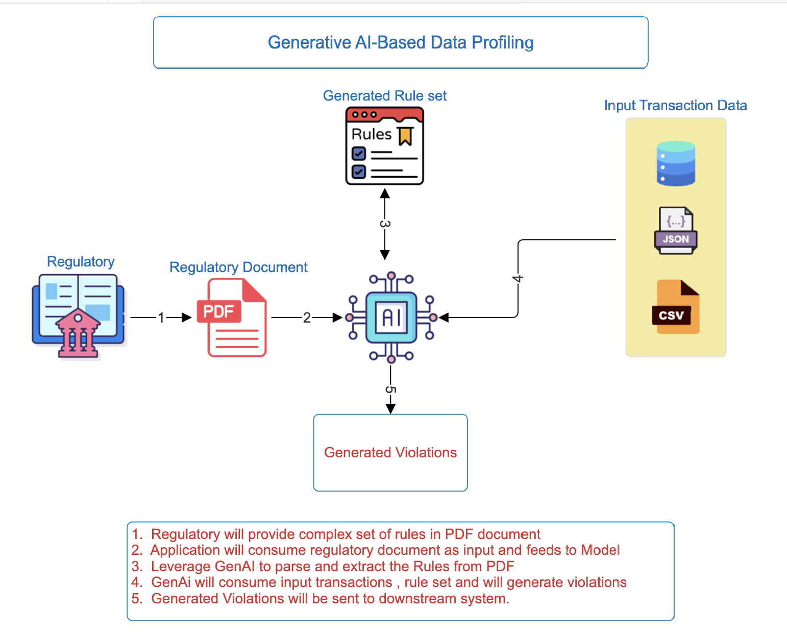
Architecture Diagram
LLM-Legends

Slide 5
Key Features
LLM-Legends
Scalable and generic.
Uses fuzzy logic for dynamic column mapping.
Works with any rule set and dataset.
No hard coding of rules or column names.
Supports Aggregations

Slide 6
How It Works
Extract text from regulatory documents (PDFs).
Parse rules using LLMs and convert them into a structured format.
Preprocess and pre-aggregate transaction data.
Map rules to dataset columns using fuzzy matching.
Validate transactions against the rules.
Display violations with detailed insights.
LLM-Legends

Slide 7
Demo - Regulated PDF rules
LLM-Legends
Rules:
Customer ID length must be between 6 to 12 characters.
Transaction Amount must be a positive number. The range depends on the Account_Type:
If Account_Type is 'Savings', the amount must be between $100 and $1,500.
For other account types, the amount must be between $100 and $1,000,000.
Transaction_Date must be in YYYY-MM-DD format.
Field 'Capital_Adequacy_Ratio' must be above 8.
Field 'Account_Type' must be one of the following: Savings, Checking, or Loan.
Field 'Transaction_Type' must be one of the following: Deposit, Withdrawal, or Transfer.
Field Permanent Account Number must be 10 characters.
Total amount for a customer must not exceed $1500.

Slide 8
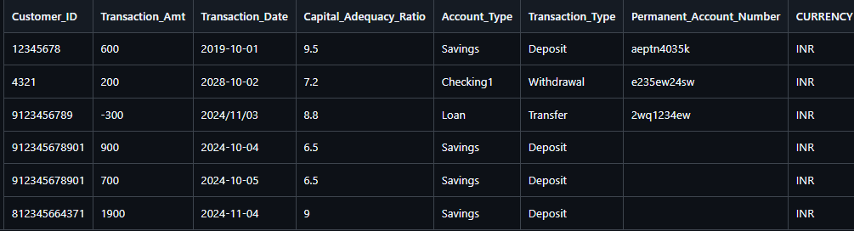
Demo - Input Data
LLM-Legends

Slide 9
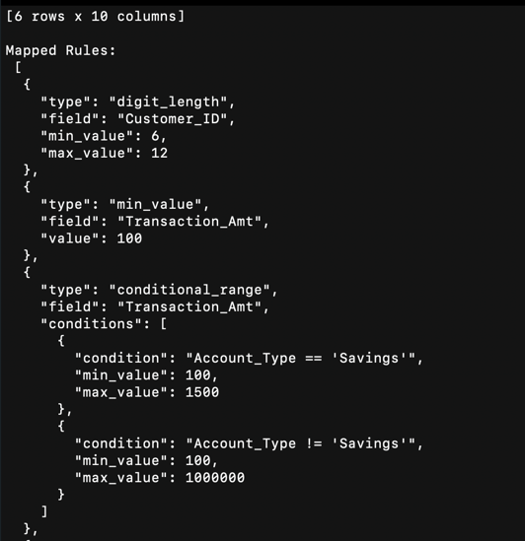
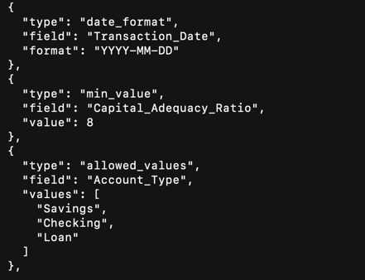
Demo - Extracted Rules - 1
LLM-Legends

Slide 10
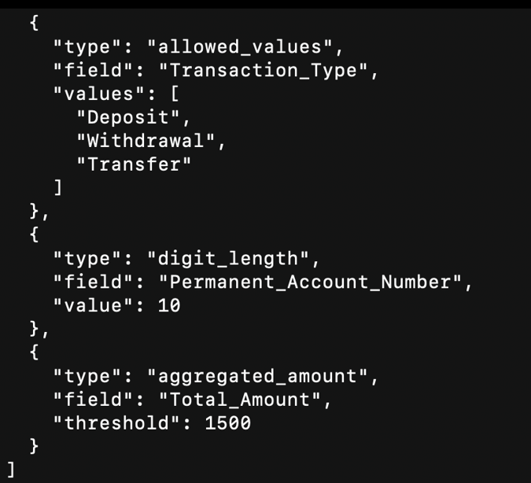
Demo - Extracted Rules - 2
LLM-Legends

Slide 11
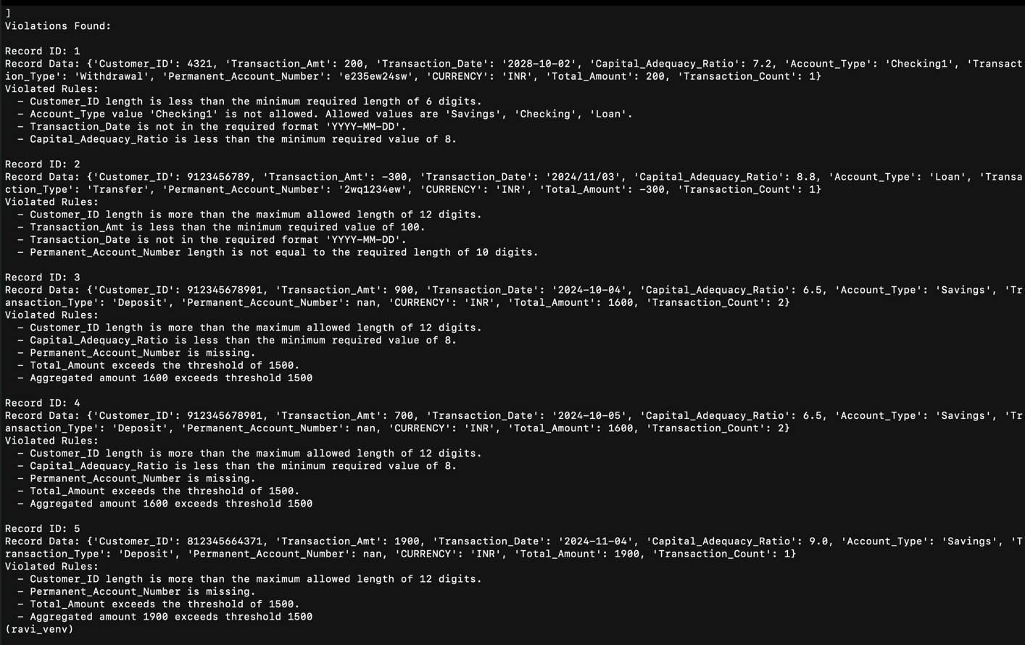
Demo - Violations Generated By Model
LLM-Legends

Slide 12
Conclusion
LLM-Legends
The GenAI-powered regulatory compliance system provides a scalable, intelligent, and adaptable solution for automating compliance validation.
It utilizes Gen AI models for rule extraction and fuzzy logic for dynamic column mapping to enhance accuracy and efficiency.
The system's flexible architecture enables seamless extension to new use cases and ensuring future scalability.

