Slide 1
Elastic Cache implementation and study of L2 cache lockdown in modern GPU architectures
Vivekanandan Kulumani Rajarajan, Raunaq NandyMajumdar

Slide 2
Elastic Cache Implementation and its performance in Pascal and Volta

Slide 3
Motivation
L1 caches in GPUs are small. In SIMT cores, multiple threads accessing the cache can lead to severe thrashing especially if accesses are not regular.
This happens for benchmarks having divergent memory access patterns like needle-man wunsch, BFS etc.
Sector cache reduces the granularity of L1 accesses from 128 bytes to 32 bytes from Pascal architecture onwards but even that doesn’t alleviate the above problem.
Sector cache still evicts entire 128 bytes when needed and even when 4 sectors in a cache line are in continuous addresses.

Slide 4
Proposal (1/2)
Elastic Caches facilitates both fine-grained (32 bytes) and coarse-grained access (128 bytes) [1].
It allows to store sectors from non-contiguous addresses in a cache line when needed so that irregular applications get better serviced for their divergent memory requests by using a single common tag (6 bits) for the line and different chunk tags (16 bits) for the sectors [1].
For regular access patterns they continue to get serviced by coarse-grained accesses to cache.

Slide 5
Proposal (2/2)
Every access must first match common tag, then chunk tag irrespective of whether it is a 32 byte or 128-byte access.
If common tag is not matched, then it’s a line miss, and eviction of an entire line might be done if required.
If common tag matches but chunk tag is not matched in any of the chunks (32 bytes) then it’s a WORD_MISS, a 32-byte sector might need to be evicted if required based on the replacement policy.

Slide 6
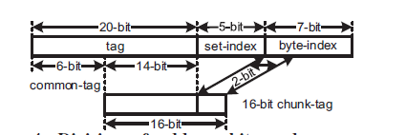
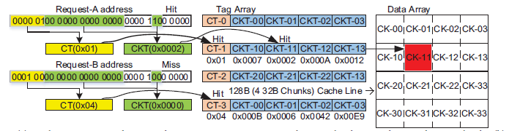
Common and Chunk Tag

Slide 7
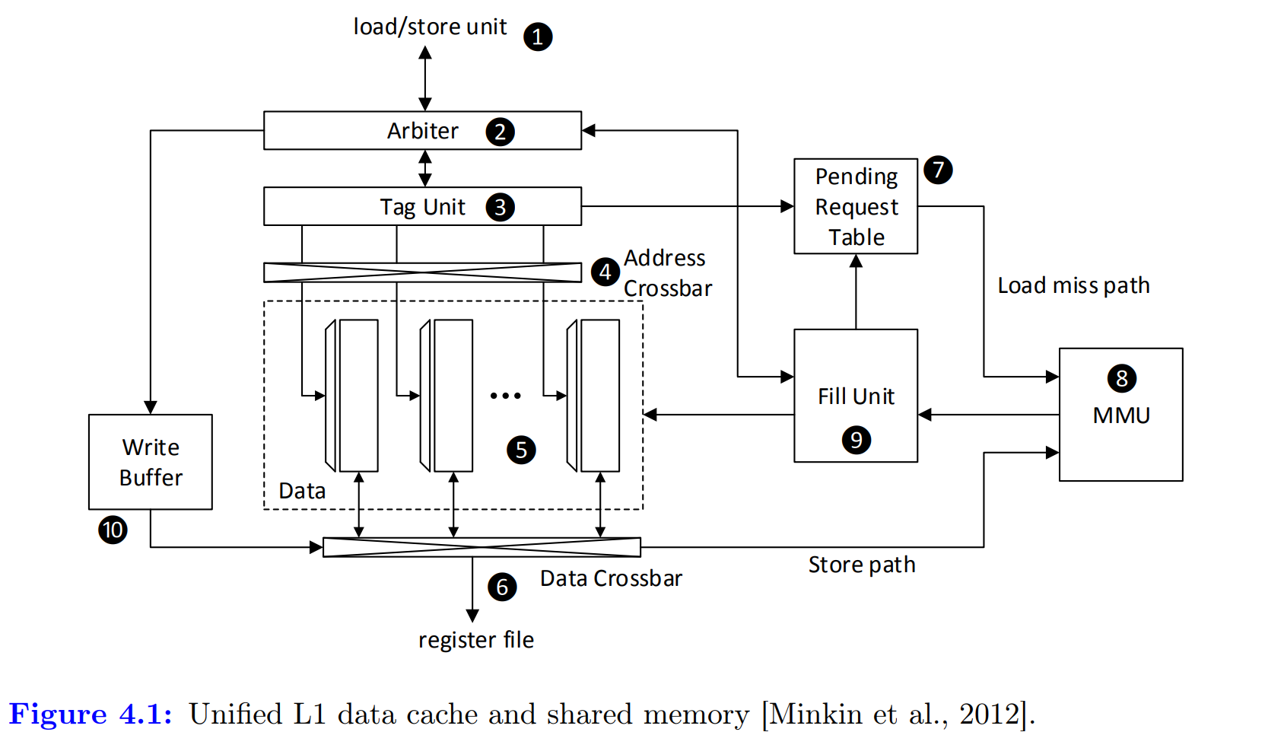
Unified L1D/Shared Memory
Tag for the line
Common Tag
3a
3b
Chunk 0
Chunk 1
Chunk 2
Chunk 3

Slide 8
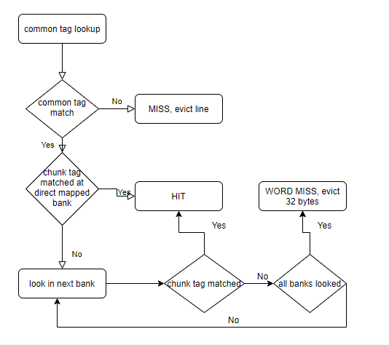
Access algorithm for the elastic cache

Slide 9
HIT in elastic cache
Address is having bank idx =2 by default.
Common tag hits, so it first looks up Chunk 2, but does not match.
Then it looks up Chunk 3 and hits, so it returns a HIT.
Common tag
1
2
4
Chunk 0
Chunk 1
Chunk 2
Chunk 3
3

Slide 10
MISS in elastic cache
Common tag doesn’t match so it’s a MISS.
Evict correct line using replacement policy if needed.
Common tag
1
2
Chunk 0
Chunk 1
Chunk 2
Chunk 3

Slide 11
WORD_MISS in elastic cache
Address having bank idx =2 by default.
Common tag hits, so it first looks up Chunk 2, but did not match.
Then it looks up Chunk 3 , Chunk 0, Chunk 1, in that order, but didn’t find any match, so it’s a WORD_MISS. So, evict a correct 32 byte sector if needed using a proper replacement policy.
1
Common tag
2
5
3
Chunk 0
Chunk 1
Chunk 2
Chunk 3
4

Slide 12
IPC of Sector vs L1-Elastic vs L1-L2-Elastic

Slide 13
IPC Sector vs L1-Elastic for different associativity

Slide 14
IPC of L1-Elastic for QV100 vs TITANV vs TITANX

Slide 15
Miss Rate of Sector vs L1-Elastic for different associativity

Slide 16
Result Highlights
NW gives a speedup of 1.2x.
BFS gives a speedup of 1.05x in fully-associative cache and 1.15x for direct mapped cache.
Regular applications don’t show much degradation. Some of them show improvement (like stream-clusters, hot-spot) when L1 cache associativity is reduced.
Making L2 elastic hurts performance as it is shared across cores and large. Coalesced accesses to L2 are crucial for performance.
We see that dynamic associativity like changing from fully-associative to 4-way or direct mapped for example based on the type of application will benefit a lot of applications in elastic cache configuration of L1.
We see that Volta performs better than Pascal in Elastic cache, giving an indication that elastic cache might perform better for newer architectures like Turing and upcoming architectures like Ampere and Hopper.

Slide 17
Performance analysis of L2 cache lockdown in Volta (TITANV)

Slide 18
Proposal
We perform a study on the impact of L2 cache performance in newer architectures by locking most frequently accessed addresses [2].
We implement the following ideas for locking the addresses to L2.
We implement the idea by profiling frequently accessed addresses before hand and locking them to cache.
We determine the lock addresses to L2 in-flight when the number of accesses goes above a threshold.
We bypass L2 when all ways in the set are locked.
We implement a relaxed version of locking where we don’t bypass when all the ways are locked, we evict a locked line with the lowest threshold.

Slide 19
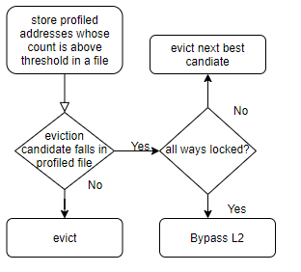
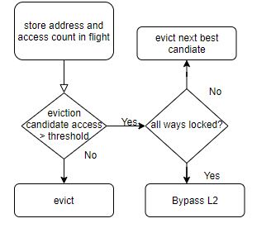
Algorithms of Locking (1/2)

Slide 20
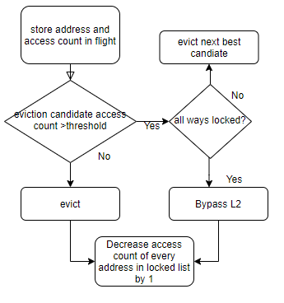
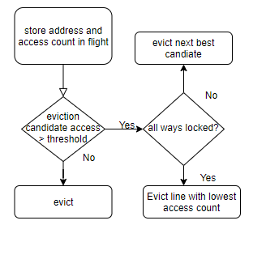
Algorithms of locking (2/2)
Relaxed locking

Slide 21
Performance of Sector L2 vs L2-strict-locking vs L2-relaxed-locking

Slide 22
Result Highlights
NW gives a speedup of 2% in strict locking and rest of all benchmarks don’t degrade or improve performance in L2 cache locking.
Mainly because L2 cache in Volta is 4.5MB in total and 24 way, the case where we must bypass L2 for some addresses in the event of all the ways of a line being locked never happens except for NW, when the locking threshold is not that high. Similarly, in NW, if locking threshold is high then it doesn’t benefit from L2 locking.
So L2 locking is not a good optimization in recent architectures as its implementation introduces some additional queues and bypassing hardware with almost zero performance benefit.

Slide 23
Future works
Optimization of elastic cache implementation for L2
Implementation of adaptive associativity , like dynamically changing cache associativity from fully-associative to n-way or direct mapped with some compiler support based on the type of applications being executed on the GPU
After improving elastic cache implementation for L2, studying its effect on Memory Controller, how it optimizes a traffic of stream of non-contiguous addresses while sending them to DRAM, and such optimization’s effect on DRAM timing parameter.

Slide 24
References
Li, B. ; Sun, J. ; Annavaram, M. ; Kim, N.S. Proceedings - 2017 IEEE 31st International Parallel and Distributed Processing Symposium, IPDPS 2017, 30 June 2017, pp.82-91, Elastic-Cache: GPU Cache Architecture for Efficient Fine- and Coarse-Grained Cache-Line Management.
Picchi, J; Zhang, W Conference Proceedings - IEEE SOUTHEASTCON, 24 June 2015, Vol.2015-(June), Impact of L2 Cache Locking on GPU Performance.
Chen Zhao ; Fei Wang ; Zhen Lin ; Huiyang Zhou ; Nanning Zheng, 2016 IEEE 22nd International Conference on Parallel and Distributed Systems (ICPADS), December 2016, pp.908-915 , Selectively GPU Cache Bypassing for Un-Coalesced Loads.

Slide 25
Thank You

