Slide 1

Data security project
Alessandro Penna (mat. Num. 0522501554) Riccardo Napoli (mat. Num. 0522501560)

Slide 2

CapyBuck
It's a new memecoin inspired by the sweetest and most relaxed animal on the planet: the Capybara. This cryptocurrency combines blockchain technology with the adorable imagery of this South American animal, creating a new online trading experience.

Slide 3

Associated with this cryptocurrency is CapySwap, a software application that allows users to exchange the cryptocurrency Ether (ETH) for CapyBuck (CPB) and vice versa.
The exchange is designed to provide users with a simple, secure, and fast trading experience, letting them buy and sell CapyBucks without having to go through multiple platforms or interfaces.

Slide 4
Functional requirements

Slide 5
FR 1 – The system must allow for the sale of ETH for CPB. Priority: High
FR 2 – The system must allow for the sale of CPB for ETH. Priority: High
FR 3 – The system must allow the user to connect an Ethereum wallet. Priority: High
FR 4 – The system must allow the user to view previous transactions, with details on the amount of swapped cryptocurrencies and applied exchange rate. Priority: Low

Slide 6
Non-functional requirements

Slide 7
USABILITY
NFR 1 – The system must provide a graphic interface. Priority: High
NFR 2 – The system’s interface must be responsive, capable of adapting to PC, smarphones and tablet screens. Priority: Medium
NFR 3 – The system must show a preview of the transaction with the amount inserted and the exchange rate. Priority: High
NFR 4 – The system must show the transaction success with a message. Priority: High
NFR 5 – The system must provide an error message in case of failed transaction. Priority: Medium
TRUSTABILITY
NFR 7 – The system must perform all the security checks to assure honest, complete and correct transactions for both parts. Priority: High
NFR 8 – The application must be able to discard wrong data. In case, it must not crash and respond accordingly. Priority: Low

Slide 8
PERFORMANCES
NFR 9 – The system must perform a transaction in 2 seconds at most. Priority: High
NFR 10 – The system must support an user load of at least 1000. Priority: High
MAINTAINABILITY
NFR 11 – The code must have comments to describe the different system features. Priority: Medium

Slide 9
scenariOS

Slide 10
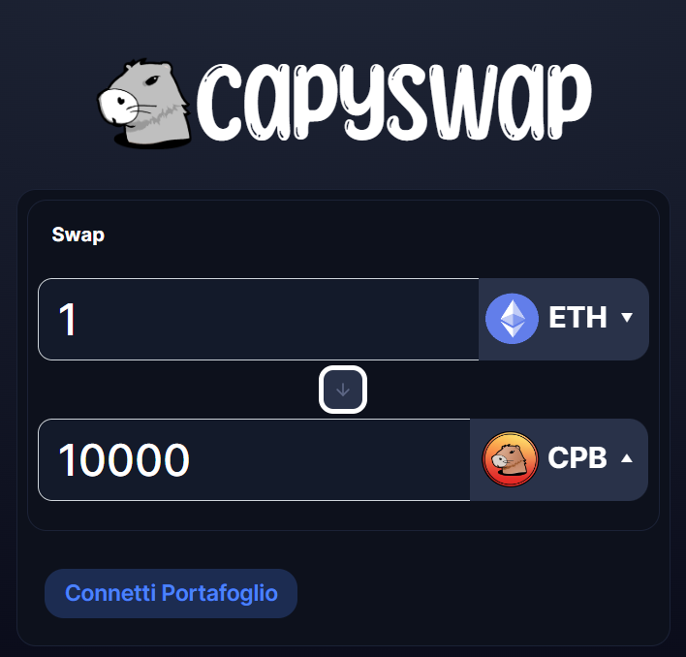
EX_1 Scambio cryptovalute
Paul, a computer science student interested in cryptocurrency trading, owns 1 ETH purchased with his savings. Paul is not convinced of how much more ETH can increase in value, so he's interested in emerging cryptocurrencies to trade his ETH with, hoping for it to go "To the Moon."
Paul accesses the CapySwap website and enters 1 ETH into the swap section to exchange it for CapyBucks. The system automatically shows him how many CapyBucks he would receive in exchange for his ETH.
Paul then clicks the "Connect Wallet" button to link his Metamask wallet for the transaction.

Slide 11
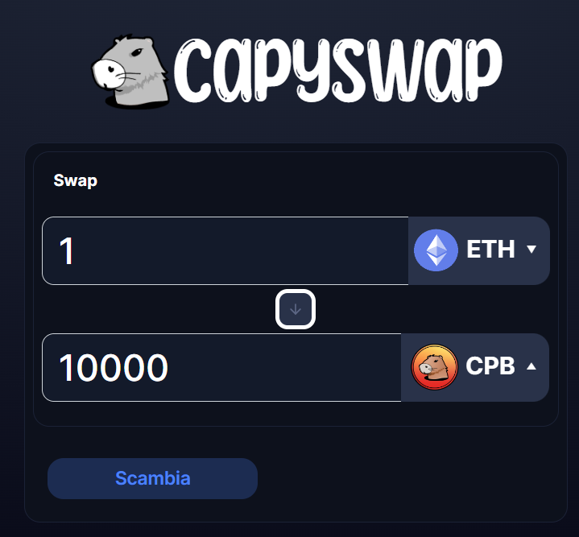
The Metamask client will open a screen to ask which Metamask account to connect to the website.
Paul enters his ETH wallet and accepts to connect it to the system.
Once the account is connected, the 'Connect Wallet' button will be replaced by the 'Exchange' button to proceed with the transaction.

Slide 12
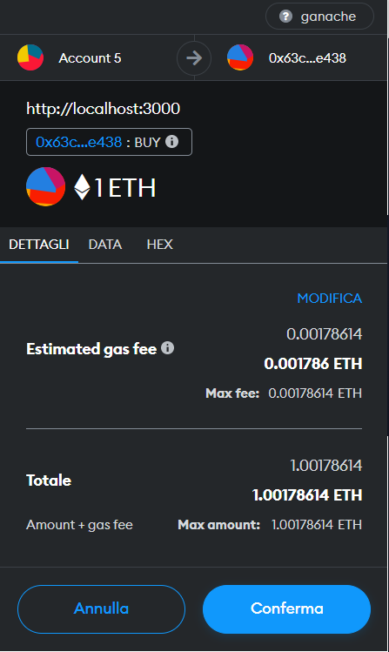
Once pressed, the system will open a Metamask screen for transaction confirmation, containing the addresses of the accounts involved in the transaction and the gas fee.
Paul confirms the transaction and receives the CapyBucks owed to him based on the exchange rate between the two currencies. He can view his balance in his Metamask account.
If Paul wants to sell some of the CapyBucks later, he can do so by pressing the swap button between the two currencies on the website and repeating the process in an equivalent manner.

Slide 13
Target environment
Lite-server as web server;
Ganache to simulate the Ethereum blockchain;
Truffle libraries to simplify development, the compiling process, testing and deployment of smart contracts on the blockchain;
Solidity to write smart contracts;
Javascript for tests and interaction with the graphic interface.

Slide 14
USE CASES

Slide 15
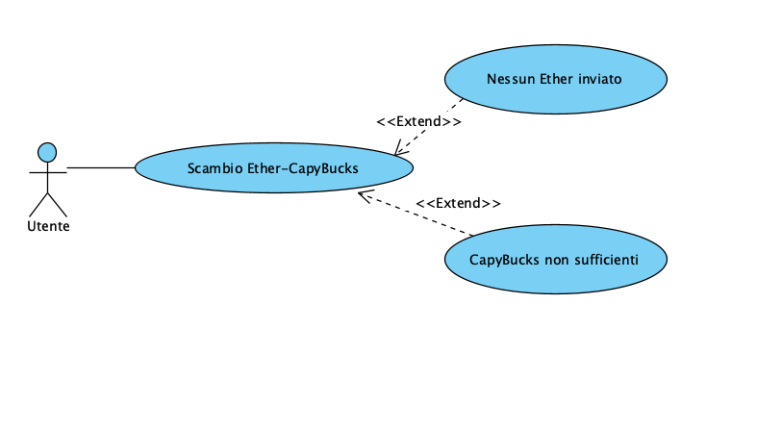
UC 01 : Ether-CapyBucks Swap
Actor: User
Entry condition:The user is in the swap page and has connected his Metamask wallet.
Events flux:
The user inserts the Ether amount that he wants to swap
The systems shows the equivalent in CapyBucks that the user will receive
The user confirms the cryptocurrency exchange
The user authorizes and signs the transaction
The system checks if an ether amount is sent with the transaction
The system checks that sufficient funds are present to send the corresponding Capybucks
7.The systems sends the corresponding CapyBucks to the user
Exit condition: The user is provided with a success message, the amount in ether is withdrawn and the one in Capybucks is received
Alternative fluxes:
If in point 5 the system notices that no ether is sent, the transaction is canceled and the error “You need more ether” is shown
If in point 6 if the system notices that there are no CapyBucks on the user’s account, the transaction is canceled ant the error “There are not enough tokens to perform the exchange” is shown

Slide 16
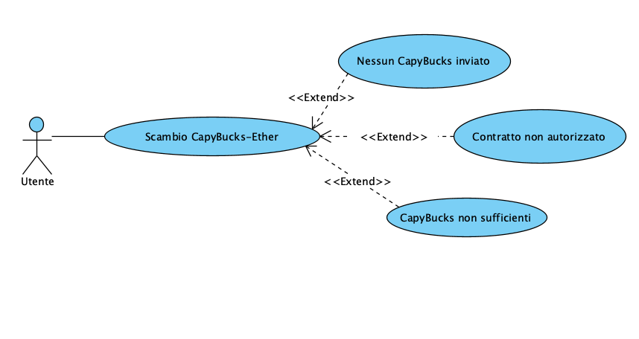
UC 02 : CapyBucks-Ether Swap
Events flux:
The user inserts the CapyBucks amount that he wants to swap
The systems shows the equivalent in Ether that the user will receive
The user confirms the cryptocurrency exchange
The system asks the user permission to spend his CapyBucks
The user authorizes and signs the transaction
The system checks if a CapyBucks amount is sent with the transaction
The system checks that it has permission to transfer the requested amount of CapyBucks
The system checks that the user has the amount of CapyBucks to transfer
9.The system sends the user the corresponding Ether amount.
Exit condition: The user is provided with a success message, the amount in CapyBucks is withdrawn and the one in Ether is received
Alternative fluxes:
If in point 6 the system notices that no CapyBucks have been sent, the transaction is canceled and the error “You must sell at least one token” is shown
If in point 7 the system notices that there is no authorization for the CapyBucks amount to swap, the transaction is canceled and the error “You did not give permission to spend your tokens” is shown
If in point 8 the system notices that the user doesn’t own the amount of CapyBucks to swap, the transaction is canceled and the error “You don't have enough tokens to perform the exchange” is shown

Slide 17
Sequence diagramS

Slide 18
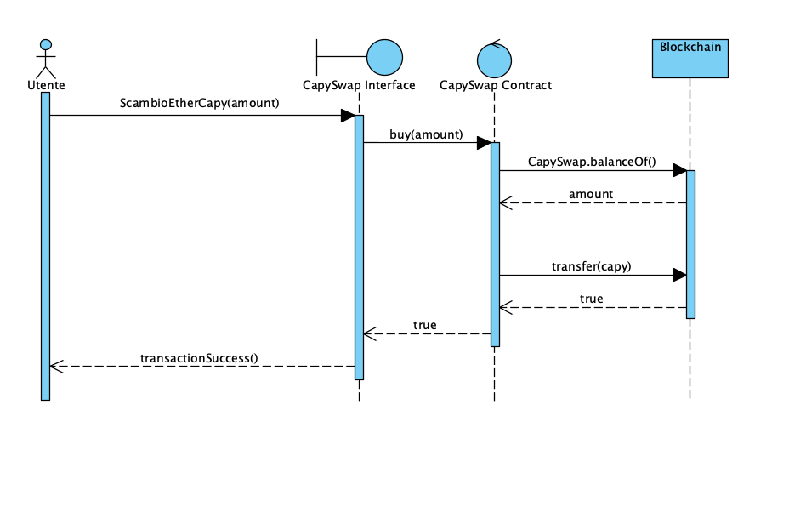
SD 01: Ether-CapyBucks Swap

Slide 19
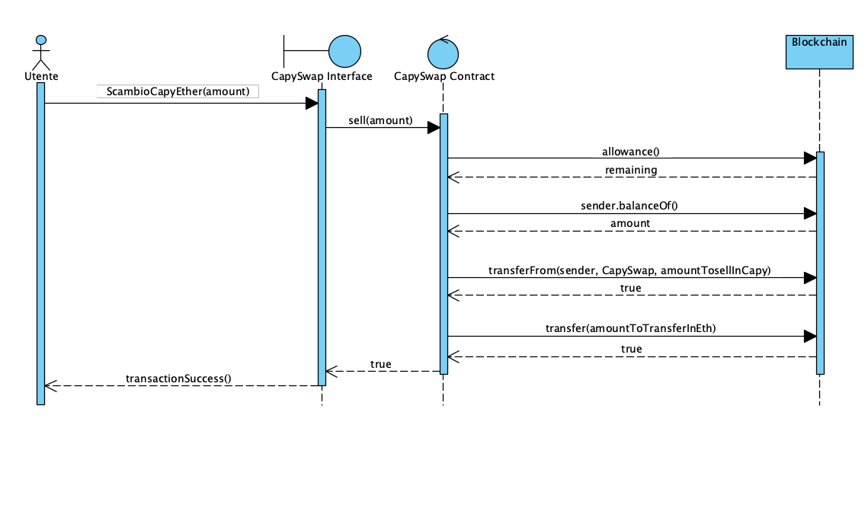
SD 02: CapyBucks-Ether Swap

Slide 20
TESTING

Slide 21
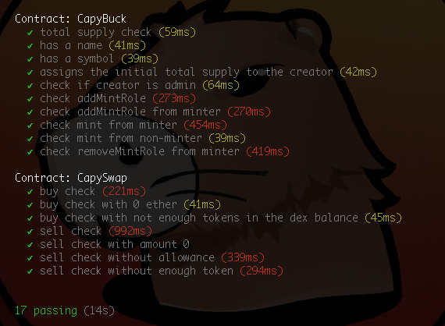
Unit tests with Chai
Unit tests have been conducted for both the "CapySwap" and "CapyBucks" contracts. The most significant tests are related to the "buy" and "sell" functionalities. All predefined error scenarios have been tested for both.

