Slide 1
머신러닝 -2023
12주차 과제

Slide 2
Unet code1
class DoubleConv(nn.Module): >>> 3
"""(convolution => [BN] => ReLU) * 2"""
def __init__(self, in_channels, out_channels, mid_channels=None):
super().__init__()
if not mid_channels:
mid_channels = out_channels
self.double_conv = nn.Sequential(
nn.Conv2d(in_channels, mid_channels, kernel_size=3, padding=1, bias=False),
nn.BatchNorm2d(mid_channels),
nn.ReLU(inplace=True),
nn.Conv2d(mid_channels, out_channels, kernel_size=3, padding=1, bias=False),
nn.BatchNorm2d(out_channels),
nn.ReLU(inplace=True)
)
def forward(self, x):
return self.double_conv(x)
class OutConv(nn.Module):
def __init__(self, in_channels, out_channels):
super(OutConv, self).__init__()
self.conv = nn.Conv2d(in_channels, out_channels, kernel_size=1) >4
def forward(self, x):
return self.conv(x

Slide 3
UNET code2
class Up(nn.Module):
"""Upscaling then double conv"""
def __init__(self, in_channels, out_channels, bilinear=True):
# if bilinear, use the normal convolutions to reduce the number of channels
if bilinear:
self.up = nn.Upsample(scale_factor=2, mode='bilinear', align_corners=True) >>>>> 2
self.conv = DoubleConv(in_channels, out_channels, in_channels // 2) >>>>>> 3
else:
self.up = nn.ConvTranspose2d(in_channels, in_channels // 2, kernel_size=2, stride=2)
self.conv = DoubleConv(in_channels, out_channels)
def forward(self, x1, x2):
x1 = self.up(x1)
# input is CHW
diffY = x2.size()[2] - x1.size()[2]
diffX = x2.size()[3] - x1.size()[3]
x1 = F.pad(x1, [diffX // 2, diffX - diffX // 2,
diffY // 2, diffY - diffY // 2])
x = torch.cat([x2, x1], dim=1) >>>>> 1
return self.conv(x)

Slide 4
UNET code3
class Down(nn.Module):
"""Downscaling with maxpool then double conv"""
def __init__(self, in_channels, out_channels):
super().__init__()
self.maxpool_conv = nn.Sequential(
nn.MaxPool2d(2),
DoubleConv(in_channels, out_channels)
)
def forward(self, x):
return self.maxpool_conv(x)

Slide 5
Unet code4
class UNet(nn.Module):
def __init__(self, n_channels, n_classes, bilinear=False):
super(UNet, self).__init__()
self.n_channels = n_channels
self.n_classes = n_classes
self.bilinear = bilinear
self.inc = (DoubleConv(n_channels, 64))
self.down1 = (Down(64, 128))
self.down2 = (Down(128, 256))
self.down3 = (Down(256, 512))
factor = 2 if bilinear else 1
self.down4 = (Down(512, 1024 // factor))
self.up1 = (Up(1024, 512 // factor, bilinear))
self.up2 = (Up(512, 256 // factor, bilinear))
self.up3 = (Up(256, 128 // factor, bilinear))
self.up4 = (Up(128, 64, bilinear)) >> 1,2, 3
self.outc = (OutConv(64, n_classes)) >>> 4
def forward(self, x):
x1 = self.inc(x)
x2 = self.down1(x1)
x3 = self.down2(x2)
x4 = self.down3(x3)
x5 = self.down4(x4)
x = self.up1(x5, x4)
x = self.up2(x, x3)
x = self.up3(x, x2)
x = self.up4(x, x1) > 1,2,3
logits = self.outc(x) >>> 4
return logits

Slide 6
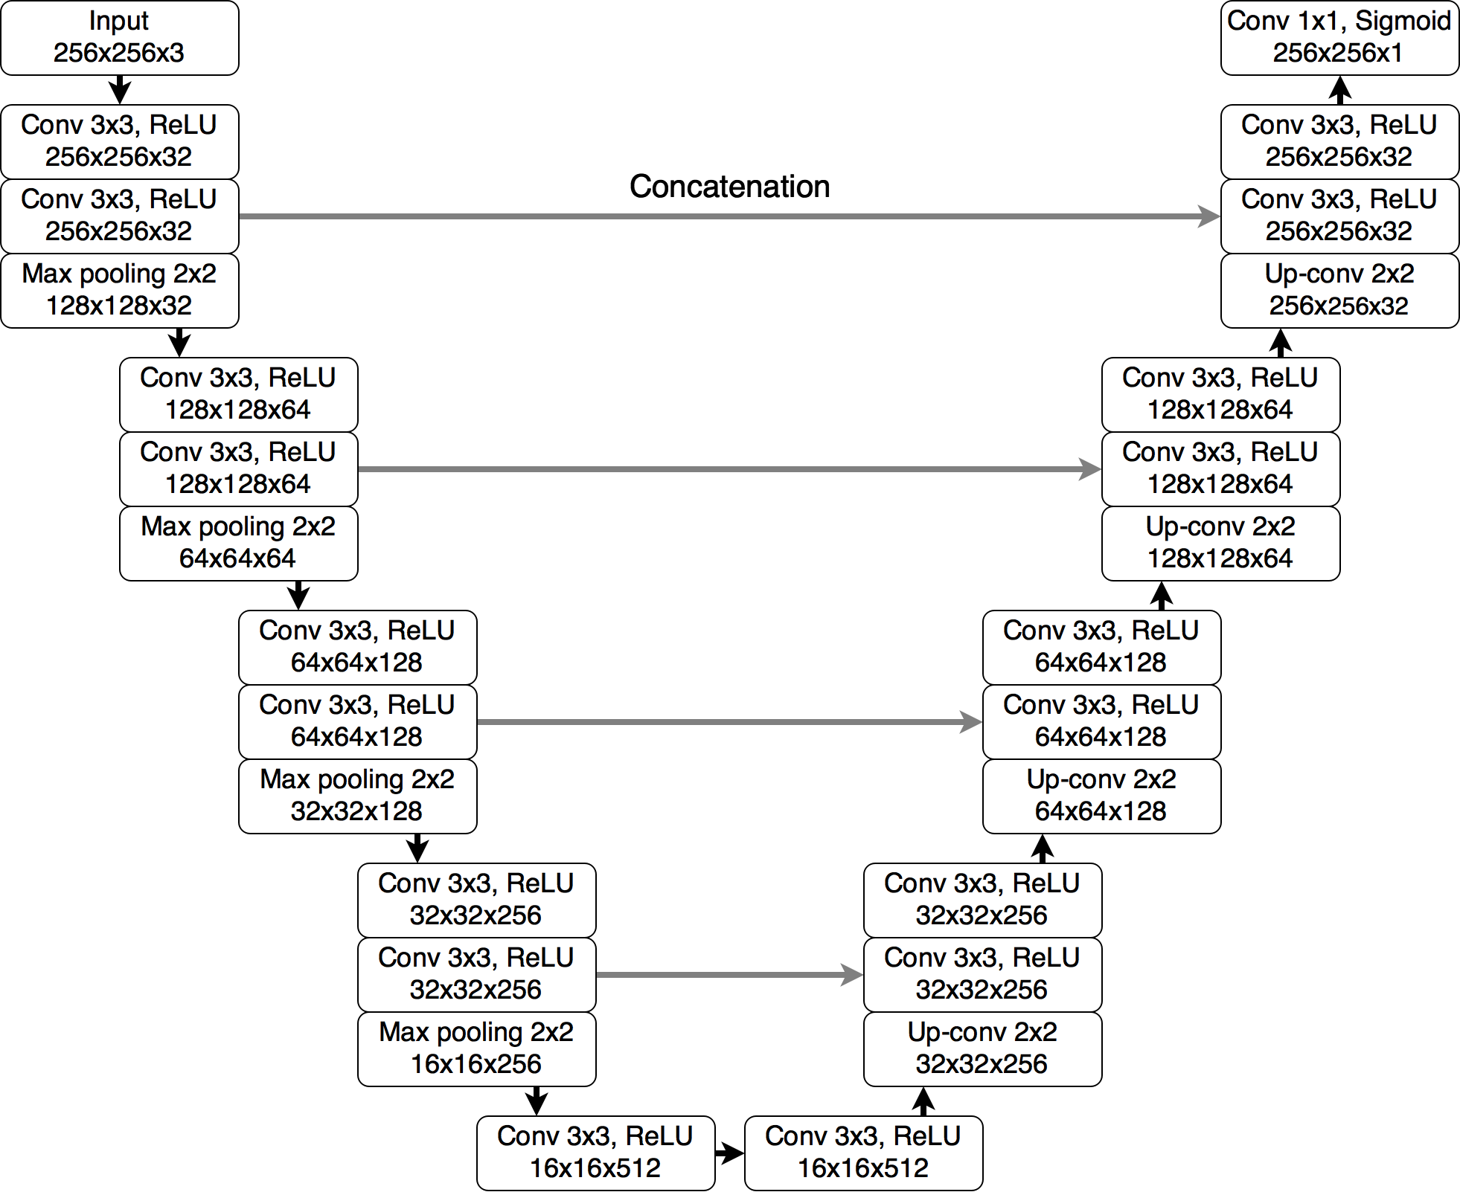
과제1 Unet
오른쪽 그림 중
1) 2) 3) 4) 번에 해당 하는 부분을
Unet code1,code2,code3,code4 에서
찾아 표시 하세요.
4
concatenate
1
3
2

Slide 7
수고하셨습니다
jhmin@inhatc.ac.kr

