Slide 1
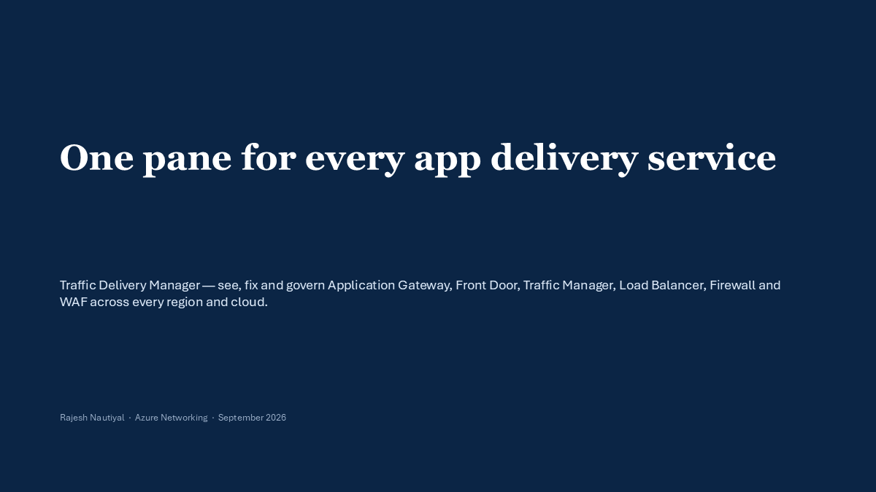
Notes:
Traffic Delivery Manager unifies health, security, resiliency, observability, and cost across application delivery services and clouds.

