Slide 1
Logic reverse engineering and runtime optimization
Markus Vogl, k11155575
Supervisor: Prof. Martina Seidl

Slide 2
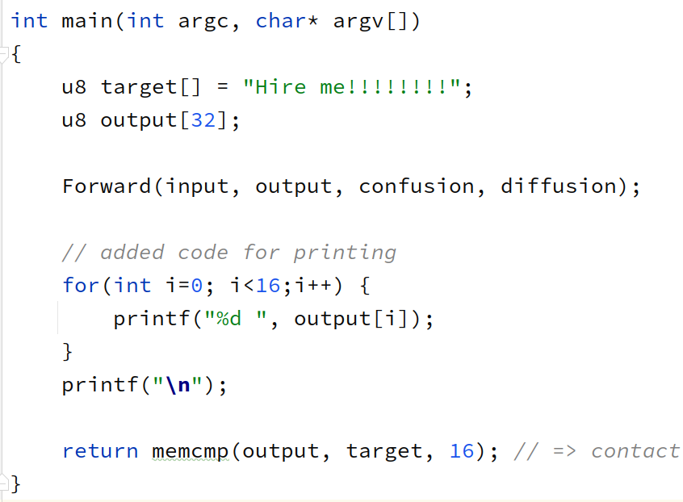
Problem statement: Hash reversal
In: 32b, Out: 16b
Const: confusion, diffusion
Hash of input == “Hire me!!!!!!!!\0”
Nintendo European Research & Development, 2019
Find 1, N, all 2^128 solutions

Slide 3
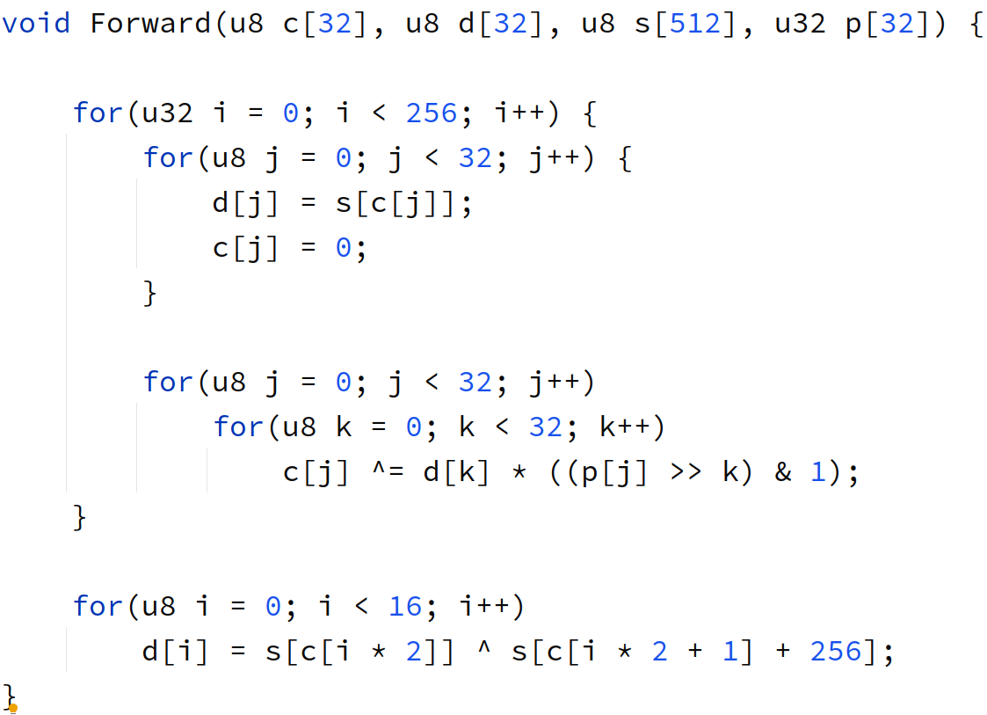
Problem Statement: 256 round “hash”
In: 32b, Out: 16b
S-Box: 32 ➔ 32
D-Box: 32 ➔ 32
S-Box 2: 32 ➔ 16
Const: s, d

Slide 4
Problem Statement: Diagram
Reversing options
in0
in1
in2
in3
...
in0
in1
0..2
0..2
s0
s1
s2
s3
...
s0
s1
1
1
d0
d1
d2
d3
...
d0
d1
2
2
s0
s1
s2
s3
...
out0
s1
1
1
out0
out1
out2
out3
...
out0
out1

Slide 5
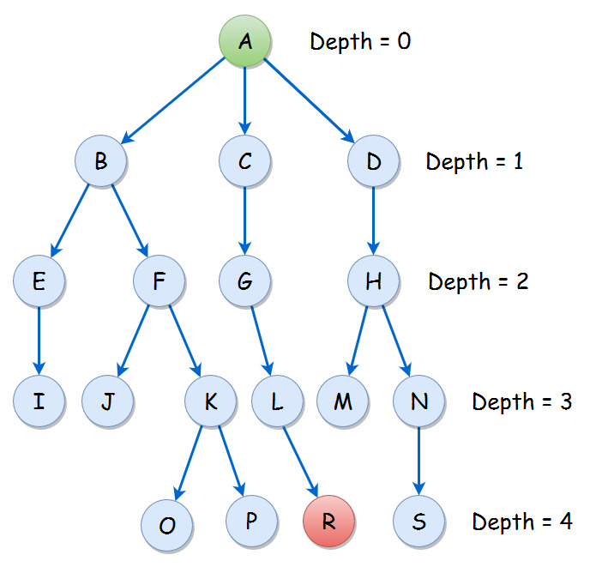
Reversing properties
Unique and non-unique lookup tables
Average Branching Factor: 1
Splitting + dead ends
256 layers

Slide 6
Prior work
Slow python solve-1 approaches [1] [2]
Only experimental proofs/analysis
Nov 20 and Nov 26: LiveOverflow video [3] [4]
  Sympy for dbox
  Runtime: 20m+ for 1 solution
  Little theoretical anlysis
No deep optimization or logic analysis
No multi-solver that turns out GB’s of solutions

Slide 7
Comparing different optimizations
Program | Device | Time in ms
native python solution | CPU | 8.515.411.968
numba | CPU | 2.165.003
heap-based CUDA | GPU | 201.165.824
heap-based C++ | CPU | 197.342
stack-based C++ | CPU | 187.158
NumPy based | CPU | 3.994.456
CuPy based | GPU | 1.169.682

Slide 8


Slide 9
Failed optimizations for this problem
Branching Code for GPUs
  GPUs are optimized for similar instructions
  Preferably big amount of “small” instructions
Bit-wise matrix operations
  Constant-Time gain of 64-bit-processors
Further simplification with logic
  Dynamic branching problems

Slide 10
Recommended optimizations
Multi-threading/processing
Reducing branching and increasing pipelining*
  Manual rewriting
  Unrolling of loops
Increasing cache-locality and memory*
  Using the program-stack and recursion
Reformulating for batch GPU computations
* Done by compilers

Slide 11
Questions
Ask!
Full report: öä.eu/nhm or https://github.com/rnbwdsh/nintendo_hireme

