Slide 1
Jeffery zeldman
Web designer
Richard N. Cooke JR.
ID1 – Professor Pang – Teach and Learn

Slide 2

Born: Queens, New York, 12 January 1955.
Educated at:
  Indiana University – Bachelors of English
  University of Virginia – Master's Degree Fictional Writing
Careers: a designer, author, educator, publisher, and entrepreneur.
Notes:
AGE: 62 years old.
OCCUPATION: Originally aspired to be writer, however he found that paying the bills was a little difficult unless your published.
CAREERS: designer, author, educator, publisher, and entrepreneur. He has done it all – Founding two major design studios, teaching at University of New York, authoring and publishing books as well as chairing events such as “An Event apart” a web designers conference.
When he isn’t busy with that, he also is the founder of “A Book Apart” publishing company, as well as participating in industry podcasts.

Slide 3

Innovations:
  Founder of the Web Standards Project.
  Responsive web design
  Web-centric layout
  Sliding Doors
  Elastic design
  Faux Columns
  CSS sprites
Author:
  Designing with Web Standards
  Taking your Talent to the Web
Notes:
WEB STANDARDS PROJECT: A project to create and standardize a universal web design language – 1998
RESPONSIVE DESIGN: Rather than a web page being nothing more than a digital print medium, responsive design allows the viewer to interact with the content. Clicking icons to create reactions, on hover commands, media queries are examples of responsive we design.
WEB-CENTRIC LAYOUT: The Mechanism on which our web designs are laid out. Items are contained in panels, and panels are arranged in towers or terraces. The digital wireframe of HTML.
SLIDING DOORS: Refers the layering of items and images at different levels within a web page. Background, Image, Text and other stacked above each other based on article presidency and instruction.
ELASTIC DESIGN: Page design that changes as requirements change, if the use increases the text viewing size, the web grows with it redefines the viewport area.
CSS SPRITES: A grouping of several images into one image to reduce loading speed.
FAUX COLUMNS: is a web design technique that allows for the creation of the illusion of equal height columns using a background image in the body.
DESIGNING WITH WEB STANDARDS – Required reading at 85 Universities including Dartmoth, Bringam Young, UCLA, and New York University.
TAKING YOUR TALENT TO THE WEB – A Guide to transitioning into the Web Design career and marketing your talents towards potential employers.

Slide 4
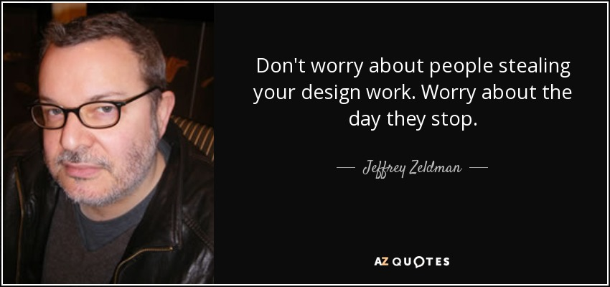
Educator:
  Founding member and Professor at the School of Visual Arts, New York.
  Professor of Interaction Design.
Notes:
ONLY TEACHS ONE NIGHT A WEEK DURING THE SUMMER SEMISTER.

Slide 5
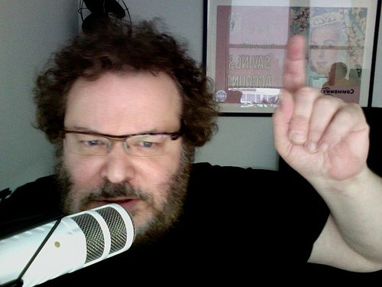
Designing With Web Standards 3rd Edition, by Jeffrey Zeldman with Ethan Marcotte,
In Defense of Font Size Widgets, December 14, 2016
Jeffrey Zeldman Shares His Advice for Aspiring Freelance Web Designers, video and article, Shopify blog, December 2, 2016
This Year More Than Ever, Blue Beanie Day Matters, November 22, 2016
20 Expert Strategies to Help Overcome Creative Blocks – Shopify Blog, September 28, 2016
Jeffrey Zeldman on agency life, the changing web and why he had to get back to his roots ,
Creative Boom, June 24, 2016
Has Design Become Too Hard? | Jeffrey Zeldman in Communication Arts,
June 2, 2016
User Defenders: Stay Enchanted with Jeffrey Zeldman (Part II),
June 1, 2016
User Defenders: Stay Enchanted with Jeffrey Zeldman (Part I),
May 9, 2016
The Web Ahead № 115: Predicting the future with Rachel Andrew, Jen Simmons, Eric Meyer, and Jeffrey Zeldman
April 29, 2016
Non Breaking Space Show № 64: Jeffrey Zeldman – Web Design History,
January 26, 2016
Ask Dr. Web—Live, 60-minute audience Q&A video with Zeldman and Sarah Parmenter,
A List Apart, December 2, 2015
Looking for Love: Standing Out from the Crowd of Web Job Seekers (Ask Dr Web),
A List Apart, November 18, 2015
Ad Blocking and the Future of the Web,
The Observer, September 23, 2015
If Ever I Should Leave You: Job Hunting For Web Designers and Developers by Jeffrey Zeldman,
A List Apart, July 30, 2015

