Slide 1
MOBILE AND CLOUD COMPUTING FINAL PROJECT TRACKIZER
NEELIMA RAMPALLI
PROF: QI ZHANG

Slide 2
SELF-INTRODUCTION
Name: NEELIMA RAMPALLI
Major: INFORMATION SYSTEM AND SCIENCE(MSIS)
Year of Study: SECOND YEAR (GRADUATE)

Slide 3
INTRODUCTION
The best iOS software that is transforming cost tracking is here to introduce you to: Trackizer. Financial management that is simple to use will replace your tedious spreadsheets. Expense monitoring is made easier with Trackizer, which also offers real-time insights into your spending patterns. Take charge of your finances like never before with our user-friendly tools and seamless connection. Try out Trackizer right now.

Slide 4
PROCESS
Conceptualization: Define the app's purpose, target audience, and core features. Identify the need for expense tracking and outline how Trackizer will address it.
Market Research: Analyze existing expense tracking apps, identify strengths and weaknesses, and determine opportunities for differentiation.
Design: Develop wireframes and mockups to visualize the app's user interface (UI) and user experience (UX). Ensure simplicity, clarity, and intuitiveness in design.

Slide 5
PROCESS
Development: Utilize iOS development tools and frameworks like Swift and Xcode to build the app's frontend and backend functionality. Implement features such as expense logging, categorization, and reporting.
Testing: To find and address any problems or flaws, carry out thorough testing. To make sure the app is responsive, test it on a range of iOS devices with different screen sizes.
Refinement: To improve the app's functionality and usability, get input from users and beta testers. Iteratively improve the product in light of user feedback.

Slide 6
PROCESS
Deployment: Send the application for evaluation and approval to the Apple App Store. Verify adherence to Apple's policies and procedures.
Launch: After receiving approval, deploy the software on the software Store and implement a marketing plan to publicize its release.
Maintenance: Keep an eye out for bugs, performance problems, and user input on the app. Release patches and updates to improve functionality and fix any problems.

Slide 7
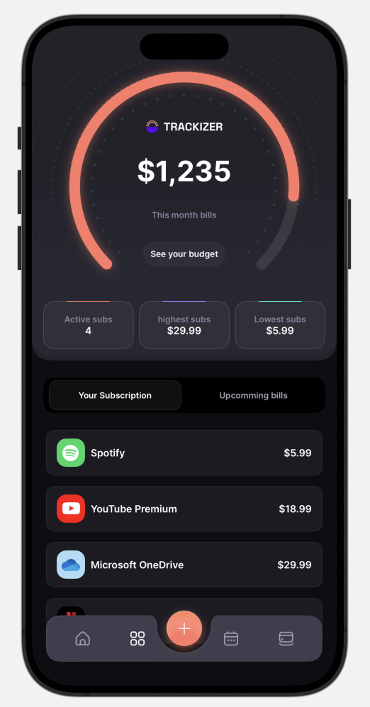
HOME PAGE:
This is the home page of Trackizer IOS app.
It shows the expenses that you've made as an arc it diagramatically shows the leftover budget.
It also shows number of active subscriptions , highest and low subscription values.
It also shows the individual subscription prizes and their upcoming bills.

Slide 8
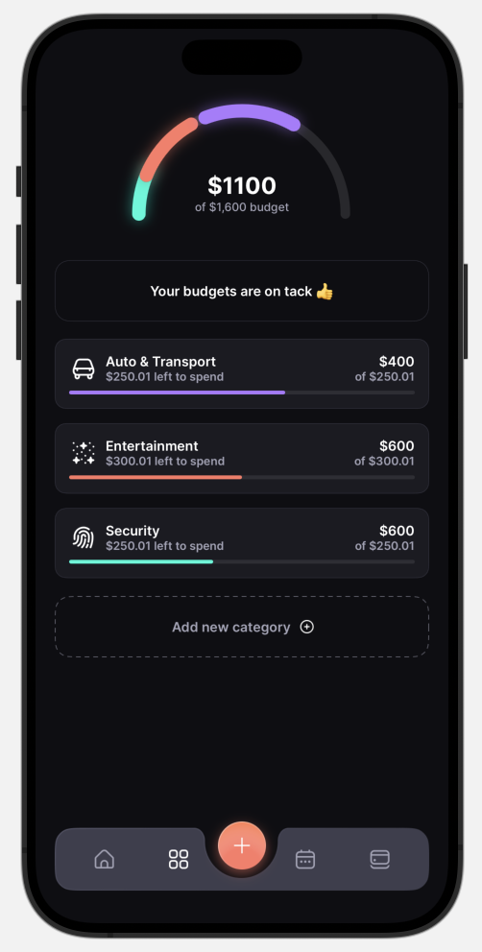
BUDGET PAGE:
This is Budget page and it shows the expenses we made in the last month and it also shows the balance budget.
This page also helps us to manage and decrease the expenses for not to override the budget.

Slide 9
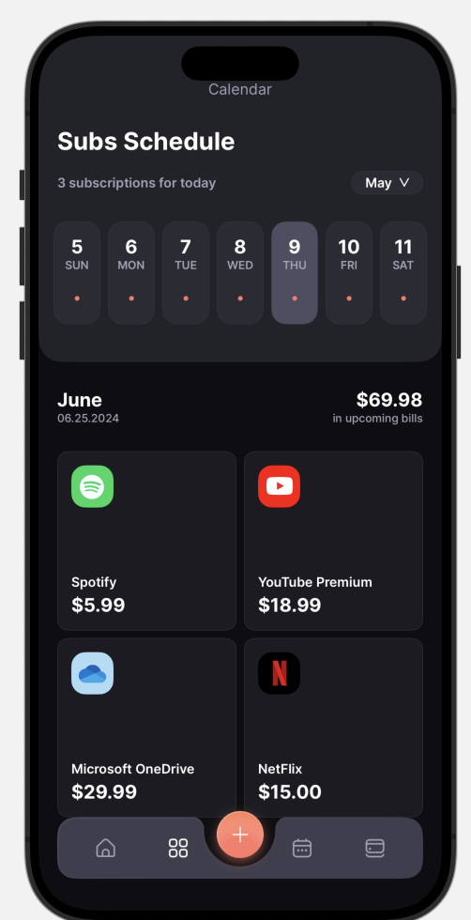
CALENDAR VIEW:
This is calendar view page.
It shows the date of that day along with the next subscription date.
It acts as a reminder page which reminds the next billing date.

Slide 10
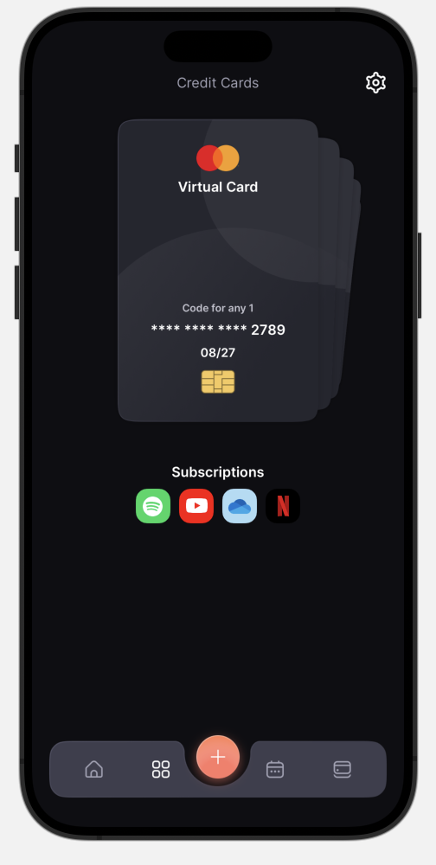
CARDS PAGE:
This is a cards view page.
This page shows all saved cards that are being used for payments.
Its also have the settings button which redirects to the settings page which contains profile edit option etc.,

Slide 11
RESEARCH:
Conducting research for a website that tracks expenses entails a thorough investigation of multiple sites. It's crucial to first comprehend the state of the market by examining the features, user interface, and competitive placement of the many expense tracker websites that are currently available. Finding opportunities and gaps for innovation and distinction is made easier with the help of this analysis. It is critical to perform user research, which includes questionnaires, interviews, and usability tests, in order to understand user preferences, needs, and pain points related to tracking expenses.

Slide 12
RESEARCH CONTD:
In addition, researching emerging technologies can help with decision-making when it comes to implementing cutting-edge features, such as blockchain-based security or AI-powered classification. Furthermore, carefully examining pricing schemes, client testimonials, and rival tactics provides priceless information about industry standards and viable winning tactics.
References
References

Slide 13
DEMO

Slide 14
THANK YOU

