Slide 1
Strings
CSCE 150EFL

Slide 2
Strings
A string is simply a series of characters
They are similar to arrays in that each symbol (letter, number, punctuation, space, etc.) in the string is stored next to each other and is of type CHARACTER
You can even access individual characters or substrings by using bounds (like arrays)
The second character in string STR is STR(2:2)
The second and third are STR(2:3)

Slide 3
Creating Strings
To create a string, specify the length on a CHARACTER
Example
CHARACTER(LEN=2) :: A
CHARACTER(LEN=8) :: B
CHARACTER(LEN=47) :: C
A can hold two symbols, B 8, and C 47.

Slide 4
String Functions
There are a number of functions for working with strings
While it may differ on other systems and compilers (really, really old ones), all strings are worked with as series of ASCII values
When comparing STR1 > STR2, it checks to see if the ASCII values of STR1 > the ASCII values of STR2
Table 10-2, page 463

Slide 5
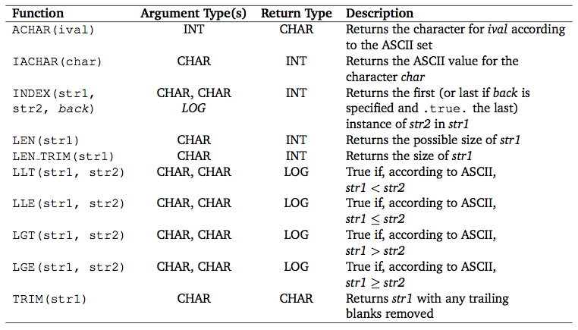
String Functions

Slide 6
INDEX
Searches for str2 inside of str1
If not found, it returns 0
The back variable is italicized on that table
That means it’s optional; these are the same
var = INDEX(s1, s2)
var = INDEX(s1, s2, .FALSE.)
If you set it to true, it will look for the last instance of str2 in str1; if you don’t use it or set it to false, it will look for the first instance of str2 in str1

Slide 7
Passing Strings to Subroutines
Similar to arrays, you need to give some size when passing a string to a subroutine
The dimension for an array
The length for a string
For subroutines, simply use * as the length
You can use LEN or LEN_TRIM to find the size later
You can specify a length, but then it allows only strings of that length

Slide 8
Returning Strings
Returning a string from a subroutine is the same as returning any other data type
Example
CHARACTER(LEN=50) FUNCTION A()
CHARACTER(LEN=50) :: RET
RET = “Hi! I’m a string”
A = RET
END FUNCTION A

Slide 9
Passing Strings to Subroutines
PROGRAM myApp
CHARACTER(LEN=8) :: STR
STR = ‘Hi there’
CALL DoSomethingWithString(STR)
END PROGRAM myApp
SUBROUTINE DoSomethingWithString(S)
CHARACTER(LEN=*), INTENT(IN) :: S
END SUBROUTINE DoSomethingWithString

Slide 10
Concatenation
To concatenate (add together) two strings, use //
Example
CHARACTER(LEN=3) :: ONE
CHARACTER(LEN=5) :: TWO
CHARACTER(LEN=8) :: THREE
ONE = “Hi “
TWO = “there”
THREE = ONE // TWO ! “Hi there”

Slide 11
Exercise
The test script is ~cse150efl/bin/test 9
You can compile and run manually with gfortran week9.f95 ~cse150efl/files/week9-main.f95
You can view the main program’s source with cat ~cse150efl/files/week9-main.f95

Slide 12
Exercise
Filename: week9.f95
Save this from the website to your Z:
You do not need to write a main program
Complete the module STRING (in week9.f95) that implements four string-related functions
The main program uses it to do some work with strings
The comments tell you the names of the functions, their return types, what value should be returned under what circumstances, and the number and type of parameters

Slide 13
Reminders
Handin:
http://cse.unl.edu/~cse150efl/handin
Compile:
gfortran filename
e.g., gfortran file.f95
Run:
a.out

