Slide 1


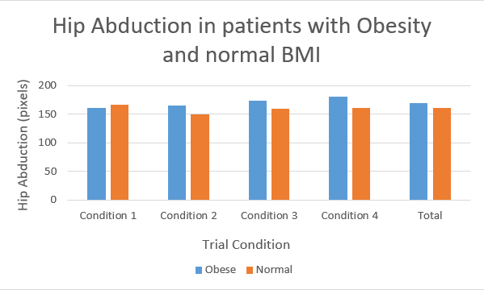
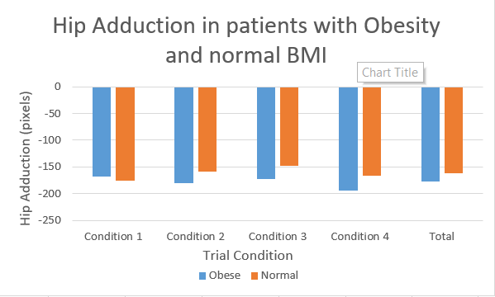
Hip Movement Strategies during Virtual Obstacle Crossing between Adults with
Obesity and Normal Body Mass Index
Raghu Nema
Motor Development Lab, Undergraduate Research Program
Research Question
Experimental Procedure
Results
What are the differences in amount of hip abduction and adduction during virtual obstacle crossing between adults living with obesity and adults without obesity?
Body-worn sensors (IMUs) were attached to participants’ waists, thighs, and shins to measure angular velocity data
Participants had one practice block before they completed five blocks with 20 Trials each consisting of 5 different Trial Conditions
Conditions:
Condition 0: No obstacle
Condition 1: Obstacle appears prior to cue
Condition 2: Obstacle appears with cue
Condition 3: Obstacle appears with movement onset
Condition 4: Obstacle appears at 20% of movement amplitude
Obesity and Alternative Movement Strategies
Individuals with obesity use different strategies to cross obstacles; moving their hips in a wide arc either outwards (Abduction) away or inwards (Adduction) from the center of their bodies
These strategies are reasonable to use when crossing obstacles. However, people with obesity have challenges with balance, which increases the risk of falling, particularly when using strategies that may tip them off balance
These differences in movement may also limit opportunities for those living with obesity to engage in physical activity
Results
Results were calculated as the amount of pixels participants moved from the center (0,0). Positive movement, to the right, was hip abduction. Negative movement, to the left, was hip adduction.
People with obesity used a hip adduction strategy more often (55.6%) when avoiding obstacles, compared to controls who tended to use a hip abduction strategy (53.5%), p < .001.
The group with obesity also showed greater degrees of hip adduction (p < .05) and abduction (p < .05) than the control group.
For both movement strategies, people with obesity had higher average movement than people without obesity.
Condition 4: people with Obesity had a mean hip adduction of -194.41, the control group had a mean of -166.45.
No significant interaction between hip movement and condition was found
We found interactions between hip adduction and group (p = 0.036) and hip abduction and group (p = 0.043).
No interaction between Trial Condition and Group were found
Participants
12 adults with obesity (BMI > 30, Age: 18-64 years)
14 adults with normal weight (18.4 < BMI < 25, Age: 18-64 years)
Conclusions
These alternative strategies might be attributed to decreased dynamic sitting balance and movement control.
These results highlight the utility of seated virtual tasks in revealing underlying impairments in motor control in individuals with obesity.
Virtual Avoidance Task
References
Peggy P.K. Lai, Aaron K.L. Leung, Agnes N.M. Li, M. Zhang, Three-dimensional gait analysis of obese adults, 2008
Gill, S. V., & Hung, Y. C. (2014). Effects of overweight and obese body mass on motor planning and motor skills during obstacle crossing in children.
Participants sat in front of the monitor at eye-level. They used their right leg to move the green dot on the screen to the red dot, while avoiding any obstacle that was presented in between the two dots.
Funding Acknowledgements
Undergraduate Research Opportunities Program

