Slide 1

Medical Health Insurance
Cost Prediction
By – Rakesh Nemu, Ankit Lakra
DST-CIMS BHU

Slide 2

What is Medical Health Insurance ?
Health insurance (sometimes called health coverage) pays for some or all of the cost of the health services you receive, like doctors’ visits, hospital stays, and visits to the emergency room. It helps keep your health care costs predictable and affordable.
Deeper definition : Health insurance is a contract where an insurance company provides medical coverage to the insured for a premium amount. It covers medical expenses incurred on hospitalization, surgeries, day care procedures, etc. A health insurance policy either reimburses the medical costs or offers cashless treatment.

Slide 3
Why to predict Medical Health Insurance Cost ?
Nowadays, the expenses of health care increases. Insurance is a policy that eliminates or decreases loss costs occurred by various risks. As there are a greater quantity of new viruses stepping into human beings, there's a want to expect health costs. This form of prediction allows the governments to decide regarding health issues. People are aware of the importance of health care costs. Various factors affect the coverage price. These issues make contributions to the insurance policy method. If human calculate he doesn't get proper accuracy. But insurers can do this task properly, who uses several tools to calculate the insurance premium. ML is one of the helping tools that helps to build model to formulate the policy. ML models can be learned by themselves. The model is trained on insurance data from the past. In this project, we want to predict health insurance cost with better accuracy by using different regressor machine learning algorithm.

Slide 4
How can we predict?
In this project, the experiment is the supervised regression problem. So we have used several machine learning algorithm to predict medical health cost insurance with better accuracy. The used algorithms are:
Linear regression
Multiple Linear Regression
Polynomial Regressor
Decision tree Regressor
Random Forest Regressor
XGBoost Regressor
k-Nearest Neighbors Regressor
Gradient Boosting Regressor
Ada Boost Regressor

Slide 5
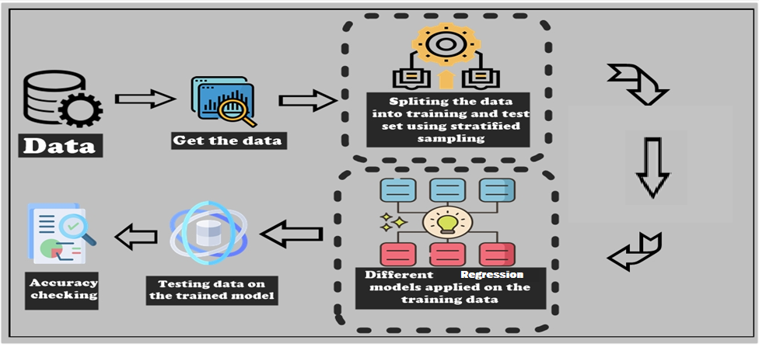
Project Process

Slide 6
Few Terminologies
Linear Regression :- It is a statistical method that is used for predictive analysis. Linear regression makes predictions for continuous or numeric variables. Linear regression algorithm shows a linear relationship between a dependent (y) and one or more independent (y) variables, hence called as linear regression
Polynomial Regression :-Polynomial Regression is a form of Linear regression known as a special case of Multiple linear regression which estimates the relationship as an nth degree polynomial. It is a linear model with some modification in order to increase the accuracy. In Polynomial regression, the original features are converted into Polynomial features of required degree (2,3,..,n) and then modelled using a linear model.
Decision Tree :- Regression models in decision tree regression builds in the form of a tree structure. It is a tree-structured classifier with three types of nodes namely root node, interior node and leaf node. This algorithm is very useful for solving decision-related problems.
Random Forest :- It is a bagging technique. It is made by combining different model. It builds decision trees on different samples and takes their average in case of regression. An important feature of the Random Forest Algorithm is that it can handle the data set containing continuous variables as in the case of regression.
Gradient Boost :- It is a type of boosting algorithm. It relies on the intuition that the best possible next model, when combined with previous models, minimizes the overall prediction error. The key idea is to set the target outcomes for this next model in order to minimize the error.

Slide 7
AdaBoost :- It is another type of boosting. An AdaBoost regressor is a meta-estimator that begins by fitting a regressor on the original dataset and then fits additional copies of the regressor on the same dataset but where the weights of instances are adjusted according to the error of the current prediction.
XGBoost :-XGBoost, which stands for Extreme Gradient Boosting, builds upon: supervised machine learning, decision trees, ensemble learning, and gradient boosting. It is a highly accurate implementation of gradient boosting that pushes the limits of computing power for boosted tree algorithms, being built largely for energizing machine learning model performance and computational speed.
K-NN :- K-NN (means K-nearest neighbors) is a simple algorithm that stores all available cases and predict the numerical target based on a similarity measure (e.g., distance functions). KNN has been used in statistical estimation and pattern recognition already in the beginning of 1970’s as a non-parametric technique.

Slide 8
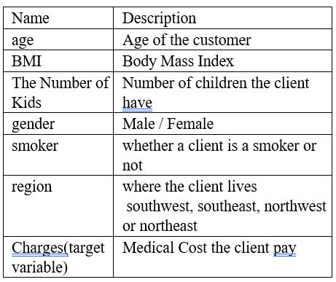
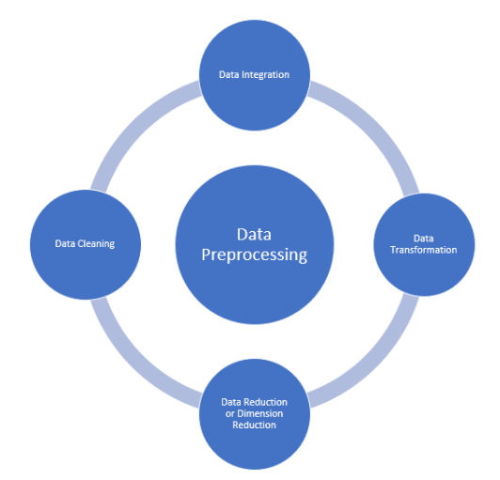
Dataset – Introduction & EDA
We have taken dataset from Kaggle site. The data set includes seven attributes see Table . We have divided the data set in two part in 3:1 ratio- training data and test data.
Data pre-processing is the process of transforming raw data into an understandable format. It is also an important step in data mining as we cannot work with raw data. The quality of the data should be checked before applying machine learning or data mining algorithms.

Slide 9
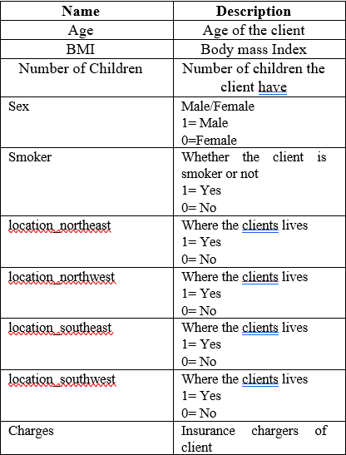
One Hot Encoding
One hot encoding is one method of converting data to prepare it for an algorithm and get a better prediction. With one-hot, we convert each categorical value into a new categorical column and assign a binary value of 1 or 0 to those columns.
Here the “Region” variable could have values
“Northeast”, ”Northwest”, ”Southeast” and ”Southwest”. After applying one hot encoding we have created individual column for different value of region variable.
The dataset becomes -

Slide 10
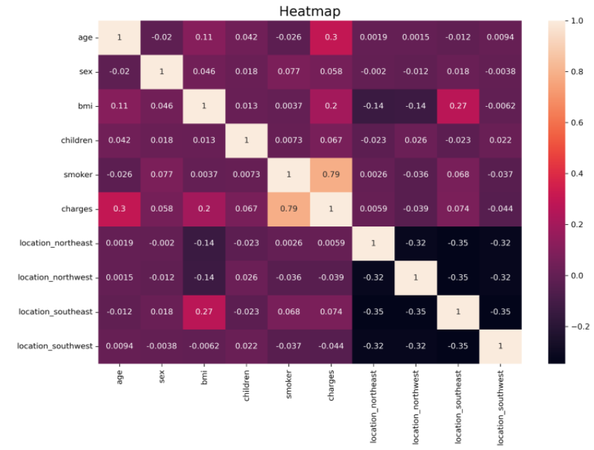
Correlation between Numerical variable after feature encoding
The above figure shows that variables which most influenced charges are age, bmi and smoker.

Slide 11
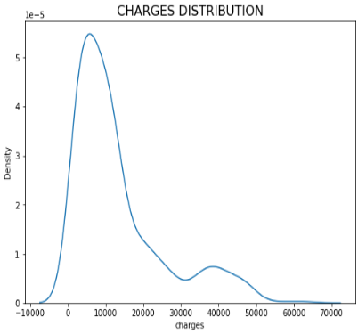
Graphical visualization of target variable
The mean value of “charges” Variable is greater than the median value. This implies that the distribution of charges is right skewed

Slide 12
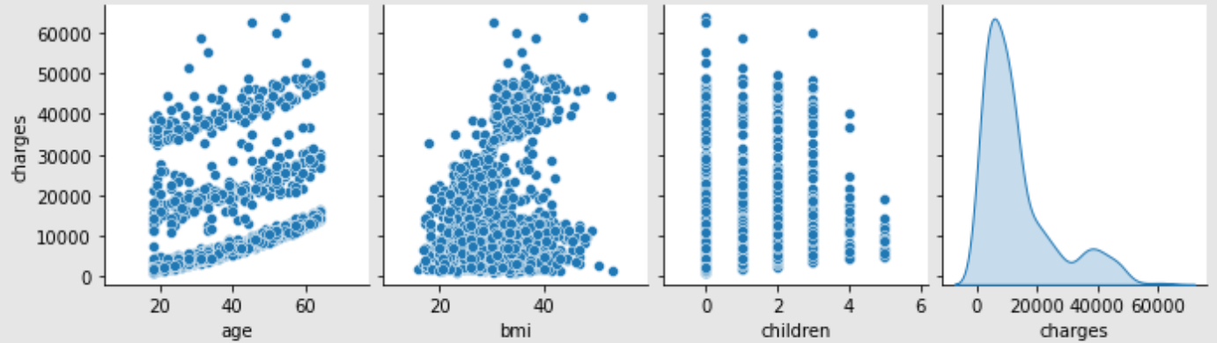
Graphical plot between target variable and numerical variable
(Age,BMI,children and charges)

Slide 13
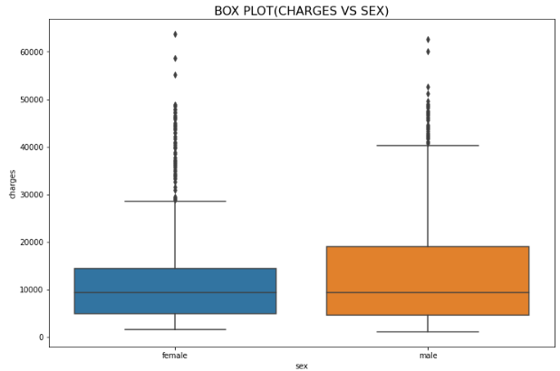
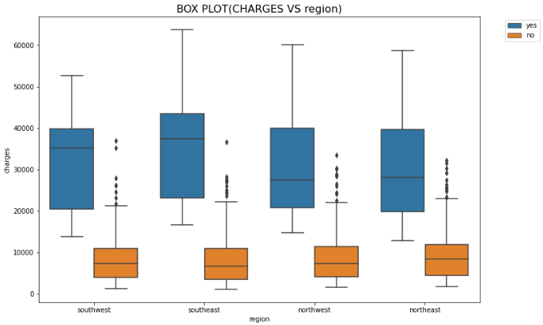
Box plot between sex & charges
Box plot between region & charges
The impact of gender variable on charges
The impact of the region variable on charges according to the smokers

Slide 14
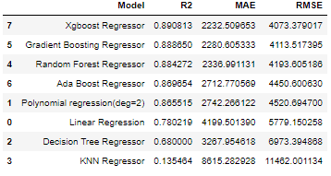
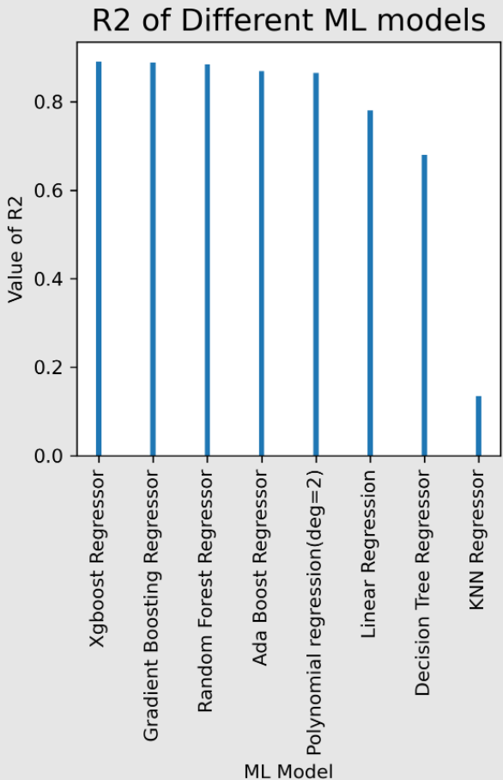
Result
Performance model
Comparison of R-squared values of different ML model graphically.
Best Model :- XGBoost Regressor
Accuracy :- 89.08%

Slide 15
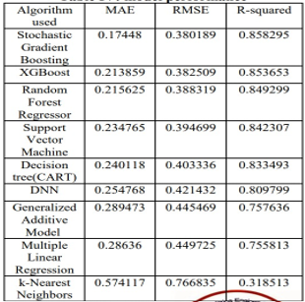
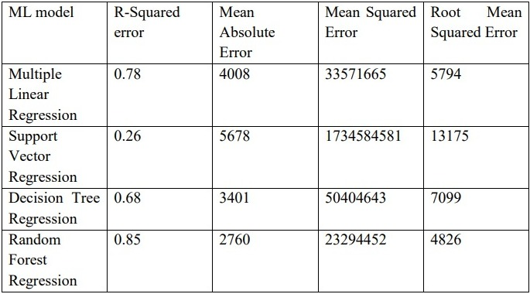

Accuracy Score Comparison
Result table of the other available paper about this topic.
R-squared
0.73
0.83
Here in this paper, we have improved the accuracy of the model successfully with respect to other available papers. We have also used Polynomial regression model which has given better result. We have got best accuracy in XGBoost model.
Result table of this paper

Slide 16
Conclusion
In this paper we have used various machine learning regression models to predict health insurance charge based on specific attributes. We have got 89.08% accuracy by XGBoost (eXtreme Gradient Boosting) regressor which is no doubt a great accuracy achieved of this kind of problem.
To increase the data records of our data set we have also applied data augmentation and got 28098 data records. But this augmentation was not successful because when we applied several ML model over the new dataset which we got by data augmentation, decreases the accuracy.
Predicting insurance charges based on certain factors help insurance policy providers to attract consumers and save time in formulating plans for every individual. ML models can do cost calculation in a short time, while a human being would be taking a long time to perform the same task. This will help businesses improve their profitability.

Slide 17
Future work
we have reached a very good accuracy, it’s not the end. We will try our best to improve the model to get 100% accuracy where our model can correctly predict health insurance charged by the health insurance company.
More data always increases the accuracy of any algorithm. So, getting more data is an issue. In future, if more data is available from public health insurance companies than we can improve the accuracy.

Slide 18
THANK YOU ALL

