Slide 1

Poker Hand Classification
Group Name:
Poker Kings
Group Members:
Rakesh Nemu
Sameer Srivastava

Slide 2
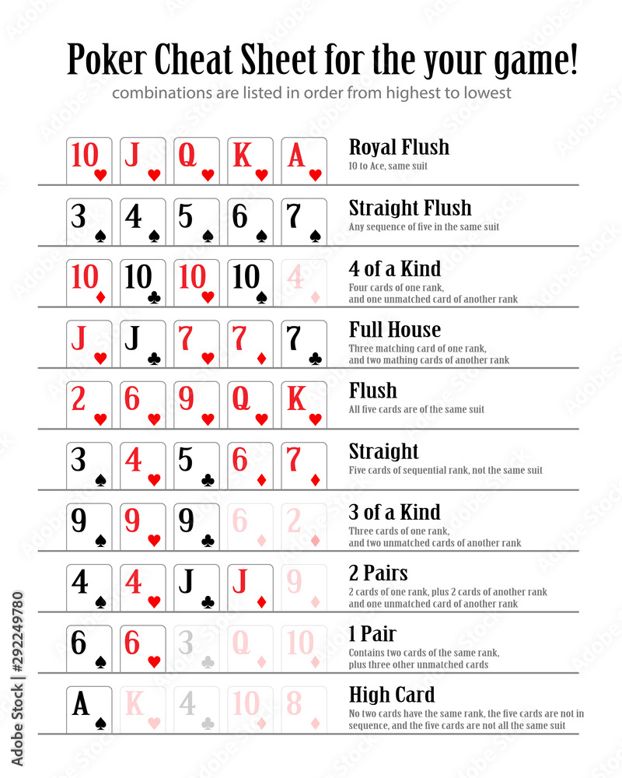
What is this Project?
To classify poker hands into 10 predefined categories as shown in the image.
Dataset for this problem has 10 predictive attributes and 1 target attribute. Source UCI ML repository Poker hand dataset
Each datapoint has information about 5 cards, odd numbered columns represent the suit information, (1-4) representing {Hearts, Spades, Diamonds, Clubs} and even numbered columns represent rank information of the card. And last column represent the poker hand combination label,(0- high card, 9-Royal Flush)
Eg. 1,10,1,11,1,13,1,12,1,1,9 (Royal Flush)

Slide 3
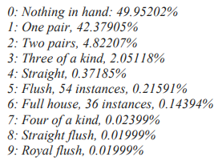
Why this Project?
Dataset distribution is given in the image, 90% of the data is concentrated in initial two classes hence the dataset is highly imbalanced.
Due to imbalance, Models struggle to classify the minority classes (Royal Flush) leading to very less accuracy.
We want to improve the accuracy of models by feature engineering.
An important application of this project is that a precise classification model benefits novice players by easily identifying the ten possible Poker hands and also strength of the corresponding poker hand.

Slide 4
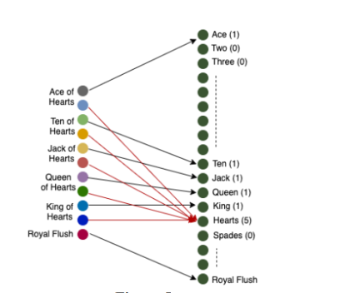
Literature Review
Walinton Cambronero (link) proposed a linear transformation method for the data.
Original data is of 10 dimension, it will be transformed into 17 dimension as given in image.
Thomas Angeland et.al. (link) addresses this imbalance problem using regular imbalance handling techniques like SMOTE etc.
Author found out that usual imbalance handling methods did not improve the model accuracy in this problem.

Slide 5
Proposed Methodology
As this is not a usual imbalance problem so to improve the accuracy of classification models four step methodology is followed as mentioned below:
Transforming the Dataset using feature engineering.
Training different classification models on dataset containing 10 lacs sample points.
Testing the model accuracy on 25000 sample points provided in UCI dataset and testing the best model on 26 lacs exhaustive sample dataset created by us.
Comparing accuracy among used models and also with state of the art result.

Slide 6
Need of Data transformation:
In original dataset order matters,
in transformed dataset, order does not matter, following things are explicitly mentioned:
how many cards from of the respective rank are there in a hand
how many cards belongs to the same suit.
Checking consecutive rank cards are present or not.
Checking the unique royal flush property.
Benefit: data becomes more machine friendly which results in better classification.

Slide 7
Example of data transformation
Data: 1,1,1,10,1,11,1,12,1,13,9 (1 for hearts)
Representation in new dimensions (17D)
Data: 1,0,0,0,0,0,0,0,0,1,1,1,1,5,0,0,0,9
Encodes: 1st column = 1 ace, 10th through 13th columns = 10, Jack, Queen and King, 14th column = 5 cards are hearts, and 18th column a Royal Flush.
additional two columns in 19D transformation
If five consecutive cards are present in a hand which means 5 consecutive ones are present in column 1 to 13 then the value of 18th column is 1 otherwise 0
If Ranking positions 0(Ace), 9(jack), 10(jack), 11(Queen), 12(king) has 1 (they are present in hand) and all belong to same suit (any of the feature value between 14 to 17 is 5) then value of 19th column is 1 otherwise 0.
Above given example of Royal Flush of Hearts after this transformation will look like this:
Data: 1,0,0,0,0,0,0,0,0,1,1,1,1,5,0,0,0 ,1,1,9

Slide 8
Implemented Models
Decision Tree
Random Forest
KNN
Naïve Bayes
Ada Boost

Slide 9
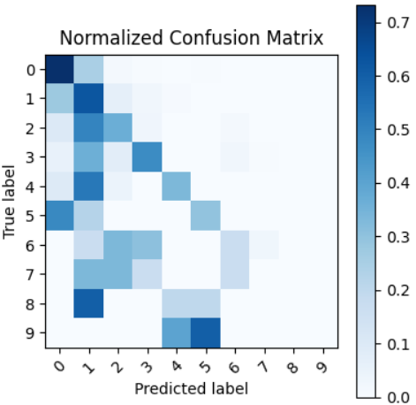
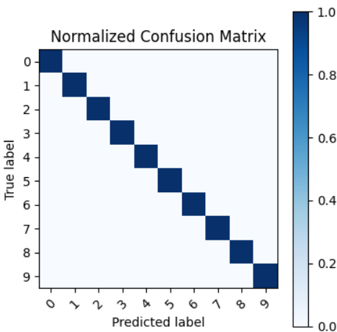
Results:
Decision Tree:
Macro F1 score for base dataset is 0.28 and after transformation macro F1 score improves to 1 (All the sample points are correctly classified). Confusion Matrix for this model is given below:
For Base Dataset (10 D)
For Base Dataset (10 D)
For Transformed Dataset (19 D)

Slide 10
Results:
Decision Tree:
Macro F1 score for base dataset is 0.28 and after transformation macro F1 score improves to 1 (All the sample points are correctly classified). Confusion Matrix for this model is given below:
For Base Dataset (10 D)
For Base Dataset (10 D)
For Transformed Dataset (19 D)

Slide 11
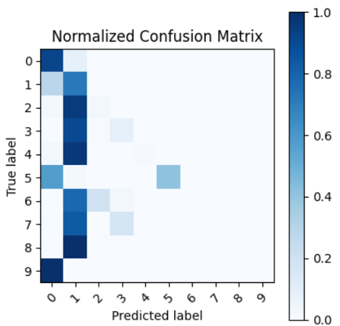
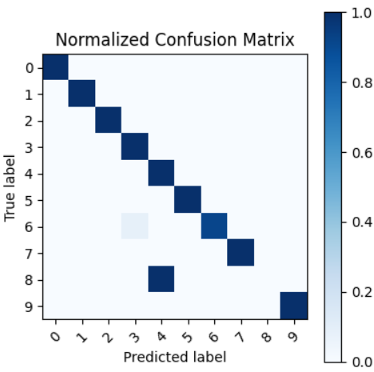
Results:
Random Forest(n_estimators=50,weight=“balanced subsample):
Macro F1 score for base dataset is 0.24 and after transformation macro F1 score improves to 0.89. Confusion Matrix for this model is given below:
For Base Dataset (10 D)
For Transformed Dataset (19 D)

Slide 12
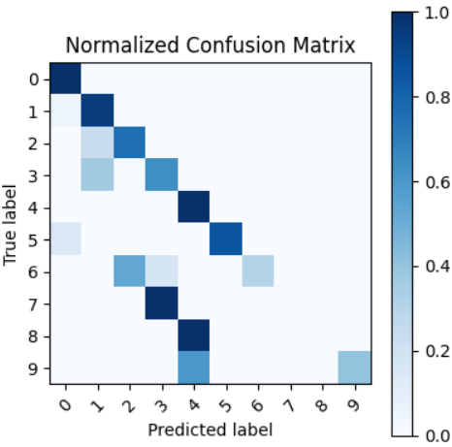
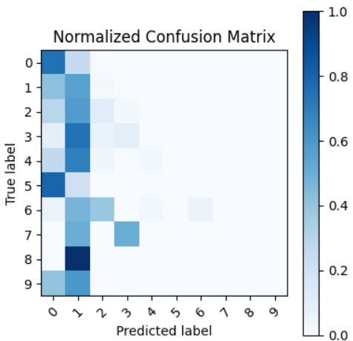
Results:
KNN Classifier(K=3):
Macro F1 score for base dataset is 0.17 and after transformation macro F1 score improves to 0.66. Confusion Matrix for this model is given below:
For Base Dataset (10 D)
For Transformed Dataset (19 D)

Slide 13
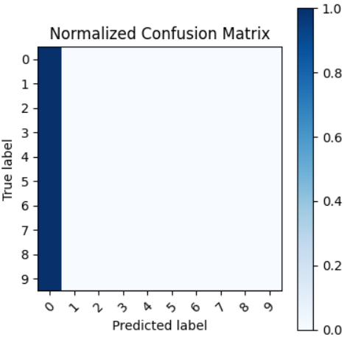
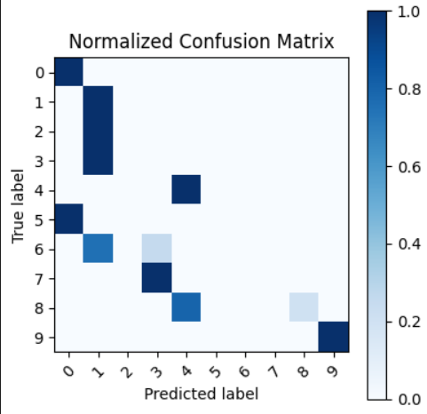
Results:
Naïve Bayes Classifier:
Macro F1 score for base dataset is 0.07 and after transformation macro F1 score improves to 0.42.Confusion Matrix for this model is given below:
For Base Dataset (10 D)
For Transformed Dataset (19 D)

Slide 14
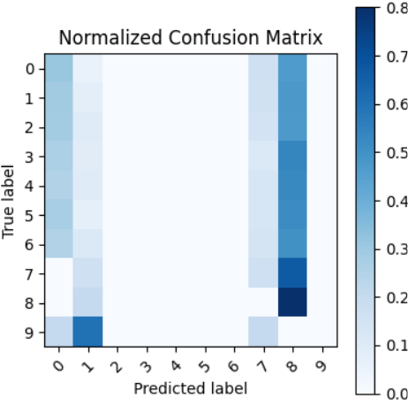
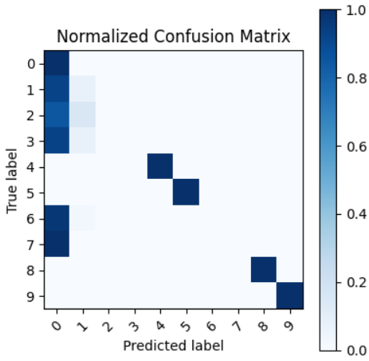
Results:
Ada Boost:
Macro F1 score for base dataset is 0.05 and after transformation macro F1 score improves to 0.48. Confusion Matrix for this model is given below:
For Base Dataset (10 D)
For Transformed Dataset (19 D)

Slide 15
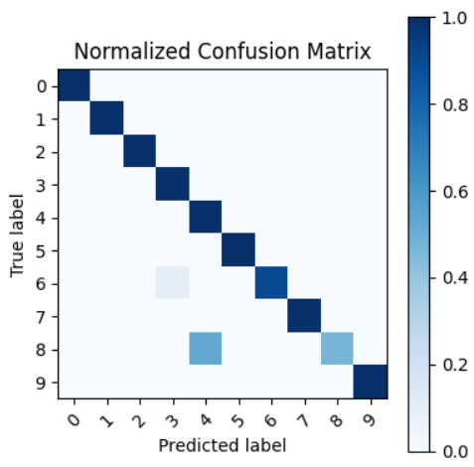
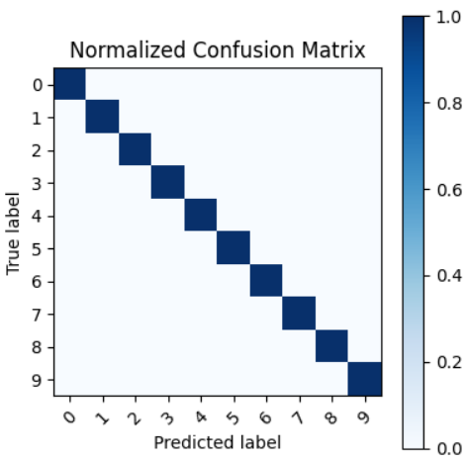
Testing best models on exhaustive dataset of 26 lakh unique samples:
Decision Tree and Random forest are the best models. We have tested these models on exhaustive 2.6m sample dataset. For Decision Tree, F1 score is 1 and for Random Forest, F1 score is 0.94.The confusion Matrix for both models given Below :
For Decision Tree
For Random Forest

Slide 16
State of the art comparison and Conclusion:
The following table shows the comparison of results of different model used by Walinton Cambronero[link] (17D transformation) and after 19D transformation proposed by us.
Models | Accuracy for 17D | Accuracy for 19D
Decision Tree | 0.69 | 1.00
KNN | 0.51 | 0.66
A significant improvement in accuracy of the models is observed after transforming the dataset. Decision tree model is giving the best result to classify the poker hand, we have tested 26 lacs exhaustive sample dataset on the trained model. F1 score for the model is 1 which is actually a good result.

Slide 17


