Slide 1

Telecom Customer Churn
Ravindra Neralla
Dsc 530

Slide 2
Introduction:
Customer churn is one of the most important concerns and major problem for large companies. Customer churn directly impacts revenues of large corporations, especially in subscription based industries like telecom filed. So, companies are working on developing technologies to predict potential customer to churn. Therefore, finding factors that increase customer churn is important to take necessary actions to reduce customer churn. The telecommunications sector has become one of the main industries in developed countries. One of the main strategies in generating more revenue is increase the retention period of customers.
Objective:
Primary objective of the analysis is predicting customer churn. I started the analysis by investigating the Telco Customer data set to see if there are any characteristics that would help to predict the customer churn. So, these variables could be single or multiple variables going to impact customer churn.

Slide 3
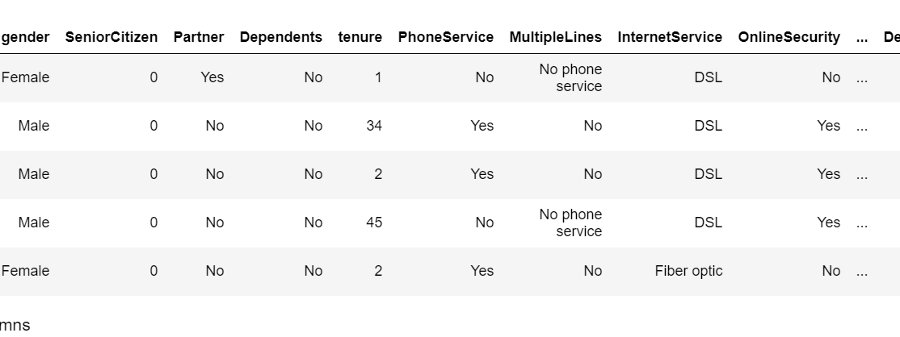
Customer Sample Data

Slide 4
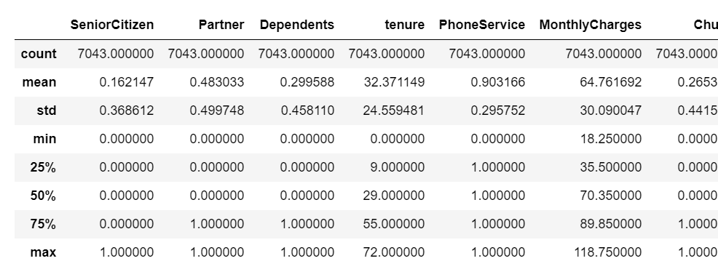
Summary of the Customer Data
Customer tenure ranges from 1 month to 72 months, this can be divided into groups to see the impact of tenure on churn

Slide 5
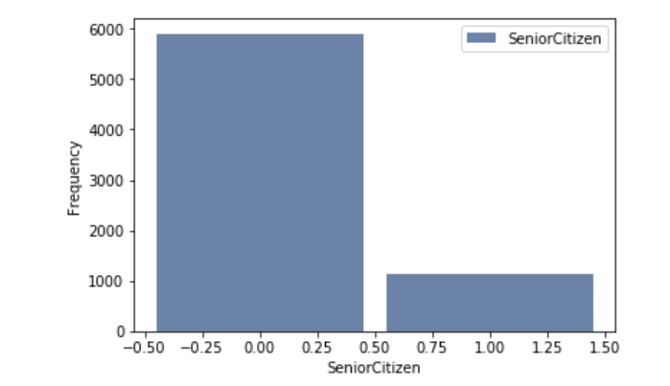
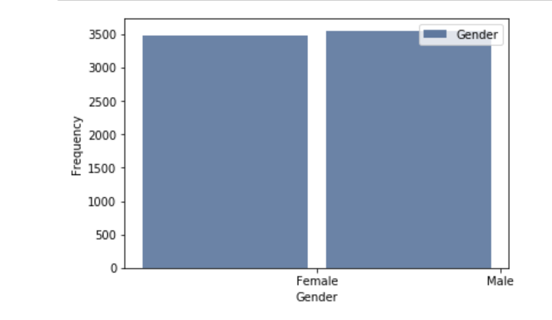
Customer Distribution
Customers distribution based on gender is almost equal.
Most of the customers are younger people and small percentage are Senior citizens

Slide 6
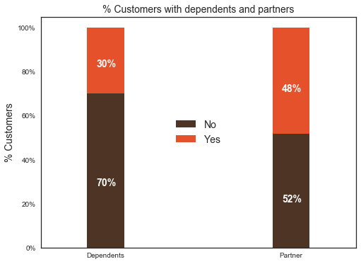
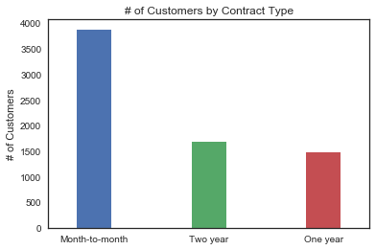
Customer distribution wrt Dependents and Partners also by Contract Type
About 50% of the customers have a partner, while only 30% of the total customers have dependents.
More percentage customers on Month-to-Month contract and less number of customers are on long term contracts.

Slide 7
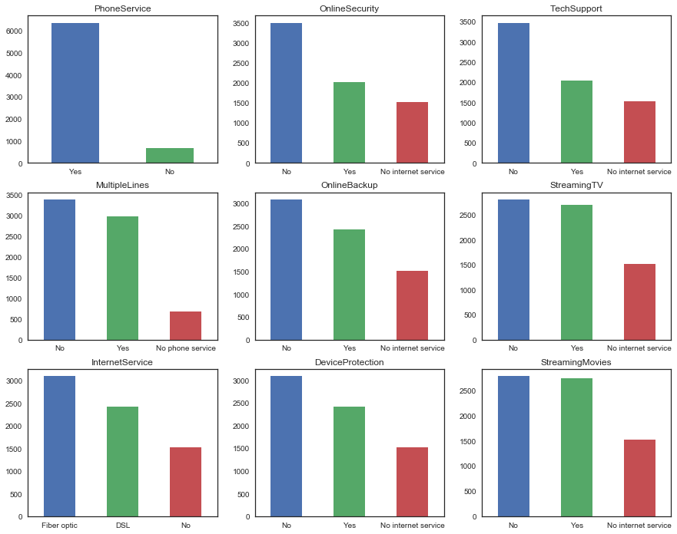
Customer distribution based on Service Type

Slide 8
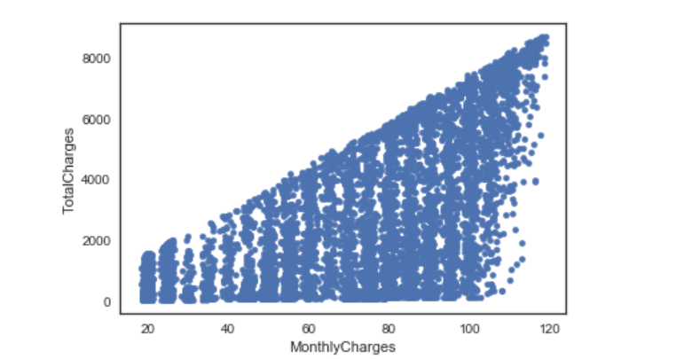
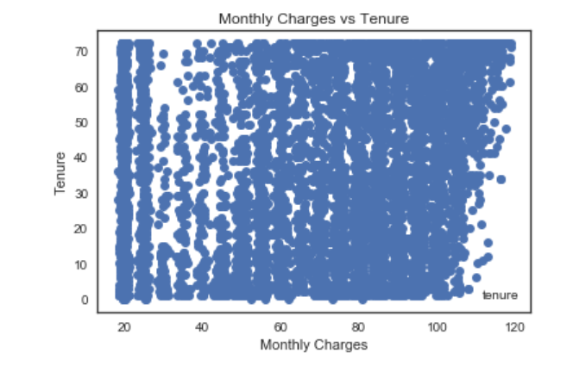
Scatter Plots
It is observed that Total Charges increases as the Monthly bill for the customer increases, both are positively correlated.

Slide 9
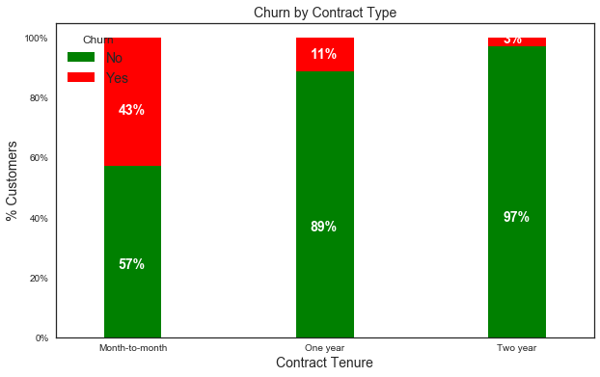
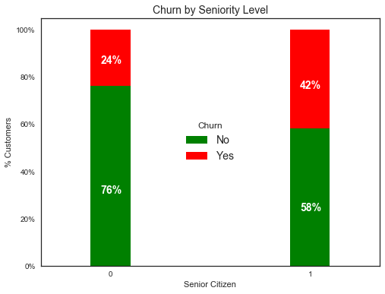
Customer Churn Rate
Churn rate is high in customers on Month-to-Month Contract and low in customers with long term contracts.
Churn rate is high in younger customers and low in Senior Citizens.

Slide 10
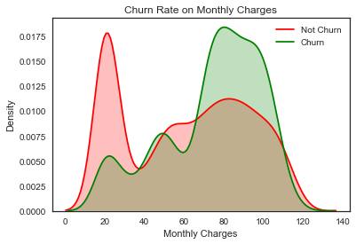
Customer Churn Rate
Churn rate is high in customers with high Monthly Charges and low in customers with less Monthly Charges

Slide 11
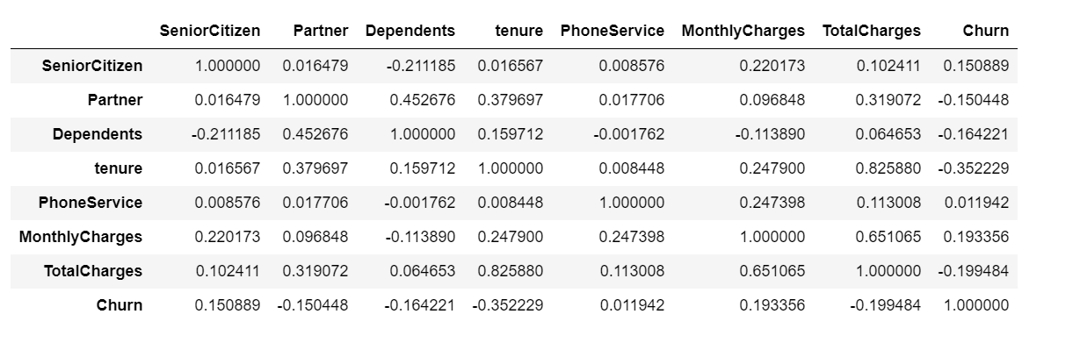
Correlation Matrix

