Slide 1

Airline Safety
By Ravindra Neralla

Slide 2
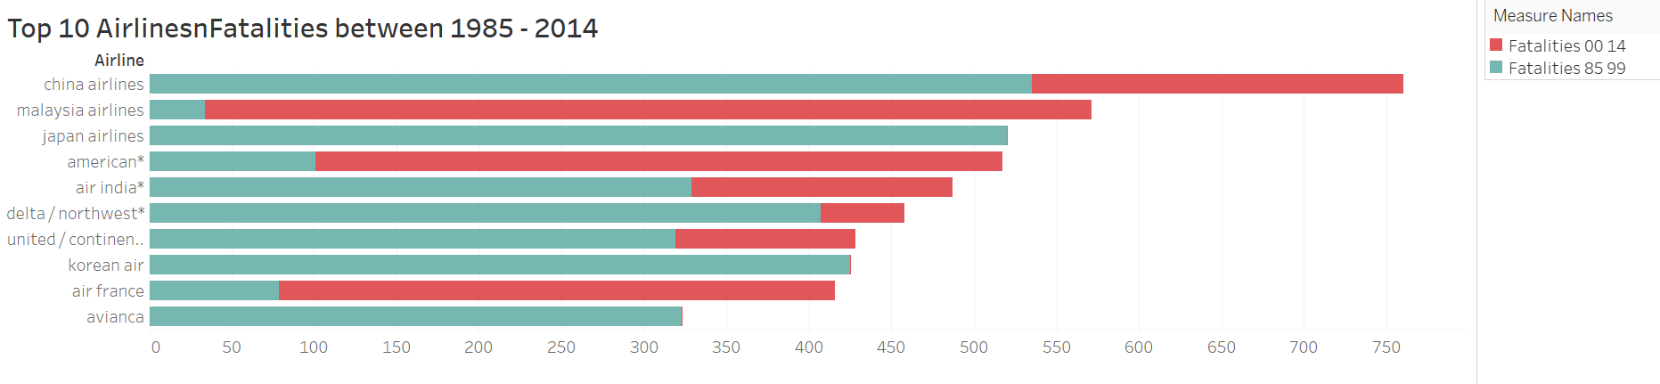
Airline Fatalities between 1985-2014
When we observe the above trend, shows the number incidents and fatalities have reduced over the time.
Decrease in number can be attributed to advancements in technology and safety precautions.
The counts have almost reduced by 50% when we compare the data from 1985-99 vs 2000-14

Slide 3

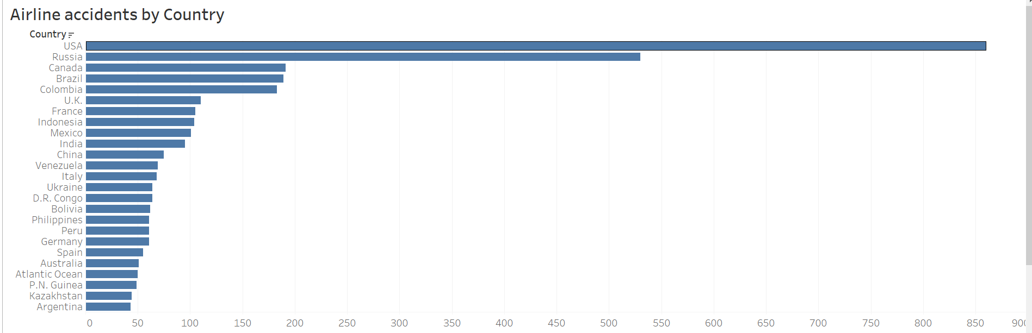
Slide Title
When we observe the number of accidents by country, it shows USA is at top position, this is due to 2001 attack incidents involving serial plane crashes.

Slide 4
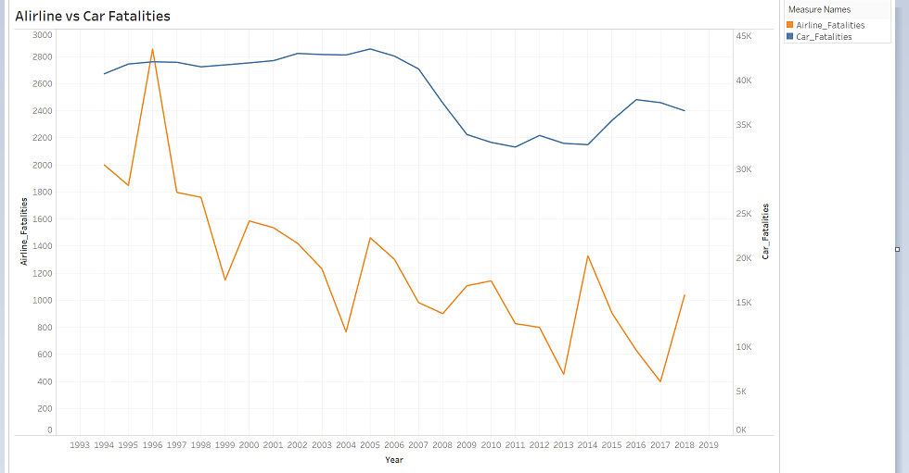
Airline vs Car Fatalities
A clear indication that Airline is the safest mode of transportation.
1995 saw the maximum number of Airline crash – 266.
2005 saw the maximum number of Automobile crash – 39,252.

Slide 5
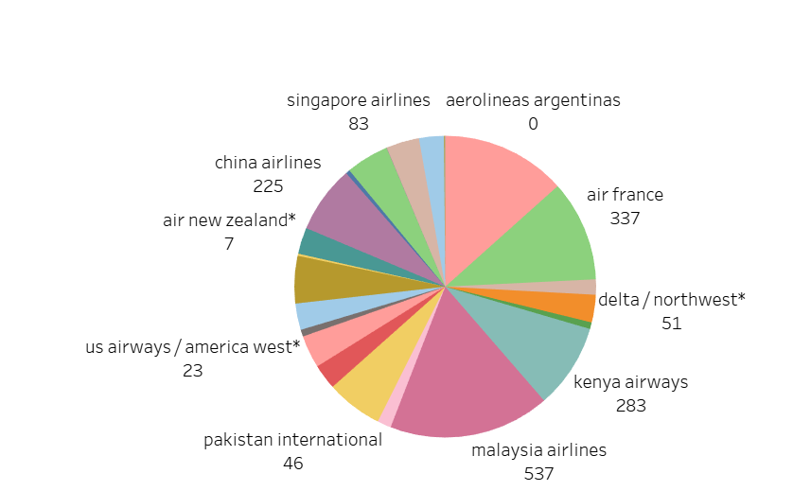
Slide Title
Pie chart clearly shows that Malaysia airlines is at the top, with number of fatalities 537 followed by air France with 337 fatalities.

Slide 6
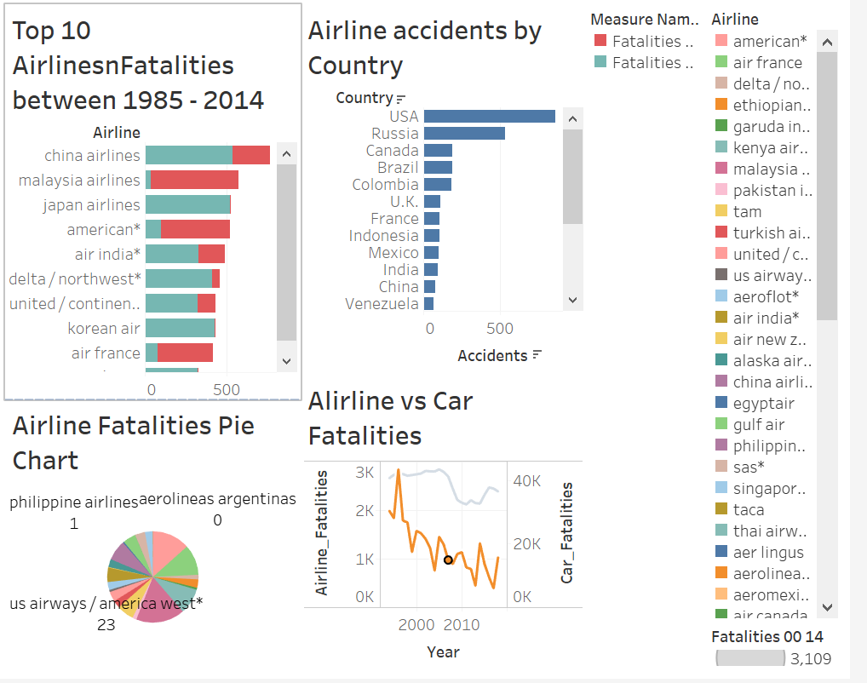
Slide Title
Final conclusion is air travel is much safer than car travel.

Slide 7
References
https://catalog.data.gov/dataset/accidents-fatalities-and-rates-1995-through-2014-for-u-s-air-carriers-operating-under-14-c
https://www-fars.nhtsa.dot.gov/Trends/TrendsGeneral.aspx
https://www.bts.gov/topics/airlines-and-airports-0
https://docs.google.com/spreadsheets/d/1SDp7p1y6m7N5xD5_fpOkYOrJvd68V7iy6etXy2cetb8/edit

