Slide 1

Mental Health Prediction with Machine Learning
Ravindra Babu Neralla
Bellevue University
DSC680 – Project 2

Slide 2


Introduction
COVID-19 pandemic impacted lives of people around the world. Many of us are facing challenges that can be stressful, overwhelming and cause strong emotions in adults and children. Public health actions, such as social distancing, are necessary to reduce the spread of COVID-19, but they can make us feel isolated and lonely and can increase stress and anxiety. Increased stress causes worsening mental health conditions

Slide 3
Objective
The main research objective in this project is predicting the mental health status of a person. It will be helpful for health care providers to assess and diagnose the condition appropriately.
Scope
Scope of the project is to use the sample dataset from Kaggle, which shows several survey questions related to assess the mental health of a person.

Slide 4
Data
The dataset, I have worked in this project is Mental Health Survey data. Dataset consists of 27 variables with 1259 observations. Each Observation in the dataset represents set of survey questions answered by individual persons. Below is the detailed list of variables.
Timestamp - Survey Date and Time
Age - Age of the Participant
Gender - Sex of the Participant
Country - Country of the Participant
State - State of the Participant
self_employed - Self-employment status
family_history - Family History of Mental Health Issues
Treatment - Previous Treatment for Mental Health Issues
work_interfere- Mental Health issue because of Work
no_employees - Number of co-Workers
remote_work - Remote work job
tech_company - Type of company
benefits - Company providing medical benefits
care_options - Additional Care options
wellness_program - Enrolled in any Wellness program
seek_help - Currently seeking help

Slide 5
Anonymity - Anonymity issues
leave - Currently on leave
mental_health_consequence - Facing Mental health issues
phys_health_consequence - Facing Physical Health issues
Coworkers - Coworker facing any similar mental health issues
Supervisor - Supervisor facing any similar mental health issues
mental_health_interview - Did go through any mental health interview
phys_health_interview - Did go through any physical health interview
mental_vs_physical - Did go through any mental vs physical health interview
obs_consequence - Observed consequence
comments - Additional comments

Slide 6
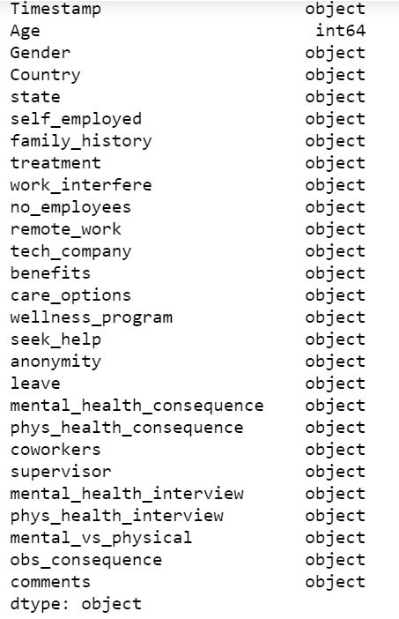
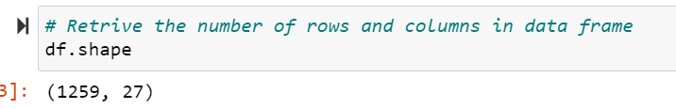
Basic Characteristics
Observations:
Only age variable is numeric
There are total 1259 observations

Slide 7
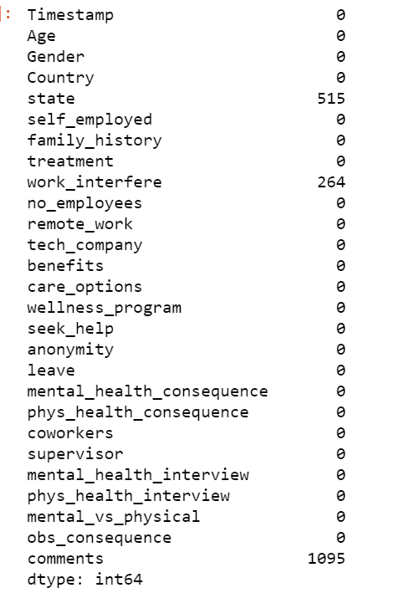
Perform NULL value check on the dataset:
Observation is that, there are high percent of null values in state and work_interfere variables.

Slide 8
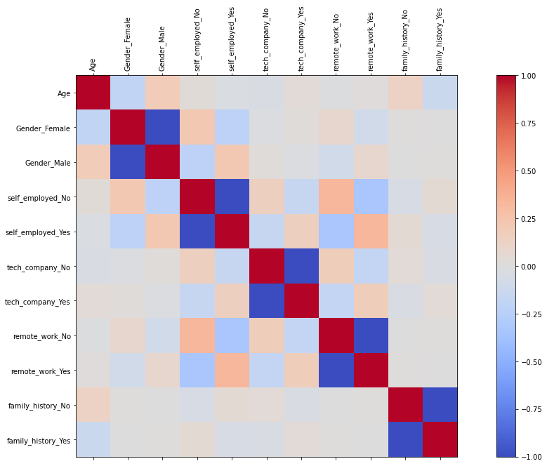
Heat Map Analysis
Observation is that, age vs family history (Yes) shows positive correlation.

Slide 9
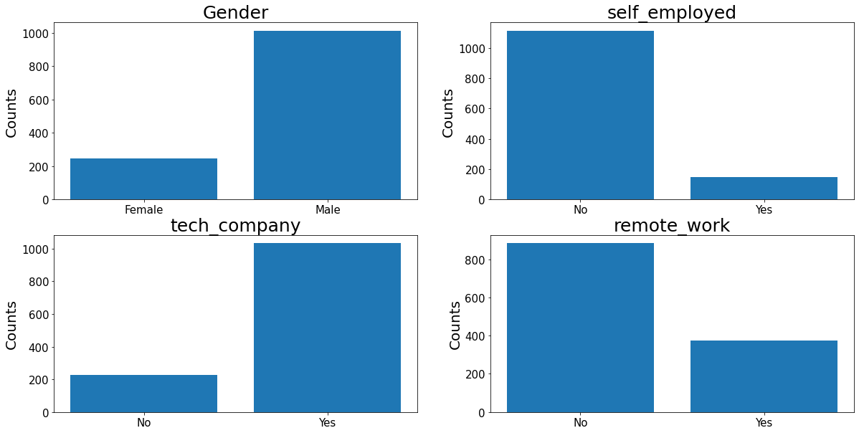
Categorical variables Analysis:
Most of the participants in the survey are Male.
Most of the participants are not self employed.
Majority of the participants are working for tech companies.

Slide 10
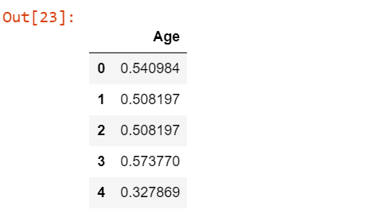
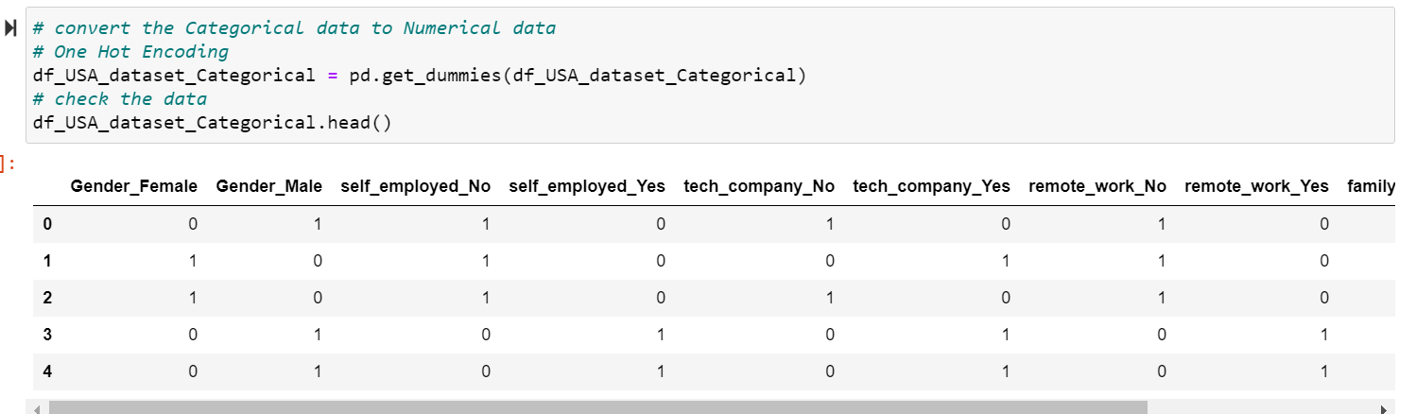
Apply Encoding methods: .
Applied Encoding method to convert Categorical variables to numerical values.
Applied Scalar method to convert the Numerical variable to reduce the value and maintain consistent value range.

Slide 11
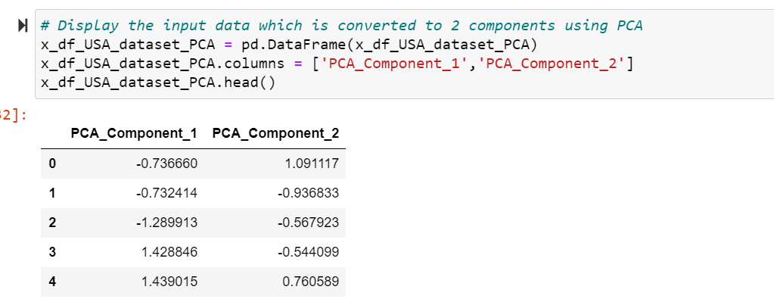
Reduce Number of Dimensions
After converting categorical variables to numeric values, the number of input variables have increased.
Applied PCA method to reduce the number of variables to 5.

Slide 12
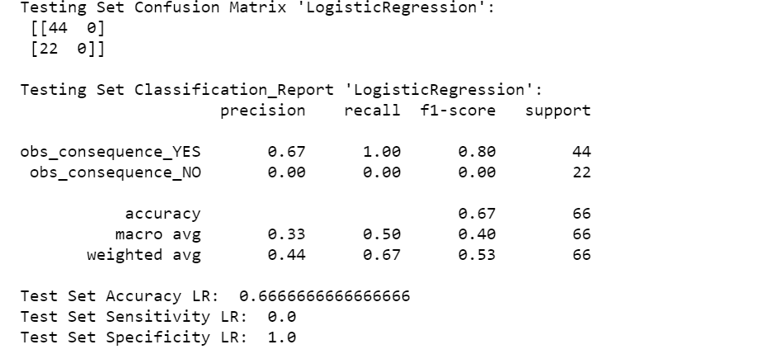
Logistic Regression
Applied Machine Learning model, “Logistic Regression” on the training data set and evaluated the performance of the model using test set.
Accuracy in Logistic Regression model is 66%.

Slide 13
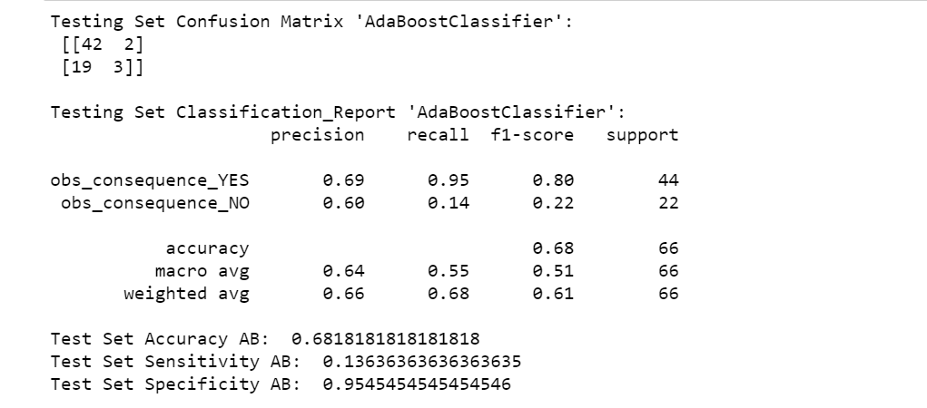
AdaBoost Classifier
Applied Machine Learning model, “AdaBoost Classifier” on the training data set and evaluated the performance of the model using test set.
Accuracy in Random Forest model is 68%.

Slide 14
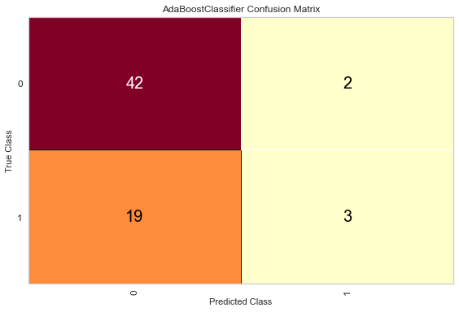
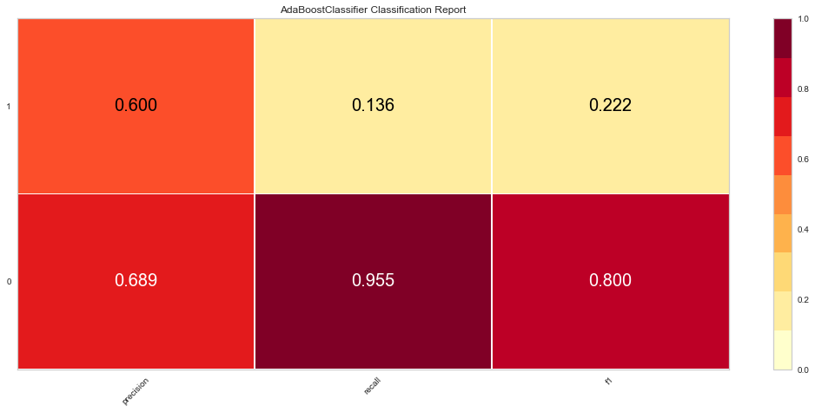
Evaluate Model Performance
Using Confusion matrix, evaluated the results and calculated ‘Precision , Recall and f1 score.

Slide 15
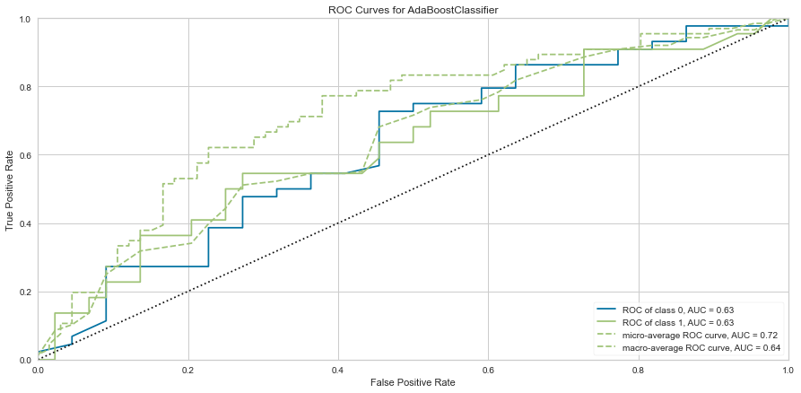
AUC (Area Under Curve)
Built ROC curve and observed the AUC (area under curve) values as 0.63 .

Slide 16
References:
[1]: How Costly Is Customer Churn in the Telecom Industry? - EBR
[2]: Customer Churn in Telecom Segment - Curi
https://towardsdatascience.com/customer-churn-in-telecom-segment-5e49356f39e5
[3]: Telco Customer Churn - BlastChar
https://www.kaggle.com/blastchar/telco-customer-churn
[4]: PCA using Python (scikit-learn) - Galarnyk
https://towardsdatascience.com/pca-using-python-scikit-learn-e653f8989e60
[5]: Churn Reduction in Telecom Industry – Arthur Middleton Hughes
http://www.dbmarketing.com/telecom/churnreduction.html

