Slide 1
Java
Thread

Slide 2
Multitasking
Multitasking allows several activities to occur concurrently on the computer
Levels of multitasking:
Process‐based multitasking
Allows programs (processes) to run concurrently
Thread‐base multitasking (multithreading)
Allows parts of the same process (threads) to run concurrently

Slide 3
Multitasking
Advantages of multithreading over process‐based multitasking
Threads share the same address space
Context switching between threads is usually inexpensive
Communication between thread is usually inexpensive
Java supports thread‐based multitasking and provides high‐level facilities for multithreaded programming

Slide 4
Main Thread
When a Java program starts up, one thread begins running immediately
This is called the main thread of the program
It is the thread from which the child threads will be spawned
Often, it must be the last thread to finish execution

Slide 5
Main Thread

Slide 6
How to create Thread
By implementing Runnable Interface
By extending the Thread class itself
Implementing Runnable
Need to implement the public void run() method
Extending Thread
Need to override the public void run() method
Which one is better ?

Slide 7
Implementing Runnable

Slide 8
Extending Thread

Slide 9
Multiple Threads
It is possible to create more than one thread inside the main
In multiple threads, often you will want the main thread to finish last. This is accomplished by
using a large delay in the main thread
using the join() method
Whether a thread has finished or not can be known using isAlive() method
Example: MultipleThreads.java, JoinAliveThreads.java

Slide 10
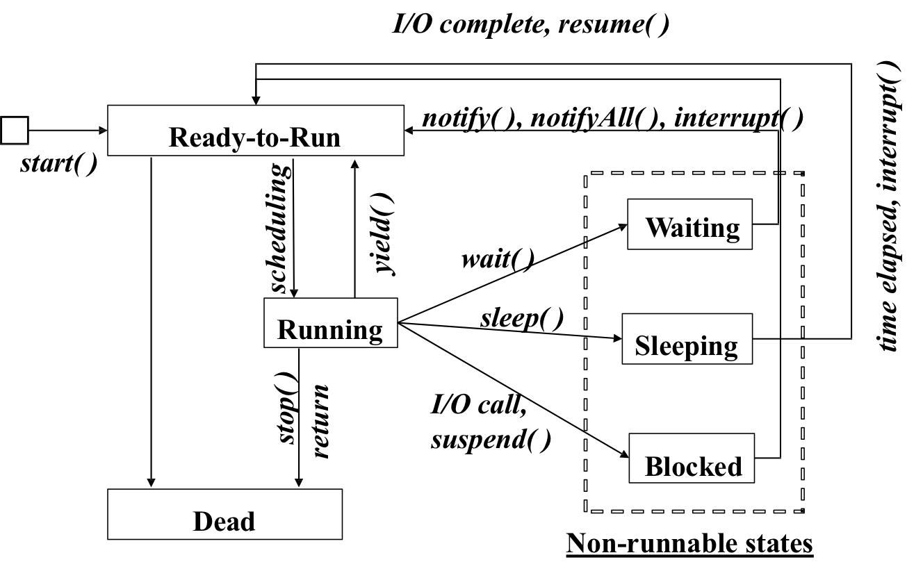
Thread States

Slide 11
Thread Pool
Thread Pools are useful when you need to limit the number of threads running in your application
Performance overhead starting a new thread
Each thread is also allocated some memory for its stack
Instead of starting a new thread for every task to execute concurrently, the task can be passed to a thread pool
As soon as the pool has any idle threads the task is assigned to one of them and executed

Slide 12
Thread Pool
Thread pools are often used in multi threaded servers
Each connection arriving at the server via the network is wrapped as a task and passed on to a thread pool
The threads in the thread pool will process the requests on the connections concurrently
Java provides Thread Pool implementation with java.util.concurrent.ExecutorService

Slide 13
ExecutorService

Slide 14
Synchronization
When two or more threads need access to a shared resource, they need some way to ensure that the resource will be used by only one thread at a time
The process by which this is achieved is called synchronization
Key to synchronization is the concept of the monitor
A monitor is an object that is used as a mutually exclusive lock
Only one thread can own a monitor at a given time

Slide 15
Synchronization
When a thread acquires a lock, it is said to have entered the monitor
All other threads attempting to enter the locked monitor will be suspended until the first thread exits the monitor
These other threads are said to be waiting for the monitor

Slide 16
Synchronization
Two way to achieve synchronization.
Synchronized method
synchronized void call(String msg) { }
Synchronized block
public void run() {
synchronized(target) { target.call(msg); }
}
Example: SynchronizedBlock.java, SynchronizedMethod.java, SynchronizationLock.java

Slide 17
Inter Thread Communication
One way is to use polling
a loop that is used to check some condition repeatedly
Once the condition is true, appropriate action is taken
Java includes an elegant inter thread communication mechanism via the wait(), notify() and notifyAll() methods
These methods are implemented as final methods in Object, so all classes have them
All three methods can be called only from within a synchronized method

Slide 18
Inter Thread Communication
wait()
tells the calling thread to give up the monitor and go to sleep until some other thread enters the same monitor and calls notify()
notify()
wakes up the first thread that called wait() on same object
notifyAll()
wakes up all the threads that called wait() on same object. The highest priority thread will run first
Example: IncorrectPC.java, CorrectPC.java, PCBlockingQueue.java

Slide 19
Suspend, Resume and Stop
Suspend
Thread t; t.suspend();
Resume
Thread t; t.resume();
Stop
Thread t; t.stop();
Cannot be resumed later
suspend and stop can sometimes cause serious system failures
Example: SuspendResume.java

